Slide 1
CDC’s TNM Coding Software
Joseph Rogers
Team Lead -- Applications, Statistics, and Informatics Support Team (ASIST)
Peter Kim and Jennifer Seiffert
Northrop Grumman
Under contract to NPCR
Selected slides for Marty Madera, AJCC
April 28, 2016
National Center for Chronic Disease Prevention and Health Promotion
Cancer Surveillance Branch, Division of Cancer Prevention and Control

Slide 2
Purposes of CDC’s TNM Coding Software
Coding Assistance Provide data and tools in the form of a DLL to be used by Registry Plus software to generate site-specific pick-lists for the direct entry of clinical and path T, N, and M components and stage groups
Stage Group Derivation Provide an algorithm for deriving clinical and path stage groups from directly entered T, N, and M components (and other items as needed) to be used in Registry Plus in the central registry
For quality control
For re-deriving stage groups based on consolidated TNM
2
Notes:
The software we are developing will serve two purposes: coding assistance and the derivation of stage group.
Direct coding of the stage group is an NPCR requirement. The derivation of stage group is for secondary uses of quality control and to allow automated re-derivation of stage group as part of consolidating stage data from multiple reports.

Slide 3
Features of CDC’s TNM Software
Schema discriminators are referenced when needed
Example: C24.0 (Extrahepatic bile duct) can be staged from 3 chapters depending on tumor location as coded in Site-Specific Factor 25
Includes data items other than T, N, and M when needed for staging
Example: PSA and Gleason score for Prostate stage group
Business rules are incorporated in derivation logic
Example: In situ is both clinical and path stage 0
AJCC is licensing CDC’s use of the manual contents for specific uses and limited distribution
3
Notes:
Here are some important features of CDC’s software.
Software for coding TNM still requires schema discriminators when an ICD-O-3 code doesn’t point to a single TNM schema or chapter. As an example, site code C24.0. Extrahepatic bile duct, can be staged from 3 AJCC chapters (Gallbladder, perihilar bile ducts, or distal bile duct) depending on tumor location as coded in SSF25.
Our software accommodates items other than T, N, and M that are needed for staging. For example, PSA and Gleason score are needed to determine stage group for Prostate.
We have incorporated ‘business rules” into the derivation function. These are pieces of logic needed to get the right answer, such as “when pathologic M is blank, the calculation logic sill use the value of clinical M to determine stage group.
It’s important to note that AJCC is licensing CDC to use parts of their manual in our software, and the licensing agreement will stipulate the specific uses and limits on distribution .

Slide 4
Four Components of CDC’s TNM Software
TNM Schema Manager
TNM AutoStager and other testing tools
TNM Test Application
Underlying DLL
4
Notes:
There are four pieces to our software [Joe—read the names of the four]. The following slides will explain each piece.

Slide 5
1. TNM Schema Manager
Interface for
defining a TNM schema by the applicable sites and types
entering data for the coding pick lists and stage derivation
For internal use by Subject Matter Expert to create the table content from the TNM manual text
5
Notes:
First we have a Schema manager. This provides an interface for the Subject Matter Expert in our team to define the TNM schemas by the applicable site and type codes and to enter the data for the pick list tables and the stage derivation tables. The content of all of the tables comes directly from the TNM manual, with some limited exceptions which we will explain in later slides.

Slide 6
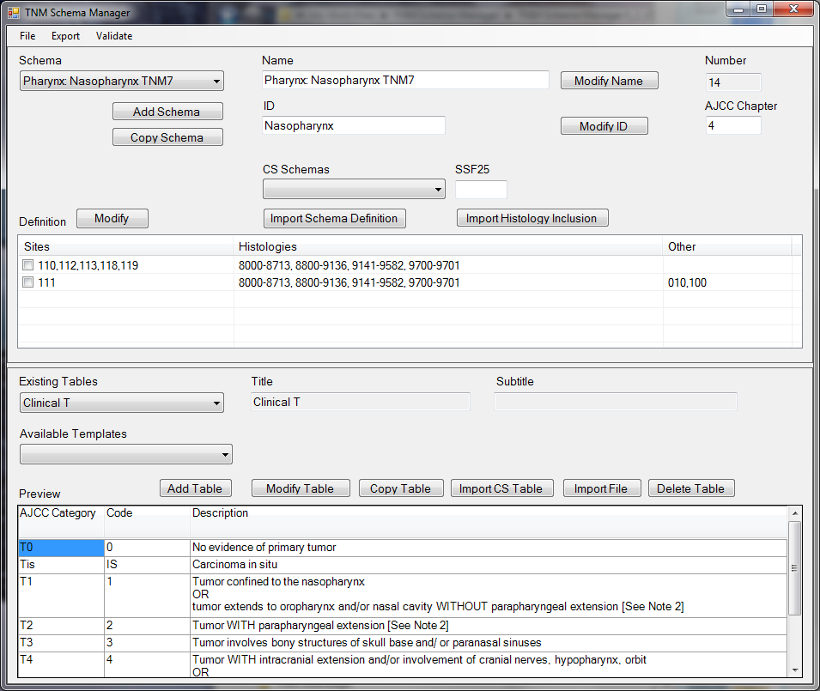
TNM Schema Manager Screen Shot
Schema Name for CDC TNM Software
Internal Short Name
AJCC chapter 4, Pharynx
Site codes, histology codes, and schema discriminator codes that belong to Nasopharynx staging schema: Sites C110, C112, C113, C118, and C119, plus C111 when SSF25 is coded 010 or 100
Area for managing tables for T, N, M, and stage group
6
Notes:
Here is a screen shot from the schema manager. A few things to note: the schemas will be assigned a name based on the AJCC chapter names, with ‘TNM7’ appended to each name. This will prevent confusion of a CS schema with a TNM coding scheme.
We also assign a short name for internal use.
The site codes and histology codes (and sometimes a schema discriminator) that belong to this TNM staging scheme are included in the software so that the software can display the correct pick list. In this example, the definition for the Nasopharynx scheme from the Pharynx chapter is shown. Nasopharynx applies to sites C110, C112, C113, C118, and C119 PLUS site C111 when SSF 25 is coded 010 or 100. This information in needed so that the Registry Plus software can display the correct pick lists based on the coded entered by the registrar for site/type and SSF25 when needed.
The bottom part of the screen shot is the area for managing all of the tables needed for the Nasopharynx coding.
The demonstration will show how this all works in the actual coding application.

Slide 7
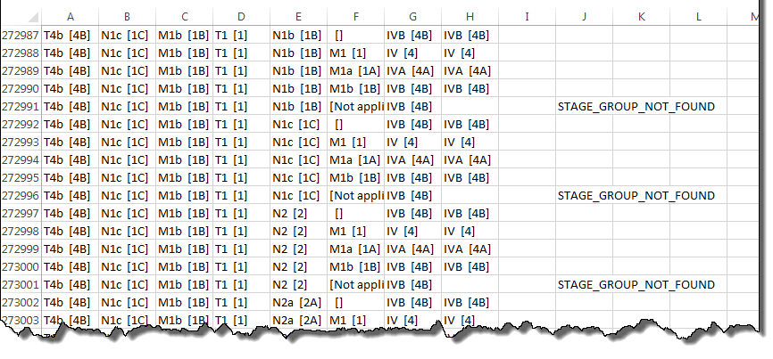
2. TNM AutoStager
Creates excel file of all possible combinations of T, N, and M for a schema and shows all calculation results
Useful for testing the derivation algorithm
7
Notes:
The second component of our TNM software is Autostager. This is one of a few programs we will be developing to test the derivation results. Autostager creates an Excel file of all possible combinations of clinical and pathologic TNM and resultant stage groups for review by a subject matter expert. Other testing tools will be created as we get closer to release.

Slide 8
3. TNM Test Application
Interface for
Direct entry of c and p T, N, M and other required stage elements, plus stage groups
Calculating c and p stage groups
To be used only for DEMONSTRATIONS and TESTING of the software and algorithms
Analogous to Test-o-Matic for CS
8
Notes:
The third component is the TNM test application. This provides an interface for the direct entry of clinical and pathologic T, N, M, other required elements, and stage groups. It also calculates the stage groups based on the tables and business rules entered in the software. Our Test Application is designed for demonstrations and testing only. It is analogous to the Test-o-Matic tool for CS.
We will be demonstrating this tool, to simulate how the registrar will be entering stage data.

Slide 9
Features of Pick List Tables Displayed in TNM Test Application
Note 1 for all tables displays attribution boilerplate text specified in license agreement
Categories and their descriptions are taken directly from AJCC manual, reformatted
Additional notes are usually taken directly from AJCC manual or other official communication
Any added words or codes are in square brackets
9
Notes:
Here are some important things to note about the pick list tables displayed in the test application.
All tables displayed to the registrar show the source of the text as the AJCC manual.
Text for categories and their definitions are taken directly from the AJCC manual, but sometimes reformatted, as will be shown in the next slide.
Additional notes that come from other AJCC sources, such as the CAnswer Forum, may be included.
Any words added to the official AJCC text appear in square brackets.

Slide 10
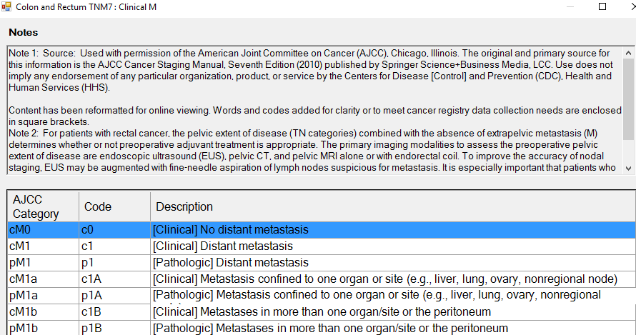
Sample Pick List Table in Test App
Notes from AJCC manual or CAnswer Forum
AJCC category
Code stored in cancer registry
Category description from AJCC manual
Notes:
Here is a sample pick list table generated by the Test App. At the top you can see that this is from the Colon and Rectum TNM 7 schema and is the Clinical M table. You can see the attribution in Note 1 followed by other relevant notes from the Manual or Forum. Each pick list table will show the AJCC category in the first column followed by the code used in cancer registries. The code is what will be stored in our cancer registry database. The last column of the table displays the description of the category taken directly from the AJCC manual

Slide 11
Example of Reformatting and Added Words
From AJCC Manual, Lung, p. 263
Lengthy description of T2 for Lung using continuous text with semicolons
Reformatted as bullet list to make conditions easier to find
Words added to make the implied condition explicit
Reformatted for Pick List
11
Notes:
This slide shows an example of the kind of re-formatting we are doing and words we are adding. At the top is the complex description of T2 categories for lung taken directly from the AJCC manual [Joe--maybe read the description from the slide to demonstrate how long and confusing it is without actually saying that it is long and confusing!]. It is shown as a paragraph with the different conditions separated by semicolons. Also note that the descriptions for T2a and T2b only indicate the size part of the definitions without repeating the extension part of the T2 definition. The extension conditions are IMPLIED but not stated.
Now look at the reformatted definition of T2 from the pick list. The words are the same but the semicolons are replaced by a bulleted list making it easier to find the code you are looking for. The implied words “Meets criteria for T2 and” are added to the descriptions of T2a and T2b so that the descriptions can be displayed on their own without being misleading. But because those words are not part of the official AJCC definition, they are placed in square brackets.

Slide 12
4. Underlying DLL
Library of functions and an Applications Program Interface to allow the TNM software to be embedded in Registry Plus products
Registry Plus will control final look of tables
DLL will not be publicly released due to licensing restrictions
12
Notes:
The fourth component of our software is the underlying DLL (Dynamic Link Library). This contains programming functions and tools to allow the content to be embedded into Registry Plus products. Registry Plus will control the final look of the pick lists for the registrars.
The DLL will not be publicly released due to licensing restrictions

Slide 13
For more information contact:
Joseph D. Rogers
jdr0@cdc.gov
The findings and conclusions in this report are those of the authors and do not necessarily represent the official position of the Centers for Disease Control and Prevention.
National Center for Chronic Disease Prevention and Health Promotion
Cancer Surveillance Branch, Division of Cancer Prevention and Control

