Slide 1
Managing the Process and Needs of Cluster Investigations
NCEH’s Health Studies Section:
Role in Providing Technical Assistance and Tool Development
Johnni Daniel, DHSc, MPH
Team Lead (Acting), Health Studies Section, Tracking, Radiation, Chemical, and Environmental Epidemiology Branch (proposed)
April 25, 2019

Slide 2
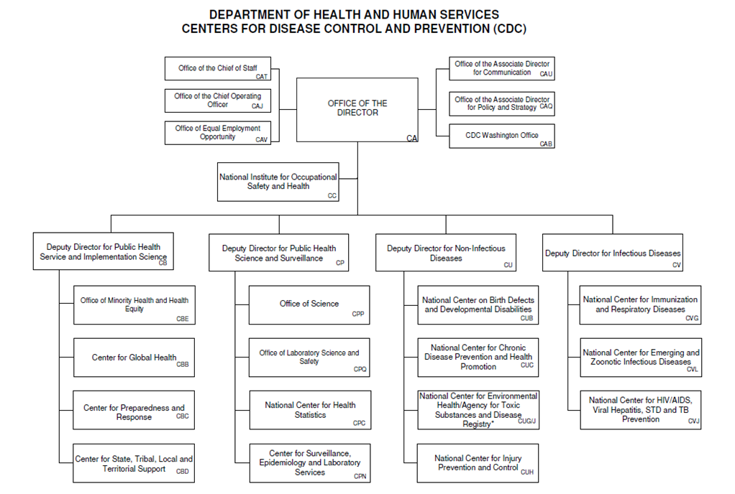
Organization Chart – Centers for Disease Control and Prevention

Slide 3
Organization Chart – Deputy Director for Non-Infectious Diseases (DDNID)

Slide 4
Organization Chart – National Center for Environmental Health
National Center for Environmental Health
Division of
Laboratory
Sciences
Division of
Environmental Health Science and Practice
Water, Food, and Environmental Health Services Branch
Asthma and Community Health Branch
Lead Poisoning Prevention
Branch (proposed)
Tracking, Radiation, Chemical, and Environmental Epidemiology Branch (proposed)

Slide 5
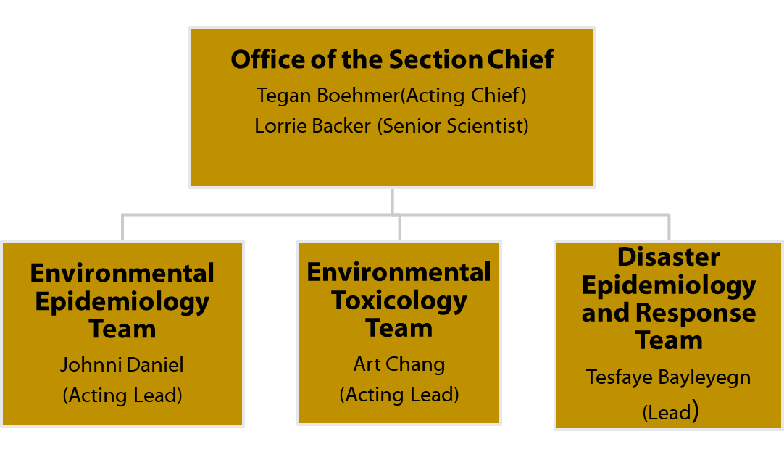
Health Studies Section – How we are organized

Slide 6
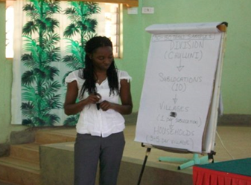
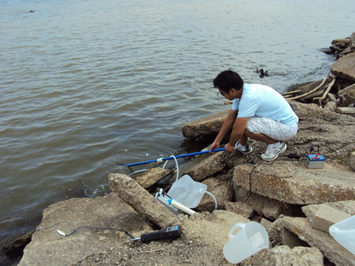
Health Studies Section – Who we are
Broad range of skills and expertise
Epidemiology
Medical Toxicology
Environmental Health
Disaster Preparedness and Response

Slide 7
Health Studies Section – What we do
Environmental epidemiology research
Characterize exposure and health effects of chemical contaminants
Characterize emerging threats – surveillance of clusters of poisoning using the National Poison Data System (NPDS)
Identify risk and protective factors for morbidity and mortality related to disasters
Prepare for and respond to environmental public health emergencies
Provide technical assistance with outbreak investigations of suspected non-infectious etiology
Respond to natural, chemical, and radiological disasters
Build environmental epidemiology capacity
Technical assistance to STLTs
Develop tools and training

Slide 8
Health Studies Section – What we do
Environmental epidemiology research
Characterize exposure and health effects of chemical contaminants
Characterize emerging threats – surveillance of clusters of poisoning using the National Poison Data System (NPDS)
Identify risk and protective factors for morbidity and mortality related to disasters
Prepare for and respond to environmental public health emergencies
Provide technical assistance with outbreak investigations of suspected non-infectious etiology
Respond to natural, chemical, and radiological disasters
Build environmental epidemiology capacity
Technical assistance to STLTs
Develop tools and training

Slide 9
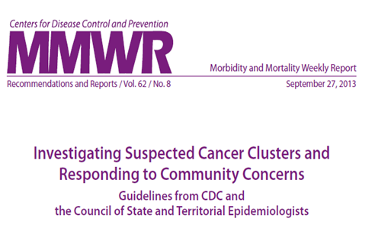
NCEH Role in Cancer Cluster Tools Development
2013 MMWR: Investigating Suspected Cancer Clusters and Responding to Community Concerns
Collaboration with CSTE, ATSDR, other CDC CIOs, and state health departments
Guidance for state and local health departments on addressing cancer cluster concerns in communities
Cancer Clusters: A toolkit for Communicators
Partnership with National Public Health Information Coalition (NPHIC)
Tools for state and local communicators to use when talking with communities about potential cancer clusters and cancer cluster investigations

Slide 10
NCEH Response to Inquiries Related to Cancer Clusters
Inquiry Source | Response
Public | Standard response or provide a contact at state/local health department
State Representative | Contact state and obtain background info and input prior to responding
State/Local Health Department | Response depends on ask from the state/local health department

Slide 11
Common Requests from State/Local Health Departments
Review state investigation protocols
Analysis of SIR calculations
Data collection tools
When to stop investigation
NCEH Epidemiologists review for adherence to 2013 CDC/CSTE Guidelines
Communications Support
Review communications plan
Discuss talking points
NCEH Risk Communication experts provide assistance in developing communication messages

Slide 12
Moving Forward: CDC/ATSDR Cancer Cluster Guideline Update
In FY 2016, Congress passed “Trevor’s Law” as part of Frank R. Lautenberg Chemical Safety for the 21st Century Act
In FY 2019, Congress appropriated $1M to CDC/NCEH to implement a portion of Trevor’s Law pertaining to updating guidelines for investigating potential cancer clusters
Goals of update:
To incorporate technical and scientific advancements since 2013 guidelines
To ensure STLT public health agencies have access to current scientific tools and approaches

Slide 13
CDC/ATSDR Cancer Cluster Guideline Update — Next Steps
Publish Federal Register Notice for public input
Estimated time frame: May, 2019
Open for 60 days
Convene SMEs via Cancer Cluster Guidelines Workgroup under NCEH/ATSDR Board of Scientific Counselors
Obtain input from state HDs through
Survey of all 50 states and territories
Multi-disciplinary focus groups with representative sample of states
Expect to publish updated guidelines in 2021

Slide 14
Questions?

Slide 15
Trevor’s Law
Requires HHS to
Develop criteria for designation of potential cancer clusters
Develop, publish, and periodically update guidelines for investigating potential cancer clusters
Coordinate investigation of potential cancer clusters
Conduct other duties such as provide technical assistance, maintain staff expertise, consult with community members, and disseminate reports
FY19 appropriations provide $1 million to CDC/NCEH to update cancer cluster guidelines
Notes:
Provides Federal agencies with the authority to
Help conduct investigations of potential cancer clusters
undertake actions to help address cancer clusters or factors that may contribute to the creation of potential cancer clusters
coordinate with other entities and the public to investigate and address cancer clusters
CDC received provided $1 m in FY19 specifically to update the guidelines. The rest of Trevor’s Law has not been delegated to CDC to implement.

Slide 16
CDC/ATSDR Cancer Cluster Guideline Update — Process*
Follow CDC’s official Guidelines Development Process
Form internal CDC/ATSDR Steering committee
Members from ATSDR, NCEH, NIOSH, NCCDPHP
Expertise in cancer, communications, epidemiology, geospatial science, policy
Establish Cancer Cluster Guidelines Workgroup under Board of Scientific Counselors, NCEH/ATSDR
Gather input from multiple sources
*Proposed
Notes:
Steering Committee includes senior-level scientists from NCEH, ATSDR, NCCDPHP (Division of Cancer Prevention and Control), and NIOSH. And will request ad-hoc advice from SMEs (e.g., statisticians, spatial statisticians, toxicologists, community engagement, exposure assessment, etc) and other Feds (e.g., EPA, NCI).
Engage key partners????????? Are there other partners that are not mentioned in the solicit input slide?????????????????

Slide 17
CDC/ATSDR Cancer Cluster Guideline Update — Inputs*
Steering Committee
Published and Grey literature
State and Local HDs
BSC
NCEH/ATSDR
Individual SMEs
Public and Community Members
Cancer Cluster Guidelines Workgroup
*Proposed
Notes:
Process for gathering input → 5 key sources/approaches
Initiate review of literature and cancer cluster guidance used by other national and international public health agencies
Post Federal Register Notice for public comment
Survey state and local public health partners
Solicit individual input from subject matter experts
Stakeholders
Council State and Territorial Epidemiologists (CSTE)
Other federal agencies (EPA, NCI)
Non-governmental organizations (American Cancer Society, North American Association of Central Cancer Registries)
Academia
Advocacy groups
Provide specific questions pertaining to current guidelines for consideration

