Slide 1
NTSS-CR National Tuberculosis Surveillance System – Case Reporting

Slide 2
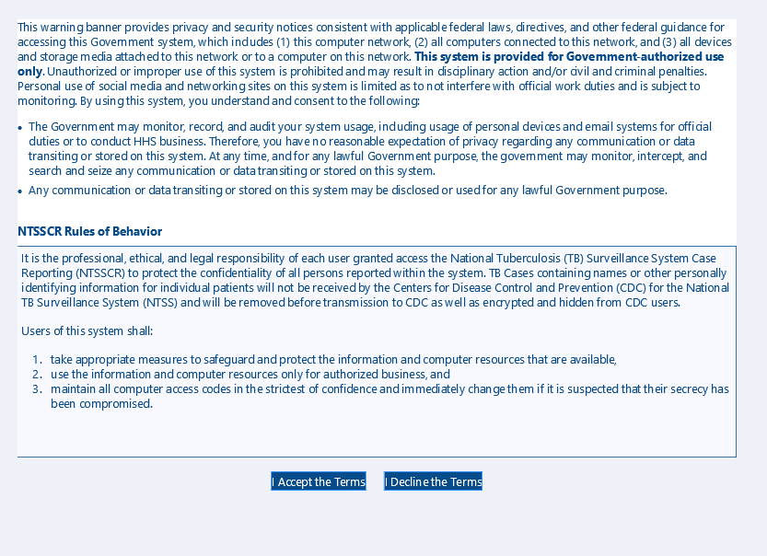

Slide 3
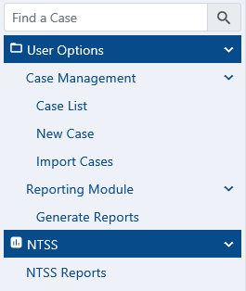
Welcome to NTSSCR

Slide 4
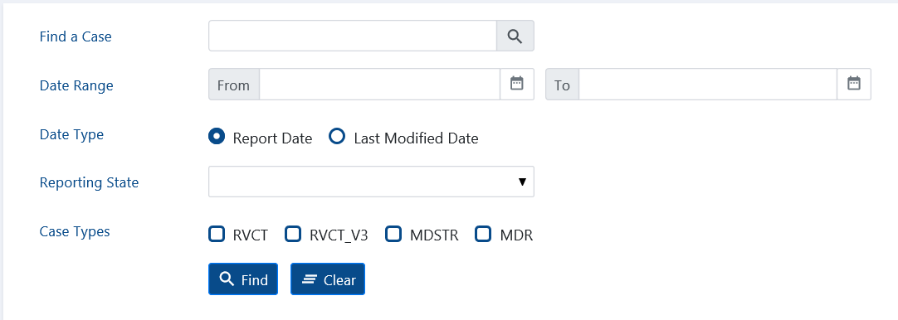
Case List

Slide 5
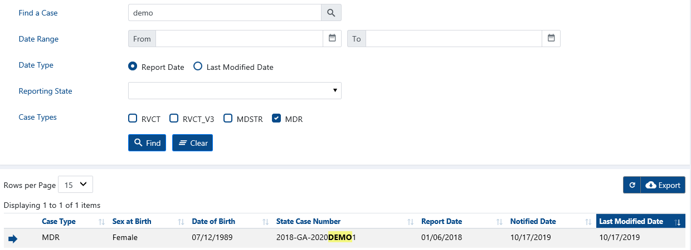
MDR – Multidrug-Resistant

Slide 6
MDR Case
View
Edit

Slide 7
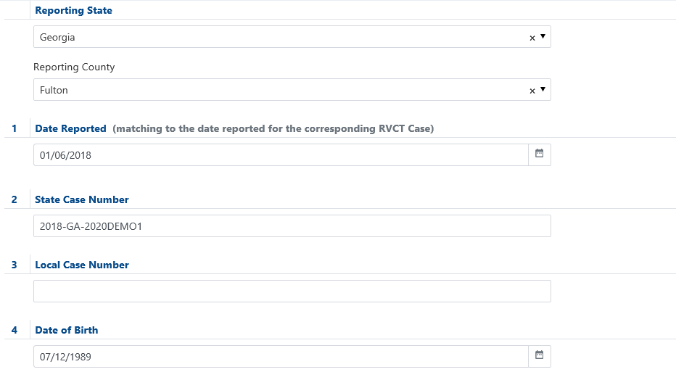
Georgia 2018-GA-2020DEMO1

Slide 8
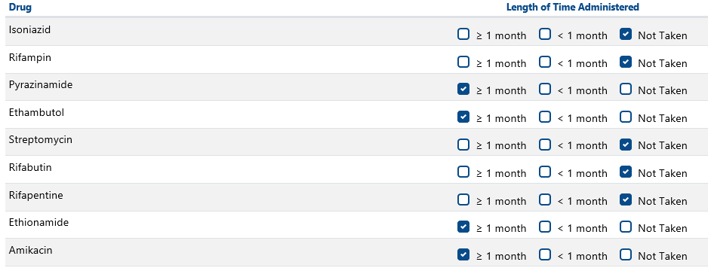
Easy Button – mark the >= 1 month and < 1 month items below then press button to mark the rest as Not Taken – will change to a Unmark Rest Not Taken (shown here)
Still need to add Pretomanid – awaiting coding by vocab team and addition to value set

Slide 9
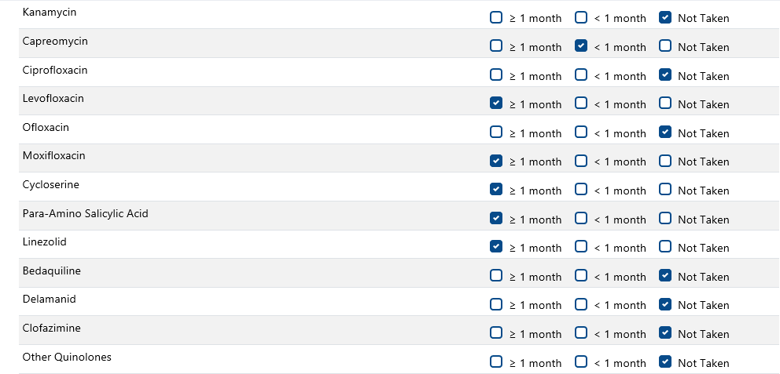

Slide 10
Easy Button – mark the Yes/Unk in Experienced items below then press button to mark the rest as No – will change to a Unmark Rest No (shown here)

Slide 11
