Slide 1
Regional Network Coordinating Organizations RNCOs
Angie Deokar & Sally Thigpen
Violence and Injury Prevention Team
Core SVIPP Awardee Meeting
February 22-24, 2017

Slide 2
Regional Network Coordinating Organization (RNCO)
Purpose: To provide coordination across and between states(regardless of funding status), and to collaborate with injury and violence prevention organizations to share scientific evidence and programmatic best practices.
Notes:
To make connections between people, science, and practice.

Slide 3
Regional Network Coordinating Organization (RNCO) States and Regional Coordinators
Regions 1 and 2: Cindy Rogers
Connecticut, Maine, Massachusetts, New Hampshire, New Jersey, New York, Puerto Rico, Rhode Island, Vermont, and the Virgin Islands
Regions 3 and 5: Joyce Dantzler
Delaware, District of Columbia, Illinois, Indiana, Maryland, Michigan, Minnesota, Ohio, Pennsylvania, Virginia, West Virginia, and Wisconsin
Regions 4 and 6: Jennifer Woody
Alabama, Arkansas, Florida, Georgia, Kentucky, Louisiana, Mississippi, New Mexico, North Carolina, Oklahoma, South Carolina, Tennessee, and Texas
Regions 7 and 8: Giorgianna Venetis
Iowa, Kansas, Missouri, Montana, Nebraska, North Dakota, South Dakota, Utah, and Wyoming
Regions 9 and 10: Will Hitchcock
Alaska, Arizona, California, Hawaii, Idaho, Oregon, Nevada, Washington, American Samoa, Commonwealth of Northern Mariana Islands, Federated States of Micronesia, Guam, Marshall Islands, Republic of Palau

Slide 4
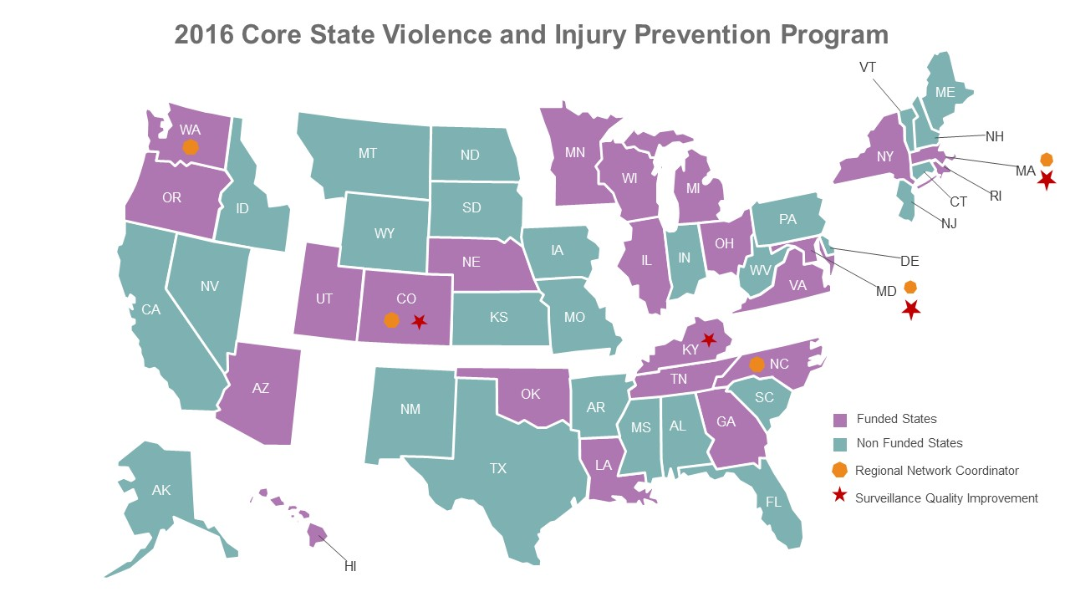
Core SVIPP States and Regions
Funded states include: Colorado, Maryland, Massachusetts, North Carolina, and Washington
Notes:
The Core VIPP is comprised of multiple components including:
Base Integration Component (BIC) - A total of 20 states receive BIC or base funding. These states are funded to: maintain and strengthen their injury and violence prevention programs with a focus on key components: building a public health infrastructure; collecting and analyzing data; designing, implementing and evaluating strategies, both program and policy; providing technical support and training; and education. Funded states include: Arizona, Colorado, Florida, Hawaii, Kansas, Kentucky, Maryland, Massachusetts, Minnesota, Nebraska, New York, North Carolina, Ohio, Oklahoma, Oregon, Pennsylvania, Rhode Island, Tennessee, Utah, and Washington.
Regional Network Leaders Component (RNLs)- Five states serve as RNLs and provide a structure for cross-state collaboration and assistance to all states (funded or unfunded) within their designated regions. These states include: Massachusetts; Maryland; Kansas; North Carolina; and Washington State.
Surveillance Quality Improvement Component - Four states are also funded to conduct injury data investigations supportive of promoting and advancing uniform injury case definitions, improving data quality and advancing methodology so as to improve and standardize injury data collection efforts among all states. These states include: Colorado, Massachusetts, North Carolina, and Utah.
Older Adult Falls Component - Three states are funded to implement older adult falls prevention interventions in community settings and clinical care practice to determine components, which can be applied to other states. These states include: Colorado, New York, and Oregon.
Motor Vehicle Component - Four states are funded to address the issue of motor vehicle-related injuries among children and teens by using data to better understand who is at risk and what works to prevent motor vehicle-related injury; developing programs; and, educating decision makers about evidence based strategies to help keep drivers, passengers, bicyclists and pedestrians safe on the road each day. These states include: Colorado, Nebraska, New York, and Washington.
5 states are funded and regions are grouped according to the HHS Regions.

Slide 5
Benefits of Getting Involved
Network with your peers across the country on topics that matter to you
Learn new ways to approach injury and violence programmatic and policy interventions
Don’t reinvent the wheel if it doesn’t need to be
Bounce challenges and ideas off of others who understand the field and have likely encountered similar challenges
Connect new staff with others to help increase their knowledge and networks
Create new partners with academia, community or tribal groups, and others working to prevent injury and violence
Work jointly on projects or manuscripts
Opportunities to practice or improve skills by volunteering for work groups and other projects

Slide 6
RNCO Regional Network Year 1 Activities
Conduct needs assessment within first 3 months (November) to inform Charter
Develop Charter in first 6 months (February) through a consensus, shared decision making process with network states and organizations
Develop action plan for regional network activities (webinars, trainings, technical assistance, etc.)
Initiate regional network Peer Learning Teams. Network members are expected to decide topics through consensus process based on burden or other emerging issues
Recruit relevant agencies and organizations to participate as members in the regional network including at least one ICRC or similar research entity

Slide 7
National Peer Learning Teams
Peer learning teams that connect partners across the country to focus on a specific topic area related to injury and violence prevention.

Slide 8
National Peer Learning Team Topic Areas
NPLT Lead RNCO and Contact | Topic Area
Colorado Giorgianna Venetis Giorgianna.venetis@state.co.us | Child Abuse and Neglect
Maryland Joyce Dantzler Joyce.Dantzler@Maryland.gov | Intimate Partner Violence
Massachusetts Bekah Thomas Rthomas@edc.org | Motor Vehicle Crash
North Carolina Jennifer Woody Jennifer.woody@dhhs.nc.gov | Systems Thinking
Washington Will Hitchcock Will.hitchcock@doh.wa.gov | Traumatic Brain Injury

Slide 9
RNCO National Peer Learning Teams
Initially develop, coordinate, and facilitate a national peer learning team for one of the 5 topic areas
IPV/SV, CAN, Motor Vehicle, TBI, Systems Thinking
Once established, RNCO will provide support and facilitation to the peer learning team
Collaborate with other regions, national associations, academic/research and other national organizations working on the topic
Conduct a SWOT analysis to determine the best approach for operationalizing the RNCO and moving forward

Slide 10
Evaluation of RNCO
Evaluation partners – awardees, CDC, and Safe States Alliance
Evaluation Focus:
Inform program improvement
Identify Research to Practice and Practice to Research opportunities, barriers, and facilitators
Assess development and disseminations of knowledge
Assess partnerships, peer-to-peer connections, training and technical assistance
Understand the best practices of developing and implementing national peer learning teams

Slide 11
From RNL’s to RNCO’s: Successes
Established or expanded networks by engaging regional stakeholders
Provided training and mentoring opportunities to state programs to help strengthen and support program capacity
Coordinated cross regional collaborations involving face to face meetings, training opportunities and webinars
Developed and implemented unique regional activities
Participated in evaluation activities including the regional satisfaction surveys
Notes:
Example of using evaluation to inform next steps. The lessons learned from RNL’s helped develop the expectations for RNCO’s

Slide 12
Questions or Comments

Slide 13
Meet Your National Peer Learning Team Leads
NPLTs are being developed in Year 1 and will be rolled out in Year 2
We need you to share what your interests are and to connect others to the topic areas
NPLT leads are located throughout the room
Please go and introduce yourselves, sign-up to keep updated about the NPLTs and hear about ways you can get involved
NPLT lead RNCO and Contact | Topic Area
Colorado Giorgianna Venetis, Giorgianna.venetis@state.co.us | Child Abuse and Neglect
Maryland Joyce Dantzler, Joyce.Dantzler@Maryland.gov | Intimate Partner Violence
Massachusetts Bekah Thomas, Rthomas@edc.org | Motor Vehicle Crash
North Carolina Jennifer Woody, Jennifer.woody@dhhs.nc.gov | Systems Thinking
Washington Will Hitchcock, Will.hitchcock@doh.wa.gov | Traumatic Brain Injury

