Slide 1
National Program of Cancer Registries
Lisa Richardson, MD, MPH
Program Review Meeting
Division Director, Cancer Prevention and Control
April 25, 2019

Slide 2


Slide 3

Notes:
All about perspective….
Why do we do what we do?
How are we going to have an impact in the world?
What?
Golden circle…

Slide 4
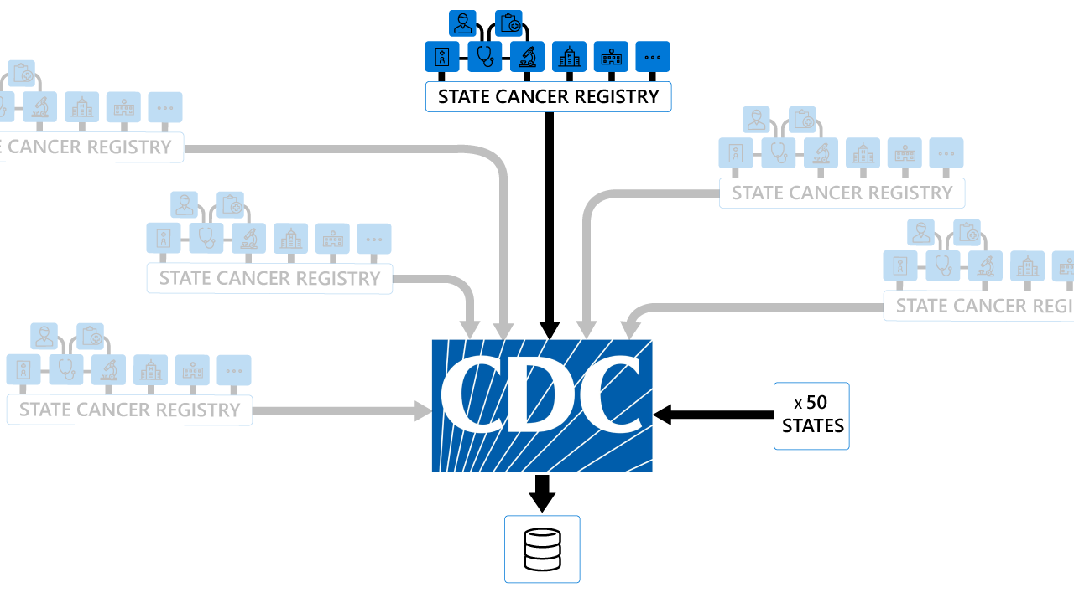
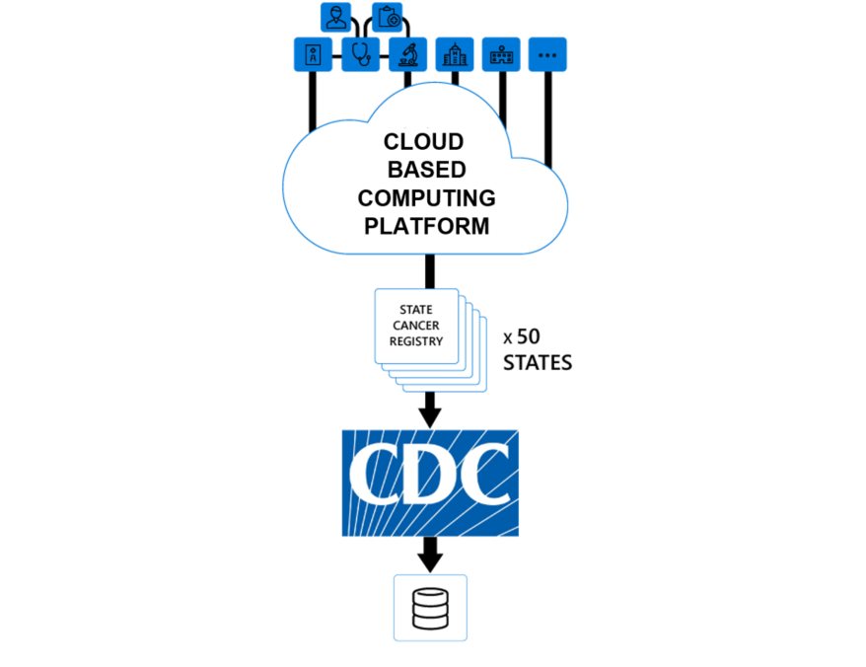
Current State versus Future State

Slide 5
Cervical Cancer Disparities in the United States
Higher rates of cervical
cancer in:
  Black and Hispanic women
  Women living in
  nonmetropolitan areas
  Women with lower
  socioeconomic status
  Women who have never been screening or not screened in
  past 5 years
AAPC: Average annual percent change
NS: Non-significant
Henley SJ, Anderson RN, Thomas, CC, et al. MMWR Surveill Summ 2017; Jul 7;66(14):1-13. ):1-13
Notes:
Higher rates of cervical cancer
Among black and Hispanic women
Women living in rural areas are re likely to die from cervical cancer—as seen on the graph on the right where see a higher death rate in nonmetro reas than metropolitan areas
Cervical cancer is a disease of poverty and those with lower SES are more likely to get and die from cervical cancer
And most importantly, almost 50 of cervical cancer cases occur among women who have never or rarely been screened for cervical cancer

Slide 6
IHS Linkages and Analytic Database
Link administrative records from IHS with cancer records from
  CDC’s National Program of Cancer Registries (NPCR)
  NCI’s Surveillance, Epidemiology, and End Results (SEER) Program
Identify misclassified AI/AN cases
Create analytic datasets with improved AI/AN data: United States Cancer Statistics (USCS) American Indian Alaska Native Incidence Analytic Database (AIAD)
Regional data shown by Purchased/Referred Care Delivery Area County
Notes:
Linkages between IHS and central cancer registries
To improve racial misclassification in registry data
Identify case previously misclassified as non native
Resulting database includes IHS link cariable, updated yearly
Data aggregated by region, shown by Purchased/referred care delivery area counties ( PRCDA counties)
These counties located on or adjacent to federally recognized tribal lands- linkages most accurate in these areas.
Some of the most important finding from the initial linkages was the substantial geographic variation in cancer incidence rates observed between these areas

Slide 7



Cancer Disparities in the American Indian and Alaska Native Population
Liver Cancer Incidence, AI/AN vs. White,
PRCDA Counties, 2010–2015
Leading causes of cancer
  Breast/prostate
  Lung
  Colorectal
Cancers with the largest relative burden
  Liver
  Kidney
  Stomach
Cancers with increasing trends
  Breast
  Liver
  Kidney
  Pancreas
  Uterine
Notes:
USCS AIAD data shows disparities: AI/AN vs white, as well as within AI/AN by region
Leading causes of cancer same as white population (breast/prostate, lung colorectal)
But there are several cancers that, relative to white population, have a greater excess burden ( based on rate ratio) – liver, kidney stomach
Cancers in AI/An with significantly increasing trends include breast, liver, kidney, pancreas and uterine
On the right, demonstration of this geographic variation – looking at liver cancer.
No substantial variation in NHW whites, but we do see variation in AI/AN
Rate ratios range from 1.66-3.17
Regional variation highlights importance of targeted/tailored intervention strategies for this population

Slide 8

Notes:
The DCPC-sponsored American Indian/Alaska Native Cancer Summit brought together Comprehensive Cancer Control Program, National Breast and Cervical Cancer Early Detection Program, and Colorectal Cancer Control Program grantees and partners to celebrate achievements over the last 10 years and to set the agenda for cancer control over the next decade

Slide 9
“The best way to predict your future is to create it” ― Abraham Lincoln

Slide 10


