Slide 1
Ensuring collaboration:
Staging, software and reporting
Loria Pollack, MD, MPH
Manxia Wu, MD
CDC National Programs of Cancer Registries
Lori Koch , MS, CTR
Illinois State Cancer Registry
NPCR 2019 Program Review
April 25, 2019
Notes:
Hello everyone, I am Loria Pollack, I am Medical Officer/Epidemiologist for NPCR
One of my roles is to build and maintain effective partnerships with key NPCR stakeholders.

Slide 2

Notes:
Conventional wisdom says you should end on a note of hope.
As we are near the end of the meeting - that is what I hope to do.
In this session, you will hear how our relationships and expectations with key partners have transformed to ensure that the some of the factors which hindered the implementation of 2018 will be NOT repeated in the future.
After I speak, Manxia Wu, SERT lead, along with Lori Koch from the IL registry, will give an overview of two new groups that were established to facilitate and coordinate input among the NAACCR committees and formalize decision-making among cancer standards setting organization.

Slide 3
Nationally Notifiable Diseases
Annual Case Counts
Cancer:
+ Complexity
+ Data items
+ Consolidation
+ Coordination
Notes:
I want to begin by saying – Kudos to all of you!
IMO, cancer surveillance is the CDC’s largest, most complex surveillance system.
It is only chronic disease with mandatory reporting.
Compared to our other ‘biggies’
We handle about the same number of cases as, chlamydia, the most frequently reported infectious NND
3x more than next most frequently occurring reportable disease gonorrhea (555,608);
There are over 45x more cancer cases than new HIV cases (33,938) (2017)
Plus,
Cancer is MANY unique diseases, not one
We collect or derive >200 data items
We have more reporting sources than say influenza surveillance; wneed to the consolidate data; AND
NPCR is part of a larger surveillance system is not CDC-centric
It is a blessing-curse our system that cancer surveillance is interdependent on other systems outside our control -- including SEER, CoC, NAACCR, Pathologists, EMRs

Slide 4

Surveillance: We are all in this together
Surveillance Systems
NPCR, SEER
Clinicians
Diagnosis, Staging
Registrars
AJCC/CoC
TNM Staging
NCDB
Prognostic Factors
Notes:
I first used this slide at an AJCC Exec Comm meeting. I serve as CDC’s liaison to AJCC and twice a year go up to Chicago to advocate on behalf of our registries
The line that connects us like a Celtic knot – with a continual and interdependent path between us.
Without coordination and communication among multiple organization, including education and support to reporters and registries, the system stops working.
I want to spend some time discussing our relationship with AJCC because we all know that a major factor contributing to the current state of affairs was the number and extent of changes in 2018, particularly the revised AJCC TNM staging and many have asked ‘how did we get here/ why did this happen?’
When Christie Eheman was BC and the 8th ed was under development
CDC had committed to collect AJCC TMN because Collaborative Stage was being phased out.
NPCR desired to have data that was a bit richer than Summary Stage and thought it made sense to use a system used by clinicians and employed by many of the hospitals reporting into our system.
SEER EOD was underdevelopment and we had no idea what that would look like

Slide 5
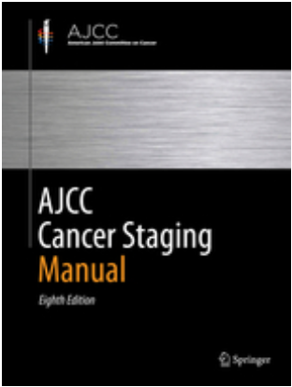

CDC:AJCC
?
Notes:
My first in-person AJCC meeting in April 2016 was memorable because at that meeting AJCC had just completed the 8th edition, and celebrated sending it off to the publisher. They were under the impression that all registries could and would begin collected revised TNM 1/1/2017 – three months after the manual was available in October 2016!
CDC had no advance preview of the book & no head start on software development
It became evident that AJCC did not have a realistic idea on the process and timeline it would take registries to incorporate and educate the revised TNM, and the impact on the entire cancer surveillance system.

Slide 6
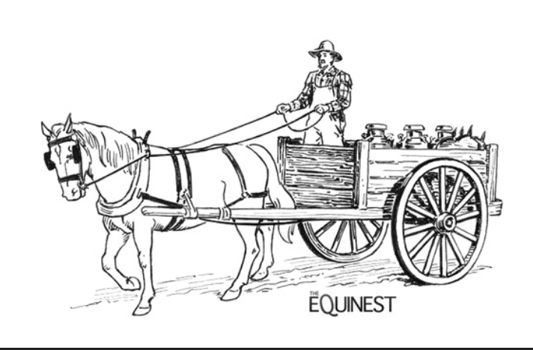
AJCC 8th ed.
Clinicians
Surveillance community
Implementation
The wheels on the cart
Notes:
Over a year later, I shared this slide with AJCC to convey that the publication of the book without readiness of software and education was like putting the cart & horse.
And to extend the analogy
Implementation – the data definitions, standards, layout and software development -- are the wheels that support the cart;
without the wheels, it’s a lot harder for the clinicians and surveillance community to move the cart forward.
FRoss: Use of a 1000+ page physical book as the vehicle for conveying the concepts of the AJCC Staging 8th edition to its users is comparable to using a horse and buggy in the 21st century!

Slide 7
CDC:AJCC
Delayed implementation
Ensured staging of previously-used histology codes
Educated on steps for implementation
Improvements in awareness & processes
Notes:
This is the type of input we have given to AJCC. We advocate on behalf of our registries!
Keeping with Vicki’s tsunami metaphor - Ironically Tsunami MMA is the name of gym where my family works-out. So when the going gets thought, I envision fighting a way through all these challenges.
We were successful in:
Working together with other standard setters to delay AJCC TNM implementation one year to 1/1/2018
Later, NPCR made TNM reporting optional for non-CoC hospitals
Ensuring the inclusion of non-specific and historical histologic codes that were left out of original 8th addition due to preference in using most UTD WHO BB codes
I have taken every opportunity to speak to AJCC on impact of TNM changes on hospital and CCRs and eventually national statistics.
It was a major effort was educating AJCC executive committee on how changes in cancer surveillance standards, like TNM, are implemented
From defining data to placing in NAACCR layout to developing software.
Keeping in mind…they are surgeons…they used to just writing orders and having things happen!
But they are also very smart…and have been willing to listen and learn.
And this has resulting in some changes
We are in a better place now because of changes that occurred in response to the 2018 implementation mess:
AJCC has tripled the surveillance /registry representative on their Exec Comm from 2 organizations (UICC, CDC) to 6 by including NCI, NAACCR, NCDB, and NCRA.
They now have a greater awareness that they are not just publishing a book or rule, but that there is a need for the content to be ‘electronically consumable’
In other words, the world has move from print to the information age.
The content must be accessible and interoperable with EMR and registry software system from the start. It is not a secondary, niche product.
This change will lend itself to more innovative ways to collect and transmit data.
At the start of this year there has been a leadership change at the top of ACoS.
Dr. Heidi Nelson, from Mayo, is over all the cancer programs and has a vision to bring the many facets of ACoS cancer groups together such that AJCC (staging standard) will work more closely with NCDB (CoC registry, which understand the IT implementation arm)
Her manager for this change is a CTR, so that is good for us!

Slide 8



National Partnerships to Promote Cancer Surveillance Standards and Support Data Quality and Operations of
National Program of Cancer Registries*
Collaboration!
Ensure coordination to advance cancer surveillance through…
  Combined subject matter expertise
  Define and implement data standards
  Support central cancer registries
  Build working relationships
* CDC Cooperative Agreement DP18-1802
Notes:
Another major change related to partnerships is that we re-structured our cooperative agreements with national organization that support NPCR so the communication and cooperation are not merely encouraged but required.
In the past, we provided support to NAACCR, ACoS, and CAP to ensure their work serves the interest of our registries. Each organization was funded through separate CoAgs to align activities related to their organizations’ mission and NPCR interests.
The final year of the 5-year funding cycle was 2018, right when we were struggling with 2018 implementation.
It made perfect sense at the time, to bring their respective activities closer together by issuing ONE funding opportunity comprised of 3 components that, by design, work together.
Not only were WE excited about this approach, so were the respective organizations!
Each of the organizations have committed to work together to:
Define and implement cancer surveillance standards.
Provide training
Develop relationships/partnerships to support efficient and innovative data collection.

Slide 9
College of American Pathologists
Promote registry informatics solutions
Ensure coordination of SSDI, NAACCR Vol V, and Structured Data Capture (SDC) Work
Provide education and training for registries
Encourage/support vendors and clinicians to adopt SDC-based data entry forms to standardize content.
Notes:
In addition to coordinated activities, based on their respective missions:
CAP plans to:
Short-term
Promote Registry Informatics Interests and Solutions:
Provide Education and Training for Registries:
Ensure coordination of SSDI, NAACCR Vol V, and SDC Work
Long-term
Encourage/support vendors and clinicians to adopt SDC-based data entry forms to standardize content.
This work will set us up for more efficient data collection in the future!

Slide 10
American College of Surgeons
Planning to synchronize content and implementation
Benefits
  Enable a faster implementation
  Increase quality
  Decrease errata
  Focus on education earlier
AJCC content development
Implementation committee
Notes:
Circling back to AJCC, with support the new cooperative agreement, AJCC has committed to better coordination among the experts writing the chapter and the parties involved further defining in incorporating data into into standards and software.
They are now establishing an Implementation Committee to ensure any future content coming from AJCC is defined in a way that internally consistent, error-free, and informatics-friendly.
The IC, which will include surveillance partners, will work with AJCC Editorial Board to develop or refine content BEFORE its release.
This idea resulted from our input/recommended to the AJCC Executive Committee
Vice-chair is Dr. Sam Shepard from CAP, excellent choice and also fulfills CoopAg requirement of working together.
The benefits to involving surveillance partners and developers on the front-end, during chapter development, are [read]

Slide 11
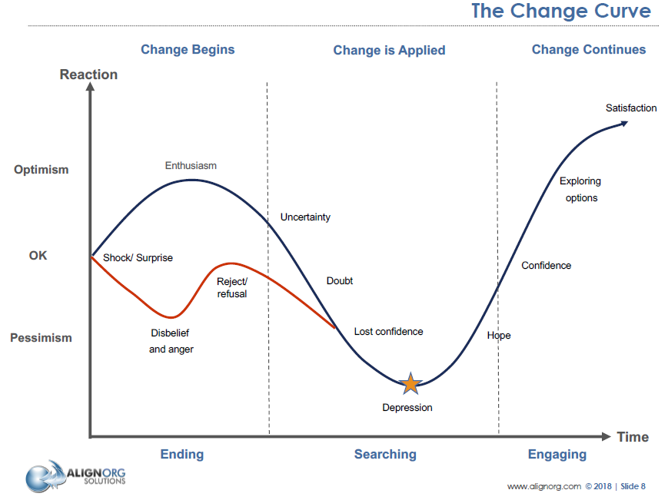
Reflect on the past, look towards the future
Getting to v18…and beyond

Slide 12

Notes:
Sunrise or sunset? It supposed to be a sunrise.
Bottom line, is that despite of the challenges that have contributed to the delays, frustrations, and current state of reporting to NPCR.
The decisions we made for NPCR have been very deliberate and based on the best information and input available at the time when a decisions were needed.
Behind the scenes, we have been pro-active to build and re-wire systems that ensure better communication and coordination among surveillance partners.
Although I did not mention SEER and NCRA, they are aware and included in this work.
I can take a few questions now before I hand it over to
Manxia and Lori will discuss in more detail additional new processes established to support information sharing and decisions……

