Slide 1
NPCR 2019 Program Review Meeting
Cancer Cluster Resources: South Carolina
10:15 am – 11:15 am
April 25, 2019
South Carolina Central Cancer Registry
Bureau of Health Improvement & Equity
SC Department of Health & Environmental Control
Deborah Hurley: hurleydm@dhec.sc.gov
Susan Bolick: bolicks@dhec.sc.gov

Slide 2
South Carolina
Requests: average 50/year
  Excludes ‘bulk’ requests for special grants/projects
  1 meaningful cluster event
Challenges: High profile, Legal
  Media: e.g., childhood brain
  Legal: e.g., childhood brain, leukemia (Trevor’s Law)
  Internal Partners
  External Partners
Successes: Routine, High Profile, Legal
  Follow CDC/CSTE guidelines?
  Stat/Epid Support Staff
  Internal Partners
    Administration
    Office of General Council
  External Partners
    State Senator’s Office
    CDC, NPCR
    ATSDR, NCEH

Slide 3
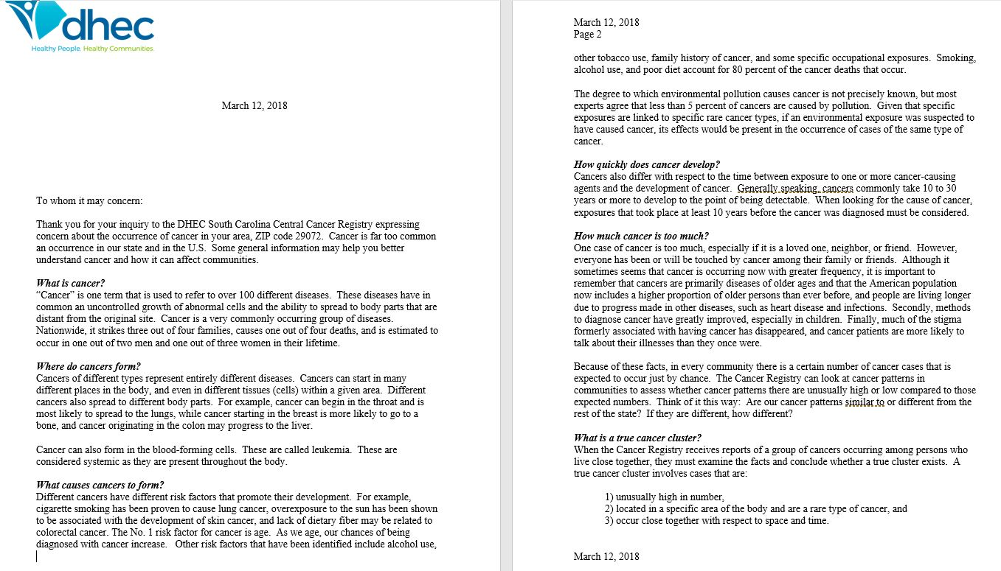
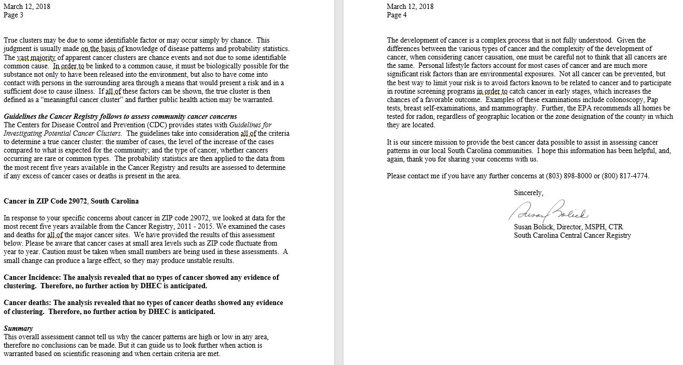
Community Cancer Assessment (CCA) Report
Sample CCA Report

Slide 4
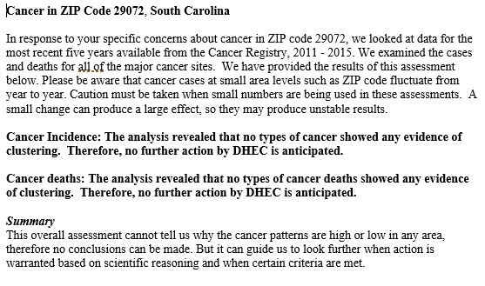
Sample CCA Report: Summary
What is cancer?
Where do cancers form?
What causes cancer to form?
How quickly does cancer develop?
How much cancer is too much?
What is a true cancer cluster?
Guidelines the Cancer Registry Follows to assess community cancer concerns
Key findings of analysis

Slide 5
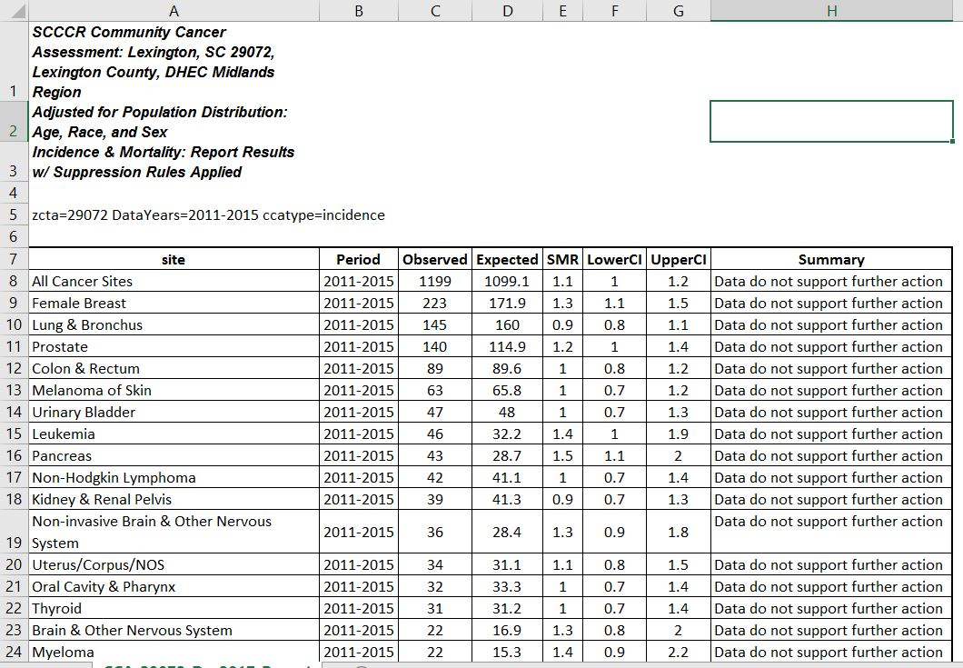
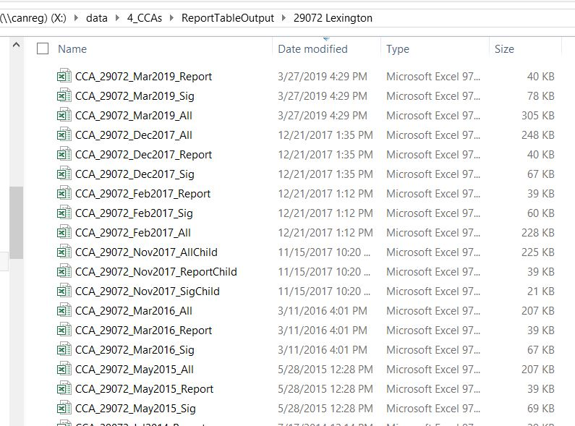
Results Tables for CCA Reports

