Slide 1
Managing the Process and Needs of Cluster Investigations
ATSDR’s Environmental Epidemiology Branch: Technical Consultation and Assistance
Elizabeth Irvin-Barnwell, PhD
Chief (Acting), Environmental Epidemiology Branch
April 25, 2019
Notes:
Thank you for the opportunity to present today. I am currently the acting chief for the Environmental Epidemiology Branch in the Agency for Toxic Substances and Disease Registry. Today, I will give a short overview of ATSDR, while we are the “sister agency” to CDC, we have a different mandate which I will briefly touch on. Additionally, I will provide some insight into the types of technical consultation and assistance the Environmental Epi Branch offers.

Slide 2
Agency for Toxic Substances and Disease Registry Mission and Impact
Mission
  ATSDR protects communities from harmful health effects related to exposure to natural and man-made hazardous substances. We do this by responding to environmental health emergencies; investigating emerging environmental health threats; conducting research on the health impacts of hazardous waste sites; and building capabilities of and providing actionable guidance to state and local health partners.
Impact
  Reduce morbidity and mortality related to exposure to natural and man-made toxic substances.
Notes:
The Agency for Toxic Substances and Disease Registry (ATSDR), based in Atlanta, Georgia, is a federal public health agency of the U.S. Department of Health and Human Services. In 1980, Congress created ATSDR to implement health-related sections of the Comprehensive Environmental Response, Compensation, and Liability Act of 1980 (CERCLA)External. Under this mandate, along with amendments to the RCRA Act and passage of the SARA act, ATSDR protects communities from harmful health effects related to exposure to natural and man-made hazardous substances. We do this by responding to environmental health emergencies; investigating emerging environmental health threats; conducting research on the health impacts of hazardous waste sites; and building capabilities of and providing actionable guidance to state and local health partners.
ATSDR is directed by these congressional mandates to perform specific functions concerning the effect on public health of hazardous substances in the environment. These functions include public health assessments of waste sites, health consultations concerning specific hazardous substances, health surveillance and registries, response to emergency releases of hazardous substances, applied research, information development and dissemination, and education and training concerning hazardous substances. With the impact of the Agency to reduce morbidity and mortality related to exposure to natural and man-made toxic substances.
.

Slide 3
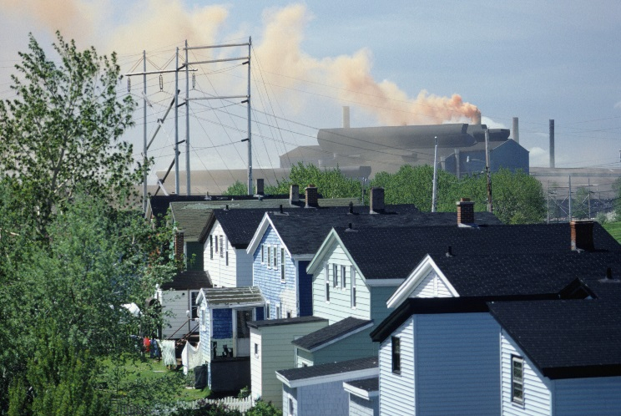
ATSDR Focus
Congressionally mandated to
  Perform public health assessments at hazardous waste sites
  Develop toxicological profiles on harmful substances
  Conduct epidemiological health studies
  Maintain health registries and conduct medical surveillance
Regional offices give national presence
Community engagement key
Notes:
Under the mandates mentioned previously
ATSDR was created to
Perform public health assessments at hazardous waste sites
Develop toxicological profiles on harmful substances
Conduct epidemiological health studies
Maintain health registries and conduct medical surveillance
The agency has ten regional offices which not only give us a presence across the US, but also provide a mechanism for community engagement and outreach with affected populations. Community engagement is key for successfully performing the duties of the agency.

Slide 4
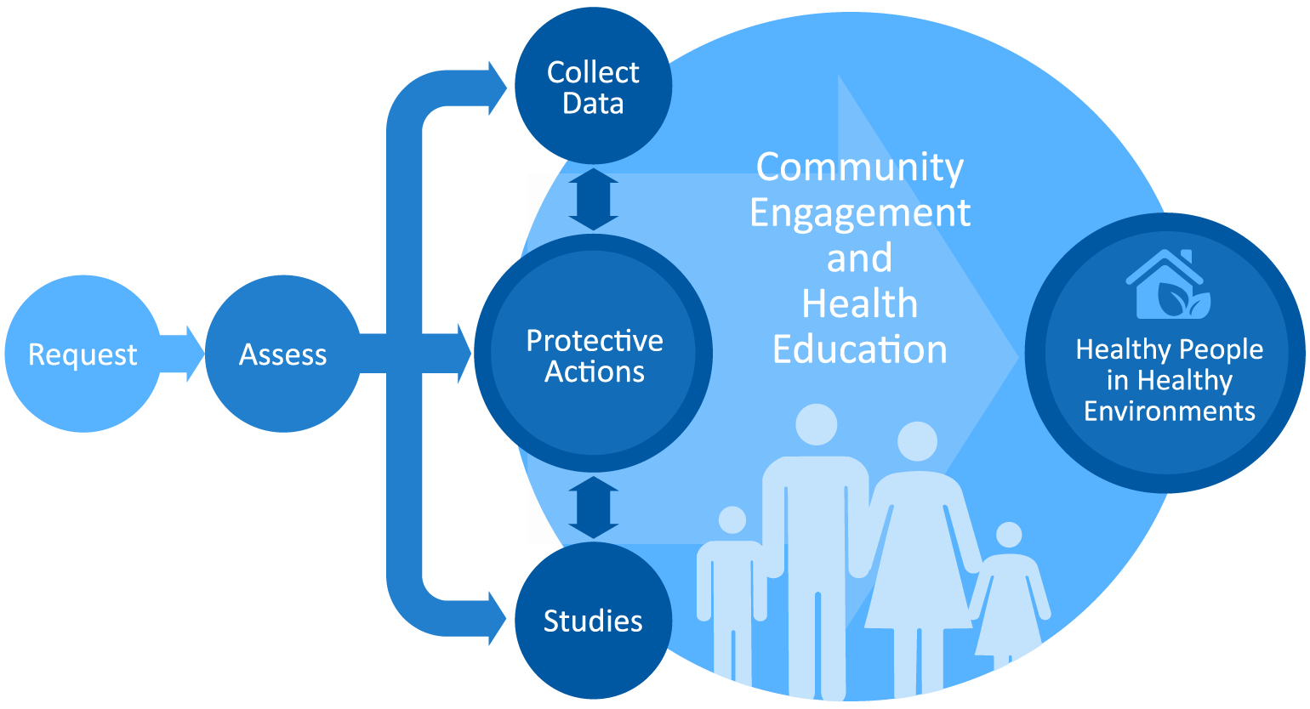
Protecting Communities
Notes:
request for support from EPA, a state or local agency or a resident.
Once we receive a request,
Assess existing environmental and health data to determine whether or not people are at risk because of their exposures
Based on those assessments, we make recommendations to EPA, state regulatory and health agencies, and other stakeholders for stopping and preventing harmful exposures.
For example, we might recommend that filters be installed for a resident’s private well or that soil contaminated with high levels of lead be removed from a backyard. Or recommending that residents talk with their health providers.
follow-up and help ensure that those clean-up actions are taken.
Some of our recommendations are things that we need to do—like providing information to local communities on their risks and what they can do to protect themselves—leading to our final main activity. . .
Sometimes our assessments identify important data gaps that stop us from answering people’s questions about their health risks. So we can undertake or recommend further investigation—like:
the collection of more environmental data or biological data
An epi study to determine the association between an exposure and a particular health outcome
Throughout these activities we work closely with local residents. In this case we are different from many of CDC’s programs because we work directly with community members.
We talk to people on the phone, meet with them in their homes, and hold public meetings and availability sessions so that people understand our findings and recommendations. We develop factsheets and other reference info so that people understand the risks associated with different chemicals. And we get their input on what needs to be done.
We work with health professionals so that they can better answer people’s questions and have the information to effectively treat patients who come to them for care. This means reaching out to health providers around sites where we’re working. Additionally we can offer referrals to environmental experts.

Slide 5

Protecting Communities: What it takes
Extensive staff expertise
  Toxicology
  Exposure Science
  Environmental Science
  Epidemiology
  Risk Science
  Environmental Medicine
  Physical Science and Engineering (radiation, hydrology, modeling, etc.)
  Health Education and Community Engagement
Notes:
The type of work we do at ATSDR and in environmental health in general is not simple, we draw on expertise from many scientific fields. Just as an airport ground crew, with a variety of specialized expertise, works together to ensure the successful take-off and landing of an airplane, ATSDR brings together a variety of experts to ensure the public’s health and safety. From toxicology to engineering to environmental medicine to epidemiology. And then we draw on expertise in health education and community engagement to make sure that the science is understandable to people dealing with environmental issues in their communities.

Slide 6
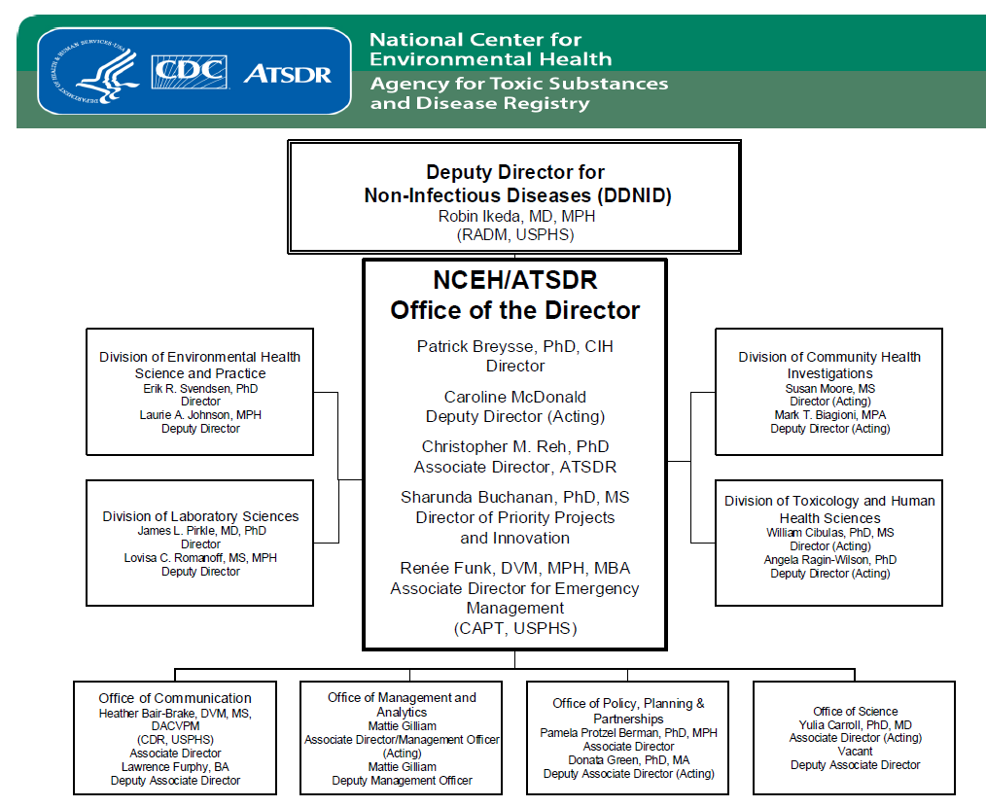
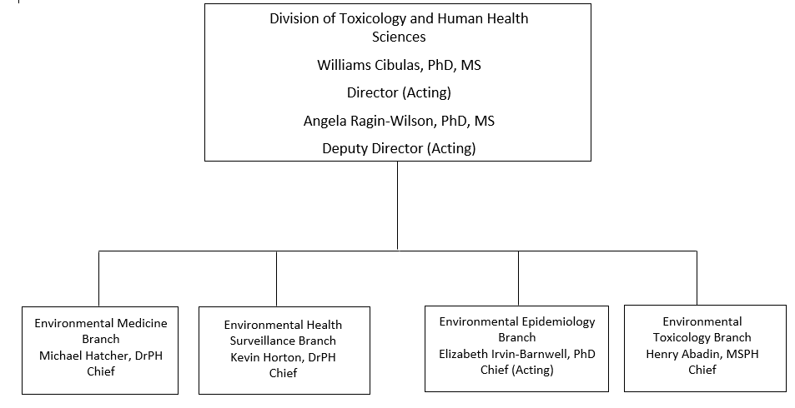
Organizational Chart
Notes:
I apologize in advance for the hard to see figures. ATSDR, along with NCEH, are under the Deputy Director for Non-Infectious Diseases. There are currently two divisions in ATSDR, the Division of Community Health Investigations and the Division of Toxicology and Human Health Sciences. The Environmental Epidemiology Branch is under the Division of Toxicology and Human Health Sciences.

Slide 7
Environmental Epidemiology Branch
The Environmental Epidemiology Branch (EEB) designs and conducts environmental epidemiology studies to evaluate the association between exposure to environmental contaminants and adverse health effects.
Ongoing health studies/projects include:
Anniston Community Health Survey
Biomonitoring of Great Lakes Populations
Camp Lejeune Cancer Incidence Study
Comprehensive Disaster Assessment and Readiness Toolkit Project
PFAS Health Study Initiative
Polycythemia Vera Cancer Cluster Investigation
Synthetic Turf Investigation
Notes:
As an overview, the Environmental Epi Branch designs and conducts environmental epidemiology studies to evaluate the association between exposure to environmental contaminants and adverse health effects. We have a variety of project/health studies ongoing in the branch, including the Anniston Community Health Survey, the Biomonitoring of Great Lakes Populations Program, the Camp Lejeune Cancer Incidence Study, the Comprehensive Disaster Assessment and Readiness Toolkit Project, the PFAS Health Study Initiatives, the Polycythemia Vera Cancer Cluster Investigation, and the Federal Research Action Plan on Recycled Tire Crumb Rubber Used on Playing Fields and Playgrounds (or more easily referred to as the Synthetic Turf Study.
We have a variety of staff in the branch, including epidemiologists, toxicologists, environmental health scientists, and chemists.

Slide 8
Technical Advice, Consultation, and Assistance
ATSDR’s Partnership to Promote Local Efforts to Reduce Environmental Exposure (APPLETREE) Program
  EEB staff provide epidemiological guidance and assistance to 25 state health department grantees for site-specific work.
Technical Reviews
  EEB staff provide technical reviews of epidemiological reports, such as cancer incidence analyses, when formally requested by the state or local health department.
Technical Assistance
  EEB staff provide technical assistance, such as epidemiological guidance.
Notes:
So to transition a little to the topic today; the Environmental Epi Branch assists state and local health departments as well. In general, there are three main avenues where we provide technical advice, consultation, and assistance to state health departments.
1. The Agency for Toxic Substances and Disease Registry’s (ATSDR’s) Cooperative Agreement Program, which is housed in the Division of Community Health Investigations, is critical to ATSDR’s success in accomplishing its mission in communities nationwide. The Program funds 25 partner organizations. Twenty-five states use Cooperative Agreement Program funding to build their ability to evaluate and respond to environmental public health issues.
The Cooperative Agreement Program’s primary goal is to give partners the resources to build their capacity to assess and respond to site-specific issues involving human exposure to hazardous substances in the environment.
The Program helps ATSDR’s partners
identify exposure pathways at specific sites;
educate affected communities and local health professionals about site contamination and potential health effects;
review health outcome data to evaluate potential links between site contaminants and community health outcomes.
The Cooperative Agreement Program enhances ATSDR’s communication and collaboration with state, local, and federal health and environmental agencies. Since the Cooperative Agreement Partners are located nationwide and require less travel times, this program enhances the capability of ATSDR to conduct its site-specific activities in a timely fashion. Each member of EEB is assigned to APPLETREE state grantees to provide epidemiological assistance and guidance for the site-specific work. This often involves reviewing Public Health Assessments and Health Consultations for Health Outcome Data, including Cancer Incidence Analyses.
Technical Reviews: EEB staff, normally a statistician and an epidemiologist, will provide a formal technical review of epidemiological reports when requested by the state or local health department. These can include cancer incidence assessment reports.
Technical Assistance: EEB staff can provide technical assistance when requested by the state health department. This can be expertise, such as expert epidemiological guidance or statistical assistance.

Slide 9
Technical Advice, Consultation, and Assistance - Examples
ATSDR’s Partnership to Promote Local Efforts to Reduce Environmental Exposure (APPLETREE) Program
  Reviewed site-specific health outcome data reports
Technical Reviews
  Reviewed cancer incidence analysis reports
Technical Assistance
  Provided statistical expertise for Bayes empirical modeling
Notes:
A few quick examples of this (without naming specific states or sites):
As part of our normal duties in EEB, we review the health outcome data-containing documents for the APPLETREE program. For example, there was recently a landfill site where the community was concerned about potential exposures to chemicals, including benzene and formaldehyde. The EEB TPO reviewed the health outcome data analysis, specifically the cancer incidence analysis, and provided feedback on the methodology, results reporting and interpretation, and the conclusions.
Similarly, EEB staff provide technical review of documents, outside of the APPLETREE program or specific sites, when requested by the state. An example of this was a request from a state to review a cancer incidence analysis report on childhood cancer, specifically leukemia, for a number of counties. For this review, the EEB SMEs provided feedback on the methodology, results reporting and interpretation, and the conclusions. While we have previously reviewed documents that have already been published, it is likely of benefit to the requestor to request the document review prior to finalization and publication.
For the technical assistance, we can provide specific expertise, as applicable, to state and/or local health departments. An example of this is statistical modeling. After publication of a cancer incidence analysis, the state received input that some additional statistical modeling might elucidate some potential issues identified due to potential for variance instability and multiple comparisons in the original analysis. As such, the state requested ATSDR’s assistance in refining the original analysis using Bayes Empirical Modeling. The technical assistance, specifically the modeling, was provided by an SME in EEB.
Those are just a few brief examples of the ways in which ATSDR, specifically the EEB, can provide technical advice, consultation, and assistance to states regarding suspected cancer clusters.

Slide 10

Questions?
Notes:
I am happy to answer any questions.

