Slide 1

Ohio Cancer Incidence Surveillance System
Cancer Reporting from Federal Agencies
2019 NPCR Program Review Meeting
Atlanta, Georgia
April 25, 2019

Slide 2
Objectives
Describe Ohio’s experiences in getting data directly from:
  Ohio’s 5 Veterans Affairs (VA) hospitals
  Ohio’s 1 Department of Defense (DoD) hospital
Describe Ohio’s experience in getting data from the Veterans Affairs Central Cancer Registry
Describe Ohio’s experience in obtaining data from the Department of Defense

Slide 3
Background
Ohio’s VA and DoD hospitals have never reported directly to the Ohio cancer registry
Historically, facilities have indicated:
  prohibited from reporting
  state reporting law and rules do not apply

Slide 4
Veterans Affairs Background
August 17, 2007: VHA Directive 2007-023
October 1, 2009: VHA Directive 2009-046
July 23, 2014: VHA Directive 1072
Directives:
  Allow for reporting by VA facilities to state cancer registries
  Require data use agreements and written request letter from State
  De-identified data can be sent to CDC, NAACCR, SEER
  Identified data can be sent to NDI and IHS for linkage
  Identified data cannot be released to other states
  Data can be used for research with appropriate approvals

Slide 5
Veterans Affairs Background
Ohio started to develop individual data use agreements with all 5 Ohio VA facilities
Learned that a single agreement with the VA Central Cancer Registry (in Washington, DC) was possible
Pursued option for single agreement

Slide 6
VA Single Agreement
Data Security
  Data transmission
  Server environment
  Firewall technology
  Encryption standard
September 28, 2012: CDC informs states that VA indicates Web Plus is acceptable for uploading data

Slide 7
VA Single Agreement
Lengthy process
Agreement in effect for 3 years from 2012-2014
VA provided data on all Ohio residents – not just from the 5 Ohio facilities
VA provided data back to our reference year
New data provided annually
Increased data completeness by 1.5%

Slide 8
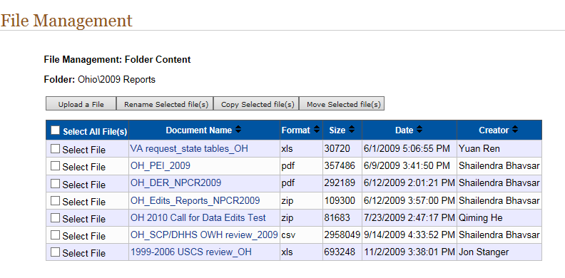

Slide 9
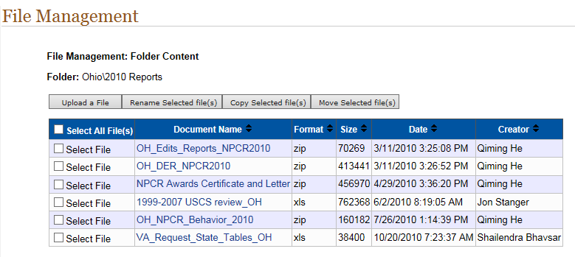

Slide 10
VA Single Agreement
Started renewal process
New requirements for data security
Concerns re: Web Plus; decided to go with secure FTP
Changes in VA personnel
Person who previously provided data retired; position not backfilled
VA approved new MOU but did not obtain all necessary signatures to execute
No agreement in place; no VA data since 2014

Slide 11
Department of Defense Background
Communication from 2010 indicated states needed to sign a Memorandum of Understanding to obtain data
Ohio began this process in 2013
Agreement is with the Department of Defense (DoD) Defense Manpower Data Center Automated Central Tumor Registry (ACTUR)

Slide 12
DoD Agreement
Data Security
  Data transmission
  Certification and accreditation standards
Worked with CDC re: Web Plus acceptability
Worked with internal IT to obtain Certification and Accreditation documentation – Authority to Operate (ATO)

Slide 13
DoD Agreement
Initially, took some time to set up
Agreement in effect since 2014; remains in effect for 10 years
DoD provided data back to our reference year
Data for single DoD facility in Ohio
New data provided annually
Need to update Authority to Operate letter every 3 years

Slide 14
DoD Data
Ohio receives 150-250 new cases each year
DoD unable to send only new cases – we must de-duplicate
Due to size of files, no longer use Web Plus for file transfer
Good working relationship with our DoD facility – follow-up if we see issues with data quality
  Need to specify that we only want ‘complete’ data

Slide 15
Conclusions
Cancer reports from federal agencies are important to the completeness of central cancer registry data.
Ohio’s experience is that agreements must be in place to obtain these data.
Need to coordinate with internal IT.
We look forward to learning from other states’ experiences.

Slide 16
Questions?
Contact Information
Ohio Cancer Incidence Surveillance System
Lynn Giljahn, lynn.giljahn@odh.ohio.gov or 614-644-1844

