Slide 1
Surveillance, Evaluation, and Research Team (SERT)
Welcomes You!

Slide 2
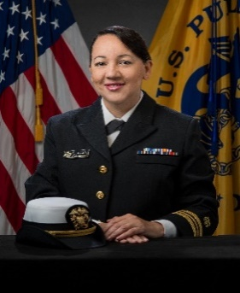
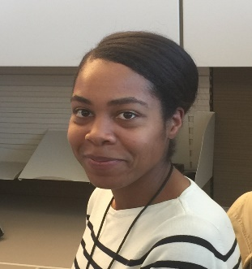


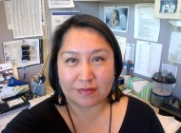
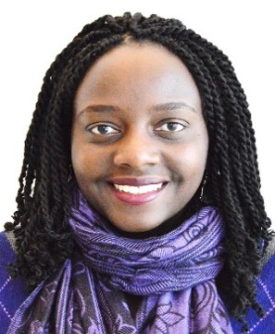


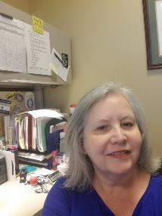
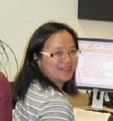
SERT Members
Denise Duran
Taylor Ellington
Jane Henley
Melissa Jim
Mary Elizabeth O’Neil
Virginia Senkomago
Simple Singh
Trevor Thompson
Reda Wilson
Manxia Wu

Slide 3
What SERT Does
CSS:
Data Submission
Data Linkage:
NDI
IHS
Data Quality Evaluation: DQE, DER, PEI, DQI
Surveillance Enhancements:
CER, PCOR, Component Two
Surveillance | Evaluation
Research | Dissemination
Data Tools
Publications:
MMWR, ARN, Data Briefs, Special studies
U.S. Cancer Statistics:
Data Viz.
Public Data

Slide 4
We’d Love Your Questions and Input!
Thank You!

