Slide 1
NTSS-CR National Tuberculosis Surveillance System – Case Reporting

Slide 2
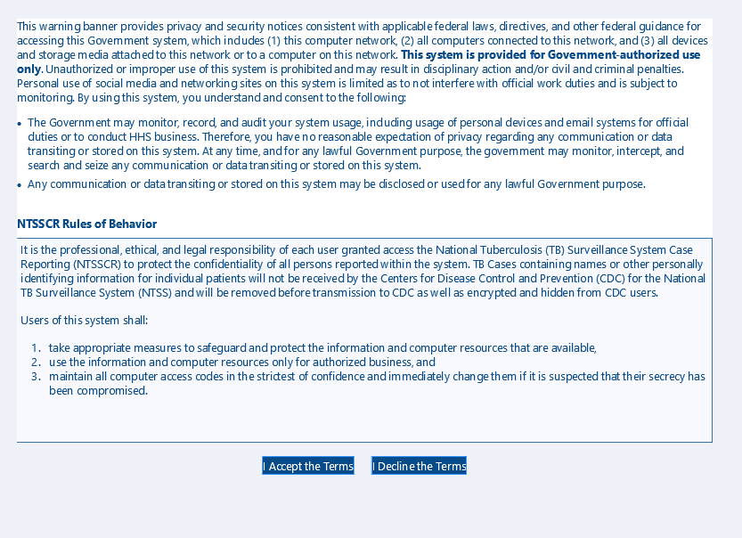

Slide 3
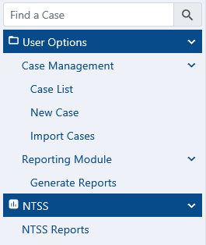
Welcome to NTSSCR

Slide 4
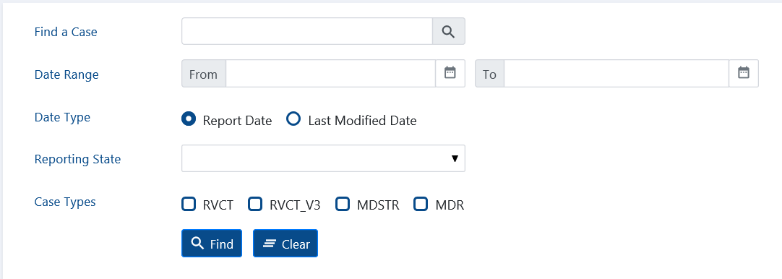
Case List

Slide 5
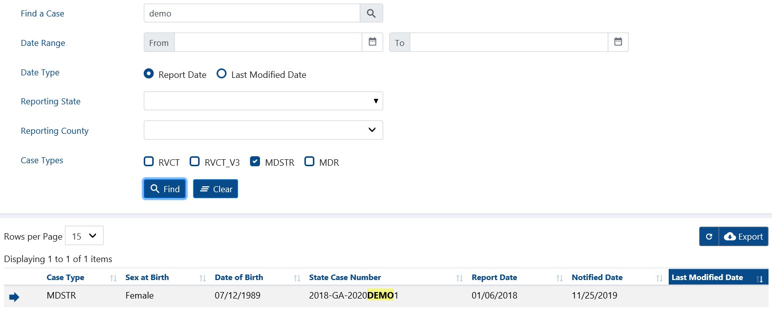
Search

Slide 6
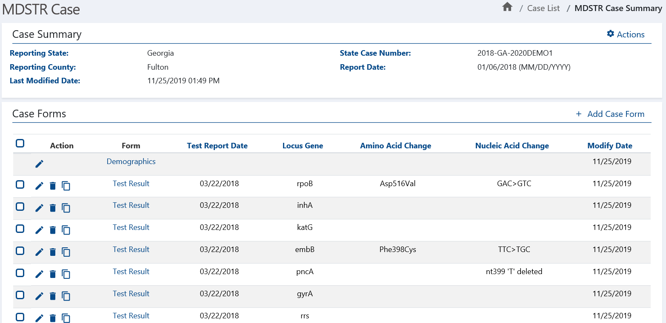
Edit
Delete
Copy

Slide 7
Add Notify Case
Edit
Delete
Copy

Slide 8
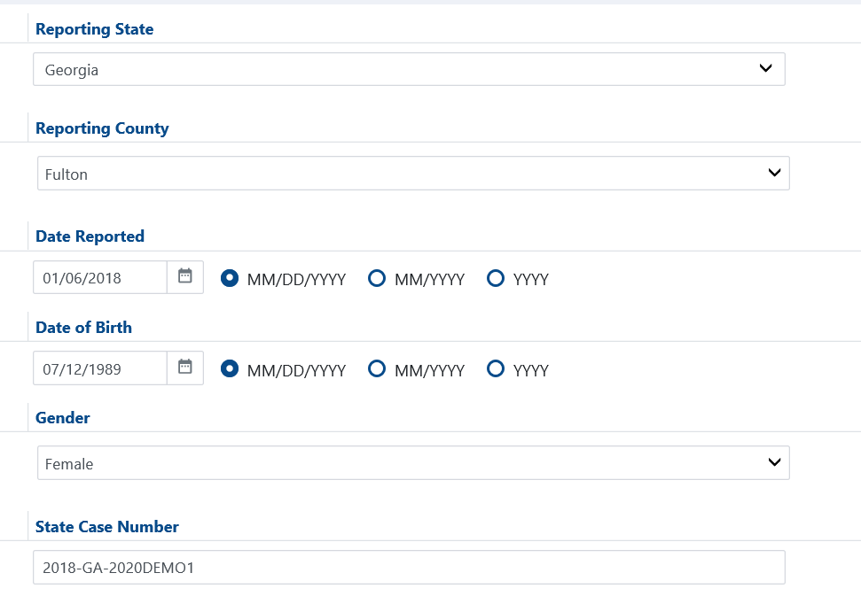
Georgia 2018-GA-2020DEMO1
Demographics Form

Slide 9
Georgia 2018-GA-2020DEMO1
Test Result -- Section A
Test Type Options
Sequencing
Non-sequencing
Unknown
Other
Molecular Test Options
Pyrosequencing
Sanger Sequencing
Next Generation Sequencing (NGS)
Targeted-Based Sequencing
Amplicon-Based Sequencing
Whole Genome Sequencing (WGS)
Real-time PCR
Line probe assay
Xpert MTB/RIF
Other
Starred items are reportable with RVCT

Slide 10
Georgia 2018-GA-2020DEMO1
Test Result -- Section A
Gene Options
ahpC-oxyR
Eis
embB
ethA
fabG1 (mabA)
gyrA
gyrB
inhA
katG
pncA
rpoB
rpsL
rrs
tlyA
Other
Results Options
Mutation detected
No mutation detected
Unknown
Starred items are reportable with RVCT

Slide 11
Georgia 2018-GA-2020DEMO1
Test Result -- Section A
No dropdown – free text
Amino Acid Options
Alanine Ala A
Aspartic acid or Asparagine Asx B
Cysteine Cys C
Aspartic acid Asp D
Glutamic acid Glu E
Phenylalanine Phe F
Glycine Gly G
Histidine His H
Isoleucine Ile I
Lysine Lys K
Leucine Leu L
Methionine Met M
Asparagine Asn N
Proline Pro P
Glutamine Gln Q
Arginine Arg R
Serine Ser S
Threonine Thr T
Valine Val V
Tryptophan Trp W
Unknown Xxx X
Tyrosine Tyr Y
Glutamic acid or Glutamine Glx Z
Choices are to enter the Amino Acid Change by picking the left side (or blank) then the position then the right side – results
might show the 3 letter or 1 letter codes OR leave that section empty and complete the Other (Specify) which is free text.
Starred items are reportable with RVCT

Slide 12
Georgia 2018-GA-2020DEMO1
Test Result -- Section A
No dropdown – free text
Indel Options
Deletion
Insertion
Indel (NOS)
Unknown (add option)
Select from TB medications listing as many drugs as desired for association to this result. May also include Other with the Specify free text
Starred items are reportable with RVCT

Slide 13
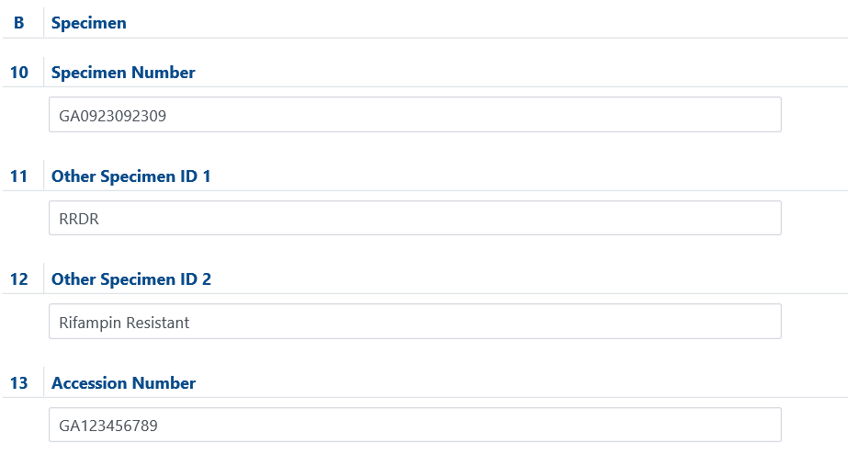
Georgia 2018-GA-2020DEMO1
Specimen -- Section B
Rework – as Region and move to be next to the Gene in the Test Result section
Rework – as Interpretation and move into the Test Result section
Relabel as Molecular DST Accession (or ID) Number

Slide 14
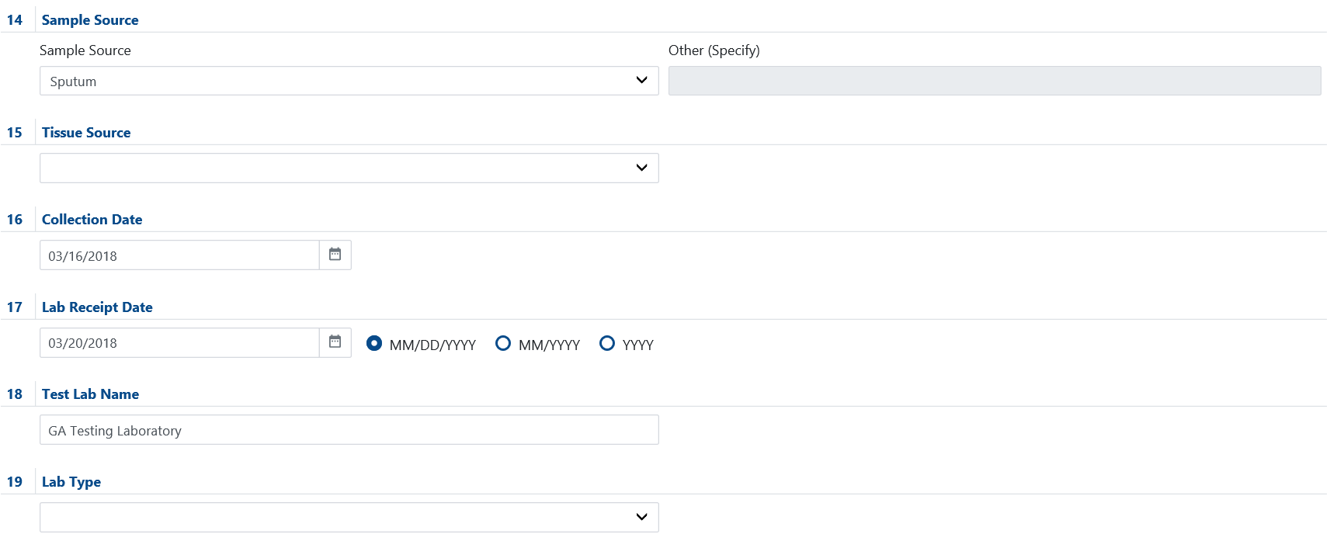
Georgia 2018-GA-2020DEMO1
Specimen -- Section B
Rework Q14 and Q15 as single question Specimen Source Site (with normal anatomic sites from RVCT in dropdown)
Remove question
Starred items are reportable with RVCT

