Slide 1

Report of Verified Case of Tuberculosis, 2020
Training provided by:
Division of Tuberculosis Elimination
Notes:
This slide set and webinars were prepared by the Division of Tuberculosis Elimination (DTBE), National Center for HIV/AIDS, Viral Hepatitis, STD, and TB Prevention (NCHHSTP), Centers for Disease Control and Prevention (CDC), U.S. Department of Health and Human Services (HHS). This training describes updates to the data collection form used to collect TB surveillance data, standardized for national surveillance, known as the 2020 Report of Verified Case of TB, or RVCT.

Slide 2
Acknowledgments
2020 Report of Verified Case of Tuberculosis (RVCT) Work Group/Pilot sites
  Janice Westenhouse, Shona Smith, Lisa Paulos, Jason Cummins, Kelly White, Juli Bettridge, Karen Fujii, Maria Rodriguez, Suzanne Keller, Muriel Silin, Jesse Ellis, Jerry Carlile, Rose Sales, Cheryl Kearns, Lori Johnston, Evan Timme, Leonard Mukasa, Mayleen Ekiek, Kiley Ariail, Laura Young, Shawn McBrien
National Tuberculosis Controllers Association (NTCA) Executive Board
Council of State and Territorial Epidemiologists (CSTE)
Notes:
The 2020 RVCT was made possible with the collaboration of many partners. DTBE Surveillance Team met routinely with the 2020 RVCT Revision Work Group that included state and local health departments. DTBE would like to acknowledge the following individuals from the 2020 RVCT Work Group and pilot sites for their insight in developing the 2020 RVCT and supporting materials.
We also consulted with and received important input from the National TB Controllers Association (NTCA) and the Council of State and Territorial Epidemiologists.

Slide 3
Acknowledgments
DTBE
CDC
Surveillance Team, SEOIB
Education Team, CEBSB
Data Management Team, DMSEB
Medical Consultation Team, FSB
Program Evaluation and Health Economics Team, DMSEB
Laboratory Branch
Tom Navin, Angela Starks, Carla Winston, Peri Hopkins, Maryam Haddad, Tracy Dalton
Nationally Notifiable Disease Surveillance System (NNDSS)
Office of Smoking and Health, National Center for Chronic Disease Prevention and Health Promotion (NCCDPHP)
National Institute for Occupational Safety and Health (NIOSH)
Notes:
Many colleagues in the Division of TB Elimination also contributed to development of the 2020 RVCT and these training materials.
We also want to thank CDC’s Nationally Notifiable Disease Surveillance System, Office of Smoking and Health in the National Center for Chronic Disease Prevention and Health Promotion, and the National Institute for Occupational Safety and Health.

Slide 4
Training Overview
Audience and goals
Logistics
  Reference and training materials
  Key deadlines
Overview of 2020 RVCT
  Review of reportable and countable definitions
  Highlights of RVCT changes
Item by item discussion of each RVCT variable + related case studies
Wrap-up, composite case study, and evaluation
Notes:
The training includes a summary of the target audience and goals of this training as well as available references, training materials, and key deadlines for implementation of the new 2020 RVCT. We will review the definitions of reportable and countable cases and summarize the highlights of the new RVCT changes compared to the last revision in 2009. The main segment of this training will involve an item-by-item discussion of each of the 43 variables of the RVCT with related case studies for each item.
[For in-person training: we will wrap up with a composite case study exercise and distribute evaluation forms to receive your valuable feedback.]

Slide 5
Goals
Educate public health staff who…
  Collect information about TB patients in their jurisdictions
  Decide whether a TB case is reportable in the United States and,
  if so, whether countable and which U.S. jurisdiction should count
  Complete the RVCT for reportable cases
  Monitor quality of RVCT data
  Use RVCT data
…to achieve accurate, timely, and complete TB case reporting
from all U.S. reporting areas
Notes:
The goals of this training are to educate public health staff who…
collect information about TB patients in their jurisdictions; decide whether a TB case is reportable in the United States and,
if so, whether countable and which U.S. jurisdiction should count.
It is also for staff who complete the RVCT for reportable cases; monitor quality of RVCT data; and use RVCT data.
These goals are important so that we can achieve accurate, timely, and complete TB case reporting from all U.S. reporting areas.

Slide 6
Reference and Training Materials
2020 RVCT Instruction Manual
  RVCT 2009 to RVCT 2020 Form Comparison Guide
  Message Mapping Guide for IT staff handling transition to new RVCT
Recorded webinars with item-by-item review and related case studies
FAQs
Notes:
Available reference and training materials include the 2020 RVCT instruction manual. Supporting documents for the instruction manual include a comparison guide between the 2009 RVCT and the 2020 RVCT collection form as well as a message mapping guide for IT staff. This recorded training and the slides will be posted online and include an item-by-item review of each variable on the 2020 RVCT with related case studies. In addition, Frequently Asked Questions or FAQs are being created to assist with unanswered questions.

Slide 7
Key 2020 RVCT Deadline
December
2022
31
Case notification messages
must be sent in new format
All new RVCT variables
collected and sent to CDC
Notes:
There is one important deadline to remember for the 2020 RVCT. By December 31, 2022, case notification messages must be sent in the new format, and all new RVCT variables should be collected and reported. Because of the need to focus available resources on the current COVID-19 response, the Division of TB Elimination extended the previous deadline for switching over to the new case notification message format to December 31, 2022. However, DTBE is prepared to assist with 2020 RVCT onboarding at any time.

Slide 8
2020 RVCT overview
Reportable, countable, and summary of revisions
Notes:
Before we dive into the specific items of the 2020 RVCT, let’s first talk about whether cases are reportable and countable in a U.S. reporting area. And if countable in a U.S. reporting area, what jurisdiction should count the case.

Slide 9
U.S. Reporting Areas for TB Surveillance Purposes
Each of the 50 U.S. states
  New York City is also a reporting area (separate from NY State)
District of Columbia is its own reporting area
5 U.S. territories
  Puerto Rico (PR)
  U.S. Virgin Islands (VI)
  American Samoa (AS)
  Guam (GU)
  Commonwealth of the Northern Mariana Islands (MP)
3 freely associated states
  Federated States of Micronesia (FM)
  Republic of the Marshall Islands (MH)
  Republic of Palau (PW)
Notes:
Reporting of all verified TB cases that meet the Council of State and Territorial Epidemiologists’ surveillance case definition in these reporting areas for ≥90 days (inclusive of the report date) is required by the cooperative agreements between CDC and TB programs.
Health departments in the 50 U.S. states and the District of Columbia report all verified TB cases to CDC. New York City is also its own reporting area (separate from New York State) that reports cases directly to CDC. In addition, five U.S. territories (Puerto Rico, U.S. Virgin Islands, American Samoa, Guam, and Commonwealth of the Northern Mariana Islands), and three independent countries that are in compacts of free association with the United States (Federated States of Micronesia, Republic of the Marshall Islands, and Republic of Palau) report to CDC. For example, although Palau is an independent country, it is a U.S. reporting area for TB surveillance purposes.
Appendix C of the RVCT instruction manual provides a list of the reporting areas with corresponding 2-digit abbreviations. These abbreviations are needed when reporting on cases that are transferred to your jurisdiction, and you need to complete the other reporting area’s RVCT and state case number.

Slide 10
1. Is this case reportable?
Reporting of all verified TB cases who are in a U.S. reporting area for
≥90 days (inclusive of the report date) is required
  Based on the cooperative agreements between CDC and TB programs
  Regardless of whether the case is counted as part of the jurisdiction’s official TB case count
Notes:
First we want to determine if a case is reportable. Based on the guidance in the 2020 RVCT Instruction Manual in Appendix B: Reporting of all verified cases who have been in a U.S. reporting area for ≥90 days (inclusive of the report date) is required by the cooperative agreement between CDC and state and local TB programs, regardless of whether the case is counted as part of the jurisdiction’s official TB case count.

Slide 11
Examples of “90-Day Rule” for TB reporting
Reportable?
A |  | Y / N
B |  | Y / N
C |  | Y / N
D |  | Y / N
E |  | Y / N
F |  | Y / N
G |  | Y / N
X
= U.S. arrival date
= Report date
= U.S. departure date
= 90 days
= Died
X
Notes:
The “90-day rule” is often confusing. This diagram gives scenarios to help identify whether you should report a TB case to CDC. In each of these scenarios, TB diagnosis was reported after arrival in the United States or U.S. reporting area. The red circle indicates U.S. arrival date and marks the beginning of the 90-day period. The 90-day period is represented by the gray box. Report date is indicated by the orange-yellow diamond and the blue dot represents U.S. departure date.
In scenarios A and B, the departure date is after the 90-day period of being in the United States or U.S. reporting area. In scenario A, the report date occurred before the patient had been in the United States or U.S. reporting area for 90 days, but the patient remained in the U.S. reporting area for more than 90 days total. In scenario B, the report date occurred after being in the United States/U.S. reporting area for 90 days. In both scenarios A and B, the patients were in the United States or U.S. reporting area for at least 90 days and thus both cases would be reportable to CDC.
In scenario C, the departure date is right at 90 days in the United States/U.S. reporting area so this case would also be reportable to CDC.
In scenario D, the departure date is before the 90-day mark so this case would NOT be reportable to CDC.
Scenario E has the same U.S. departure date as scenario D so this case is not reportable to CDC, even though the report date was at 90 days. In this scenario, the time that the patient was in the United States/U.S. reporting area did not overlap with the report date.
In scenario F, departure date is right at 90 days in the United States/U.S. reporting area, so this case is reportable to CDC even though the report date occurred after the patient departed.
In scenario G, the patient died before being in the United States/U.S. reporting area for 90 days. Even though this patient was not living in the reporting area for 90 or more days, they might have done so if they had survived. As long as this case is not counted in another country, we ask that you report this case to CDC.
It is important to note that the 90-day period starts when the person arrives in the United States or U.S. reporting area and ends when the person departs the United States or U.S. reporting area and is not related to the TB report date to the health department.

Slide 12
2. Is this case countable?
No if already diagnosed with TB in another country
  Even if unclear whether the other country is counting the case
No if person was in U.S. reporting area <90 days when TB evaluation began and
  did not start TB treatment in a U.S. reporting area
  (e.g., ICE detainee no longer in U.S. by time culture result came back)
  or
  began TB treatment in a U.S. reporting area, but returned to other country without having lived ≥90 days in a U.S. reporting area
Notes:
After you determine whether a case is reportable, the next question is “Is this case countable?”
Here are the no options:
The case has already been counted by another country—if it is unclear whether the other country is counting the case, we consider the case to have been counted by the other country if the patient started TB (not LTBI) treatment before arriving in a U.S. reporting area. This remains true even if the patient takes treatment for ≥90 days in a U.S. reporting area.
On Pg 14 of the RVCT instruction manual it says, consider the case to have been counted in the other country if the diagnostic evaluation was completed and the patient was prescribed anti-TB medications before arriving in the United States.
If the person was in a U.S. reporting area for <90 days when TB diagnosis evaluation was done and did not start TB treatment in a U.S. reporting area, then this case is not countable. For example, if there was an Immigration and Customs Enforcement (ICE) detainee who was tested and then deported before the positive culture TB result came back. Also, if this person began TB treatment in a U.S. reporting area, but return to their native country to continue therapy, the case would still not be counted in the U.S. because the person was here for <90 days.
However, persons from other countries who are in a U.S. reporting area at least 90 days, inclusive of report date, are all considered countable here, even if they return home to continue treatment.

Slide 13
2. Is this case countable? (continued)
Yes if person in a U.S. reporting area for ≥90 days (inclusive of report date)
  Regardless of whether any TB treatment provided
Also, border crossers* receiving treatment in the United States
≥90 consecutive days (excluding weekends) should be counted by
the U.S. locality where they receive treatment
*Border crosser is an alien resident of the United States reentering the country after an absence of less than 6 months in Canada or Mexico, or a nonresident alien entering the United States across the Canadian border for stays of no more than 6 months, or across the Mexican border for stays of no more than 72 hours.
Notes:
Here are the yes options for “Is this case countable”:
Based on Appendix B of the RVCT instruction manual, for persons diagnosed with TB who are in a U.S. reporting area for ≥90 consecutive days, inclusive of report date, the case should be reported and counted by the locality where the diagnostic evaluation for TB began. This is true even if the person did not start treatment.
Also, for border crossers who receive TB treatment from a locality in the United States for a total of ≥ 90 days consecutive days (excluding weekends), the cases should be reported and counted by the U.S. locality where the person receives TB treatment.
More information about the definition of border crosser is available in the 2020 RVCT Instruction Manual.

Slide 14
3. Which U.S. reporting area should count the case?
The reporting area where the patient was residing (however temporarily)
at the time the diagnostic evaluation for TB began
  Even if that reporting area is not involved in treating the patient’s TB
Exception is a person who returns home to another U.S. reporting area
to continue and complete TB treatment there
  The U.S. reporting area that is entering the home address in item 6 (Reporting Address) should count this case
Notes:
If you determine the case to be countable as a U.S. case…Which U.S. reporting area should count the case?
The RVCT instruction manual provides more detailed examples about which jurisdiction should count the case.
Generally, count in the reporting area in which he/she lived at the time that the TB diagnostic evaluation was initiated. This is true however temporarily the patient was in that reporting area and does not matter if that reporting area is involved in treating the patient’s TB. This includes a person from a different country who is living in a U.S. reporting area for at least 90 days.
The exception is if the patient returns home to another U.S. reporting area to complete treatment. The case should be counted in the patient’s home reporting area. The reporting address would be the home reporting area. We’ll talk about this more in item 6.

Slide 15
How should recurrent TB be reported and counted?
Recurrent TB only countable again if diagnosed >12 months after last dose
If TB diagnosed again in a patient who was taking TB treatment within
past 12 months, do not count again — but report in one of two ways:
  Reopen the RVCT for the
  original TB episode and
  update the appropriate variables
  (e.g., sputum conversion,
  date of treatment completion)
  This is preferred way to report
  Submit a new RVCT and in item 5 indicate that the case has already been counted by another U.S. reporting area
  Enter current reporting area as the “other” reporting area
Notes:
We have one more special circumstance to clarify which U.S. reporting area should count the case, recurrent TB.
Just as always, recurrent TB is not countable as a new case of TB unless it is diagnosed at least 12 months after the last dose of treatment for the earlier case of TB.
For persons diagnosed with TB again within 12 months, we previously asked you to complete a new RVCT form, and our instructions were not to count that second report.
Now we’re asking you not to do that extra work. Instead, we’d prefer that you reopen the original RVCT and update the appropriate variables,
such as the new sputum conversion date and the new treatment completion date.
However, if your reporting area does not allow previously submitted RVCTs to be reopened and updated, you may submit a new RVCT but in item 5 note that the case has already been counted by another reporting area, even though that other reporting area is just the same reporting area again.

Slide 16
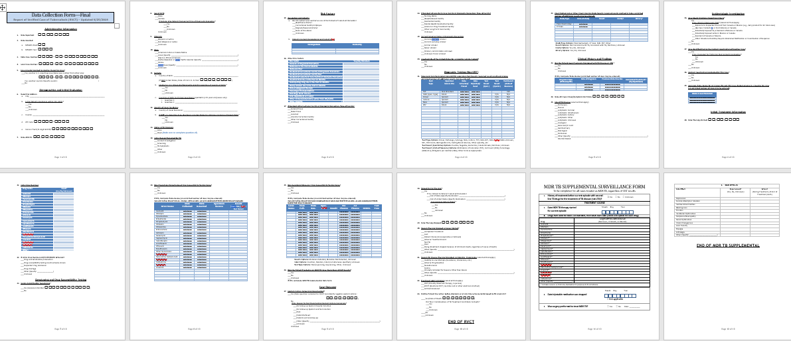
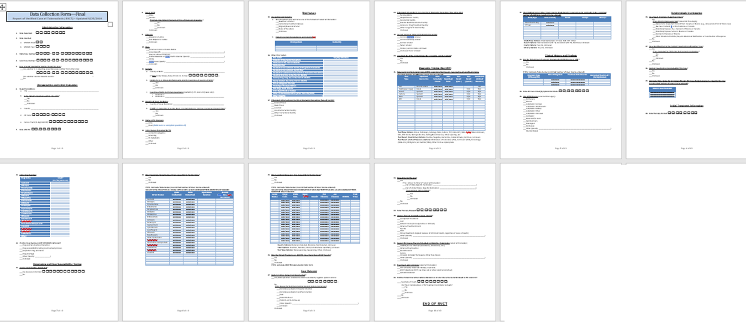
2020 RVCT has 43 items + MDR TB
Supplemental
Form
Notes:
Here is a snapshot of the new 2020 form plus the 2-page supplementary case report for MDR TB cases. The 2009 RVCT had 49 items, and this revised 2020 RVCT has 43 items.

Slide 17
What has been deleted?
For all cases
  Date form submitted to state health department
  Within-state moves
  Type of reporting laboratory or outpatient healthcare provider
  Number of treatment doses given by directly observed therapy (DOT)
For non-U.S.–born persons, initial visa type
For persons incarcerated at TB diagnosis, the follow-up question of
whether under custody of Immigration and Customs Enforcement (ICE)
Notes:
What has been deleted from the 2009 RVCT?
For all cases, items that were removed include:
Date form submitted to state health department,
Within-state moves, and
Also removed are type of reporting laboratory or outpatient healthcare provider
As well as number of treatment doses given by directly observed therapy (DOT)
For non-U.S.–born persons, initial visa type is no longer on the RVCT form.
For persons incarcerated at TB diagnosis, the follow-up question of whether under custody of Immigration and Customs Enforcement (ICE) is now removed.

Slide 18
What has been revised? (slide 1 of 2)
Slight wording and date adjustments to harmonize with other diseases reported to National Notifiable Diseases Surveillance System
Simplified options for initial reason evaluated for TB
Added Hemoglobin A1c or fasting blood glucose for TB patients with diabetes
Whether case is a missed contact or thought to be recently infected
New medications in initial drug regimen
Added date of death if after TB diagnosis
Treatment administration now “check all that apply” and includes eDOT
Notes:
What has been revised from the 2009 RVCT?
There have been slight wording and date adjustments to harmonize with other diseases reported to the National Notifiable Diseases Surveillance System (NNDSS).
As well as simplified options for initial reason evaluated for TB.
We also added Hemoglobin A1c or fasting blood glucose for TB patients with diabetes.
Whether case is a missed contact or thought to be recently infected (which will now be captured under the Epidemiologic Investigation section).
There have been new medication choices added to initial drug regimen.
We also added date of death if after TB diagnosis.
Treatment administration now has “check all that apply” and includes eDOT.

Slide 19
What has been revised? (slide 2 of 2)
Introduction of repeating group blocks
  Allows flexibility of
  unlimited number
  of responses for
  Lab/imaging results
  Previous TB details
  Links to other cases
  Medications used
  Additional TB risk factors
Test Type | Specimen Source Site | Date | Result
TST | Skin Structure | □□/□□/□□□□
IGRA | Blood | □□/□□/□□□□
HIV | Blood | □□/□□/□□□□
Smear | Sputum | □□/□□/□□□□
Smear | Sputum | □□/□□/□□□□
Smear | Sputum | □□/□□/□□□□
NAA | Sputum | □□/□□/□□□□
Culture | Sputum | □□/□□/□□□□
Culture | Sputum | □□/□□/□□□□
Culture | Sputum | □□/□□/□□□□
Notes:
We have also introduced the use of repeating group blocks. This allows flexibility of unlimited number of responses for the following categories on this slide.
Lab/imaging results are no longer individual items on the RVCT, but can all be recorded in a repeating group block. You can now add as many previous TB cases as you want and capture links to other cases. Medications used and additional risk factors are no longer listed in check box format but part of a repeating group block.
.

Slide 20
What has been added?
Census tract
Pregnancy status
Smoking status
Ever homeless / incarcerated
Previous LTBI diagnosis
Symptom onset date
Molecular drug susceptibility testing
Reason for not initially using standard first-line 4-drug regimen (RIPE/HRZE)
Epidemiologic investigation data
Ever lived outside USA >2 months
Country of usual residence*
Binational status*
Occupation and industry*
*Added at request of Council of State
and Territorial Epidemiologists (CSTE)
Notes:
What has been added? Please take a moment to review this list.
Of note, census tract is now part of reporting address. Pregnancy status has been added to the female portion of sex at birth.
Smoking status is a new item that was created because smoking came up frequently as a fill in response under Other Additional TB Risk Factors in the 2009 RVCT.
Previous LTBI diagnosis and not just TB diagnosis is now captured.
We have also added symptom onset date to estimate infectious period.
With the advances of molecular drug susceptibility testing, it now has its own section on the RVCT.
We also want to better understand reason for not initially using the standard first-line 4-drug regimen (RIPE/HRZE) so this item was added.
Epidemiologic investigation data is a new section, that includes binational status.
Ever lived outside USA >2 months was expanded to include all patients.
We changed how we capture occupation by adapting to NIOSH’s method in recording occupation and industry.
For the last three items with an asterisk, state and territorial epidemiologists meet yearly to agree on which diseases and information should remain nationally notifiable and collected in a standardized format.

Slide 21
Administrative Information
RVCT items Q1–Q5
Notes:
Next, let’s begin reviewing the 2020 RVCT item by item. The first section of the new 2020 RVCT begins with Administrative Information, which are RVCT items 1 through 5.

Slide 22
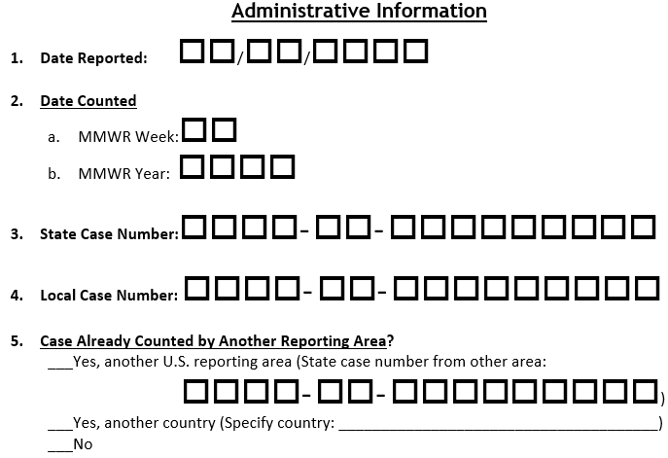
Unchanged item
Revised item
Unchanged
Unchanged
New item
Notes:
Here is a snapshot of the Administrative Information section on the 2020 RVCT. Date reported, state case number, and local case number are the same as the 2009 RVCT. Date counted has been revised to used the MMWR week and year format. MMWR stands for Morbidity and Mortality Weekly Report. There is a new item “Case Already Counted by Another Reporting Area” to provide clarification for case counting.

Slide 23
Q1: Date Reported
Unchanged RVCT item
Date health dept first suspects or is notified that a person might have TB
Notes:
Item 1. The Date Reported is the date that a health department first suspects that the patient might have TB or it is the first date that a health department is notified about a suspected or confirmed new TB case, whichever comes first.
This is when the health department first receives a report (verbal or written notification) from a health care provider or laboratory that a patient might have TB. It does not matter if it’s a local, state, tribal, or national health department that receives the report.

Slide 24
Q1 Case Study: Rose
On January 6, 2020, a private physician
notifies the county health dept about
Rose, a patient with TB signs and symptoms
On January 10, lab sends fax that
her sputum is AFB smear positive
On January 27, county health dept
sends RVCT to state TB program
Jan 6 Jan 10 Jan 27
Notes:
Here is a case study about Rose. On January 6, 2020, a private physician notifies the county health department about Rose who has TB signs and symptoms. On January 10, the laboratory sends a fax that Rose’s sputum is acid-fast bacillus or AFB smear positive. On January 27, the county health department sends the RVCT to the state TB program.

Slide 25
Q1 Case Study: Rose, continued
How should you complete item 1 on the RVCT for Rose?
Notes:
How should you complete item 1 on the RVCT for Rose?
Please pause the recording if you need to review the previous slides before answering. When you are ready, start the recording again.

Slide 26
Q1 Case Study: Rose, correct answer
0 1 0 6 2 0 2 0
Notes:
For Rose, the Date Reported is January 6, 2020. This is the date when her physician first notified the health department.

Slide 27
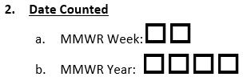
Q2: Date Counted
Revision to Q2: Instead of entering month/year, enter MMWR week/year
Date that state health department or other designated counting authority
verifies the case meets criteria in national TB surveillance case definition
(see Appendix B)
  This is just the decision to make this case reportable in the USA
  Which jurisdiction actually counts the case is addressed later in Q5
Notes:
Item 2 is date counted. The change made to date counted was done to harmonize with other diseases reported to the National Notifiable Diseases Surveillance System (NNDSS). Instead of asking you to provide a calendar month, now we ask for MMWR week.
Even though MMWR week has been used for most other nationally notifiable diseases for years, this is new to TB. We will spend several slides talking about it
Date counted is just the decision to make this case reportable in the United States, please refer to the Introduction slides to understand more about reporting and counting and the 90-day rule.
Date counted is a little bit of a misnomer because it also should be recorded for non-counted cases, sometimes also known as burden cases.
Whether this case will be counted by your jurisdiction or another jurisdiction in the United States or elsewhere is a separate question (Q5).
If you’re not counting the case in your jurisdiction, this date is still required. Please make it correspond to the week that your jurisdiction verified this case and began to follow or manage it for public health purposes.

Slide 28
MMWR Week
calendar example
 | Weeks Ending Saturday
MMWR Week | 2020
1 | Jan 4
15 | Apr 11
16 | Apr 18
22 | May 30
25 | Jun 20
26 | Jun 27
This date type is used by the other reportable
diseases in CDC’s Summary of Notifiable Diseases
Online guidance and calendars:
  https://wwwn.cdc.gov/nndss/downloads.html
Local software should be coded to calculate
Notes:
This concept of MMWR week will probably already be familiar to you if you’re involved in your state’s reporting of other notifiable diseases.
MMWR week is the week of the epidemiologic year for which NNDSS disease report is assigned by the reporting health department. It was designed for the purposes of MMWR disease incidence reporting and publishing (https://wonder.cdc.gov/nndss/static/2018/annual/2018-table3.html). The MMWR week calendar is numbered based on the Saturday end date as seen on the right. For example, if your report date is Apr 10, then it would be MMWR week 15. If your report date is Apr 12, then it would be MMWR week 16.
Your own surveillance system might already be programmed to give you MMWR week when you choose a count date. If not, you can look it up using the online calendar provided at this link.

Slide 29
MMWR Year ≠ Calendar Year
Some years (2020) have 53 weeks
Decision based on day of week January 1 occurs
  If Thur, Fri, Sat → that week is MMWR week #52 or #53 for previous year
  If Sun, Mon, Tue, Wed → that week is MMWR week #1 of new year
Some years (2021) have 52 weeks
 | Weeks Ending Saturday
MMWR Week | 2020
1 | Jan 4
52 | Dec 26
53 | Jan 2
 | Weeks Ending Saturday
MMWR Week | 2021
1 | Jan 9
51 | Dec 25
52 | Jan 1
Notes:
Here is an example of the online NNDSS calendar. This is your reference if your software doesn’t calculate MMWR week and year automatically.
Values for MMWR week range from 1 to 53, although most years consist of 52 weeks.
For example, the year 2020, has 53 weeks, and other years, like 2021, have only 52. This is determined based on the day of the week that January 1 happens to land on.
The year 2020 started on a Wednesday, so that entire week, including the last few days of December 2019, were counted as MMWR week 1 of MMWR year 2020.
And New Years Day for 2021 fell on a Friday, so that means the first few days of January 2021 are still be counted as part of 2020, so that’s how you end up with 53 weeks for 2020.

Slide 30
Q2 Case Study: Richard
On September 3, 2020, Richard diagnosed
with culture-positive TB
On September 11, county health dept
submits RVCT on Richard to state
On September 21, state TB program verifies and transmits his RVCT to CDC
Sept 3 Sept 11 Sept 21
Notes:
Here is a case study about Richard. On September 3, 2020, Richard was diagnosed with culture-positive TB. On September 11, the county health department submits the RVCT on Richard to the state health department. On September 21, the state TB program verifies and transmits his RVCT to CDC.

Slide 31
Q2 Case Study: Richard, continued
How should you complete item 2 on the RVCT for Richard?
 | Weeks Ending Saturday
MMWR Week | 2020
1 | Jan 4
36 | Sep 5
37 | Sep 12
38 | Sep 19
39 | Sep 26
  https://wwwn.cdc.gov/nndss/downloads.html
Notes:
How should you complete item 2 on the RVCT for Richard? Note that the calendar can be found at this link at the bottom of the slide.
Please pause the recording if you need to review the previous slides before answering. When you are ready, start the recording again.

Slide 32
Q2 Case Study: Richard, correct answer
Mon, Sept 21 occurs in the week ending Sat, Sept 26 → MMWR week 39
 | Weeks Ending Saturday
MMWR Week | 2020
1 | Jan 4
36 | Sep 5
37 | Sep 12
38 | Sep 19
39 | Sep 26
3 9
2 0 2 0
Notes:
Monday, September 21 occurs in the week ending Saturday, September 26. Thus, according to the table, this falls in MMWR week #39. And this is the MMWR year 2020.

Slide 33
Q3: State Case Number
Unchanged RVCT item
Nationally unique ID facilitates communications between TB programs, CDC
3 components: Report Year — State — State Case ID
      year corresponds to 2-letter whatever 9-character
      Q1 Date Reported, postal code string assigned by your
      not Q2 Date Counted (ex: IN for TB reporting area, but
      Indiana) no personal identifiers
Notes:
Item 3.
There are 3 components to the state case number: report year, state, and state case ID. Report year is the year that corresponds to item 1 date reported, not item 2 date counted. The state is the 2-letter postal code. The state case ID is the 9-character string assigned by your TB reporting area.
Because this number is transmitted to CDC, do not use names, initials, social security number, telephone number, or other information that could identify the patient.

Slide 34



Q3: Case Study: Timothy
In December 2020, the county health dept is notified
about Timothy, a Texas resident being worked up for TB
Lab results confirming his TB diagnosis
not available until January 2021
Once his TB case is verified,
Texas TB program assigns him
State Case Number 012TB3456
Notes:
This is a case study about Timothy. In December 2020, the county health department is notified about Timothy, a Texas resident being worked up for TB. Lab results confirming his TB diagnosis were not available until January 2021. Once his TB case is verified, Texas TB program assigns him State Case Number 012TB3456.

Slide 35
Q3 Case Study: Timothy, continued
How should you complete item 3 on the RVCT for Timothy?
Notes:
How should you complete item 3 on the RVCT for Timothy?
Please pause the recording if you need to review the previous slides before answering. When you are ready, start the recording again.

Slide 36
Q3 Case Study: Timothy, correct answer
2 0 2 0
T X
0 1 2 T B 3 4 5 6
Notes:
2020-TX-012TB3456. 2020 is the year of report. TX is the reporting area. And the last 9 characters are state case ID assigned by Texas.

Slide 37
Q4: Local Case Number
Unchanged RVCT item, still optional
Report Year — State — City/County Case ID
Local ID for TB case goes here
because in some states
there’s a different unique ID
assigned at the local level
Notes:
Item 4. In some states, there’s a different unique ID assigned at the local level that might not be the exact same as the state case number. For this reason, this item is optional.
Similar to state case number, there are 3 components to the local case number: report year, state, and city/county case ID. Report year is the year that corresponds to item 1 date reported, not item 2 date counted. The state is the 2-letter postal code. The city/county case ID is the 9-character string assigned by the local TB reporting area.

Slide 38
Q4 Case Study: Raul
Raul lives in El Paso, Texas
  Diagnosed with TB disease in September 2020
  and completes treatment in March 2021
His locally assigned TB case ID is 202000121
Notes:
This is a case study about Raul. Raul lives in El Paso, Texas. He is diagnosed with TB disease in September 2020 and completes treatment in March 2021. His locally assigned TB case ID is 202000121.

Slide 39
Q4 Case Study: Raul, continued
How should you complete item 4 on the RVCT for Raul?
Notes:
How should you complete item 4 on the RVCT for Raul?
Please pause the recording if you need to review the previous slides before answering. When you are ready, start the recording again.

Slide 40
Q4 Case Study: Raul, correct answer
2 0 2 0
T X
2 0 2 0 0 0 1 2 1
Notes:
2020-TX-202000121. 2020 is the year of report. TX is the reporting area. And the last 9 characters is the locally assigned case ID.

Slide 41
New item
Q5: Case Already Counted by Another Reporting Area?
Helps avoid double-counting in official national TB case counts
Multiple jurisdictions might report; only one should count
If Q5 = Yes, counted elsewhere, Q2 = date your area began to follow/manage
Notes:
Item 5 indicates whether this case report should be considered “countable” for incidence calculations.
Patients might move between reporting areas while being evaluated and treated for TB. As long as the person is in the United States for at least 90 days, inclusive of report date, each of those reporting areas should report the case.
However, only one U.S. jurisdiction should officially count each case. Generally, it’s the jurisdiction where the patient resided when the diagnostic evaluation that led to the TB diagnosis began. Please refer to the RVCT instruction manual and the Introduction slides for more guidance about reporting and counting. If another U.S. reporting area is counting this case, please provide the state case number from that reporting area.
Note if the case is not being counted by a U.S. reporting area but in another country, specify the country.
<CLICK>
If another jurisdiction is counting the case, then you might wonder what you should do about item 2, Date Counted, when you are only reporting the case. Remember that we said item 2 is a bit of a misnomer.
Even though item 2 is normally the date that your jurisdiction counts the case, in situations where item 5 is Yes, item 2 should list the date your area began to follow or manage that patient. For example, it could be the date your jurisdiction took over providing medications to the patient.

Slide 42
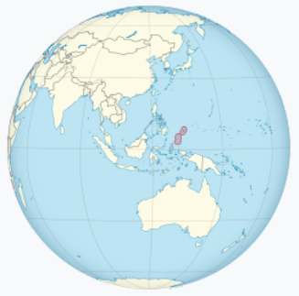
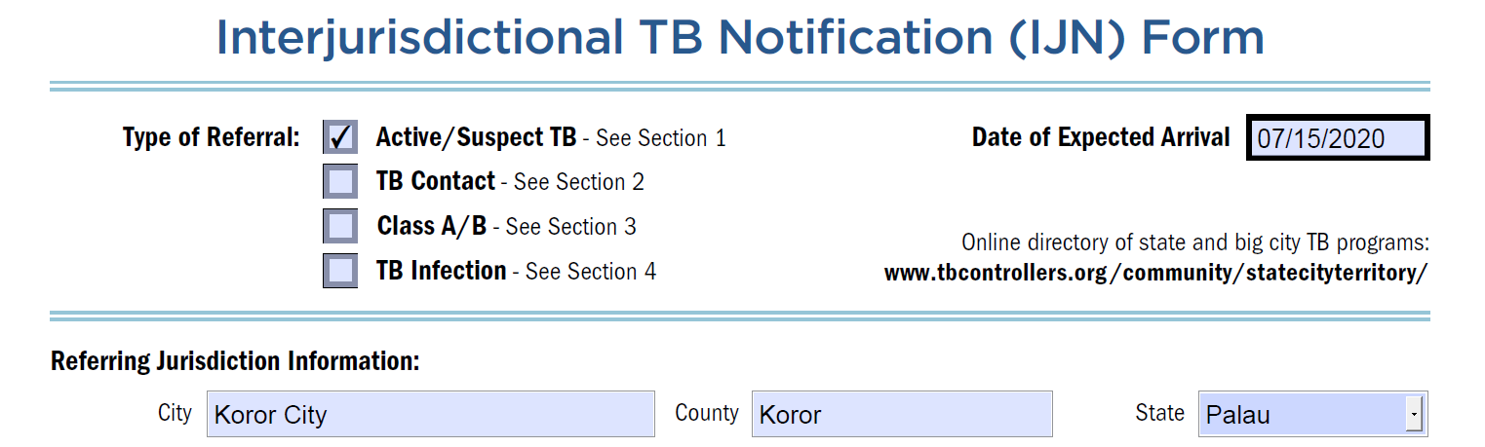
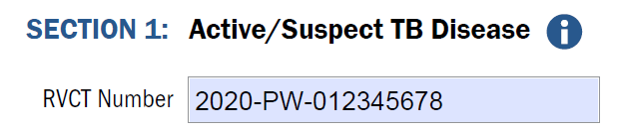
Q5 Case Study 1 of 4: Renato from Palau
Republic of Palau TB program notifies you that
Renato plans to move to your state in July
  He began TB treatment in March, where his
  state case number was 2020-PW-012345678
  While in your state, Renato completes treatment
map image source: https://en.wikipedia.org/wiki/Palau
IJN source:
www.tbcontrollers.org/resources
/interjurisdictional-transfers
Notes:
In this first case study for item 5, the Republic of Palau TB program notifies you that a patient named Renato plans to move to your state in July. He began TB treatment in March, where his state case number was 2020-PW-012345678 as illustrated in the Interjurisdictional TB notification or IJN Form in this slide.
<CLICK>
While in your state, Renato completes his TB treatment.
So, Renato was already counted by Palau, a sovereign country and U.S. reporting area, and he is now on his way to you.
www.tbcontrollers.org/resources/interjurisdictional-transfers

Slide 43
Q5 Case Study 1 of 4: Renato, continued
How should you complete item 5 on the RVCT for Renato?
Notes:
How should you complete item 5 on the RVCT for Renato?
Note the 2-letter abbreviation for Palau is PW. You can also refer to the IJN form shown on this slide as a reminder.
Please pause the recording if you need to review the previous slides before answering. When you are ready, start the recording again.

Slide 44
Q5 Case Study 1 of 4: Renato, correct answer
X
2 0 2 0 P W 0 1 2 3 4 5 6 7 8
And be sure to send treatment completion info back to Palau TB program so that they can complete Renato’s RVCT Case Outcome (items Q37–Q43)
Notes:
The answer is “yes, another U.S. reporting area” and the case number from Palau is 2020-PW-012345678.
It is important to also note that the 3 countries (Palau, Federated States of Micronesia, and the Republic of the Marshall Islands) are considered U.S. reporting areas, even though they are independent countries.
In this scenario, Palau will be responsible for obtaining case outcome closeout information from you, so please try to relay that information back to them.

Slide 45
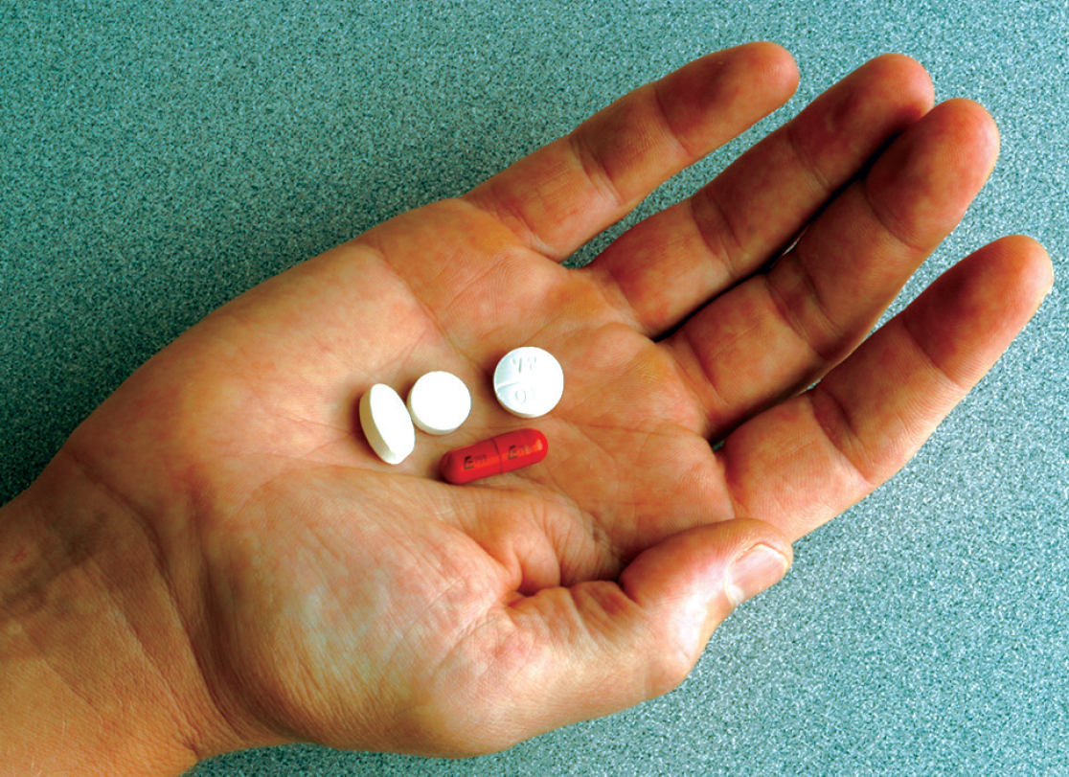
Q5 Case Study 2 of 4: Carlos from Guatemala
Within days of arriving from Guatemala,
Carlos is detained in an ICE facility in your state
He has TB medications with him and says he
was diagnosed with TB before starting his journey
ICE informs the health department to anticipate
up to a year before his asylum claim is adjudicated
  Health dept follows and treats TB while Carlos is in ICE custody for next 7 months
Although Carlos is in federal custody and treatment was initiated elsewhere, it is still your jurisdiction’s responsibility to report this noncountable case
Notes:
In the second case study, Carlos recently arrived from Guatemala and is detained in an Immigration and Customs Enforcement, or ICE facility in your state. He has TB medications with him and says he was diagnosed with TB before starting his journey.
ICE informs the health department to anticipate up to a year before his asylum claim is adjudicated. The health department follows and treats Carlos for the next 7 months.
Although Carlos is in federal custody and treatment was initiated elsewhere, it is still your jurisdiction’s responsibility to report this noncountable case, which your jurisdiction may also sometimes refer to as a burden case. A “burden case” means that your jurisdiction is responsible for following up with this case even though it is not counted in your jurisdiction.
Image from https://www.cdc.gov/tb/publications/pamphlets/tb_trtmnt.pdf

Slide 46
Q5 Case Study 2 of 4: Carlos, continued
How should you complete item 5 on the RVCT for Carlos?
Notes:
How should you complete item 5 on the RVCT for Carlos?
Please pause the recording if you need to review the previous slides before answering. When you are ready, start the recording again.

Slide 47
Q5 Case Study 2 of 4: Carlos, correct answer
X
Guatemala
Since patient was prescribed TB medications before U.S. arrival,
consider the case as having already been counted by Guatemala
(even if unable to verify with Guatemala)
Notes:
The answer is “Yes, another country” and you would specify “Guatemala”. Even though it may be difficult to verify that a TB case was counted in another country, the RVCT instruction manual provides guidance that if confirmation cannot be obtained, you must consider the case to have been counted in the other country if that other country completed the diagnostic evaluation and started the patient on TB treatment.

Slide 48

Q5 Case Study 3 of 4: Gilberto from Honduras
Within days of arriving from Honduras,
Gilberto is detained
in an ICE facility in your state
He reports no TB history, but is coughing
on medical intake, and his chest x-ray
shows lung infiltrates, so sputum is collected
When the lab detects acid-fast bacilli (AFB) on the smear, ICE works with
health department to order additional testing, establish a TB diagnosis,
and start his TB treatment
  Gilberto remains in the USA for ~4 months
Notes:
In the third case study, Gilberto recently arrived from Honduras and is detained in an Immigration and Customs Enforcement, or ICE facility in your state. He reports no TB history, but is coughing on medical intake, and his chest x-ray shows lung infiltrates. Sputum is collected, and the lab detects acid-fast bacilli or AFB on the smear. ICE works with the health department to order additional testing and establish a TB diagnosis. Gilberto starts TB treatment and continues it for the next 4 months while he is in the United States.
Istockphoto.com photo ID:696767760 (don’t need to attribute on the slide)

Slide 49
Q5 Case Study 3 of 4: Gilberto, continued
How should you complete item 5 on the RVCT for Gilberto?
Notes:
How should you complete item 5 on the RVCT for Gilberto?
Please pause the recording if you need to review the previous slides before answering. When you are ready, start the recording again.

Slide 50
Q5 Case Study 3 of 4: Gilberto, correct answer
X
Because even though he just arrived, Gilberto stayed ≥90 days in USA
Further, because his medical evaluation for TB began in your jurisdiction,
this is countable by your jurisdiction even if ICE has transferred him to
another state by time TB diagnosed and all treatment is done elsewhere
Notes:
The answer is “No.” Even though Gilberto just arrived in the United States, he ends up staying for at least 90 days.
Furthermore, because his medical evaluation for TB began in your jurisdiction, if this case meets U.S. case counting criteria then this is countable by your jurisdiction even if ICE has transferred him to another state’s facility by the time his TB was diagnosed and even if all treatment was provided in a different jurisdiction. DTBE guidance is that the jurisdiction where the patient was living, however temporarily, at the time the diagnostic evaluation that led to the TB diagnosis was initiated, is the jurisdiction that should count the patient.

Slide 51
Q5 Case Study 4 of 4: Gilberto, but different scenario
What if instead of staying ~4 months,
Gilberto was in the United States for only 2 months and deported before his sputum grew M. tuberculosis?
  He wasn’t diagnosed before arriving in the USA
  He is diagnosed but never starts treatment in the USA
  Neither he nor the Honduran authorities know about his TB diagnosis
Notes:
In the final case study, what if instead of staying for 4 months, Gilberto was in the United States for only 2 months and then deported before his sputum grew M. tuberculosis? Thus,
he wasn’t diagnosed before arriving in the USA.
He is diagnosed but never starts treatment in the USA
And at this point, neither he nor the Honduran authorities know about his TB diagnosis
Istockphoto.com photo ID:1155732961

Slide 52
Q5 Case Study 4 of 4: Gilberto, but different scenario
How should you complete item 5 for Gilberto (if deported scenario)?
Notes:
How should you complete item 5 for Gilberto?
Please pause the recording if you need to review the previous slides before answering. When you are ready, start the recording again.

Slide 53
Q5 Case Study 4 of 4: Gilberto again, correct answer
Don’t! This is not a countable or even reportable case in the USA
Ideally contact the Honduras Ministry of Health with transnational referral
Notes:
In this case study, an RVCT form for Gilberto should not be completed. According to the RVCT instruction manual, those that are in the USA for <90 consecutive days, inclusive of Report Date, are not reportable.
For this case study, it would be ideal to contact the Honduras Ministry of Health with transnational referral information.

Slide 54
If you have any questions, please contact:
DTBE Technical Support Helpdesk
SAMS.CDC.GOV
DTBESupport@cdc.gov
Toll Free: 888-300-4261
Notes:
This concludes the Introduction and Administrative sections of the 2020 RVCT training. Additional information can be found in the 2020 RVCT instruction manual.
If you have questions, please contact the DTBE Technical Support Helpdesk via Service Now in the SAMS portal, or by emailing DTBESupport@cdc.gov or calling 888-300-4261.

