Slide 1
Quality Assurance for
TB Surveillance Data
Division of Tuberculosis Elimination
Centers for Disease Control and Prevention
National Center for HIV/AIDS, Viral Hepatitis, STD, and TB Prevention
Place Division name here

Slide 2
Goal and Purpose of Course
Goal
Increase QA for TB surveillance data within the United States and its jurisdictions.
Purpose
Enhance knowledge, skills, and processes required to perform QA for TB surveillance data.

Slide 3
Target Audience
Health care workers from state and local health departments, territories, and U.S. -affiliated Pacific Islands who
Collect data from patients
Complete RVCT form
Enter data from RVCT into data system
Monitor accuracy of TB program data collection
Analyze data from RVCT

Slide 4
Objectives
After reading this manual you will be able to
List the five components of the QA process
Describe tools that can be used to perform QA
Describe what to include in a QA written protocol as required by the Cooperative Agreement (CoAg)

Slide 5
Chapter 1
Introduction to the QA Guide and Toolkit
Notes:
Introduction slide for presentation by Sandy Price or Stacey Parker.

Slide 6
Basis of QA Process
QA process is based on the 2011 Tuberculosis Elimination and Laboratory Cooperative Agreement (CoAg)
Results of a QA needs assessment conducted with 11 of the 60 reporting jurisdictions

Slide 7

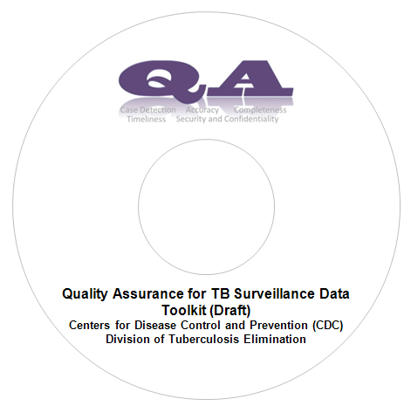
QA Guide and Toolkit
QA Manual
(Provides a standardized process for conducting QA)
Tool Kit
(Includes over 50 tools to use and adapt for conducting QA)
  Download from DTBE RVCT website
http://www.cdc.gov/tb/programs/rvct/default.htm

Slide 8
Sections of the Guide
Chapter | Sections
1 | Introduction to the Guide and Toolkit
2 | National Tuberculosis Surveillance System Data Flow
3 | Overview of the Quality Assurance Process
4 | Case Detection
5 | Data Accuracy
6 | Data Completeness
7 | Data Timeliness
8 | Data Security and Confidentiality
9 | QA Cross-cutting Systems and Process (NTIP, TB GIMS, and Cohort Review)
10 | Toolkit for Quality Assurance
5 QA
Components

Slide 9
Sections of the Guide (cont.)
Appendix | Section
A | References
B | Glossary
C | QA Process Slides
D | Report of Verified Case of Tuberculosis Questions and Clarifications
E | Answers to the Exercises

Slide 10
Sections Within Each Component
Definitions
Primary Purpose
QA Process (based on CoAg requirements)
Examples and Related Topics
Exercises
List of QA Tools

Slide 11
Chapter 2
TB Surveillance Systems Structure and Data Flow
Notes:
Introduction slide for presentation by Sandy Price or Stacey Parker.

Slide 12
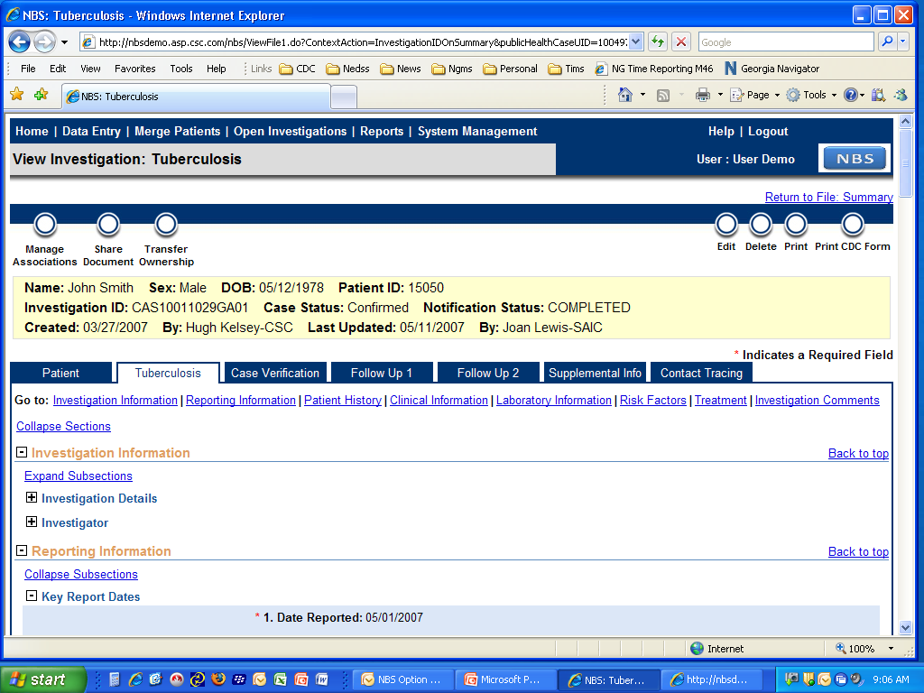
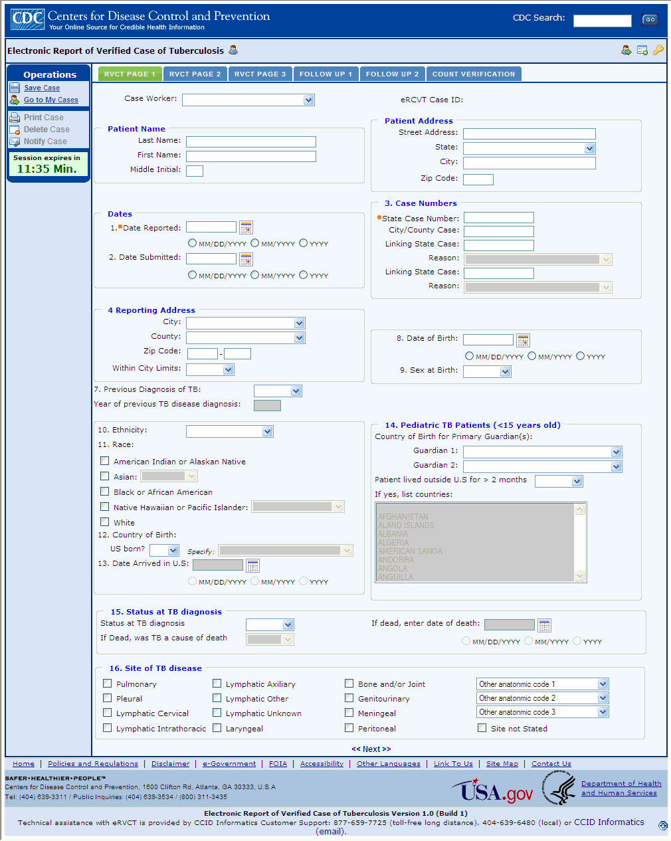
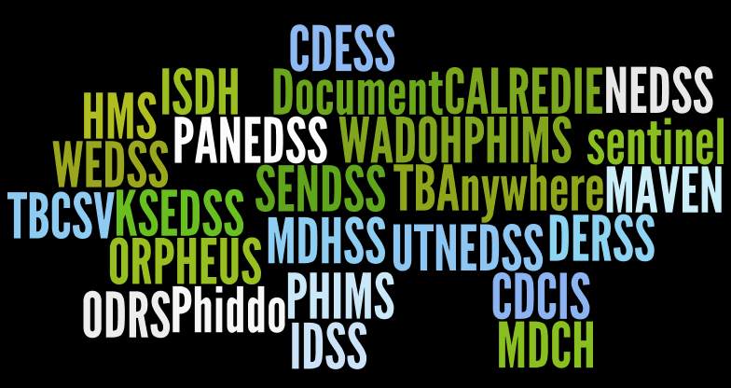
Surveillance Systems Update
NEDSS Base System (NBS)
eRVCT
State Developed System
Commercial System
*www.wordle.net

Slide 13
Tuberculosis Surveillance Systems in the United States, 2013
AK
NH
WA
VT
ME
MA
MT
ND
RI
OR
MN
NY
SD
WI
CT
ID
WY
MI
New York City
IA
PA
NJ
NE
IN
OH
NV
UT
IL
WV
CA
CO
MO
VA
DE
KS
KY
MD
TN
NC
AZ
NM
OK
AR
SC
Washington DC
MS
AL
GA
TX
LA
FL
HI
Transition Option Status
eRVCT Option - 7
PR
Pacific Islands
Virgin Islands
NBS Option - 18
Commercial Option - 19
State-Developed Option - 16

Slide 14
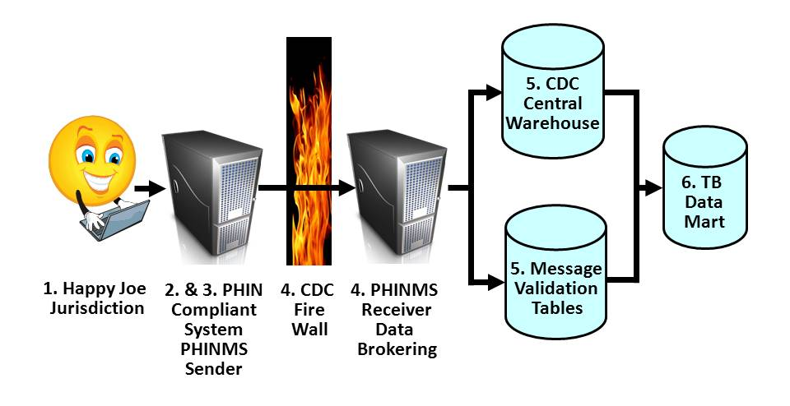
TB Surveillance Data Flow
From Jurisdiction to DTBE

Slide 15
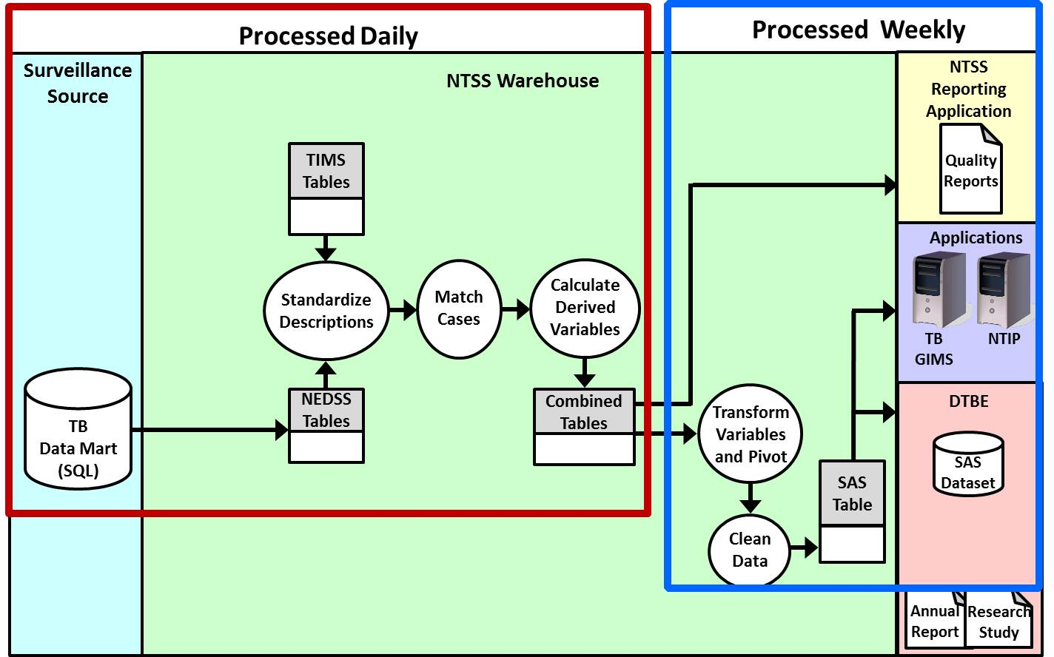
TB Surveillance Data Flow within DTBE

Slide 16
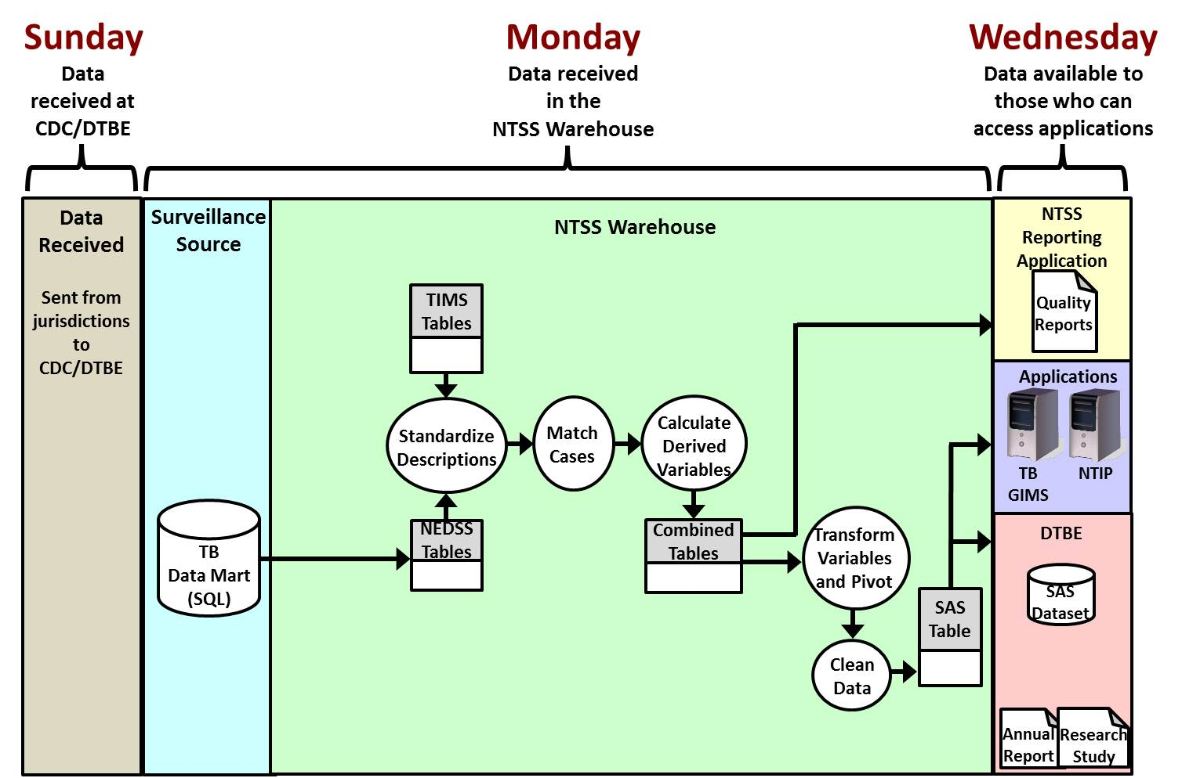
Sample Schedule for of TB Surveillance Data

Slide 17
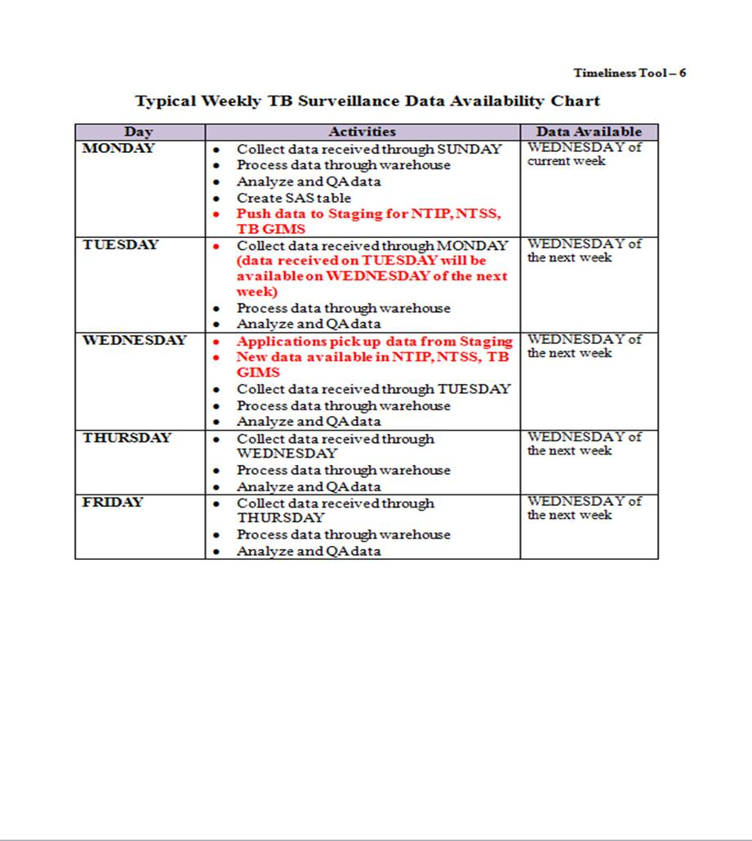
Typical Weekly TB Surveillance Data Availability
Timeliness Tool – 5, Chapter 10

Slide 18
For More Information
Contact
TB Applications Support
ntss@cdc.gov
678-460-7828 /
404-639-8444

Slide 19
Chapter 3
Quality Assurance for TB Surveillance Data
Notes:
Introduction slide for QA.

Slide 20
Cooperative Agreement
CoAg
Agreement between National TB Surveillance System reporting jurisdictions and DTBE
Requirement: QA for TB surveillance data

Slide 21
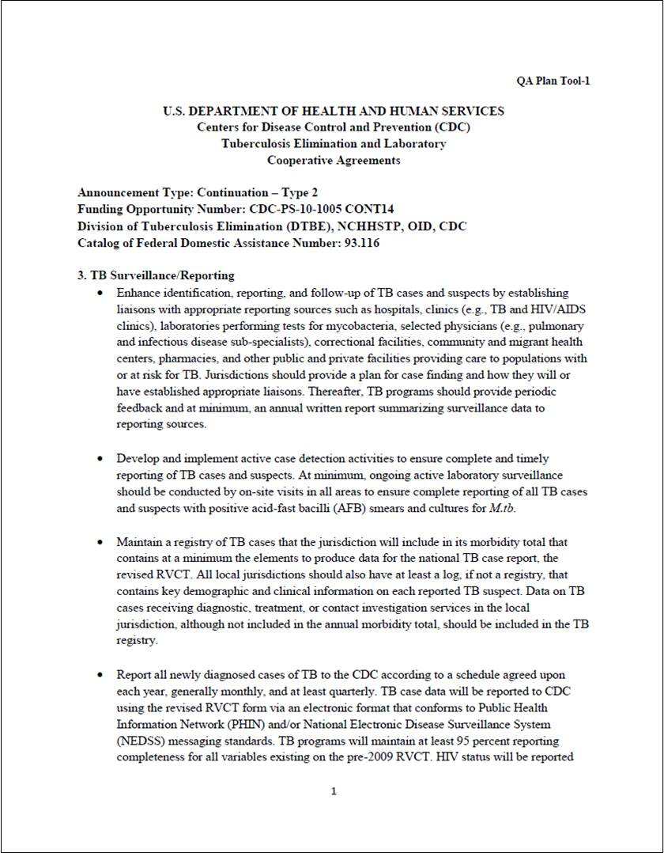
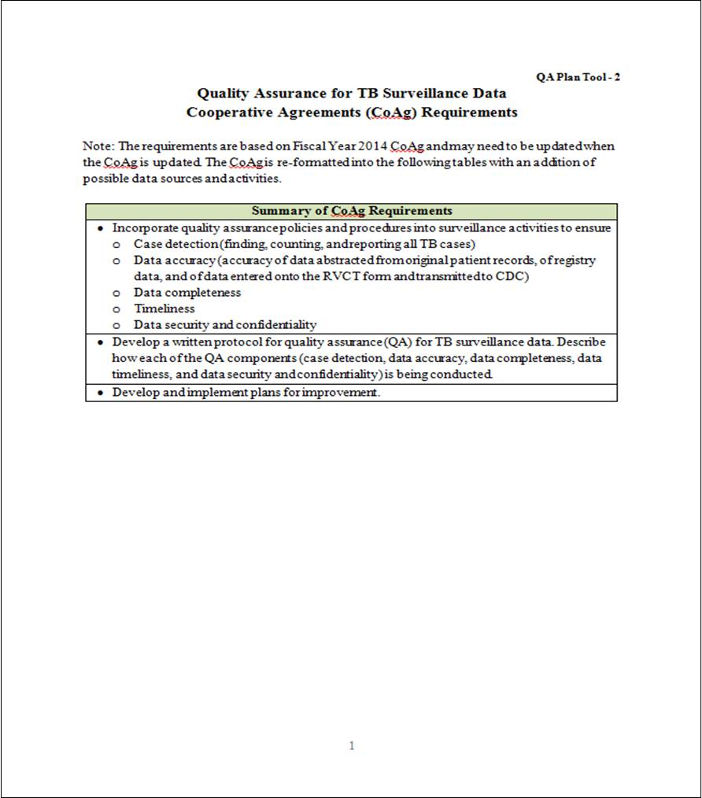
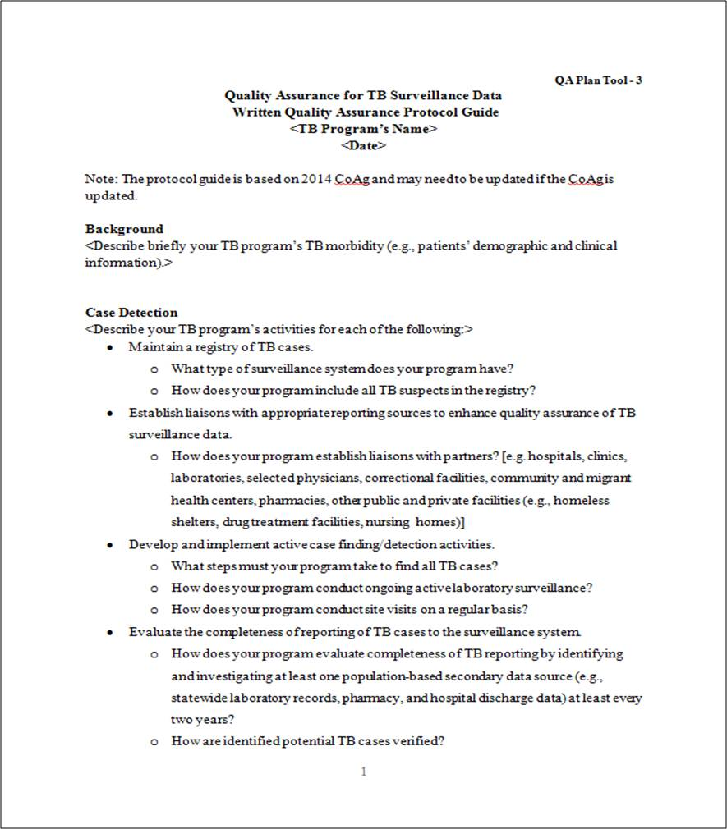
Cooperative Agreement (CoAg) Requirements for QA of TB Surveillance Data
CoAg
QA Plan Tool – 1
Chapter 10
QA Requirements
QA Plan Tool – 2
Chapter 10
Written Protocol QA Plan Tool – 3
Chapter 10
Notes:
Handout and briefly mention these documents.

Slide 22
QA Components and Process
Based on
requirements for QA of TB surveillance data
Needs Assessment
CoAg
Notes:
Mention that the QA Components and the process that are used for this course are based on:
The CoAg
Needs Assessment conducted during the past year.

Slide 23
Summary of Cooperative Agreement Requirements
CoAg
Incorporate quality assurance policies and procedures into surveillance activities to ensure
  Case detection
  Data accuracy
  Data completeness
  Data timeliness
  Data security and confidentiality
Develop a written protocol for QA for case detection, data accuracy ,data completeness, data timeliness, and data security and confidentiality
Develop and implement plans for improvement

Slide 24
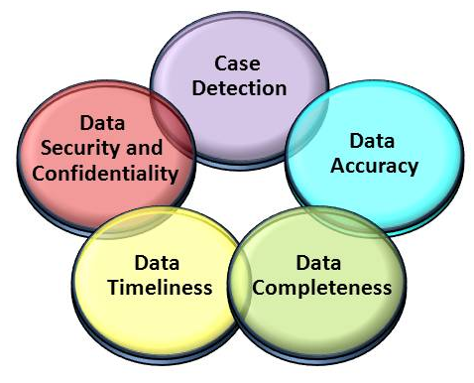
QA Components
  QA for TB surveillance data is a continuous process of improving all five QA components

Slide 25
Definitions (1)
Quality Assurance
  A continuous process to improve TB surveillance data. It is a continuous cycle of planning, doing, checking, and improving data quality.
Data Quality
  The accuracy and completeness of the data recorded in the TB surveillance system.

Slide 26
Definitions (2)
Active surveillance
  Health departments actively contact and interact with health care facilities or individual providers to stimulate disease reporting, sometimes directly assuming the primary responsibility of reporting cases from large or high-volume institutions.
Passive surveillance
  Health departments passively receive case reports from health care providers and are dependent on health care providers to comply with reporting requirements.
Notes:
Definitions come from the RVCT Manual page 4.

Slide 27
Process Overview (1)
Ensure all TB patients are reported and relevant data collected and entered correctly into an electronic disease surveillance system.
Ensure data are congruent and reflect true diagnostic, treatment, and other clinical patient information.
Capture completeness of case detection/ inclusion.

Slide 28
Process Overview (2)
Ensure data are accurate, timely, complete, and relevant to program needs.
Maintain data security and confidentiality.
Monitor data system to confirm objectives are being met.

Slide 29
Factors Influencing Quality of Data
How are TB screening and diagnostic tests (i.e., the case detection) performed?
How clear are the hardcopy or electronic surveillance forms?
What is the quality of training and supervision of staff who complete these forms?
Are staff managing data carefully?

Slide 30
Quality Assurance Plan
Tools
Chapter 10
Pages 10-3 – 10-25

Slide 31
Chapter 4
Case Detection

Slide 32
Case Detection
Definition
  Detection of one instance of a specific disease or exposure, e.g., TB. A front-line surveillance activity, it is typically accomplished as a by-product of routine
  Medical care
  Veterinary care
  Laboratory work
  An astute observer
Purpose
  To find all patients with TB diagnosis so that they are reported to NTSS.

Slide 33
Case Detection Process
CoAg
Maintain a registry of TB cases
Establish liaisons with appropriate reporting sources to enhance QA of surveillance data
Develop and implement active case detection activities
Evaluate completeness of reporting of TB cases to the system

Slide 34
A. Maintain a registry of TB cases (1)
CoAg
Contains at a minimum the elements to produce data for the RVCT.
All local jurisdictions should also have at least a log, if not a registry, that contains key demographic and clinical information on each reported TB suspect.

Slide 35
A. Maintain a registry of TB cases (2)
CoAg
Data on TB cases receiving diagnostic, treatment, or contact investigation services in the local jurisdiction, although not included in the annual morbidity total, should be included in the TB registry.

Slide 36
B. Establish liaisons with appropriate reporting sources to enhance quality assurance of TB surveillance data (1)
CoAg
Enhance identification, reporting, and follow up of TB cases and suspects by establishing liaisons with appropriate reporting sources.
Jurisdictions should provide a plan for case finding and how they will or have established appropriate liaisons.

Slide 37
B. Establish liaisons with appropriate reporting sources to enhance QA of TB surveillance data (2)
CoAg
TB programs should provide periodic feedback and at minimum, an annual written report summarizing surveillance data to reporting sources.

Slide 38
C. Develop and implement active case detection activities
CoAg
At a minimum, ongoing active laboratory surveillance should be conducted by on-site visits in all areas to ensure complete reporting of all TB cases and suspects with positive acid-fast bacilli (AFB) smears and cultures for M.tuberculosis.

Slide 39
D. Evaluate the completeness of reporting of TB cases to the surveillance system (1)
CoAg
To find potentially unreported TB cases, at least every two years, identify and investigate at least one population based secondary data source by reviewing:
  Statewide laboratory records
  Pharmacy records
  Hospital discharge data

Slide 40
D. Evaluate the completeness of reporting of TB cases to the surveillance system (2)
CoAg
Potential TB cases identified during the evaluation must be verified.
Reasons for nonreporting of TB cases should be determined and a plan for improvement developed and implemented.

Slide 41
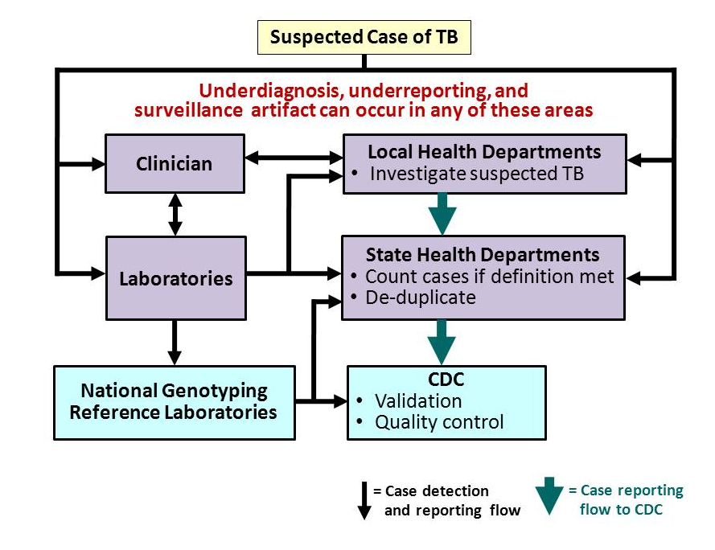
Notes:
This slide is a simplified representation of the U.S TB reporting and surveillance system and by no means does it capture all the details. However it will provide you with a basic idea about U.S TB and surveillance and reporting, to put the remaining talk into context.
When a patient with suspected TB presents to a clinician (in any setting public or private), the standard of care mandates that specimens be sent to a laboratory (public or private) for diagnostics. If a TB diagnosis is made (either clinically or lab confirmed), clinicians are legally required to report the case to the local health department usually by fax, phone, or mail although some jurisdictions can report through secured web-based systems. LHD investigates the case and if TB is verified, reports case to state HD. Laboratories are also required by law to report and do so both to the local and state health departments. State HD ensure case meets the national TB case definitions, and if so, adds the case towards the state’s case count and reports to it CDC, ensuring case is not a duplicate. CDC receives reports on a daily basis and validates data and conducts quality control checks both electronically through programmed algorithms and manually. All laboratories, through the public health laboratories, send TB isolates to two national genotyping reference labs for genotyping. The results are reporting both to the state HD and CDC, which maintains the data in a secure electronic database.
CDC published provisional TB data for the previous year on world TB day in the MMWR and final data for that year in an annual report in the fall

Slide 42
Decrease in Reported Tuberculosis
Lessons Learned (1)
Surveillance artifact important to rule out
Underdiagnosis very difficult to assess
  Required chart reviews
  No simple method to determine if TB patients did not seek care

Slide 43
Decrease in Reported Tuberculosis
Lessons Learned (2)
Laboratory data can be an objective measure of TB incidence
  Caveat: good coverage, no changes in procedures
Crossmatch of secondary TB data sources and surveillance data simple but follow-up of unmatched cases can be challenging

Slide 44
Decrease in Reported Tuberculosis
Conclusions
Multiple factors contributed to 2009 decline in TB
  Unlikely surveillance artifact or underreporting
  Unable to rule out underdiagnosis due to TB patients failing to seek care
Educating clinicians to maintain suspicion for TB important
  Could see more advanced disease if patient delays in care
Ongoing collection and analysis surveillance data necessary to continue to assess trends
  Timeliness and quality of data key

Slide 45
Case Detection Tools
Chapter 10
Pages 10-26 – 10-38

Slide 46
Chapter 5
Data Accuracy

Slide 47
Data Accuracy
Definition
  The data submitted matches patient records maintained at the point of care. The recorded data in the surveillance system are consistent with what happens in a clinical encounter, whether or not it is clinically appropriate.
Purpose
  To identify and correct errors in the surveillance data.

Slide 48
Accuracy Process
CoAg
Evaluate accuracy/validity of RVCT data
Assess knowledge, skills, and abilities of staff and provide training if needed

Slide 49
A. Evaluate Accuracy/Validity of
RVCT Data
CoAg
At least annually, compare:
  RVCT data
  Jurisdiction’s TB registry data
  Original data sources

Slide 50
B. Assess Knowledge, Skills, and
Abilities of Staff and Provide Training
CoAg
Assess knowledge, skills, and abilities of all existing personnel and new hires.
Provide training and evaluation.

Slide 51
Data Accuracy Tools
Chapter 10
Pages 10-39 – 10-53

Slide 52
Chapter 6
Data Completeness

Slide 53
Data Completeness
Definition
  A measure that indicates whether the information submitted contains the complete set of mandatory data items.
Purpose
  To capture all relevant data on TB patients on the RVCT to support and improve the function of NTSS.

Slide 54
Completeness Process
CoAg
Maintain completeness for all RVCT variables
Match TB and AIDS registries

Slide 55
A. Maintain completeness for all RVCT variables (1)
CoAg
Achieve 95% completeness of all RVCT variables.
Achieve at least 95% reporting of HIV status of all newly reported TB cases.

Slide 56
A. Maintain completeness for all RVCT variables (2)
CoAg
Report a valid genotype accession number for at least 85% of all reported culture-positive cases.

Slide 57
B. Match TB and AIDS registries (1)
CoAg
Collaborate with HIV/AIDS program to conduct TB and AIDS registry matches,
at least annually.
Investigate and verify all TB cases reported to the HIV/AIDS program and not reported to the TB program.

Slide 58
B. Match TB and AIDS registries (2)
CoAg
Assess reasons for incomplete HIV results on RVCT at least annually.
Determine if patients were not tested for HIV or were tested but results not reported to TB program.
Develop and implement plans for improvement in increasing HIV testing and reporting to TB program.

Slide 59

What’s a MUNK?
Report of Invalid, Missing, and UNKnown
TB surveillance data variables
Notes:
The acronym MUNK stands for Missing and UNKnown. Our MUNK report therefore will list for you which TB surveillance variables are either missing any data at all or have been entered as being unknown data.

Slide 60
How do we calculate the MUNK report?
Missing and unknown responses for a specified list of variables
MUNK includes current year’s data and goes back 3 years
Verified cases only
Includes validation check
Notes:
The MUNK is calculated for a specified list of variables—not all items on the RVCT are included in the MUNK. It is a spreadsheet depicting for which questions you are missing data—so for example, if you are a state that had 15 cases of TB. 13 of these cases had RVCT item #4 filled out (which is CITY information) but 2 did not. You will see 2 rows in your MUNK spreadsheet that lets you know you are missing a city name for that variable for each of your cases. Or let’s say you are missing injecting drug use information as well as alcohol for the same patient. Your MUNK report will also show a line for each variable, even though it is the same case id number.
The report will include this year’s data and that of the previous 3 years as well. So you will find missing and unknown variables from 2010 in your MUNK report right now, as well as 2009, 2008 and 2007.
Only counted and verified cases will make it into the MUNK report.
And in addition to being a report for missing/unknown data, it also includes a light data validation check. For example—in the case of state case ID numbers: A state case id # is supposed to contain the year + 2 digits state + 9 numbers following. If you happen to add an extra zero in there, MUNK will find this and report it as an invalid state case id number.

Slide 61
Where and when can you find your MUNK report?
Where?
  Secure FTP site
  SAMS portal
  https://sams.cdc.gov/
  NTSS application
    ntss@cdc.gov
When?
  Reports updated weekly
    Refreshed every Monday
Notes:
Your MUNK report is accessible in 2 different locations: One is the secure FTP site where you’ve been able to access it for some time. And now it may also be accessed online using the SAMS portal that Sandy Price has discussed.
Your MUNK report is refreshed on a weekly basis—every Monday there will be the most recent data available for you to look at.

Slide 62
Data Completeness Tools
Chapter 10
Pages 10-54 – 10-61

Slide 63
Chapter 7
Data Timeliness

Slide 64
Data Timeliness
Definition
  Prompt reporting of surveillance data to health authorities.
Purpose
  To ensure that data is available for TB program planning and appropriate distribution of resources.

Slide 65
Timeliness Process
CoAg
Report all newly diagnosed cases of TB to the CDC according to schedule
Submit complete RVCT reports according to schedule
Analyze TB surveillance data at least quarterly
Evaluate programmatic performance by using TB surveillance data at least annually

Slide 66
A. Report all newly diagnosed cases of TB to CDC according to schedule
CoAg
Report all newly diagnosed cases of TB to the CDC according to a schedule agreed upon each year
  Generally, monthly
  At least, quarterly

Slide 67
B. Submit complete RVCT reports according to schedule (1)
CoAg
RVCT Initial Case Reports monthly and at least quarterly.
RVCT Follow Up 1 Report, for cases with positive culture, within 2 months after initial RVCT submitted or when drug susceptibility results available.

Slide 68
B. Submit complete RVCT reports according to schedule (2)
CoAg
RVCT Follow Up 2 Report, for all cases alive at diagnosis, updated when data available, and completed when case closed.
All Follow Up 2 Reports completed within two years of initial case reporting.

Slide 69
C. Analyze TB surveillance data at least quarterly
CoAg
Analyze data to monitor trends, detect potential outbreaks, and define high-risk groups
Produce and disseminate at least an annual report summarizing current data and trends.

Slide 70
D. Evaluate programmatic performance by using TB surveillance data at least annually
CoAg
To determine extent to which program objectives are being met
To assist in developing strategies for improvement.

Slide 71
Data Timeliness Tools
Chapter 10
Pages 10-62 – 10-70

Slide 72
Chapter 8
Data Security and
Confidentiality

Slide 73
Data Security and Confidentiality
Definition and Purpose
Definition
  Security: the protection of public health data and information systems to prevent unauthorized release of identifying information and accidental loss of data for damage to the systems.
  Confidentiality: the protection of personally identifiable information collected by public health organizations.

Slide 74
Data Security and Confidentiality
Definition and Purpose
Purpose
  Security: to prevent unauthorized release of identifying information and accidental data loss or damage to the systems.
  Confidentiality: to ensure that personal information is not released without the consent of the person involved, except as necessary to protect public health.

Slide 75
Data Security and Confidentiality Process (1)
CoAg
Ensure that TB surveillance data are kept confidential and all data files are secure.
Adhere to the Data Security and Confidentiality Guidelines for HIV, Viral Hepatitis, Sexually Transmitted Disease, and Tuberculosis Programs.

Slide 76
Data Security and Confidentiality Process (2)
CoAg
Policies and procedures
  To protect confidentiality of all surveillance case reports and files.
  To protect HIV test results, must conform to the confidentiality requirements of the state and local HIV/AIDS programs.
Training on security and confidentiality of data.

Slide 77
Security and Confidentiality Guidelines for HIV, Viral Hepatitis, Sexually Transmitted Disease, and Tuberculosis Programs
NEW
Minimum Standards and Use to
Facilitate Data Sharing and Use of
Surveillance Data for Public Health
Action
Certification will be required annually

Slide 78
Initial Assessments
A baseline review of current policies and procedures to identify gaps and barriers.
Follow a set of specified steps

Slide 79
Initial Assessment Steps (1)
Assess current policies and gather resources.
Assess physical security and define the secure area.
Assess electronic security, protections, and methods of data transfer and storage.
Assess current training needs.

Slide 80
Initial Assessment Steps (2)
Identify key individuals and designate an overall responsible party/person (ORP)
Identify weaknesses and barriers to data sharing
Address non-traditional work environments
  Teleworking
  Field work
  Remote work

Slide 81
Data Security and Confidentiality
Tools
Chapter 10
Pages 10-71 – 10-76

Slide 82
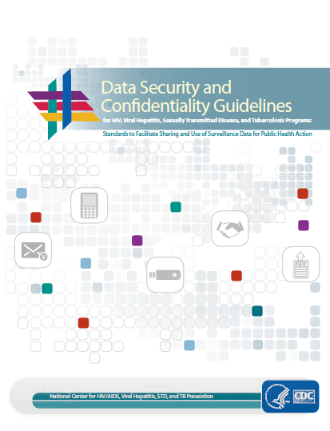
NCHHSTP Data Security and Confidentiality Guidelines
http://www.cdc.gov/nchhstp/ProgramIntegration/docs/PCSIDataSecurityGuidelines.pdf

Slide 83
Chapter 9
QA Cross-cutting Systems and Process
(NTIP, TB GIMS, and Cohort Review)

Slide 84
QA Cross-cutting Systems and Process
Examples of systems and a process that can be used for improving at least three of the five QA components .
National Tuberculosis Indicator Project (NTIP)
Tuberculosis Genotyping Information Management System (TB GIMS)
Cohort Review

Slide 85
Quality Assurance Cross-cutting
Tools
Chapter 10
Pages 10-77 – 10-86

Slide 86
Chapter 10
Toolkit for Quality Assurance

Slide 87
Toolkit
Over 50 QA tools (e.g., tables, charts, graphs, processes, and templates)
Available in commonly used word processing formats (e.g., Word, Excel, PowerPoint, or PDF)
Can be used by and adapted to your setting
Developed by staff from CDC and various jurisdictions

Slide 88
Appendicies

Slide 89
Appendices
Appendix | Title | Description
A | References | List of all references used in the development of this guide
B | Glossary | Compilation of all the definitions provided in this guide
C | QA Process Slides | Set of slides that describe the QA process

Slide 90
Appendices
Appendix | Title | Description
D | Report of Verified Case of Tuberculosis Questions and Clarifications | Compilation of questions and clarifications since the 2009 publication of the RVCT instructions . Updated periodically and is available at http://www.cdc.gov/tb/ programs/rvct/default.htm
E | Answers to the Exercises | Discussions of answers to exercises included in the guide

Slide 91
Additional Information

Slide 92
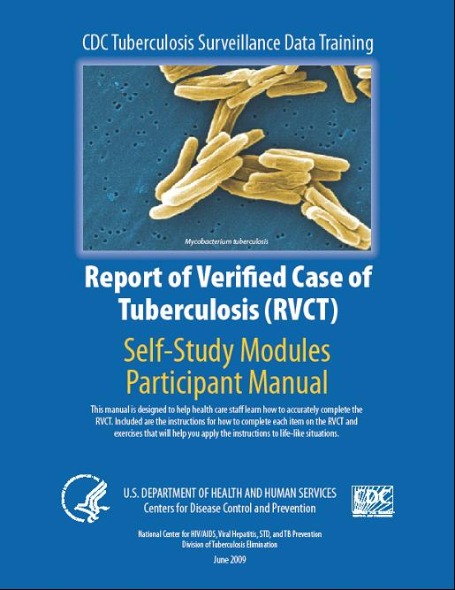
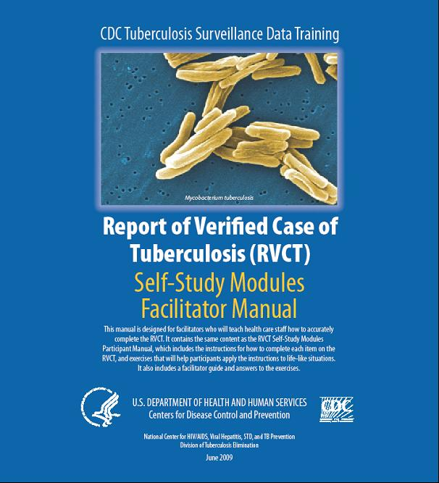
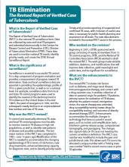
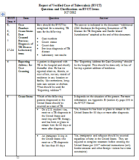
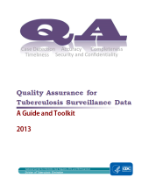
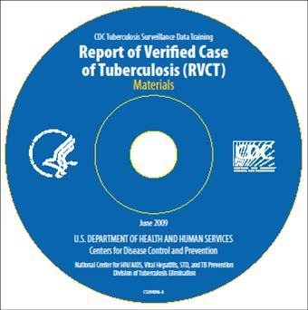
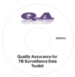
Summary of RVCT/QA Materials http://www.cdc.gov/tb/programs/rvct/default.ht
RVCT
QA
2 Manuals (for facilitators and participants)
CD ROM
Brochure
Fact sheet
Questions & Clarifications document
Continuing Education Units
1 Manual
CD ROM (includes Toolkit)
Fact sheet

Slide 93
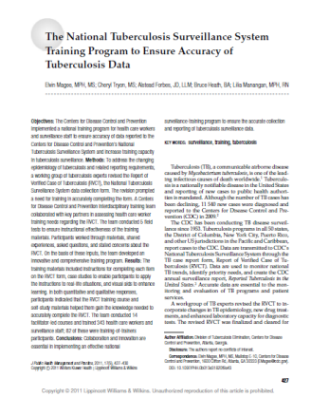
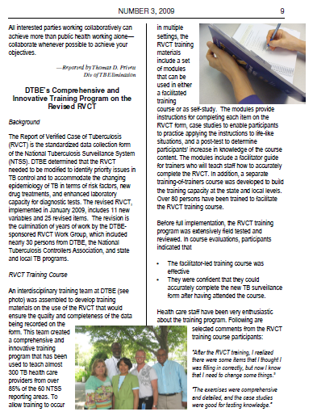
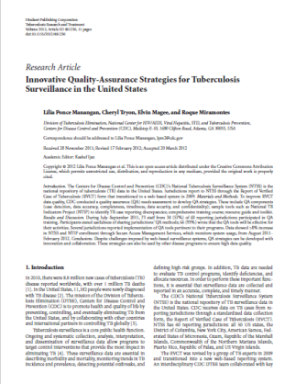
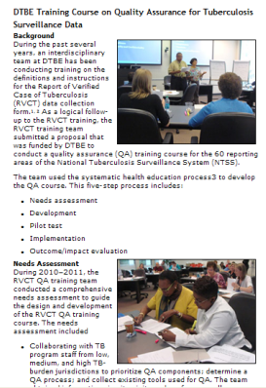
RVCT/QA Publications
RVCT
QA
J Public Health Management and Practice 2011; 17(5): 427–430.
The National Tuberculosis Surveillance System training program to ensure accuracy of tuberculosis data
TB Notes No. 3, 2009
DTBE’s comprehensive and innovative training program on the revised RVCT
Tuberculosis Research and Treatment May 2012.
Innovative quality-assurance strategies for tuberculosis surveillance in the United States
TB Notes No. 4, 2011
  DTBE training course on quality assurance for tuberculosis surveillance data

Slide 94
For More Information
Contact
The RVCT/QA Training Team
rvctqualityassurance@cdc.gov

