Slide 1
Trends and Developments in the Future Use of OELs
Dr. Andrew Maier

Slide 2
Learning Objectives
Harmonization concept as a tool for putting the confusing landscape of occupational risk assessment guidance into perspective.
The concept of problem formation and use of tiered risk assessment: clarifying how OELs and DNELs, and other metrics, serve their own purposes.
Other opportunities on the horizon for OEL Setting.

Slide 3
Harmonization of Occupational Exposure Guidelines

Slide 4
Exposure Guideline Disharmony?
n-Hexane Exposure Guidelines
Type of Limit | Value (ppm) | Agency
DNEL – Derived No Effect Level | 4.7 | REACH – European Union
IOELV - Indicative Occupational Exposure Limit Values | 20 | SCOEL – European Union
TLV® – Threshold Limit Value | 50 | ACGIH – American Conference of Governmental Industrial Hygienists
AEGL2 – Acute Exposure Guideline Level (2) | 4800 (10-min) 3300 (30-min to 8-hr) | NRC – National Research Council
IDLH – Immediately Dangerous to Life and Health | 1,100 | NIOSH – National Institute for Occupational Health and Safety
RFC – Inhalation Reference Concentration | 0.2 | U.S. EPA – Environmental Protection Agency

Slide 5
What is Harmonization?
Harmonization is not standardization.
Understanding the methods and practices used by various organizations.
Developing confidence in and acceptance of assessments using different approaches.
Willingness to work toward a convergence of methodologies as long-term goal.
Harmonization does not imply moving away from weight of evidence or diminish role of expert judgment by a group of peer experts. It does, however, provide a framework to guide the evaluation of data.

Slide 6
Need for Harmonization
OELs and other guidance may exist for the same chemical often vary considerably among organizations.
Few organizations have written methodology documents.
Most of these do not provide detailed guidance on OEL- setting that addresses key science in a definitive way.
Continued efforts are needed to provide such guidance, building on basic biology and risk science – this will allow for harmonization of OEL approaches.

Slide 7
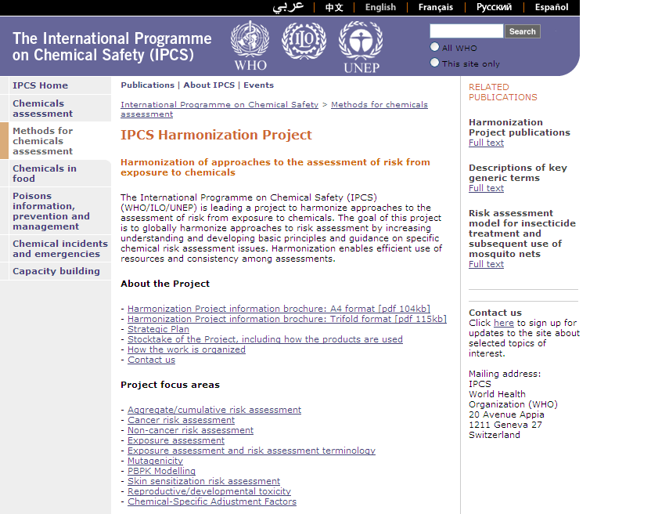
http://www.who.int/ipcs/methods/harmonization/en/

Slide 8
Key Points on Harmonization
OELs play a critical role in occupational health.
Methods and resulting OELs and other Occupational Exposure Guidelines differ among agencies.
There is growing emphasis on harmonization of methods.
Shared information facilitates harmonization.
Numerous sources of information are available, but no unified source of aggregated OEL information has been compiled.
Decision guides assist to sort through the confusing landscape of guidance.

Slide 9
Types of Exposure Guidance
There are many sources and types of exposure limit information that can be applied to different scenarios:
Purpose of assessment
Priority setting, Registration, Worker exposure assessment?
Exposure duration
Acute versus chronic?
Exposure population
Responders, workers, general population?
Exposure frequency
Routine or infrequent?
How do you find these and select one for your scenario?
Notes:
.

Slide 10
Why Does the IH Need to Know?
Increased duties outside of routine operation:
Growing role in product stewardship support,
Increased role in evaluating off-site community exposures or releases for emergency response,
Greater roles in assessing releases that affect the general population.
Understanding basis of other values – allows for better judgments in:
Interpreting results for an existing value,
Current value seems reasonable compared to array of existing values?
Filling gaps when an existing value is not available or may be out-dated.
Notes:
IH professionals will apply a wide range of exposure guides for diverse scenarios

Slide 11
Selecting Among Resources
How to decide which value among many?
Mandated regulatory hierarchy in-place?
Other considerations to weigh in decision:
Relevance of the guide value to the scenario or use of interest,
The degree to which the exposure guidance includes current literature and methods,
Confidence in the value,
Screening vs. full assessment
Robustness of limit setting process (e.g., authoritative agency, peer review, etc.).

Slide 12
Evaluate Relevance
of New Value
Define Use or Scenario
Availability of relevant
exposure guidelines
Are exposure guidelines available for the use of the assessment?
No
Yes
No Reliable Value Available
Derive value
Adopt value modified from alternative scenario
Are exposure guidelines available for the population, time pattern , and exposure route of Interest?
No
Yes
Is the value reliable?
Apply Selection/ Ranking Criteria
Does the value reflect current science?
Is there confidence in the value (peer reviewed)?
Are exposure guidelines reliable?
Yes
Provisional exposure guideline verified?
No
Yes
NOT VERIFIED
Risk management considerations
Communication basis considerations
Use selected value

Slide 13
The Continuum of Occupational Exposure Guidelines

Slide 14
Progressions in Occupational Risk Assessment
Normal progression in risk assessment is from reliance on qualitative hazard-based approaches to quantitative risk-based assessments as data increases.
Hazard approach,
Advantage: rapid assessment allows for action to be taken quickly to address most likely health concerns,
Disadvantage: absence of an objective measure of likelihood for health concern can lead to: 1) inadequate protection, 2) less confidence in the assessment, 3) difficulty in communicating risks.
The preferred IH practice is to use hazard-based approaches as an interim procedure until an OEL can be developed.

Slide 15
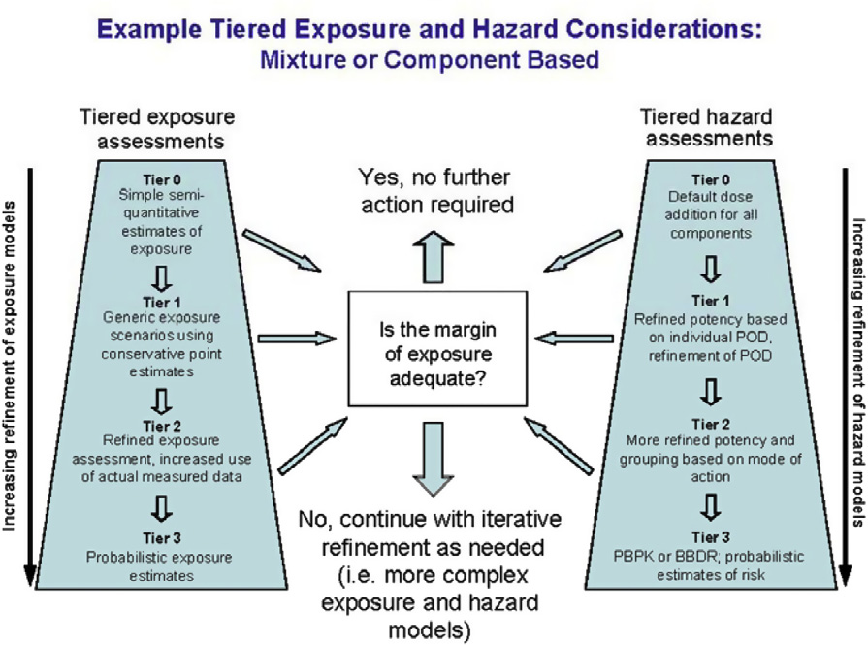
Fig. 1. A conceptual representation of the framework
M.E. (Bette) Meek, Boobis AR, Crofton KM, Heinemeyer G, Van Raaij M, Vickers C. 2011. Risk assessment of combined exposure to multiple chemicals: A WHO/IPCS framework. Regul Toxicol Pharmacol. In press.

Slide 16
AGF “Hoppering Process”

Slide 17
Guidance for Data-Poor Chemicals
Threshold of Toxicological Concern,
Statistical correlations with acute or longer-term effects,
In Silico and Quantitative Structure Activity Relationships (QSAR) – read across,
Hazard Banding Algorithms,
Default calculation schemes – e.g., DNEL approach.

Slide 18
Correlation Approaches
No toxicology data, some physicochemical property (P) or relative potency data
OEL_{a} = (P_{a}/P_{b}) x OEL_{b}
Irritancy
Acidity (pKa) for organic acids
RD50 values
Lethality
Acute Lethality (LD50 and LC50)
Systemic Toxicity
Subchronic NOAELs or LOAELs

Slide 19
Hazard Banding
Array existing data for a series of key end points.
Establish criteria for categorizing each end point.
Typically assign hazard band based on worst of the identified hazard categories.
Preliminary OEL ranges often associated with each hazard band.
Many systems exist, but there are moves toward harmonizing criteria, including validation exercises.

Slide 20
Other Approaches
Toxicity Prediction
Use chemical and physical property to predict potency with software.
Read across - use data for a related chemical as a surrogate.
Default algorithms
e.g., DNEL approach

Slide 21
Future Developments in OEL Setting

Slide 22
Drivers for Change
Science Drivers
Improved understanding of molecular toxicology.
Incorporation of biomathematics with improved computing resources.
Regulatory Drivers
Focus on MOA Frameworks.
EU Driven initiatives (e.g., REACH: DNEL, AAT).
Assessment focus on aggregate and cumulative exposure – nontraditional exposures.

Slide 23
Risk Assessment Directives
Better integration of dose-response methods across endpoints – use growing biology knowledge.
Increased use of problem formulation – Use the right risk tool for the job.
Consider cumulative exposure and risk – think exposome.
NRC (National Research Council). 2009. Science AND Decisions: Advancing Risk Assessment. Board on Environmental Studies and Toxicology. National Academy Press, Washington, DC.

Slide 24
Area of Change – Mode of Action (MOA) Frameworks
Identification of the sequence of key events and processes resulting in an adverse effect
Use of our biology understanding via MOA is becoming more formalized as part of risk assessment
MOA is not a detailed Molecular Description
IPCS (International Programme on Chemical Safety). 2008. IPCS Mode of Action Framework. IPCS Harmonization Project Document, No. 4. World Health Organization Press.

Slide 25
Hypothesized Mode of Action for Tumor Response
Metabolite
Cell Damage & Proliferation
T
U
M
O
R
S
0
0
DOSE
Key Event
Threshold
Kidney Tumors
Nonlinearity / Threshold
Notes:
Key events dose-response framework

Slide 26
Example of Calculation of a Benchmark Concentration
1
0.8
0.6
% animals responding
0.4
NOAEL
0.2
0
BMDL
BMD
0
50
100
150
200
Exposure Concentration ppm

Slide 27
Area of Change – Cumulative Risk
We are clearly moving to more systematic evaluation of “real-life” exposures.
Multiple routes of exposure
Mixtures of chemicals
Total exposure (occupational plus non- occupational)
Combined effects of chemicals plus non-chemical stresses
We need “OELs” to address these new perspectives.

Slide 28
Definitions
Aggregate exposure = one chemical, multiple routes
Mixture = exposure to more than one chemical
Cumulative risk = exposure to single or multiple chemicals and nonchemical stressors by all routes

Slide 29
Exposome
As a complementary approach to the genome, the exposome can be defined as:
The totality of exposures over a lifetime, which predispose and predict health effects in an individual.
Begins in utero,
Encompasses environmental (including occupational) sources of injuries, irritations, and other stressors including lifestyle and diet,
Dependent upon characteristics of the person.

Slide 30
Risk Characterisaton Step
ECETOC (European Centre for Ecotoxicology and Toxicology of Chemicals). 2010. Guidance on Assessment Factors to Derive a DNEL. ECETOC TR No. 110.

Slide 31
EPA’s Pesticide Approach
Identify Common Mechanism Group (CMG);
Identify Potential Exposures;
Characterize and Select Common Mechanism Endpoint(s);
Determine The Need For a Dosimetry-Based Cumulative Risk Assessment;
Determine Candidate Cumulative Assessment Group
Conduct Dose- Response Analyses and Determine Relative Potency and Points of Departure;
Develop Detailed Exposure Scenarios All Routes and Durations;
Establish Exposure Input Parameters;
Conduct Final Cumulative Risk Assessment;
Conduct Characterization of Cumulative Risk.
U.S. EPA. 2002. Guidance on Cumulative Risk Assessment of Pesticide Chemicals That Have a Common Mechanism of Toxicity. Office of Pesticide Programs. Washington, DC.
Notes:
2nd 5 steps can be dosimetry-based
Common Mechanisms Group: The group of chemicals under evaluation that induce a common effect via the same mechanism of toxicity. The Initial Analysis begins with the identification of this group of chemicals
For example – all OPs fall into the same CMG. But – not all OPs contribute meaningfully to the total OP risk. e.g. – some are being phased out or have negligible exposure.
Cumulative Assessment Group: The group of chemicals surviving the Initial Analysis, for which a dosimetry-based cumulative Risk Assessment will be conducted.
From the dosimetry-based guidance: If Chemical Q is omitted from the CMG due to lack of Effect X, the CRA will not properly characterize the cumulative risk for Chemicals A, B, C when Chemical Q is also present. For this reason, all chemicals that share common types of PK or PD interactions with biological targets should be considered as members of the CMG. This represents a specific extension of the process, as recommended by the available (OPP) guidance to address commonalities beyond those related to toxic manifestation: those pertaining to tissue doses of toxicologically active chemical species (metabolites). While OPP’s guidance defines the CMG based only on toxicodynamic events in the mechanism of action itself, The CMG is here defined differently.

Slide 32
Conclusion
This is a time of active change in occupational risk methods.
OELs remain the most robust tool available and are here to stay – but IHs need to understand role other tools and metrics too.
There are a variety of science, policy, and regulatory drivers for these changes:
More robust OEL methods,
Increased availability of OEL alternatives,
More formal evaluation of multi-route and mixed exposures.

Slide 33
Final Thoughts
The current landscape of approaches is confusing – e.g., OELs vs. DNELs.
IHs will be seeing more DNELs as well other types of OEL guidance.
Need to know how they are calculated and there intended purposes.
OELs, DNELS and other types of guidance will need to coexist – but health-based remain a critical tool for worker protection.

