Slide 1
Web Plus Abstracting Overview
Nankee Singh
CDC/NPCR Contractor
Joseph D. Rogers
Team Lead, Data Analysis and Support Team, NPCR, CDC
December 7,2016

Slide 2
Web Plus General Overview
Web-based application used to collect cancer data securely over the internet
Data collection/transfer tool for use by central registries for reporting from physicians’ offices, low volume facilities, hospital and non-hospital reporting sources, and follow-back efforts
Data only accessible to Central Registry and reporting facility
Data entry forms and edit sets to be customized by central registry
Data validated using CDC Edits Engine

Slide 3
Web Plus Main Functions
Online Abstracting
File Uploading/Downloading
Data Editing
DCO and Path Lab Follow-back
Supporting Functions
E-mail
Reports

Slide 4
Online Abstracting Features
Data entered into custom display created by the Central Registry Administrator
Lookup assisted data entry with advanced search feature
Link for each data item to the NAACCR Standards for Cancer Registries Volume II: Data Standards and Data Dictionary
Code selection from drop-down lists
Age at Diagnosis calculation
Collaborative Staging and TNM staging calculation
Edits ran on save of abstract

Slide 5
Facility Abstractor
Enters abstracts and corrects errors until abstract is complete (no errors remain)
Releases abstracts to central registry
Views reports

Slide 6
Central Registry Abstractor
Reviews abstracts released to the central registry, verifying submitted codes with submitted text
Re-releases abstracts for export into the central registry
Enters new abstracts

Slide 7
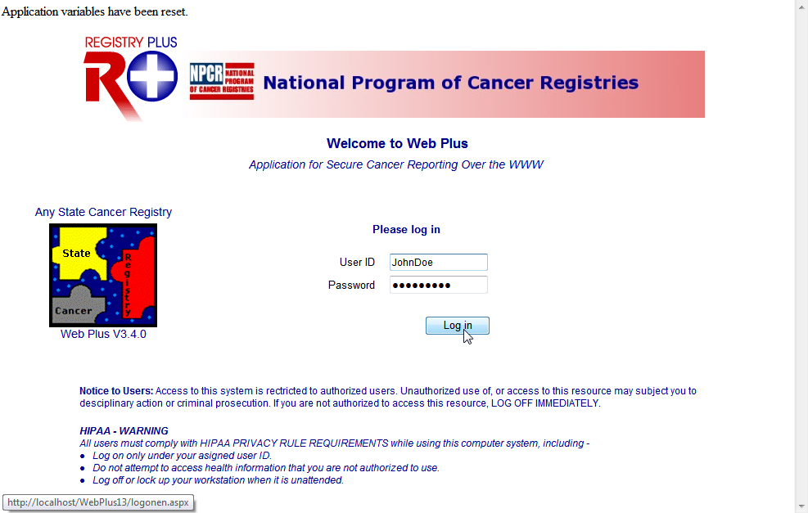
Log In
To log in, complete these steps:
Open your Internet browser and type the Internet address for your state registry’s Web Plus in the Address field.
Press Enter.
The Web Plus Log in page opens:

Slide 8
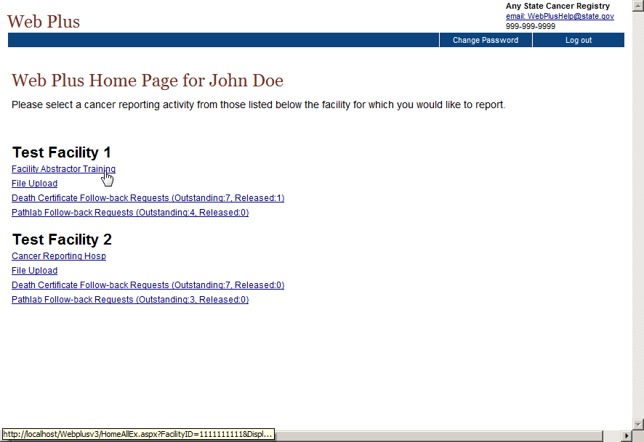
Web Plus Home Page
Web Plus homepage opens, with a list of links to the facilities and roles that have been assigned to the user.

Slide 9
Facility Abstractor Menu
From this page you can access the main parts of Web Plus. Click on an option to open the page for the option.

Slide 10
Abstractor Menu Options
Menu option | Description
Home | Opens the user’s home page, which displays a list of links for the facilities and roles that have been assigned to the user
New Abstract | Opens the data entry page for a new abstract
Find/Open Abstract | Opens the page to search for existing abstracts
Release Abstracts | Opens the page that lists all abstracts that are completed and ready for release
Reports | Opens the page that lists the reports available for viewing

Slide 11
Abstractor Menu Option (cont.)
Menu option | Description
Change Password | Opens the change password page
Help | About - Opens a page with the Web Plus, NAACCR, and Collaborative Staging and TNM Staging Algorithm Version information
Log out | Logs the user out of Web Plus; opens Web Plus Log in page

Slide 12
Abstracting Process
The process of generating an abstract includes the following steps:
Create the abstract with the pertinent demographic information and save.
Enter codes using the codes supplied by the Web Plus application and text in the in the data entry fields. Save the abstract to retain the information you have entered.
Correct errors. Each time you open or save the abstract, Web Plus automatically edits the entered information for accuracy and completeness using the edit set and required fields chosen by your Web Plus Administrator.
After you have entered all your data and corrected all errors, save the abstract and the system will designate your new abstract as complete.
Release the completed abstract to the central registry. You can release abstracts individually or several at a time.

Slide 13
Data Entry
New case information is added on the Data Entry page
On the Web Plus menu, click New Abstract.

Slide 14
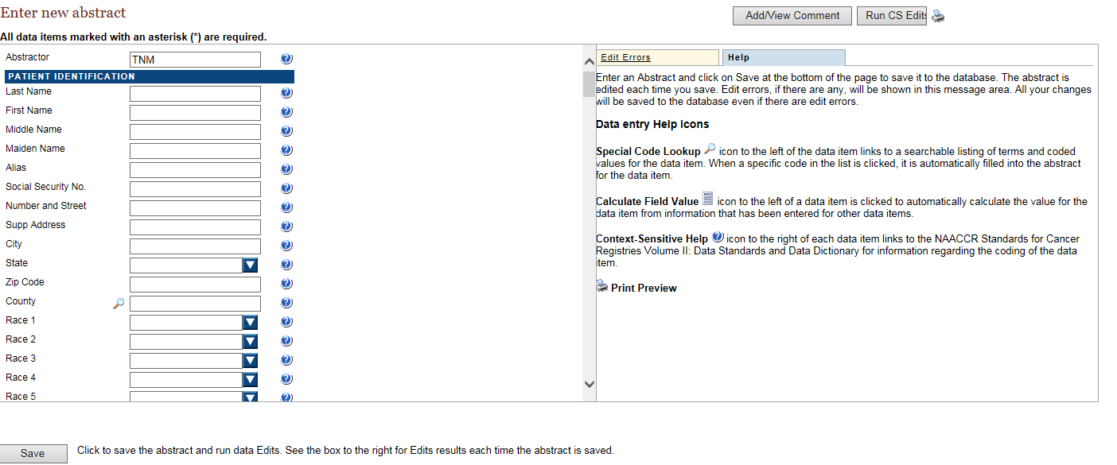
Data Entry Page

Slide 15
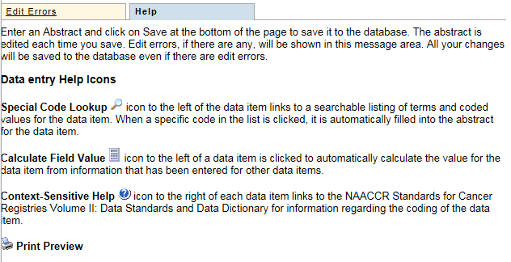
Help Tab
This area provides a legend describing the data entry help icons available to the abstractor

Slide 16
Web Plus Help Icons
Icon | Description | Click the icon to . . .
 | Special Lookups | open a listing of codes and terms to choose from. When a specific code is clicked, it is automatically filled into the abstract for the data item.
 | Calculate Field Value | calculate a value for a field from values in other fields.
 | Context-sensitive Help | open Help page with the NAACCR Standards for Cancer Registries Volume II: Data Standards and Data Dictionary for information about the data item.
 | Print Preview | open page that shows all of the fields and the content you have entered in your abstract; this page allows you to print a copy of your abstract.

Slide 17
Entering Information into Fields
Create an abstract by entering essential data into the designated fields.
On the Web Plus menu, click New Abstract.
The Data Entry page opens. Notice that the Abstractor field is pre-filled with your Abstractor ID.

Slide 18
Entering Information into Fields (cont.)
The drop downs include the available codes for the specific variable

Slide 19
Entering Information into Fields (cont.)
The question marks on the screen next to each variable is the NAACCR definition for that variable.
Click on the magnifying glass icon to the left of the County field
.
The Select county code window opens, which provides a list of county codes.

Slide 20
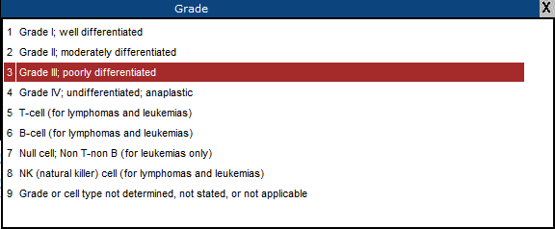
Entering Information into Fields (cont.)
The drop downs also help with the selection of grade or diagnostic confirmation, class of case etc.

Slide 21
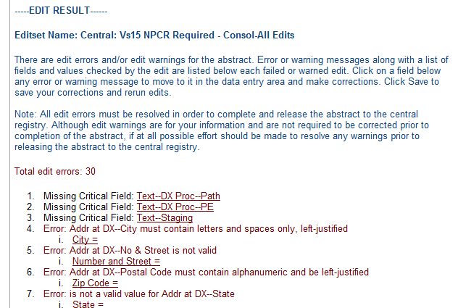
Saving an Abstract
Click Save to save your work.
When you save the abstract the system displays edit errors. Notice that the Edit Errors tab is automatically opened on the right and displays the total number of and details of the edit errors contained in the abstract.

Slide 22
Opening and Updating an Abstract
On the Web Plus menu, click Find/Open Abstract.
The Find Abstract page opens.

Slide 23
Print Preview
The Print Preview feature allows you to view all of the fields and the content you have entered in your abstract. You can also print a copy of the abstract from the Print Preview window.
Open an abstract.
Click Print Preview
.
Result: A separate window opens that displays all of your abstract entry fields and content.
To print a copy of the abstract, use your browser’s printer.

Slide 24
Completing an Abstract
Once you have resolved all edit errors and completed all missing critical fields, upon the next save of the abstract, Web Plus informs you that the abstract is complete and ready for release to the central registry.

Slide 25
Deleting an Abstract
To delete an existing abstract, use the Find Abstract page.
Click Delete in the Action column. Be sure to note the Abstract Reference ID (AbsRefID) number.

Slide 26
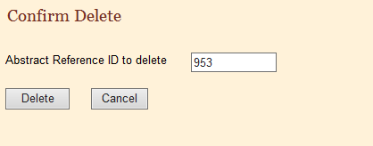
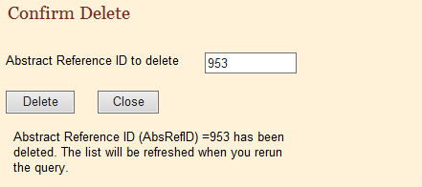
Deleting an Abstract (cont.)
The Confirm Delete window opens. It displays the Abstract Reference ID number of the abstract you want to delete
Click Delete. On the Confirm Delete window a message confirms the deletion

Slide 27
Releasing an Abstract
Once your abstract has no errors, it is completed, and you can release it to the central registry.
On the Web Plus menu, click Release Abstracts.

Slide 28
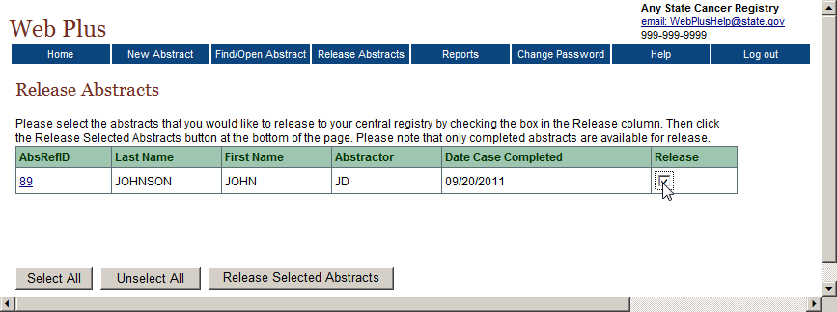
Releasing an Abstract (cont.)

Slide 29
Releasing an Abstract (cont.)
The system releases the selected abstracts to your designated central registry and changes the status of the abstracts to Released

Slide 30
Questions?
Contact Information:
Nankee Singh
Phone: 510-610-9357
Email: nsingh4@cdc.gov

