Slide 1
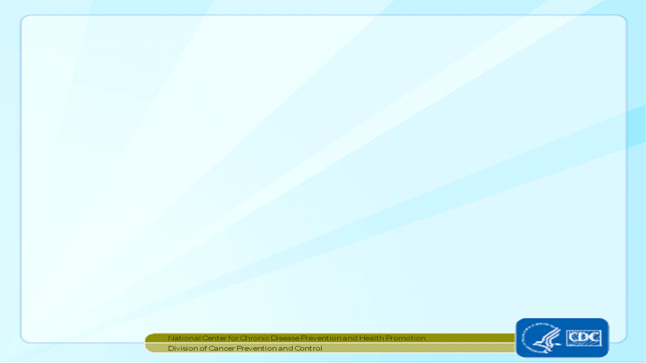

Web Plus Central Registry Administrator Training Overview
Nankee Singh
CDC/NPCR Contractor
Joseph D. Rogers
Team Lead, Data Analysis and Support Team, NPCR, CDC
December 13,2016

Slide 2
Central Registry Administrator
                Sets up facilities with access to the Web Plus software to report their data, manages facility accounts and users at both the central registry and facilities, configures display types, edit sets and system preferences, manages assignment of abstracts to central registry staff, exports data, and views reports.

Slide 3
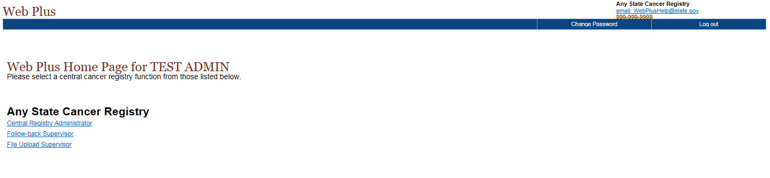
Web Plus Home Page

Slide 4
Central Registry Administrator Menu

Slide 5
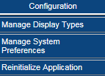
Configuration
Configuration allows the administrator to set system preferences and to create display types.

Slide 6
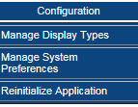
Selecting System Preferences
On the Web Plus menu, point to Configuration, then click Manage System Preferences.

Slide 7
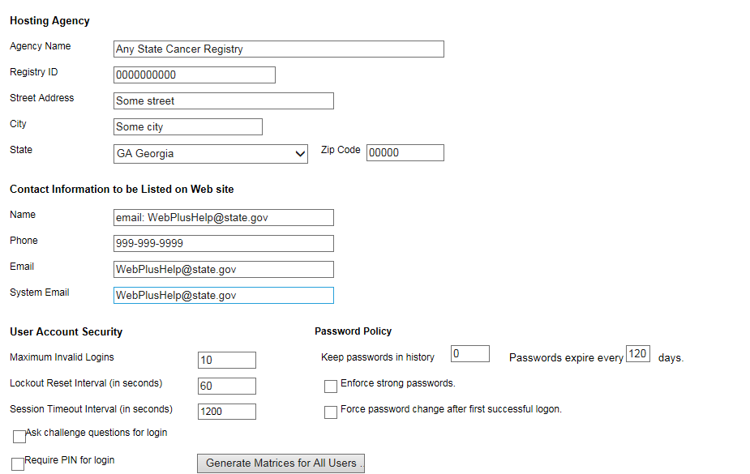
Managing System Preferences

Slide 8
Creating Display Types
To generate a display type, you first create it and then go through five main steps to build the display type:
Select Fields
Select Critical Fields
Select Edit Set
Select Individual Edit Options
Select Collaborative Staging Preference.

Slide 9
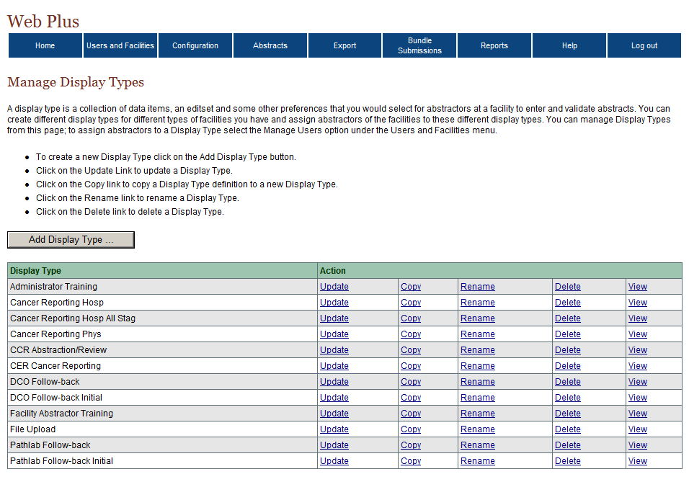
Adding a New Display Type
Log in to Web Plus. On the Web Plus menu, point to Configuration, then click Manage Display Types.

Slide 10
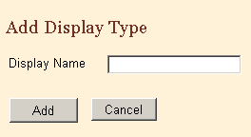
Adding a New Display Type (cont.)

Slide 11
Copying a Display Type
Another way to create a new display type is to copy an existing display type and revise it to meet your needs.
To create a display by copying, complete these steps:
Log in Web Plus
On the Web Plus menu, point to Configuration, then click Manage Display Types.

Slide 12
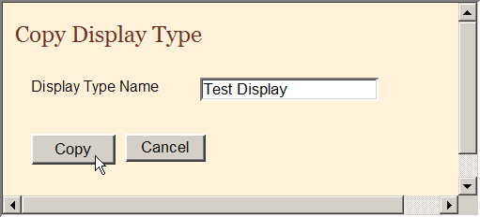
Copying a Display Type (cont.)
Locate the display type and you wish to replicate and click Copy.

Slide 13
Select Fields
To add section headings and fields:
On the Web Plus menu, point to Configuration, then click Manage Display Types.
On the Test Display row, click Update.

Slide 14
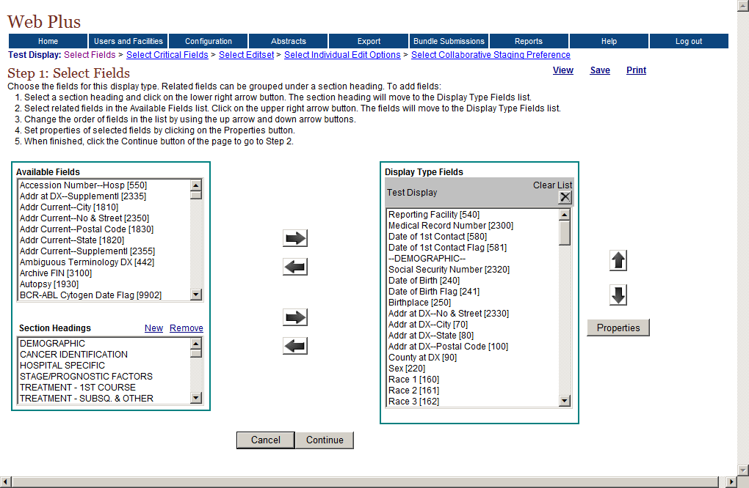
Select Fields (cont.)
Move Fields
Re-order Data Items
Move Headings

Slide 15
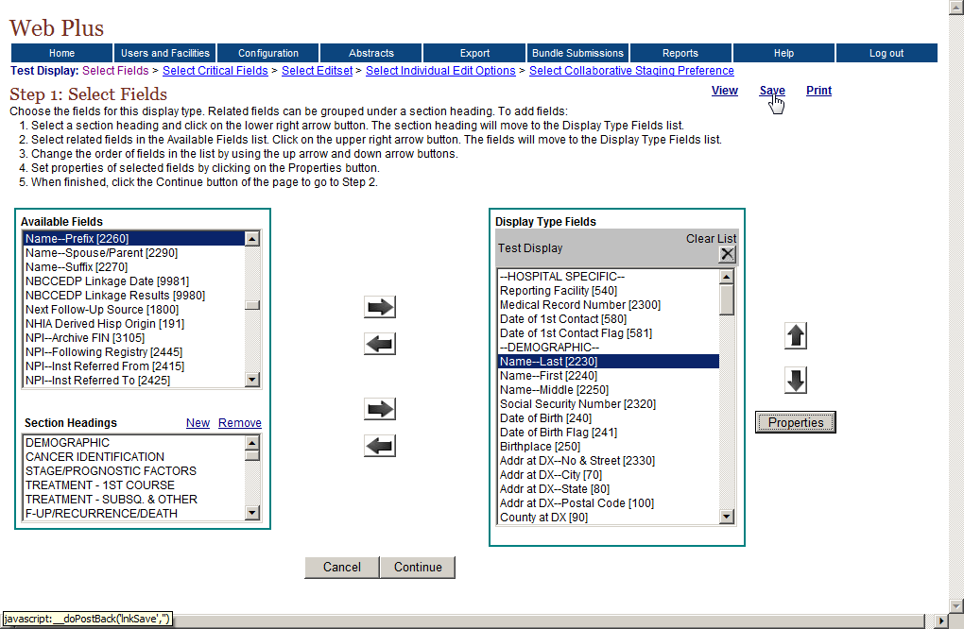


Saving the selected fields

Slide 16
Select Critical Fields
Critical fields, or required fields, are fields that must contain information in order to complete and release an abstract.
On the Web Plus menu, point to Configuration, then click Manage Display Types.
Click Update for the display type Test Display.
The Select Fields page opens with the links to all selection steps

Slide 17
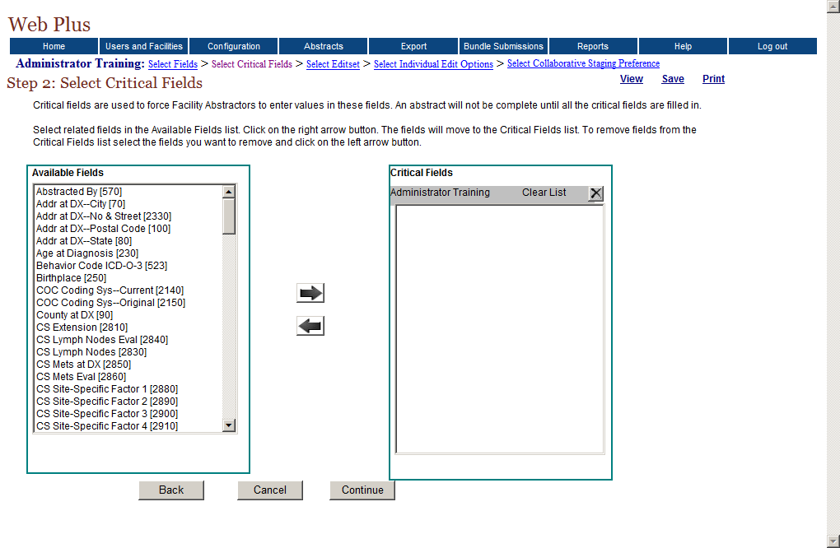
Critical Fields (cont.)

Slide 18
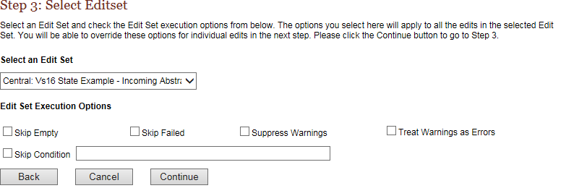
Select Edit Sets

Slide 19
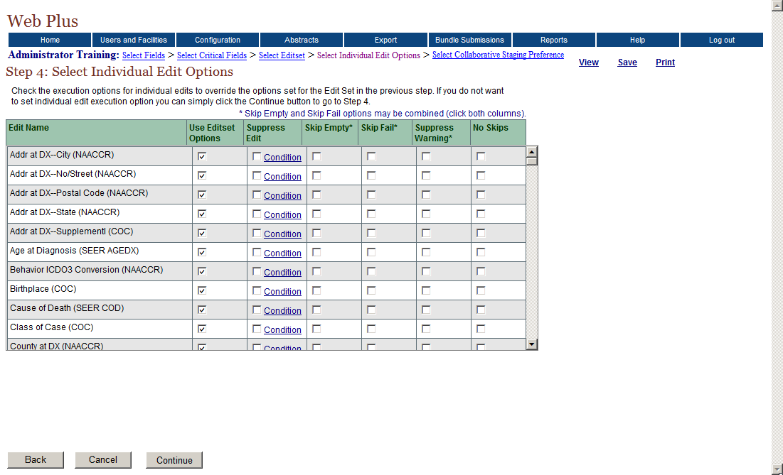
Select Individual Edit Options

Slide 20
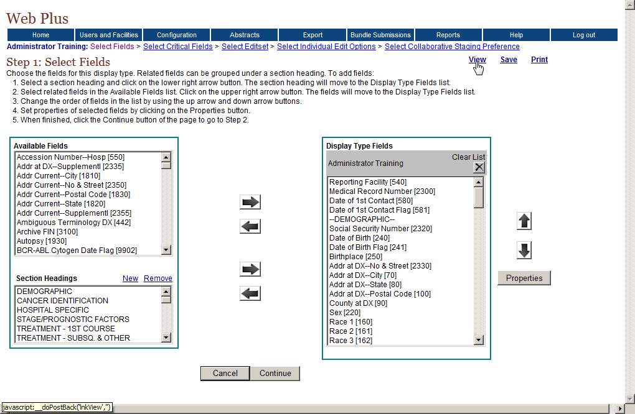
Viewing the Display Type
On any of the Manage Display Type pages click View in the upper right-hand corner of the page.

Slide 21
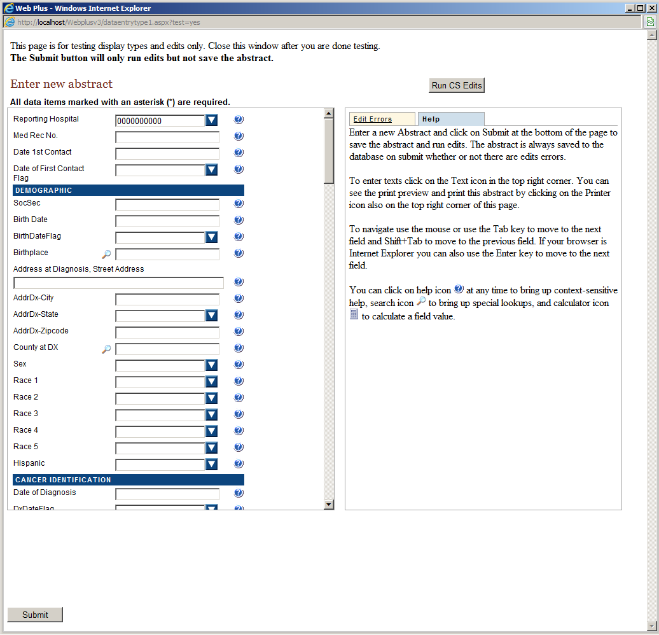
Viewing the Display Type (cont.)

Slide 22
Reinitialize Application
There are times that the Web Plus application will need to be reset. Web Plus allows the Administrator to reinitialize the application.

Slide 23
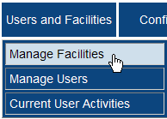
Managing Facilities- Adding a Facility
On the Web Plus menu, point to Users and Facilities, then click Manage Facilities.

Slide 24
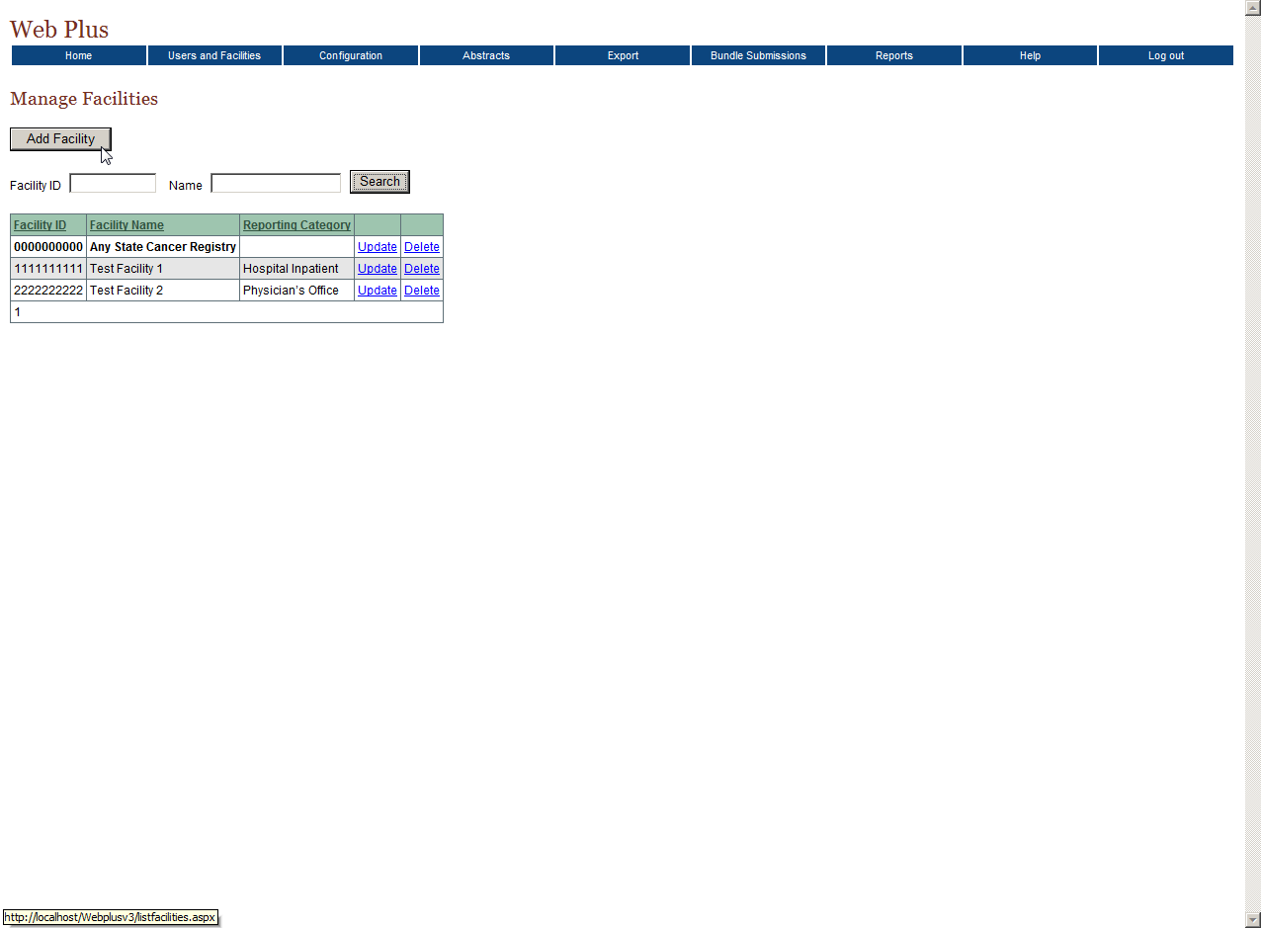
Adding a Facility

Slide 25
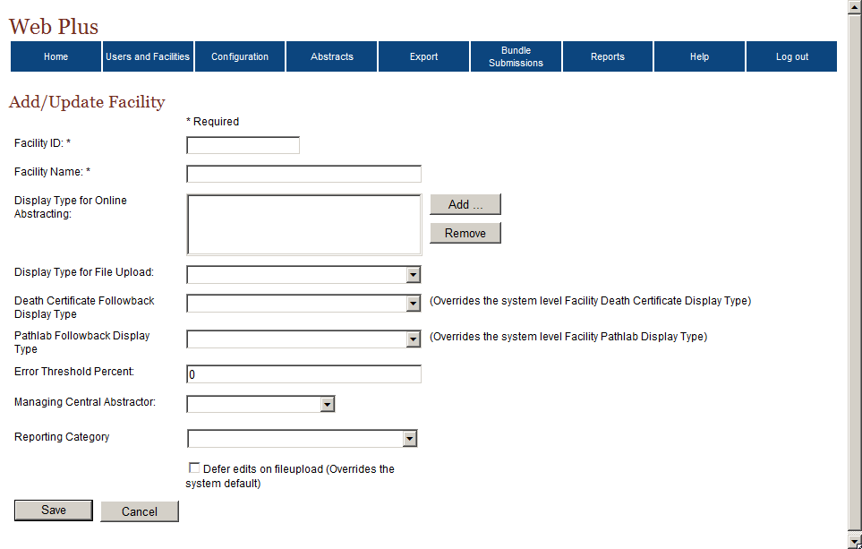
Adding a Facility (cont.)

Slide 26
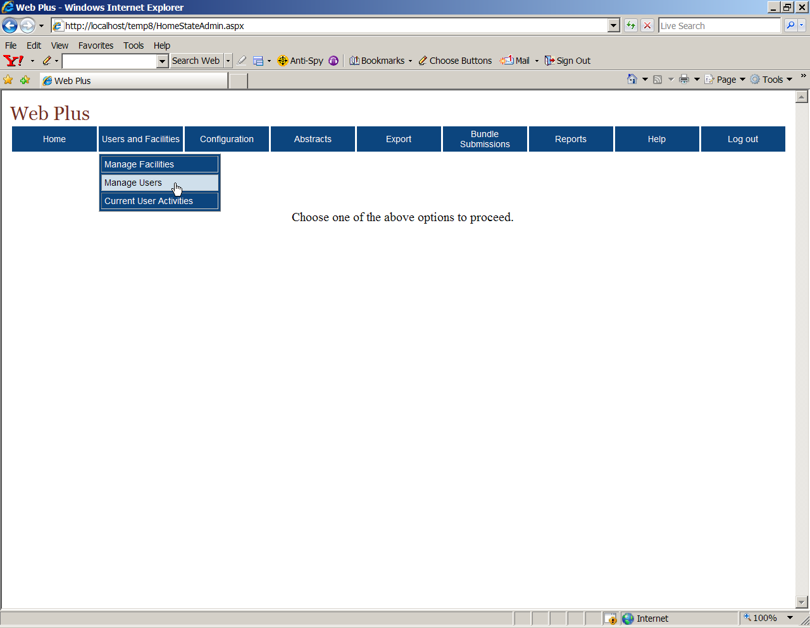
Managing User Accounts
On the Web Plus menu, point to Users and Facilities, then click Manage Users.

Slide 27
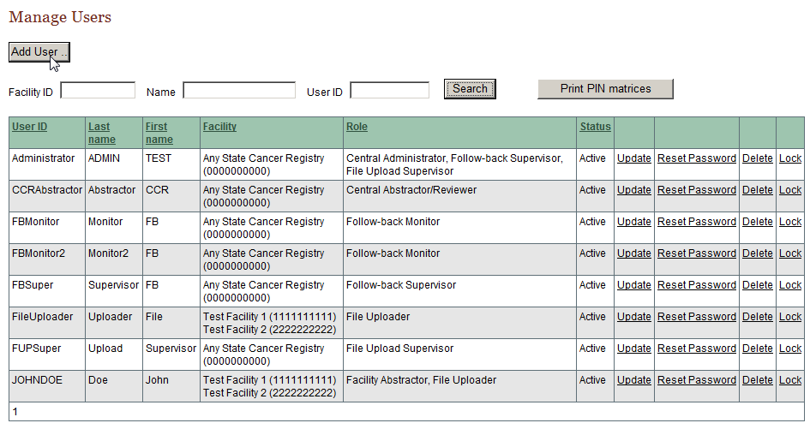
Adding a User

Slide 28
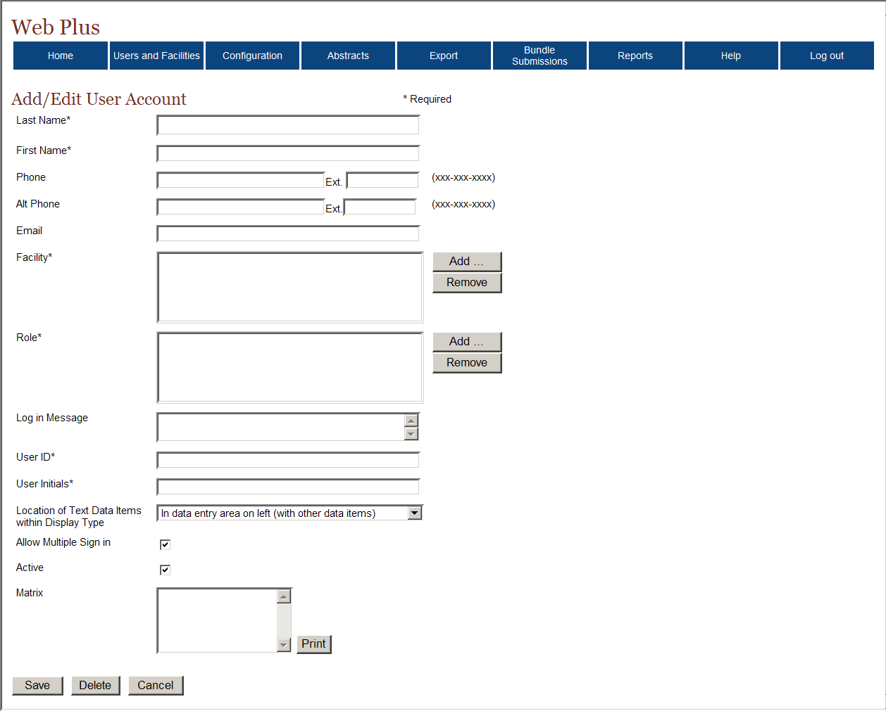
Adding a User (cont.)

Slide 29
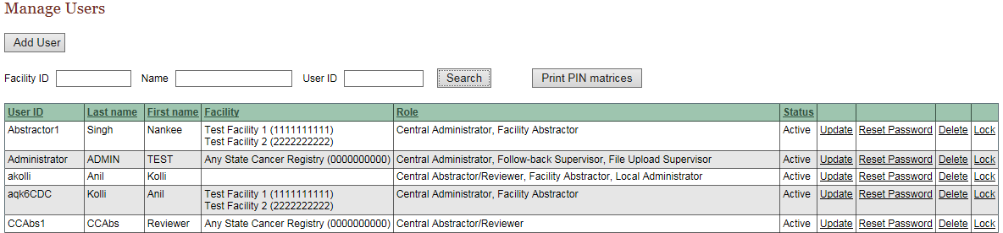
Manage a User Account

Slide 30
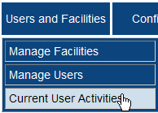
Viewing Current User Activities
On the Web Plus menu, point to Users and Facilities, then click Current User Activities.

Slide 31
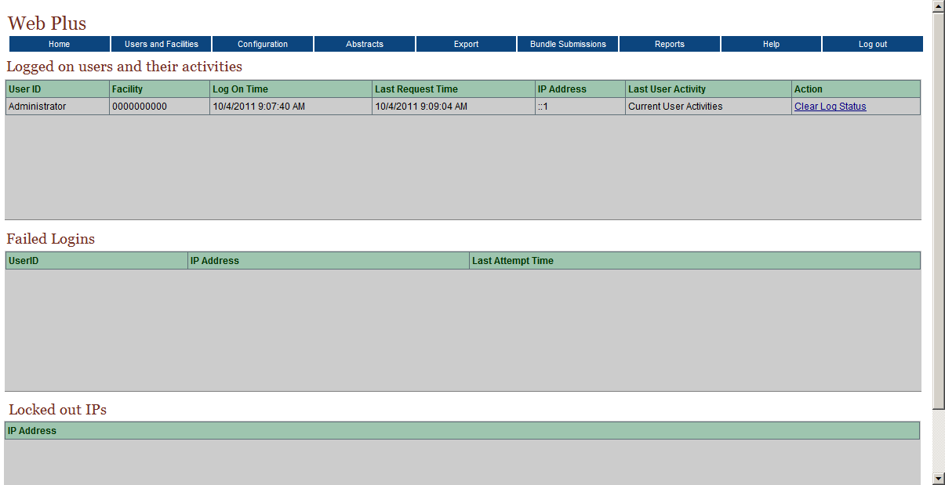
Current User Activity

Slide 32
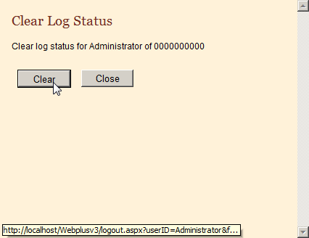
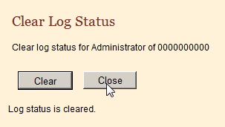
Clear Log Status
To clear a user’s log status, complete these steps:
On the Web Plus menu, point to Users and Facilities then click Current User Activity.
In the Logged on users and their activities table, find a user and click Clear Log Status.

Slide 33

Assigning Abstracts for Review
The Central Registry Administrator is responsible for assigning released abstracts to central registry abstractor/reviewers for review. The Administrator can also view abstracts at any point once they have been released to the central registry.
On the Web Plus menu, point to Abstracts, then click Assign Released Abstracts.

Slide 34
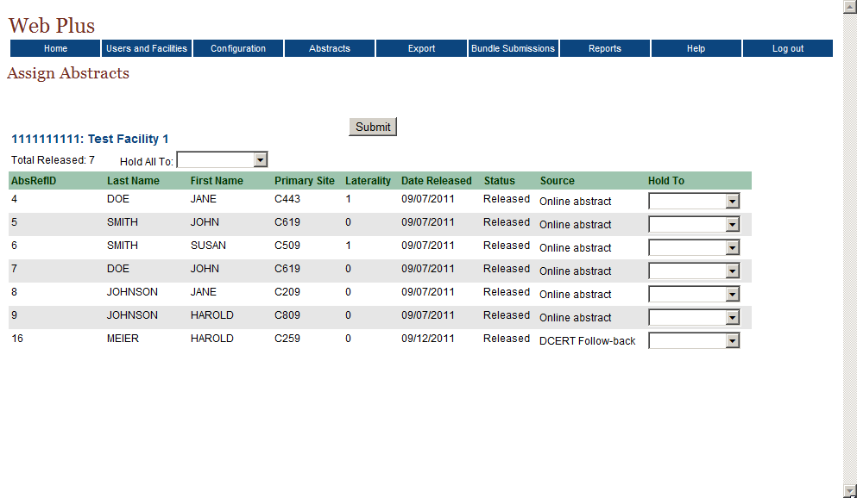
Assigning Abstracts

Slide 35
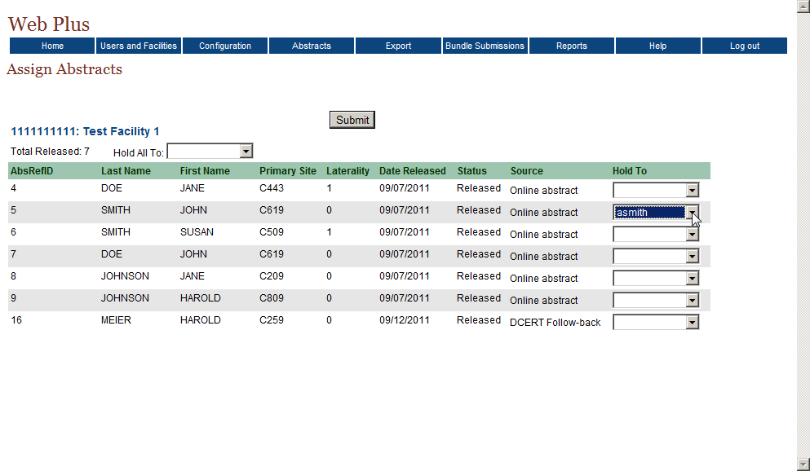
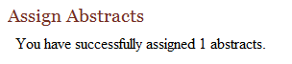
Assigning Abstracts (cont.)
Click Submit to assign the abstract

Slide 36

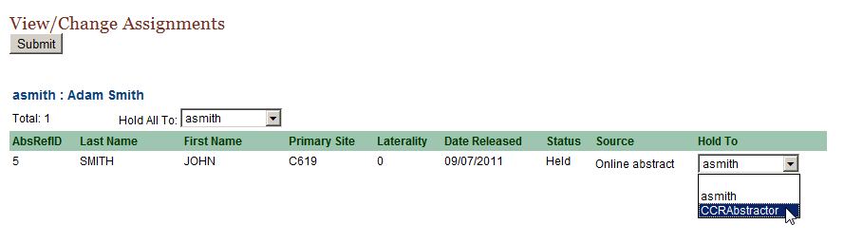
Reassigning an Abstract
The View/Change Assignments page opens.

Slide 37
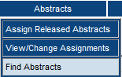
Finding and Viewing an Abstract
To find an abstract:
On the Web Plus menu, point to Abstracts, then click Find Abstracts.

Slide 38
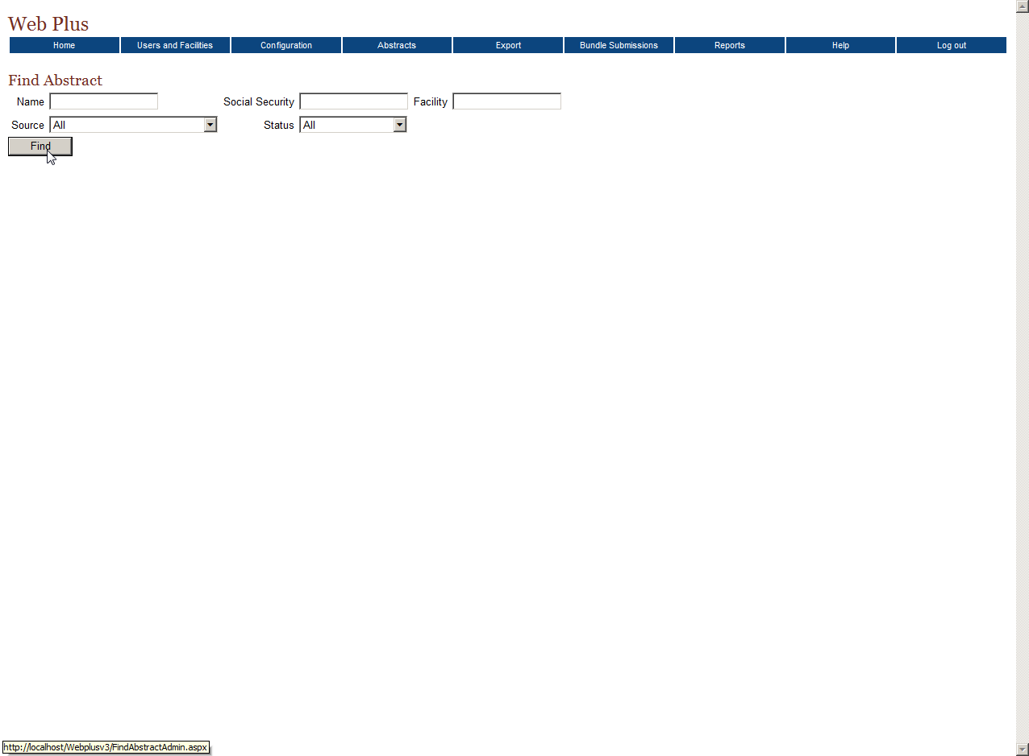
Finding and Viewing an Abstract (cont.)

Slide 39
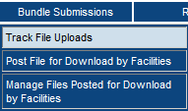
Track File Uploads
On the Web Plus menu, point to Bundle Submissions, then click Track File Uploads.

Slide 40
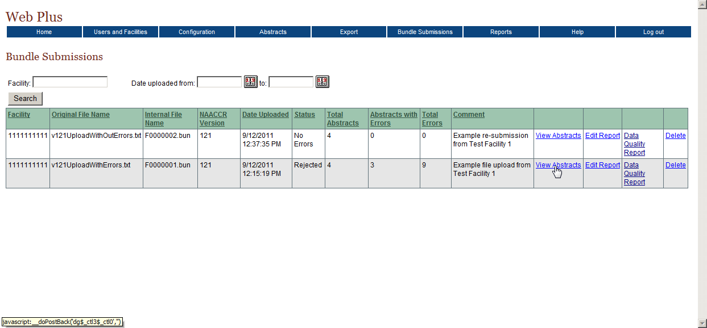
Track File Uploads (cont.)

Slide 41
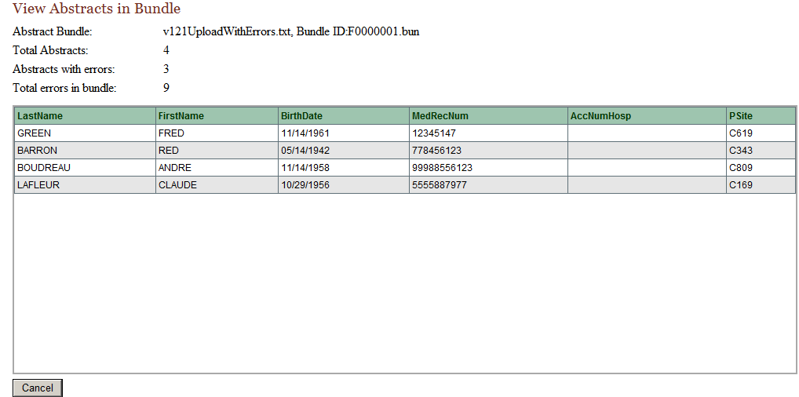
Viewing Abstracts in an Uploaded File

Slide 42

Posting Files for Facility Download
The Web Plus Central Registry Administrator can post files for download by facilities, and specify the facilities for which a file should be posted.

Slide 43
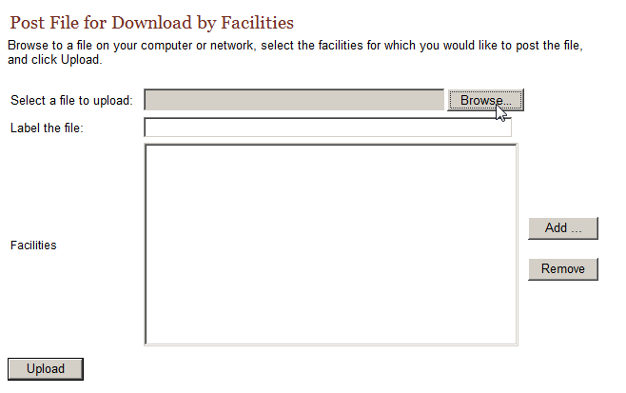
Posting Files for Facility to Download

Slide 44
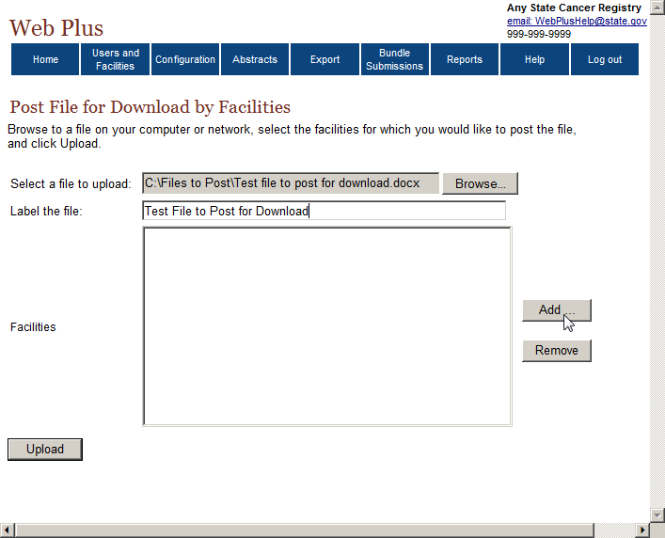
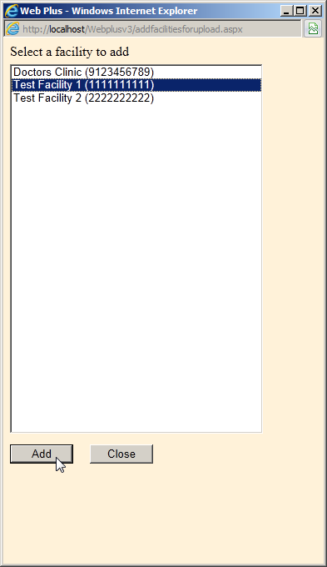
Posting Files for Facility to Download

Slide 45
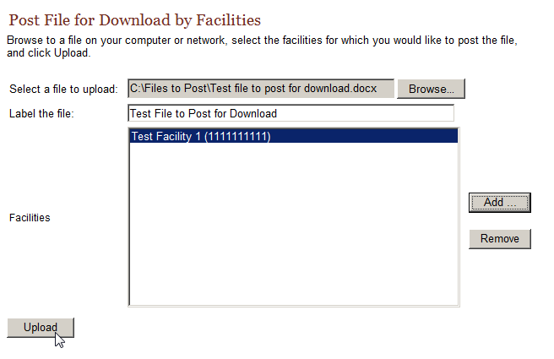
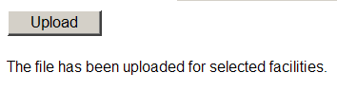
Posting Files for Facility to Download

Slide 46
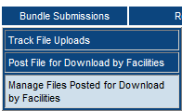
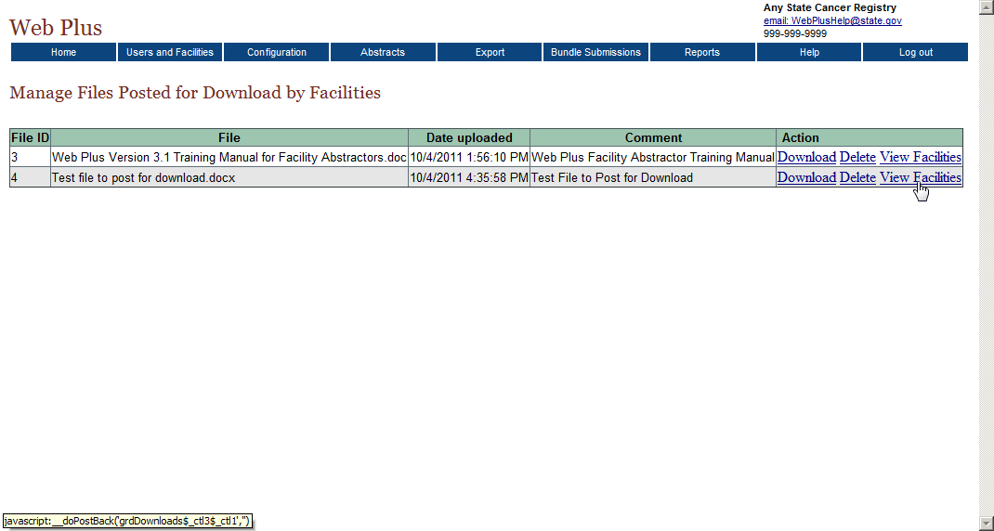
Managing Files Posted for Facility Download
As Central Registry Administrator, on the Web Plus menu, point to Bundle Submissions, then click Manage Files Posted for Download by Facilities.

Slide 47
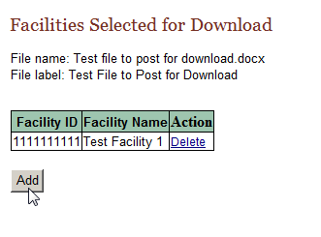
View Facilities- Adding a Facility
On the Manage Files Posted for Download by Facilities page, locate the file of interest, and click the View Facilities link in the Action column.
The Facilities Selected for Download page opens.

Slide 48
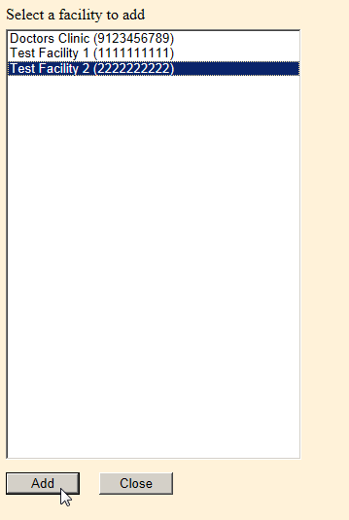
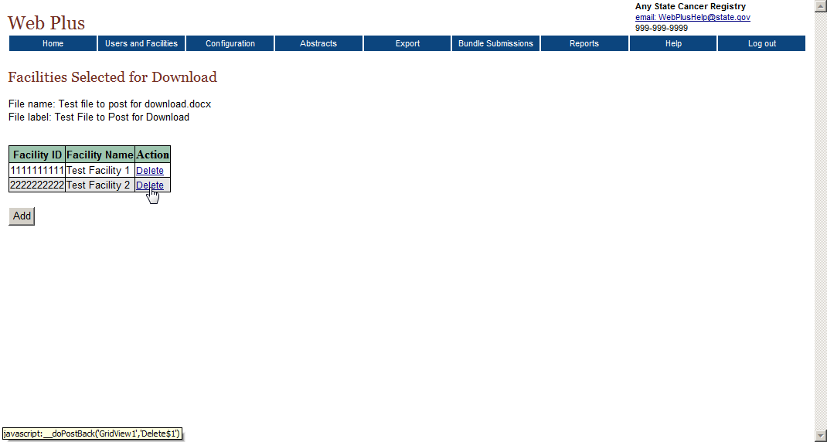
View Facilities- Adding a Facility (cont.)
You are returned to the Facilities Selected for Download page, where the selected facility has been added to the list for facilities for which the file is posted.

Slide 49
Questions?
Nankee Singh
nsingh4@cdc.gov
510-610-9357

