Slide 1
NTSS-CR National Tuberculosis Surveillance System – Case Reporting

Slide 2
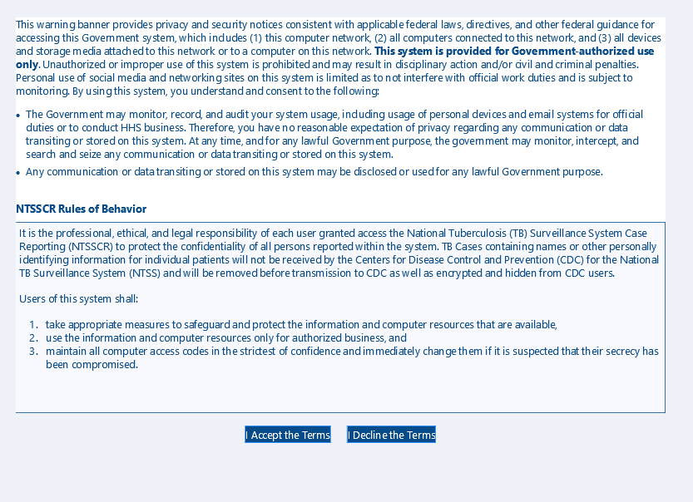

Slide 3
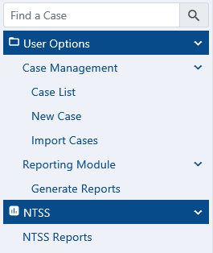
Welcome to NTSSCR

Slide 4
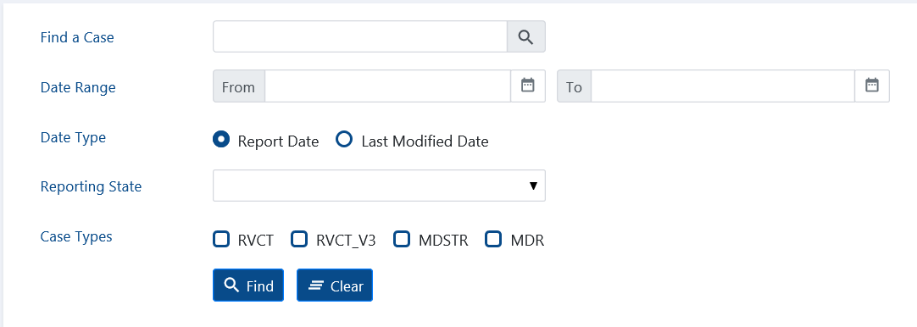
Case List

Slide 5
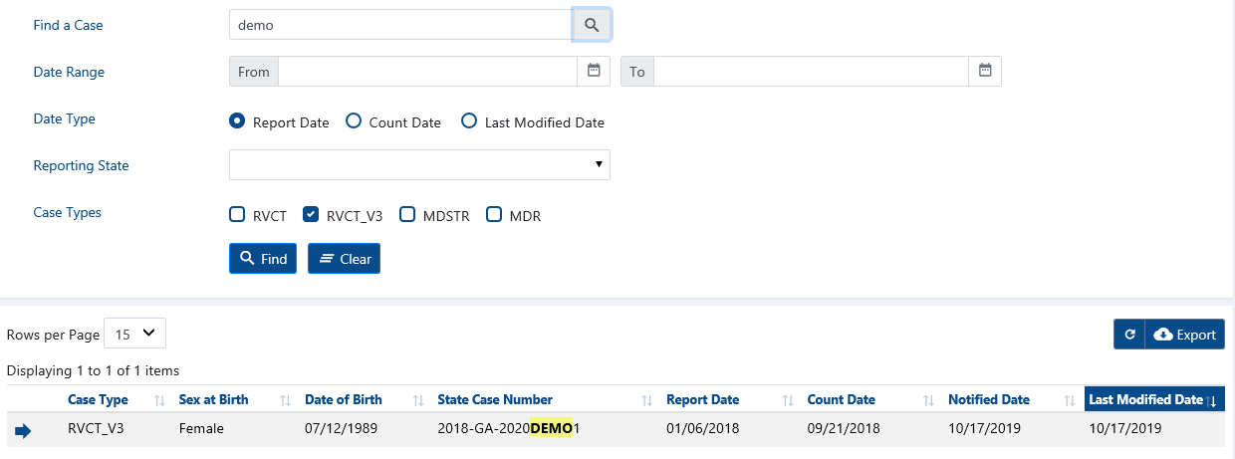
Search

Slide 6
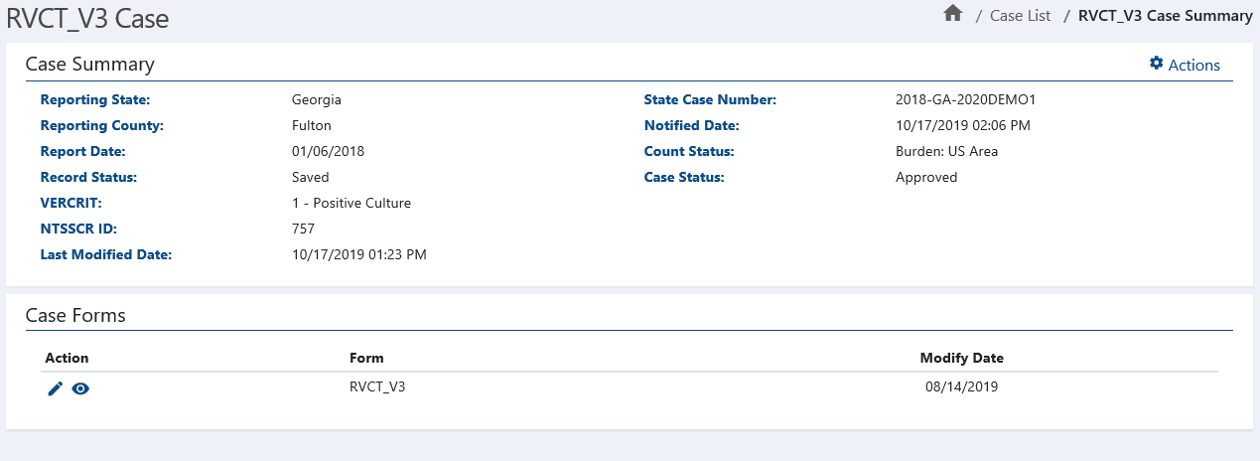
View
Edit

Slide 7
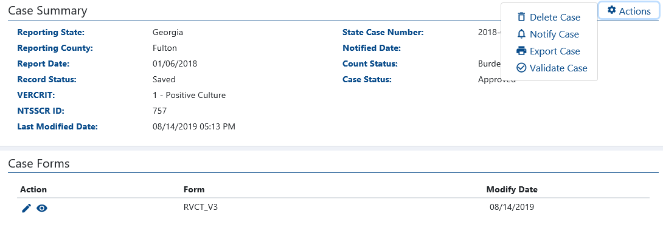
Actions
View
Edit

Slide 8
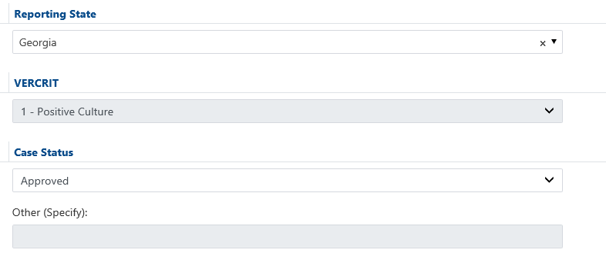
Georgia 2018-GA-2020DEMO1
Tabbed Sections

Slide 9
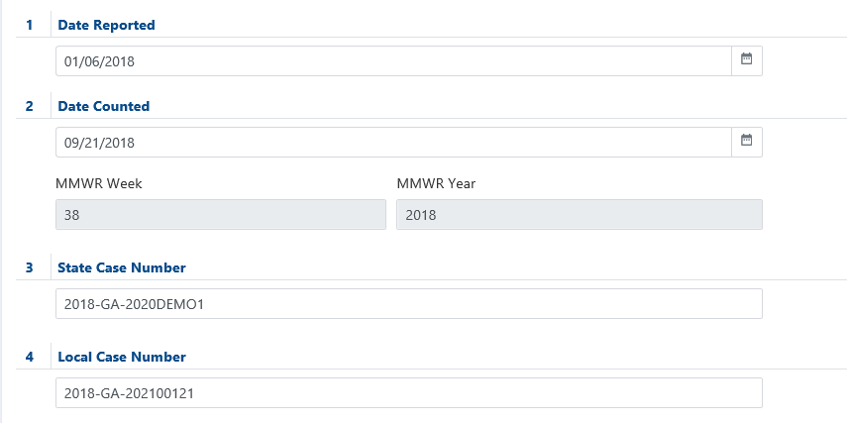

Slide 10
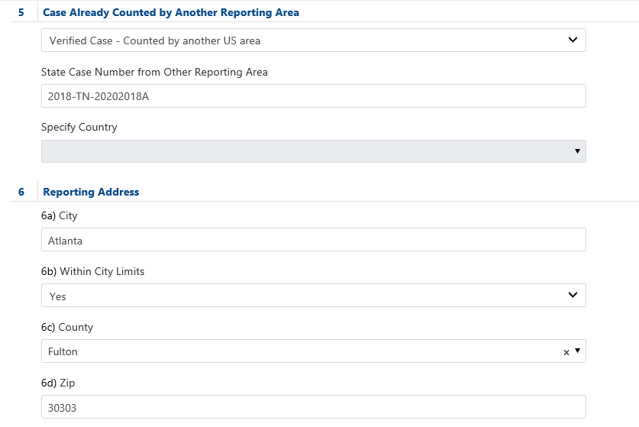

Slide 11
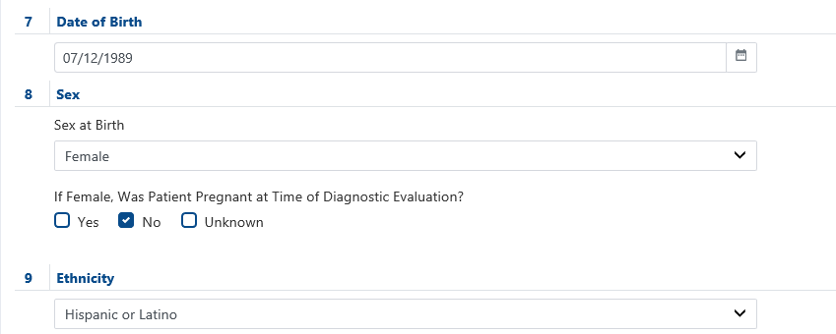

Slide 12
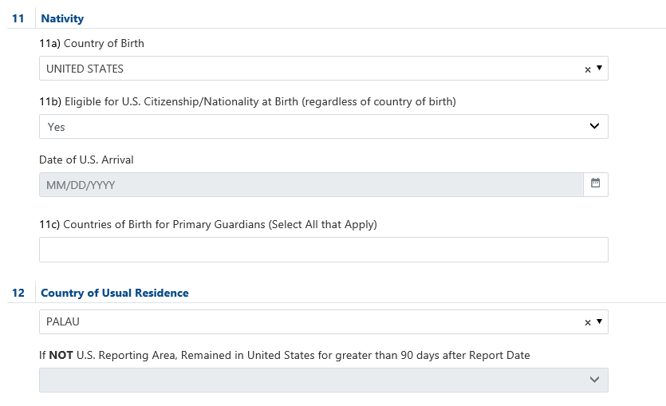

Slide 13
REMOVE word “Usual”
Make CURRENT Occupation / Industry Group MULTI-enter
REMOVE
REMOVE
THIS QUESTION IS CHANGING SLIGHTLY

Slide 14
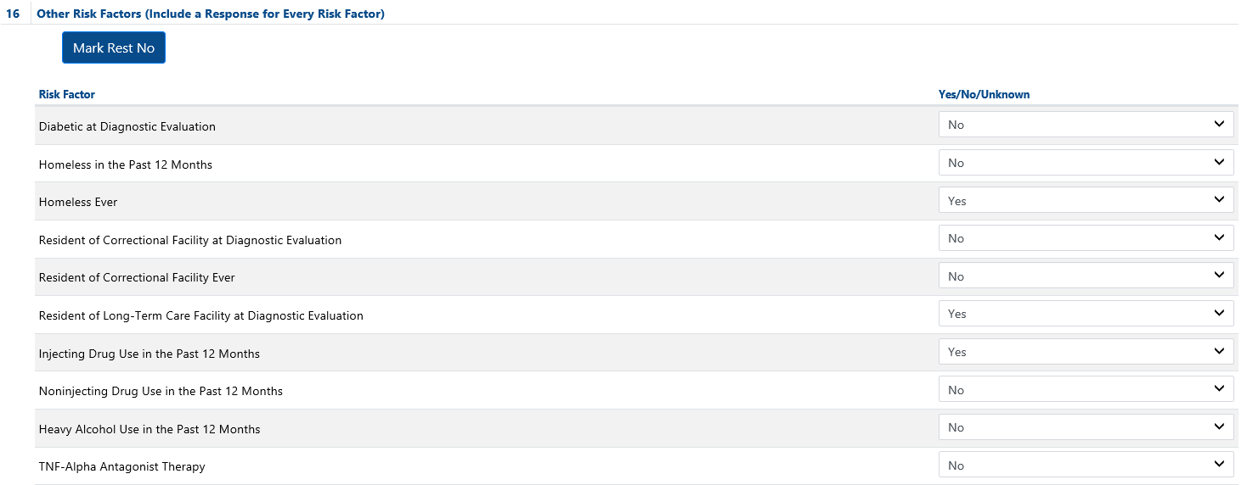
Easy Button – mark the YES items below then press button to mark the rest as No – will change to a clear the No items when used

Slide 15
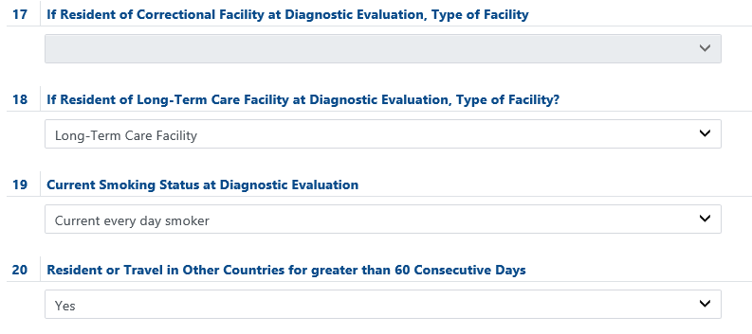
THIS QUESTION IS CHANGING SLIGHTLY

Slide 18
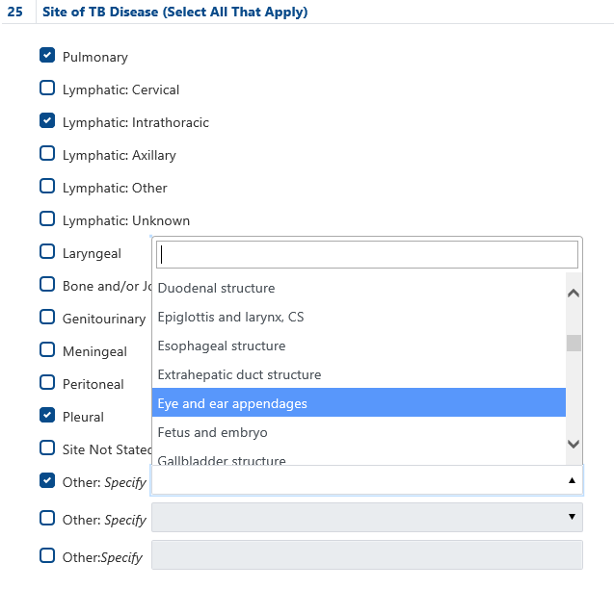

Slide 19
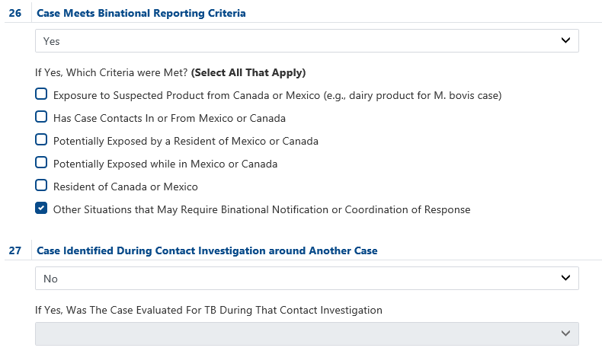
Considering adding a specify dropdown to enter TB specific criteria for binational and send as specify in message

Slide 20
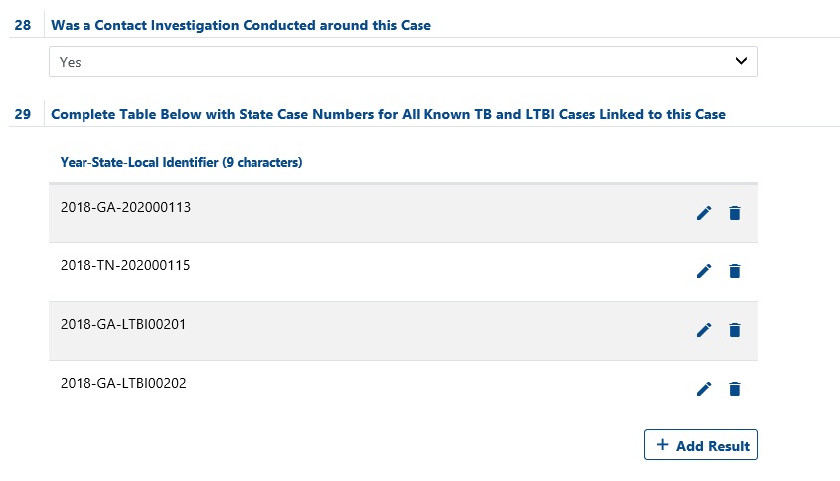

Slide 21
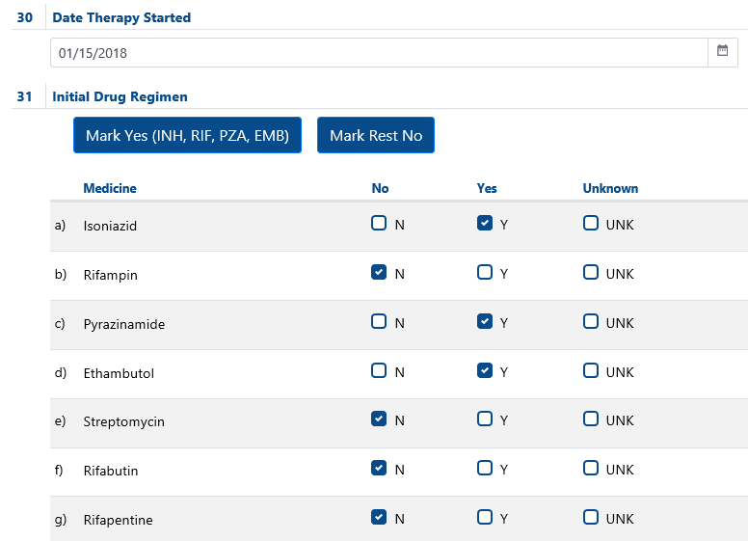
Easy buttons to mark all RIPE drugs as Yes and another button to mark drugs not selected as Yes/Unknown as No (this does not include Other – which is not a required to send drug)
Still need to add Pretomanid – awaiting coding by vocab team and addition to value set

Slide 22
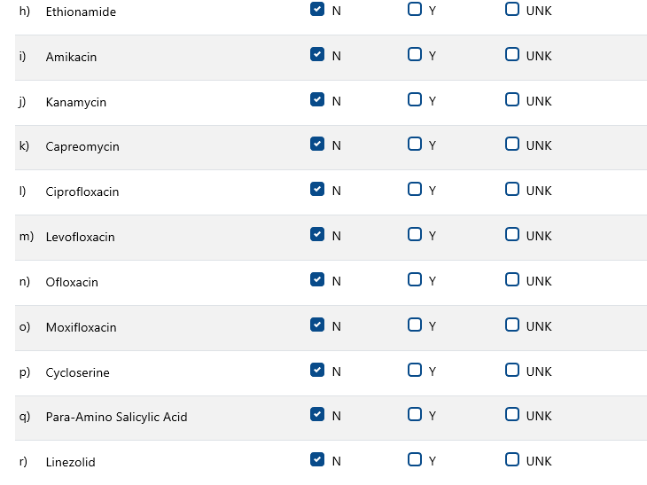

Slide 23
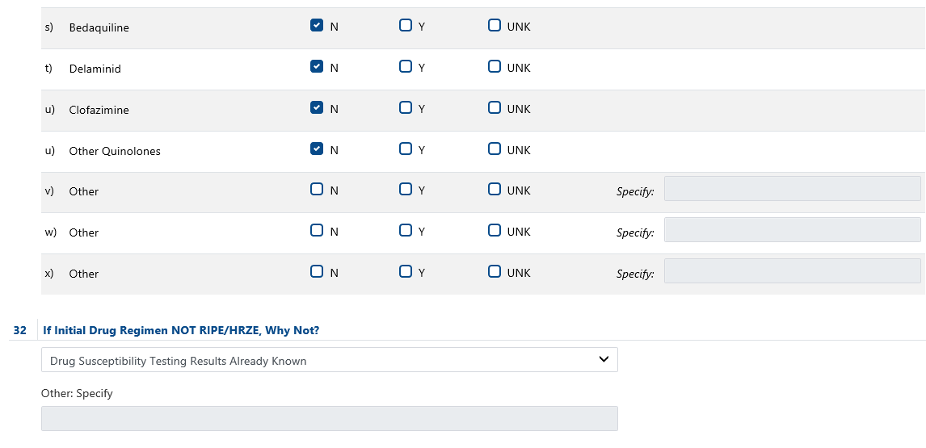

Slide 24
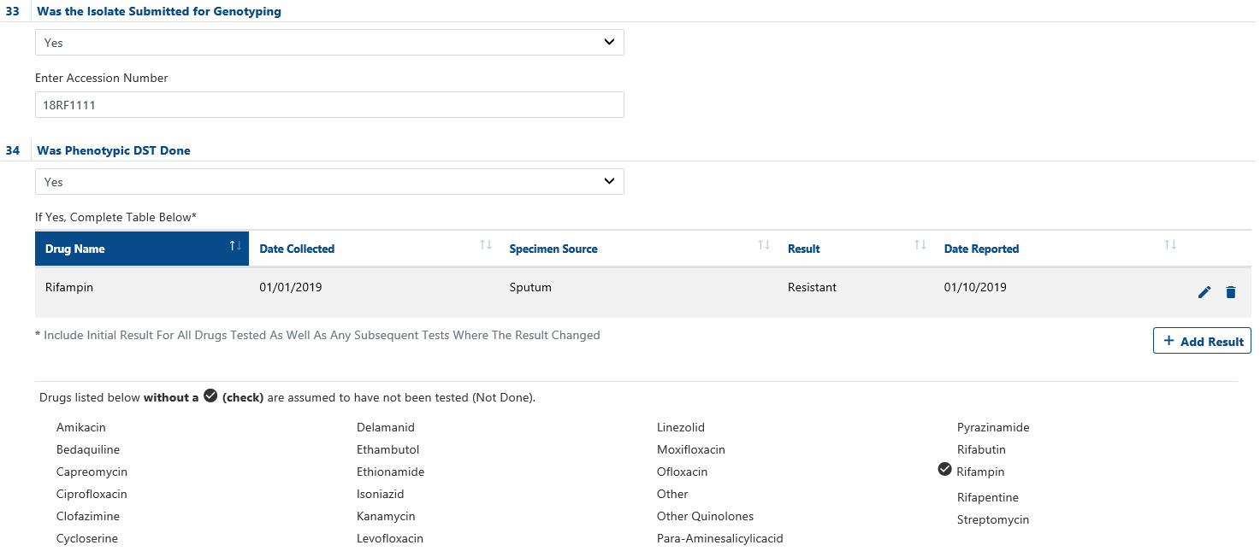
Above table will contain results and this section will check drugs that have results entered to indicate the ones that will be sent as NOT DONE in message
Still need to add Pretomanid – awaiting coding by vocab team and addition to value set

Slide 26
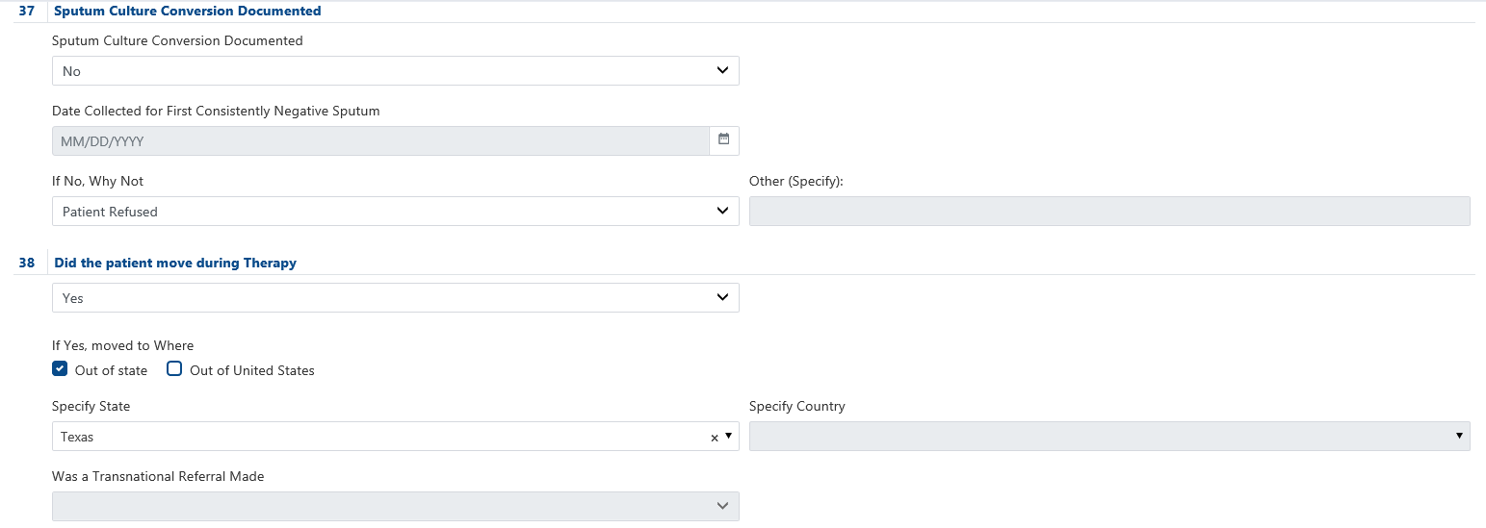

Slide 27
