Slide 1
CDC’s Advisory Committee on Immunization Practices: Art and Science
Nancy Messonnier, MD
Director, National Center for Immunization and Respiratory Diseases
Hilleman Lecture, Children’s Hospital of Philadelphia
September 28, 2016

Slide 2
Disclosure
I have no financial interests to disclose.
I will not be presenting on investigational products.

Slide 3
Comparison of 20th Century Annual Morbidity and Current Morbidity: Vaccine-Preventable Diseases
Disease | 20th Century Annual Morbidity† | 2015 Reported Cases † † | Percent Decrease
Smallpox | 29,005 | 0 | 100%
Diphtheria | 21,053 | 0 | 100%
Measles | 530,217 | 189 | > 99%
Mumps | 162,344 | 1,057 | 99%
Pertussis | 200,752 | 18,166 | 91%
Polio (paralytic) | 16,316 | 0 | 100%
Rubella | 47,745 | 5 | > 99%
Congenital Rubella Syndrome | 152 | 1 | 99%
Tetanus | 580 | 25 | 96%
Haemophilus influenzae | 20,000 | 23* | > 99%
† JAMA. 2007;298(18):2155-2163
† † CDC. MMWR January 8, 2016/ 64(52);ND-923 – ND-940. (MMWR 2015 week 52 provisional data)
* Haemophilus influenzae type b (Hib) < 5 years of age. An additional 10 cases of Hib are estimated to have occurred among the 211 reports of Hi (< 5 years of age) with unknown serotype.

Slide 4
Vaccine Coverage among Children 19-35 Months, National Immunization Survey, United States, 1994-2014
4+ PCV
2+ HepA

Slide 5
Number of Diseases Prevented by Vaccines Included in the Routine Child/Adolescent Immunization Schedule
2016 (16)
Polio
Diphtheria
Pertussis
Tetanus
Measles
Rubella
Mumps
Hib (infant)
HepB
Varicella
1995 (10)
Polio
Diphtheria
Pertussis
Tetanus
Measles
Rubella
Mumps
1985 (7)
Smallpox
Polio
Diphtheria
Pertussis
Tetanus
Measles
1964 (6)
Polio
Diphtheria
Pertussis
Tetanus
Measles
Rubella
Mumps
Hib (infant)
Polio
Diphtheria
Pertussis
Tetanus
Measles
Rubella
Mumps
Hib (infant)
HepB
HepA
Varicella
Pneumococcal
Influenza
Meningococcal
Rotavirus
HPV
HepB
HepA
Varicella
Pneumococcal
Influenza
Meningococcal
Rotavirus
HPV

Slide 6
Costs for Vaccines for One Child
$1948
$370
$70
2015 represents minimum cost to vaccinate a child (birth through 18); exceptions are 1) no preservative pediatric influenza vaccine, and 2) HPV for males and females.
Federal contract prices as of February 1, 1990, September 27, 2000, and April 1, 2015.

Slide 7
Origins of the ACIP
Vaccination Assistance Act of 1962
Instructed Secretary HEW Anthony Celebrezze to develop advisory committee
ACIP was established in 1964
Chaired by the Surgeon General of US Public Health Service James Goddard
Role: to provide advice and guidance to Director, CDC and Office of the Secretary of the Department of Health and Human Services on most effective means to prevent vaccine-preventable diseases in the civilian population
Vaccines and related agents (e.g., antisera, immune globulins, antiviral agents)
FDA-licensed vaccines (and unlicensed vaccines if warranted)

Slide 8
Childhood Vaccine Licensure and Recommendations
Pharma submits to FDA for Biologics License Application (BLA)
ACIP
Advises
Vaccines and Related Biological Products Advisory Committee (VRBPAC)
FDA Licensure
Advises
CDC recommendations
PHS Act (Sec 351a), FD&C Act (PREA, FDASIA,..)
National Regulatory Agency, has enforcement authority
Licensure for interstate commerce
Label content restricted to stated intended use in studied population and supported by data from adequate and well-controlled studies provided by manufacturer.
Recommendation for use of licensed vaccines guided by label and other considerations

Slide 9
Data Reviewed by ACIP
Disease epidemiology
Vaccine efficacy and effectiveness
Safety
Economic reviews/cost-effectiveness
Program implementation
Recommendations of liaison organizations
Surveys (parents, HCW)
Public comments from previous meetings

Slide 10
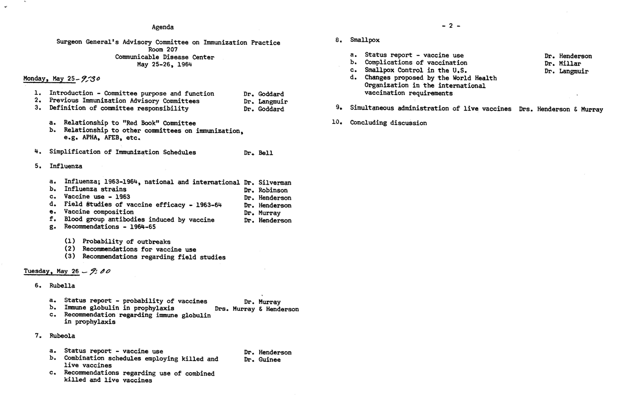
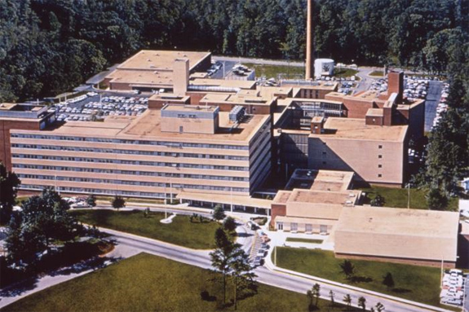
First Meeting of the ACIP – May 25-26, 1964
Communicable Disease Center, Clifton Rd, 1970

Slide 11
Vaccines for Children Program
Vaccines for Children (VFC) Program – established in August 1993, operational since October 1994
Federal entitlement program - current cost is ~$4 billion annually
Eligible children (0 through 18 years of age):
Medicaid eligible; uninsured; American Indian/Alaska native: underinsured
Currently, ~48% of young children in the US are entitled to VFC
During ACIP meetings members vote first on vaccine recommendation; then take a separate vote on whether to include the vaccine in VFC
Unique statutory authority established by Omnibus Budget Reconciliation Act of 1993 (42 U.S.C. § 1396a) gives ACIP authority to determine vaccines included in the VFC Program

Slide 12
Affordable Care Act
ACIP recommendations become policy following approval by CDC Director and MMWR publication
The Affordable Care Act (ACA) was enacted in 2010 and requires private insurance coverage for immunizations without copays/deductibles when provided by an in-network provider
Health plans have one plan year from MMWR publication to implement recommendations according to CDC Immunization schedules (graphics and footnotes)

Slide 13
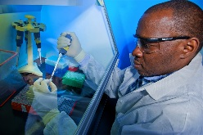
Expertise from Various Perspectives

Slide 14
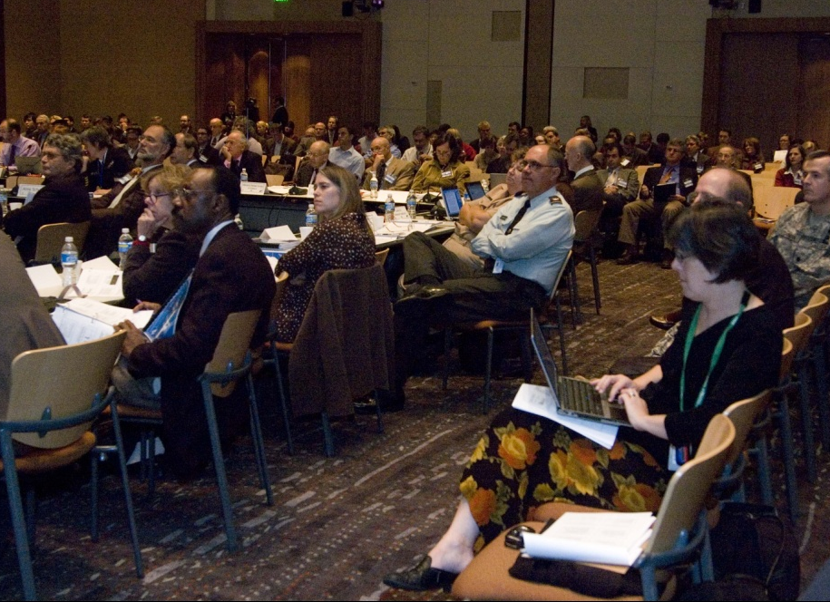
ACIP Meeting
www.cdc.gov/vaccines/acip

Slide 15
ACIP Working Groups – August 2016
Adult immunization
Child/adolescent immunization
General recommendations
Influenza
Human papillomavirus vaccines
Meningococcal vaccines
Pneumococcal vaccines
Herpes zoster vaccine
Japanese encephalitis / yellow fever vaccines
Hepatitis vaccines
RSV vaccine
Cholera vaccine
Pertussis vaccines

Slide 16
Case Study in the ACIP Process

Slide 17
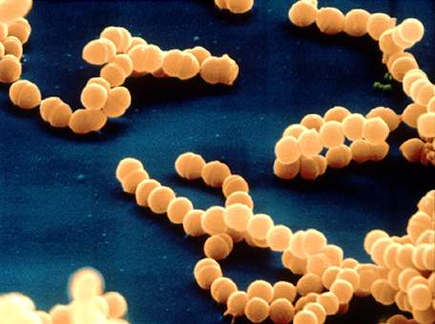
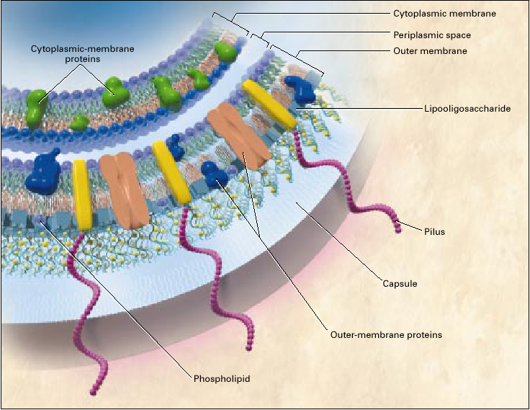
What is Meningococcal Disease?
Bacterial infection caused by Neisseria meningitidis
10-14% mortality; 11-19% sequelae
Most disease in the U.S. caused by serogroups B, C, Y
Quadrivalent conjugate vaccine recommended routinely for adolescents

Slide 18
Serogroup B outbreak, not vaccine-preventable, 10/2013

Slide 19
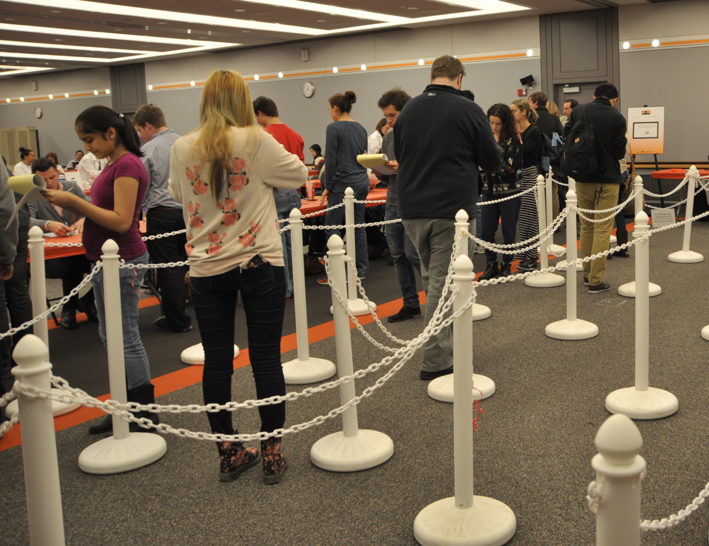
Vaccination Clinics (IND): December 2013 and February 2014

Slide 20
Two MenB Vaccines for Persons Aged 10-15 years in the US
Vaccine | Components | Schedule | Date of Licensure
MenB-FHbp (Trumenba®, Pfizer) | fHbp subfamily A/v2,3; subfamily B/v1 | 3 dose series, administered at 0, 2, 6 months | Licensed in the U.S. on October 29, 2014
MenB-4C (Bexsero®, Novartis/GSK) | fHbp subfamily B/v1, NhbA, NadA, Por A1.4 | 2 dose series, administered at 0 and ≥1 month | Licensed in the U.S. on January 23, 2015 Licensed in >37 countries for persons ≥2 months of age

Slide 21
Launch ACIP Process, Data to Review
Disease epidemiology
Vaccine efficacy and effectiveness
Safety
Economic reviews/cost-effectiveness
Program implementation
Recommendations of liaison organizations
Surveys (parents, HCW)
Public comments from previous meetings

Slide 22
Burden of Serogroup* B in Younger Age-Groups, 2005-2012
*NNDSS data with additional serogroup data from ABCs and state health departments.
Unknown serogroup (23%) and other serogroups (8%) excluded

Slide 23
Rates of Meningococcal Disease Decreased, 1993-2013
2013: 564 cases (0.18/100,000)³
¹Source: ABCs cases from 1993-2013 estimated to the U.S. population with 18% correction for under reporting
²National Immunization Survey – Teen; 2006-2013 ³NNDSSunt

Slide 24
Estimated Burden of Meningococcal Disease in Children and Adolescents During High and Low Incidence Years
 | Age Group | 1997-1999 “High Incidence Years”¹ | 2010-2012 “Low Incidence Years”²
Serogroups B | <5 years | 367 | 78-92
 | 11-24 years | 161 | 48-56
 | All ages | 767 | 197-237
Serogroups C & Y | <5 years | 335 | 39-46
 | 11-24 years | 370 | 63-74
 | All ages | 1,490 | 321-386
Average annual cases of meningococcal disease
¹NNDSS cases from 1997-1999 with serogroup proportion from 1997-1999 ABCs data applied
²Range in estimated cases: Low=NNDSS data with additional serogroup data from ABCs and state health departments (2010-2012), High= NNDSS data with additional serogroup information (2010-2012) + proportion serogroup B or serogroup C&Y applied to cases with unknown serogroup

Slide 25
How Many People Fall Into ‘High Risk’ Groups?
Group | Estimated persons aged ≥10 years | Reported cases
Persistent complement component deficiencies | Prevalence of 0.03% ~80,000 persons | 6 cases since 2005 in ABCs¹ (none serogroup B)
Anatomic or Functional Asplenia (including sickle cell) | Sickle cell ~90,000-100,000 (all ages)³ | 11 cases since 1995 in ABCs¹ (2 serogroup B)
Microbiologists | ~100,000 clinical; 400 research | 22 cases worldwide 1985-2014^{2,3} (at least 10 serogroup B)
Outbreak at-risk populations | 60,000 in 5 serogroup B university outbreaks | 32 cases combined 2009-2013⁴
Total | 300,000-350,000 persons
¹Active Bacterial Core surveillance (ABCs)
²Sejvar et al. Assessing the risk of laboratory acquired meningococcal disease. J Clin Microbiol 2005; 43:4811-4.
CDC. Laboratory-acquired meningococcal disease – United States, 2000. MMWR 2002;51:141-4.
³Borrow et al. Safe laboratory handling of Neisseria meningitidis. J of Infection 2014; 68:305-312.
⁴Reports to CDC, unpublished data

Slide 26
Data Reviewed
Disease epidemiology – low burden, high impact
Vaccine efficacy and effectiveness
Safety
Economic reviews/cost-effectiveness
Program implementation
Recommendations of liaison organizations
Surveys (parents, HCW)
Public comments from previous meetings

Slide 27
MenB Vaccine Effectiveness/Efficacy
Vaccine efficacy is estimated from serum bactericidal antibodies against a small number of serogroup B strains
Data for MenB-FHbp and MenB-4C are not directly comparable
Immunogenicity suggests short term efficacy
Evidence of waning antibody levels
Genetic and antigen expression data predict the MenB vaccines should cover a wide range of circulating strains in the United States – but not all

Slide 28
Data Reviewed
Disease epidemiology – low burden, high impact
Vaccine efficacy and effectiveness – short term, waning immunity
Safety – no concerns
Economic reviews/cost-effectiveness
Program implementation
Recommendations of liaison organizations
Surveys (parents, HCW)
Public comments from previous meetings

Slide 29
Cost-Effectiveness Analysis
Monte Carlo simulation analysis
Hypothetical 4 million birth cohort, 2.8 million college cohort
Time frame: 15 year
Analytic Horizon: Age-specific Life Expectancy
Discount rate: 3% (0%-5%)
Cost of vaccination per series (2 or 3 doses)
$402 (cost of vaccine + adm + AE + wastage)
*Courtesy of Ismael Ortega-Sanchez

Slide 30
Potential Cases and Deaths Prevented per 4M Cohort
 | Cases Prevented | Deaths Prevented | NNV* to prevent case | NNV to prevent death | Cost ($) per QALY
Series at 11 years | 15 | 2 | 203,000 | 1,512,000 | $8.700.000
Series at 16 years | 28 | 5 | 107,000 | 788,000 | $4,100,000
Series at 18 years | 29 | 5 | 102,000 | 638,000 | $3,700,000
College students | 9 | 1 | 368,000 | 2,297,000 | $9,400,000
*Number needed to vaccinate; Source: Ismael Ortega-Sanchez

Slide 31
Estimated Economic Comparison of Adolescent Vaccines
Vaccine | Target Group | Cost per QALY gained (compared to no vacc)
Hepatitis B | College freshmen | ~$0-$10,000
Hepatitis A | College freshmen | ~$0-$15,000
HPV | 12 yo females | ~$3,000-$45,000
TDaP | 11yo | ~$21,000
Influenza | 12-17 yo | ~$128,000
Mening A/C/Y/W | 2 doses, 11&16yo | ~$143,000-$200,000
Mening B | 2 or 3 doses, 16yo | ~$4,000,000
Mening B | 2 or 3 doses, college freshmen | ~$9,400,000
Sources: Ortega-Sanchez et al. Pediatrics 2008 Jan;121 Suppl 1:S63-78
Cohn et al., MMWR, 2013 Mar 22;62(RR-2):1-28.)
Simon et al. J Acquir Immune Defic Syndr. 2016 Feb 1;71(2):146-54.
Cho et al. Vaccine 2013 Dec 5; 31 (50): 6011-6021
Ortega-Sanchez, unpublished data

Slide 32
Programmatic Considerations
MenB multi-dose schedules make implementation challenging
No platform for 2–3 dose vaccine series in late adolescence
Current MenACWY vaccine program in adolescents at 11–12 years, with a booster dose at 16 years
Communications challenge of differing recommendations for MenACWY and MenB vaccines

Slide 33
Data Reviewed
Disease epidemiology – low burden, high impact
Vaccine efficacy and effectiveness – short term, waning immunity
Safety – no concerns
Economic reviews/cost-effectiveness – high cost per case prevented
Program implementation – some challenges
Recommendations of liaison organizations
Surveys (parents, HCW)
Public comments from previous meetings
Provider Engagement and Public Engagement

Slide 34
What do Doctors Think of Meningococcal Vaccines for Adolescents?
They usually follow the recommendations from CDC and their membership organizations
Adding more shots to the schedule or having to change vaccine products would lower how strongly providers would recommend the vaccine
Allison, M, Cohn, A;, Stokely, S et al. Timing of Adolescent Meningococcal Conjugate Vaccination:
Attitudes and Practices of Primary Care Physicians. Pediatric Academic Society Meeting, Denver, 2011

Slide 35
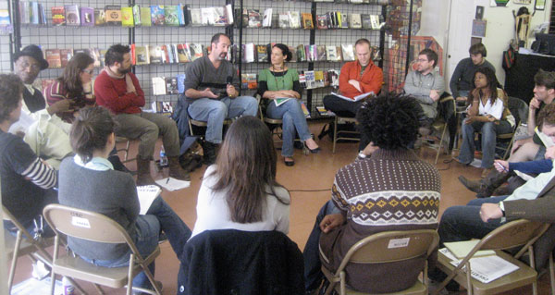
Public Engagement
Parent and Community Acceptability
How does the public feel about adding meningococcal vaccines to the immunization schedule? Is it worth the public health impact?

Slide 36
Breaking the U.S. Numbers Down
U.S. population
~320 million
Number of people who get meningococcal disease each year
Number of serogroup B meningococcal disease cases in adolescents ages 16-23 years each year
Number of adolescents ages 16-23 years for whom MenB vaccines could potentially prevent disease
~500
~50
~30

Slide 37
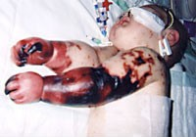
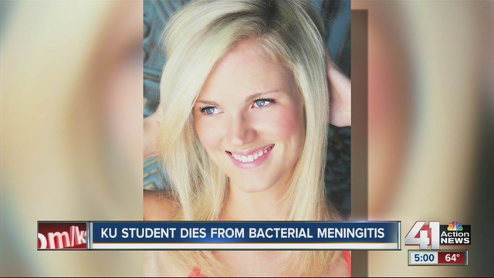
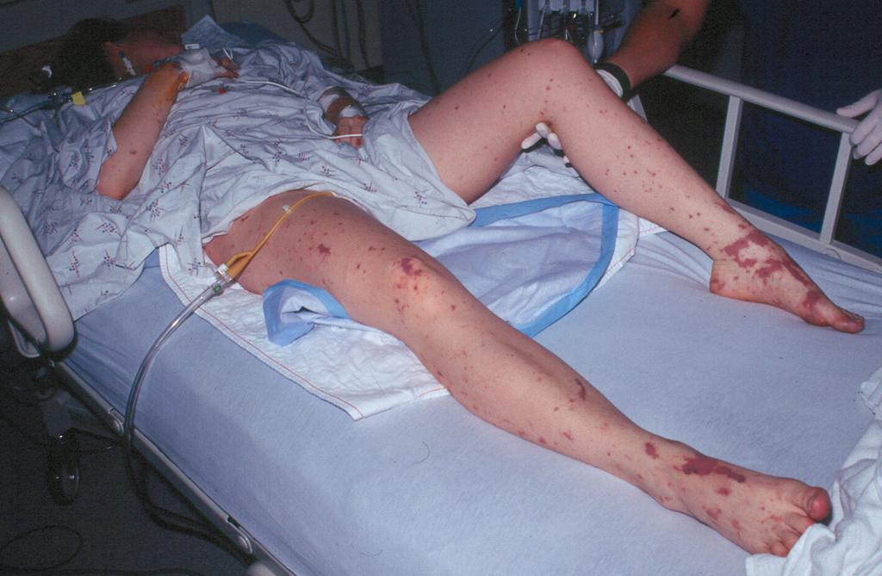
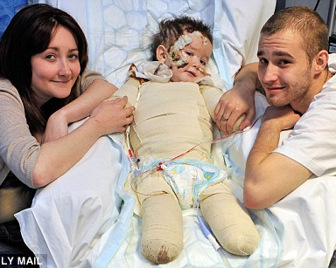
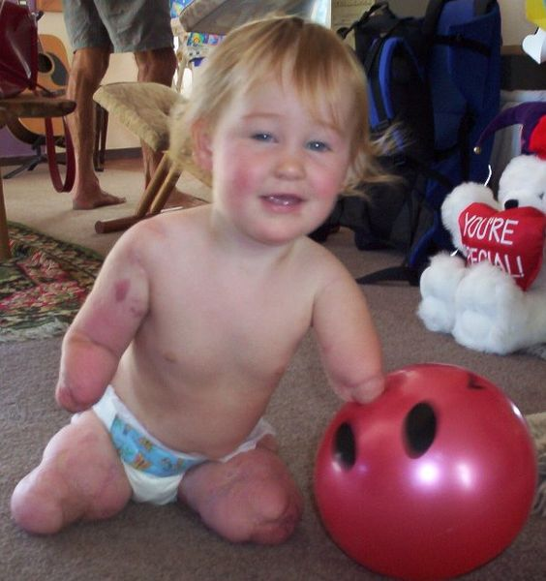
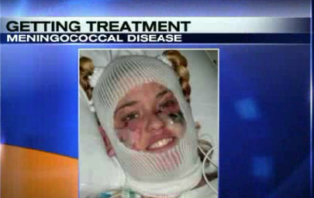
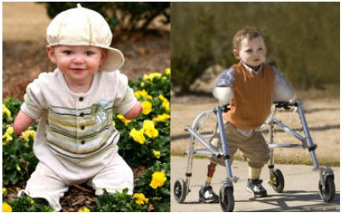
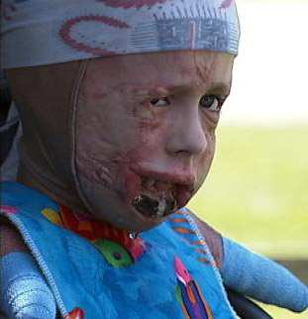
Photo Credits:
Top Left: Photo by D. Scott Smith, MD, taken at Stanford University Hospital; Bottom Left: Courtesy of The Stir;

Slide 38
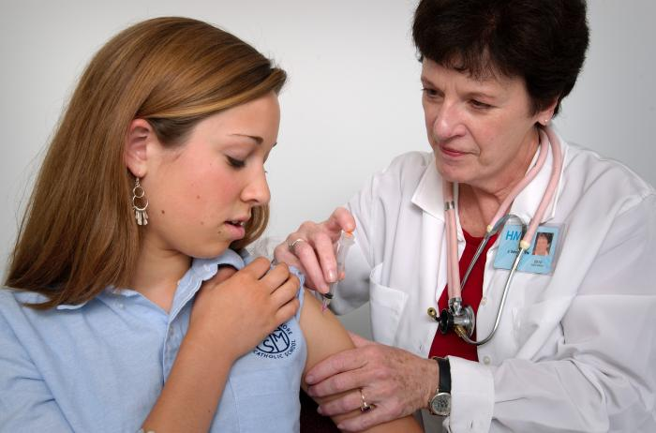
VS.
Photo Credit: Photo by D. Scott Smith, MD, taken at Stanford University Hospital.
Source: http://emedicine.medscape.com/article/221473-overview

Slide 39
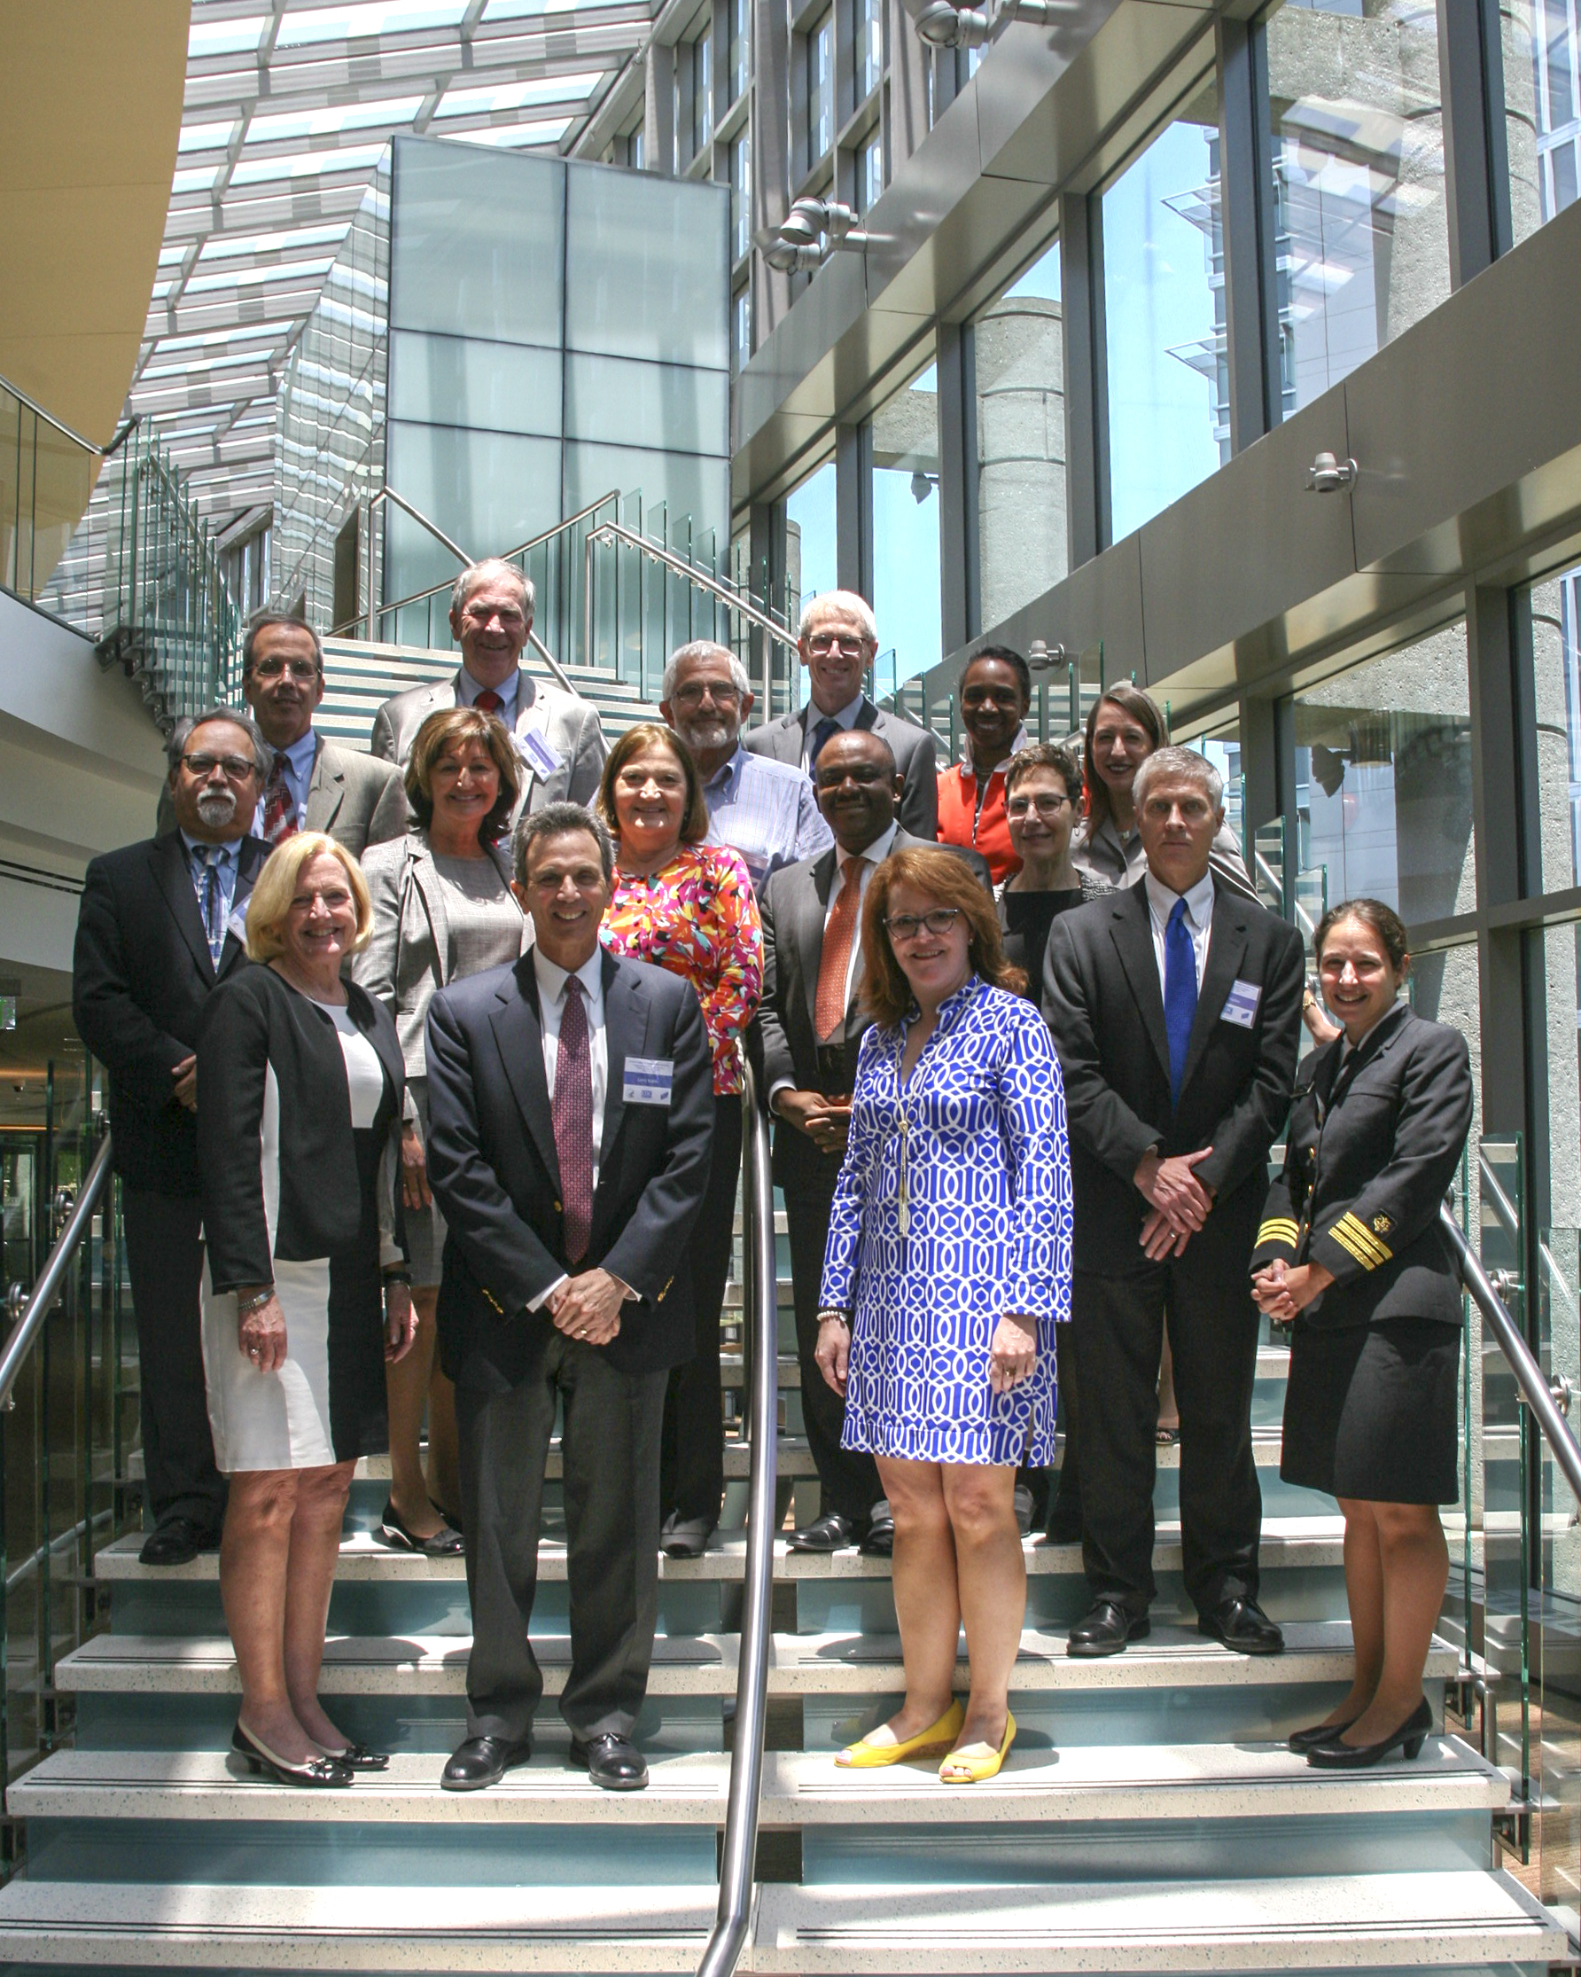
ACIP Voting Members, June 2016

Slide 40
Options for ACIP Recommendations for Serogroup B Meningococcal Vaccines
Recommend meningococcal serogroup B vaccines routinely for all adolescents
Permissive recommendation (no routine schedule)
Recommend against
Say nothing

Slide 41
Options for ACIP Recommendations for Serogroup B Meningococcal Vaccines
Recommend meningococcal serogroup B vaccines routinely for all adolescents
Permissive recommendation (no routine schedule)
Recommend against
Say nothing

Slide 42
Implications of Permissive Recommendations
Licensed vaccine is safe and effective (FDA approved)
Multiple issues to tackle during primary care visits make it difficult to regularly educate parents to make a decision about vaccination
Less effort from CDC or health departments to have a vaccination program or educate about vaccine
Manufacturers may advertise to increase sales or may choose not to produce the vaccine
Insurance coverage concerns

Slide 43
ACIP Deliberations: A Difficult Balance
Desire to prevent disease and death
Availability of a safe and effective vaccine that would prevent disease
Thoughtful approach to adding vaccines includes thinking about:
Impact of additional shot and need for additional visit
Rare adverse events in setting of low disease occurrence
Long-term implications of adding a vaccine with potentially limited impact

Slide 44
ACIP Final Language – June 2016
A serogroup B meningococcal (MenB) vaccine series may be administered to adolescents and young adults 16 through 23 years of age to provide short term protection against most strains of serogroup B meningococcal disease. The preferred age for MenB vaccination is 16 through 18 years of age.

Slide 45
ACIP Decisions at the June 2016 Meeting
Cholera vaccine (CVD 103-HgR, Vaxchora™) is recommended for adult (18-64 years old) travelers to an area of active cholera transmission.
Influenza vaccine: In light of concern regarding poor effectiveness against influenza A(H1N1)pdm09 in the U.S. during the 2013-14 and 2015-16 seasons, for the 2016-17 season, ACIP makes the interim recommendation that live attenuated influenza vaccine (LAIV4) should not be used.*
Meningococcal vaccine: Persons aged ≥2 years with HIV infection who have not been previously vaccinated should receive a 2-dose primary series of MenACWY (0, 2 months). Children 2 months through ≤2 years with HIV infection should receive an age appropriate series of MenACWY.
If approved by the CDC Director, the recommendations will become official once published in MMWR.
*Influenza vaccine recommendations published in August 25, 2016 MMWR.

Slide 46
Complicated ACIP Issues on the Horizon
Diseases with low burden and high mortality
Preferential vaccination
Diseases with multiple vaccines
Dropping a dose (risk/benefit)
Maternal vaccination
Vaccines against diseases that are primarily healthcare associated

Slide 47
Thank you

