Slide 1
Developing, Updating and Assessing State Injury Prevention Plans
Angie Deokar, MPH, & Lauren Wilson, PhD: CDC DARPI
Jennifer Martin, MSW, & Nicholas Brady: Illinois Department of Public Health
Sally Thigpen, Discussant: CDC DARPI
SVIPP Awardee Meeting
February 23rd, 2017

Slide 2
Session Goals
Give an Overview and Purpose for State Plans
Introduce a New Tool
Provide Illinois’ Experience and Process
Discuss and Share Awardees’ Experiences and Questions

Slide 3
The Purpose of Strategic State Plans
Creating plans that are helpful in overcoming challenges

Slide 4
State Plans
Think about your experience with state plans, and your vision for what would make a plan successful. Think about all of the ways a good state plan could help you advance injury and violence prevention in your state. Think about some of the things that make state plans unhelpful.
What are the things that make state plans beneficial? What are barriers and challenges have you experienced with state plans?
Notes:
Barriers/challenges with the planning process through implementation?
If a larger group, turn to the person next to you.

Slide 5
State Plans: Development – Implementation:
Beneficial
Barriers/Challenges
Notes:
Beneficial = engaged partners, vision for where to go, priorities, diverse input
Barriers/Challenges= sits on a shelf and isn’t used, no “buy in” from partners,

Slide 8
Why Have State Plans?
A necessary component for functioning programmatic infrastructure
Identify goals and priorities – A road map for where you want to go
Shared ownership and shared responsibility through collaboration
Incorporate diverse viewpoints
Leverage efforts and prepare for the future
Lavinghouze SR, Snyder K, Rieker PP. The Component Model of Infrastructure: A Practical Approach to Understanding Public Health Program Infrastructure. American journal of public health. 2014;104(8):e14-e24. doi:10.2105/AJPH.2014.302033
IOM (Institute of Medicine). 2012. Living well with chronic illness: A call for public health action. Washington, DC: The National Academies Press.

Slide 9
Overcoming Challenges: Planning to Action
How do you want the plan to be used and implemented?
Do you need workgroups or implementation plans to carry out the goals/activities of the plan?
How will your plan be responsive to contextual influences?
Responsive states plans that are dynamic and evolve in response to contextual influences, such as changes in scientific evidence, priorities, funding levels, and external support are a necessary component for functioning programmatic infrastructure. (Lavinghouze, 2014).

Slide 10
Guidance Tool for Injury/Violence Planning
The Violence and Injury Planning: Comprehensive Index Tool

Slide 11
How are quality strategic plans created?
The content to include is broad and covers multiple themes of public health.
Intervention planning and implementation is by nature flexible, adaptive, and ever-changing (and difficult to crystalize in a plan).
Each state is different, with different strengths and advantages, different challenges. One technique won’t fit all.
Where guidance does exist, there is no feedback to indicate if planning is “on track.”

Slide 12
There is a need for a tool that is…
Comprehensive, including all relevant areas of public health
Integration with research, collaboration with stakeholders, representation of subpopulations, juggling implementation process, resource planning, evaluation…
Is flexible so that each state’s strengths and challenges can be reflected
Provides feedback to allow planners to address challenges and share strengths

Slide 13
Tool Development
We developed the Violence and Injury Prevention: Comprehensive Index Tool (VIP:CIT) to help fill this need.
Our process:
Subject Matter Experts created an early draft based on work in other public health areas
Raters tested the tool using 3 plans from Core VIPP
Revisions were made based on the rating process, feedback from additional experts, and feedback from 2 states updating their plans
The 3 plans were re-rated and tool was revised
We are seeking broad Core SVIPP feedback

Slide 14
The VIP:CIT
Current draft is still “rough,” and it will likely always be an iterative process. The tool so far includes:
12 sections representing different strategic planning themes
Items within each section representing the plan content
A 5-point scale to score each item
A scoring rubric to help detail each item’s score
Notes: The rubric is meant as a guide, in some situations it is appropriate to score an item on the “spirit” rather than the “letter” of the rubric.
It is infeasible to score 100% on the tool. It is meant to be shaped to individual strengths; a 100% plan would be too complex.

Slide 15
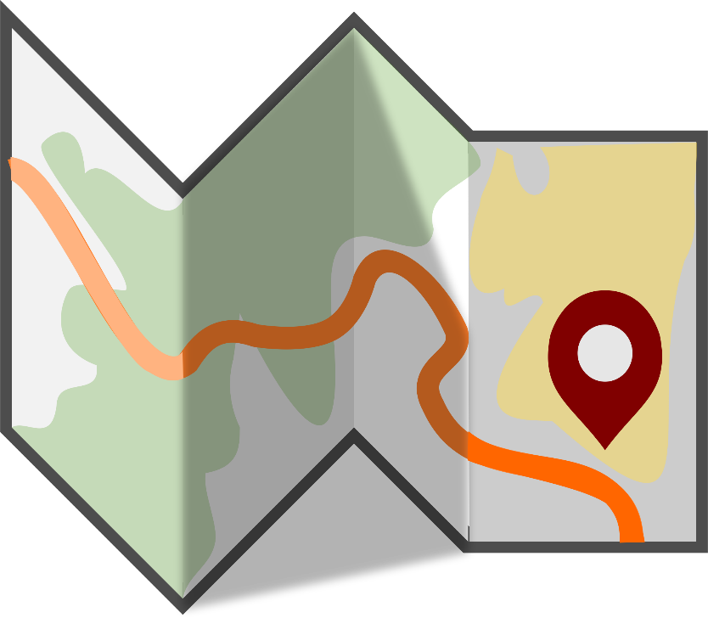
The VIP:CIT
Let’s walk through the most recent draft together….

Slide 16
How might the VIP:CIT be used?
Feedback on plan quality
Standardizing communication (with stakeholders, with other states, with us)
A guide for including comprehensive content within a plan
A way to understand unique strengths and challenges
A way to see progress on challenges (or changes in strengths) from one plan iteration to another

Slide 17
The Illinois Experience
How Illinois has approached strategic planning for Core SVIPP
Notes:
Included in here is: Illinois’ use of the VIP:CIT for Updating Plans

Slide 18
The Illinois Experience
Jennifer L. Martin, MSW
Injury and Violence Prevention (IPV) Project Manager
Special appreciation to Nick Brady, IVP Graduate Intern
February 23, 2017

Slide 19
Illinois’ planning process
Where do we begin?
Reflected on previous strategic planning efforts and current environment
Learned from other states at different stages of their planning
Consulted with CDC on what should be included in a strategic plan
Established consensus internally about the plan’s intent , intended audience and focus
Developed a timeline to outline the process
Engaged stakeholders

Slide 20
Applying the assessment tool to Illinois’ efforts
Why the assessment tool was beneficial?
Provided direction during the early phases
Outlined components to include in the plan
Identified tasks staff should work on parallel to the development of goals and objectives
Helped identify items we should track during the process

Slide 21
Moving forward
Looking ahead
Establishing a one-year timeline
Building resources to support the process
Working collaboratively and across systems to prevent duplication
Raising awareness of injury prevention
Building common language and similar prevention messages

Slide 22
Discussion

Slide 23
Discussion Questions: Strategic Planning in Core SVIPP
What obstacles and challenges are there?
What resources do you use?
How can we all work together to improve the VIP:CIT to meet your needs?
What type of resources did your program utilize during the planning process?
How do you see strategic plans being utilized by local communities if at all and how they would make the plan usable and accessible to communities.

