Slide 1
MAKING VIOLENCE PREVENTION URGENT
James A. Mercy, PhD
Division of Violence Prevention
National Center for Injury Prevention and Control
Centers for Disease Control and Prevention
Notes:
1
1
1
1
1
1

Slide 2
National Survey of Children’s Exposure to Violence, 2013-14
Child maltreatment
1 of 7 or 11.2 million children (past year)
Assault/Bullying/Teen Dating Violence
2 of 5 or 27.5 million children (past year)
Sexual victimization
1 of 20 or 3.7 million children (past year)
Witness violence
1 of 4 or 18.3 million children (past year)
Finkelhor, D., Turner, H. A., Shattuck, A., & Hamby, S. L. (2015). Prevalence of childhood
exposure to violence, crime, and abuse: Results from the National Survey of Children’s
Exposure to Violence. JAMA Pediatrics: do1:10.1001/jamapediatrics.2015.0676.

Slide 3
Violence Against Children/Youth Is Costly and Destructive
HIV/AIDS
Head Injury
Stroke
Cancer
Injury
Non-Communicable
Disease
Fractures
Internal Injury
Heart
Disease
Chronic Lung
Disease
Burns
Diabetes
Obesity
Depression and Anxiety
Violence
Alcohol
PTSD
Physical
Inactivity
Mental Health
Problems
Smoking
Suicide
Assault
Alcohol
And Drugs
Fetal
Death
Unsafe
Sexual Practices
STDs
Unintended
and Adolescent
Pregnancy
Multiple Partners
Pregnancy
Complications
Maternal and
Child Health
HIV
Communicable Disease
and Risk Behaviors

Slide 4
Adverse Childhood Experiences and Life Potential
Adjusted Odds Ratio
Source: Metzler et. al, Adverse Childhood Experiences & Life Opportunities: Time to Shift the Narrative. Children and Youth Services Review (forthcoming 2016).

Slide 5
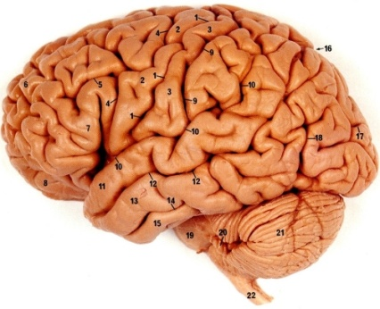
Violence Damages the Body Via Impact on the Brain
Toxic
Stress
Violence
Against Children/
Youth
Mental and Physical Health and Cognitive
Development
Risk
Behaviors
And Conditions
Premature Aging
Infancy
Adulthood

Slide 6
Research Evidence
Act on the Best Available Evidence
Experiential Evidence
Contextual Evidence

Slide 7
Packages of the Best Available Evidence
Child Abuse and Neglect:
https://www.cdc.gov/violenceprevention/pdf/can-prevention-technical-package.pdf
Sexual Violence:
https://www.cdc.gov/violenceprevention/pdf/sv-prevention-technical-package.pdf
Youth Violence:
https://www.cdc.gov/violenceprevention/pdf/yv-technicalpackage.pdf

Slide 8
Child Abuse and Neglect: Best Available Evidence
Strategy | Approach
Strengthen economic supports to families | Strengthen household financial security Family friendly work policies
Change social norms to support parents and positive parenting | Public engagement and education campaigns Legislative approaches to reduce corporal punishment
Provide quality care and education early in life | Preschool enrichment with family engagement Improved child care through licensing/accreditation
Enhance parenting skills to promote healthy child development | Early childhood home visitation Parenting skill and family relationship approaches
Intervene to lessen harms and prevent future risk | Enhanced primary care Behavioral parent training programs Treatment to lessen harms of abuse/neglect exposure Treatment to prevent sexual offending

Slide 9
Build Capacity and Infrastructure Needed to Scale Up Violence Prevention

Slide 10
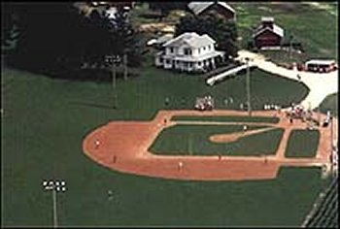
Implementing Evidence-Based Practice (EBP) - THE DREAM
IF YOU BUILD IT……….
THEY WILL COME
Source: Mark Chaffin

Slide 11
Implementing EBP—THE REALITY
IF YOU BUILD IT……….
THEY WON’T KNOW
Source: Mark Chaffin

Slide 12
Implementing EBP—THE REALITY
IF YOU BUILD IT……….
THEY WON’T CARE
Source: Mark Chaffin

Slide 13
Implementing EBP—THE REALITY
IF YOU BUILD IT……….
THEY MAY LIKE THE ONE THEY BUILT BETTER (even if it doesn’t work)
Source: Mark Chaffin

Slide 14
Implementing EBP—THE REALITY
IF YOU BUILD IT……….
THEY WILL TRY TO COME, BUT THE MAP YOU SENT WASN’T WRITTEN IN THEIR LANGUAGE
Source: Mark Chaffin

Slide 15
Implementing EBP—THE REALITY
IF YOU BUILD IT……….
THEY MAY WANT TO COME, BUT DON’T HAVE THE TIME
Source: Mark Chaffin

Slide 16
Implementing EBP—THE REALITY
IF YOU BUILD IT……….
THEY MAY WANT TO COME, BUT CAN’T AFFORD ADMISSION
Source: Mark Chaffin

Slide 17
Moving from Innovation to Action
Creating a Workforce
Synthesis and Translation: Making Violence Prevention Innovations Broadly and Easily Accessible
Prevention Support: Successful Implementation Requires Training, Monitoring, Technical Assistance, and Coaching
Prevention Delivery: Creating Organizations that can Carry Out and Sustain Effective Programs, Policies, and Practices

Slide 18
Communicate that Violence Prevention is Strategic

Slide 19
Violence Against Children/Youth Is Costly and Destructive
HIV/AIDS
Head Injury
Stroke
Cancer
Injury
Non-Communicable
Disease
Fractures
Internal Injury
Heart
Disease
Chronic Lung
Disease
Burns
Diabetes
Obesity
Depression and Anxiety
Violence
Alcohol
PTSD
Physical
Inactivity
Mental Health
Problems
Smoking
Suicide
Assault
Alcohol
And Drugs
Fetal
Death
Unsafe
Sexual Practices
STDs
Unintended
and Adolescent
Pregnancy
Multiple Partners
Pregnancy
Complications
Maternal and
Child Health
HIV
Communicable Disease
and Risk Behaviors

Slide 20
Data from the UK Shows Preventing VAC Could Reduce Risk Behaviors
Bellis MA, Hughes K, Leckenby N, Perkins C, Lowey H, National household survey of adverse childhood
experiences & their relationship with resilience to health-harming behaviors in England. BMC Medecine 2014, 12:72
Center for Public Health, Liverpool John Moores University
WHO Collaborating Centre for Violence Prevention, May 2014

Slide 21
The Strategic Importance of Preventing Violence
Big Public Health and Social Problem
Influences many different health and social outcomes
Human and Economic costs are substantial
Viable Prevention Programs and Policies Exist
Scientifically Grounded
Politically Feasible

Slide 22
“One of the most powerful ways to change the world is to make it better for kids.” Jack P. Shonkoff National Scientific Council for the Developing Child

Slide 23
For more information
Visit CDC’s National Center for
Injury Prevention and Control web site:
www.cdc.gov/ncipc

Slide 24
Disclaimer
The findings and conclusions of this presentation
have not been formally disseminated by the
Centers for Disease Control and Prevention
and should not be construed to represent
any agency determination or policy.

