Slide 1
An Overview of the WISQARS Cost of Injury Reports Module with Focus on Generating a Report using your own Case Counts

Slide 2
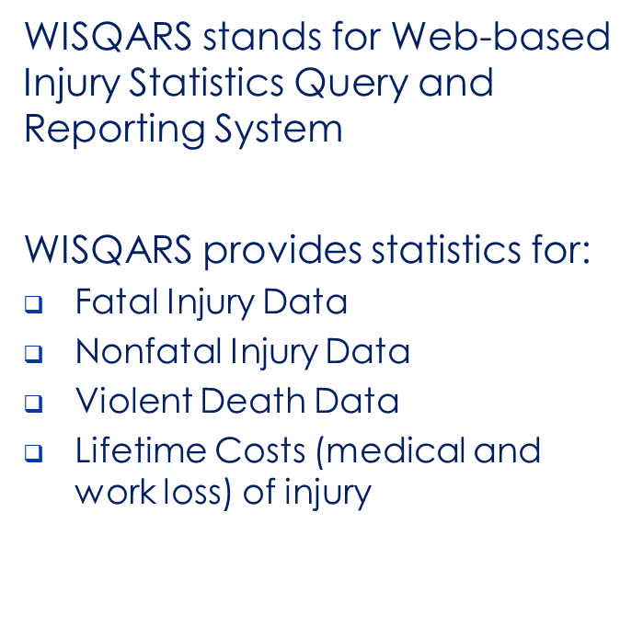
WISQARS Home Page
http://www.cdc.gov/injury/wisqars
National Center for Injury Prevention and Control
Notes:
This is the WISQARS HomePage, and recently, this page was converted into a responsive design template, making it more easily viewable and easier to interact with across mobile devices.

Slide 3
WISQARS Cost Data Sources – Fatal Injury and Nonfatal Injury
2 Data Sources / 3 Types of Injury Outcome
  Fatal Injury Data - Death certificate data from the National Vital Statistics System (NVSS)
  Nonfatal Injury Data - National estimates of injuries treated in U.S. hospital emergency departments from the National Electronic Injury Surveillance System - All Injury Program (NEISS-AIP)
2 Injury Classification Schemes
  Intent by Mechanism
  Body Region by Nature of Injury

Slide 4
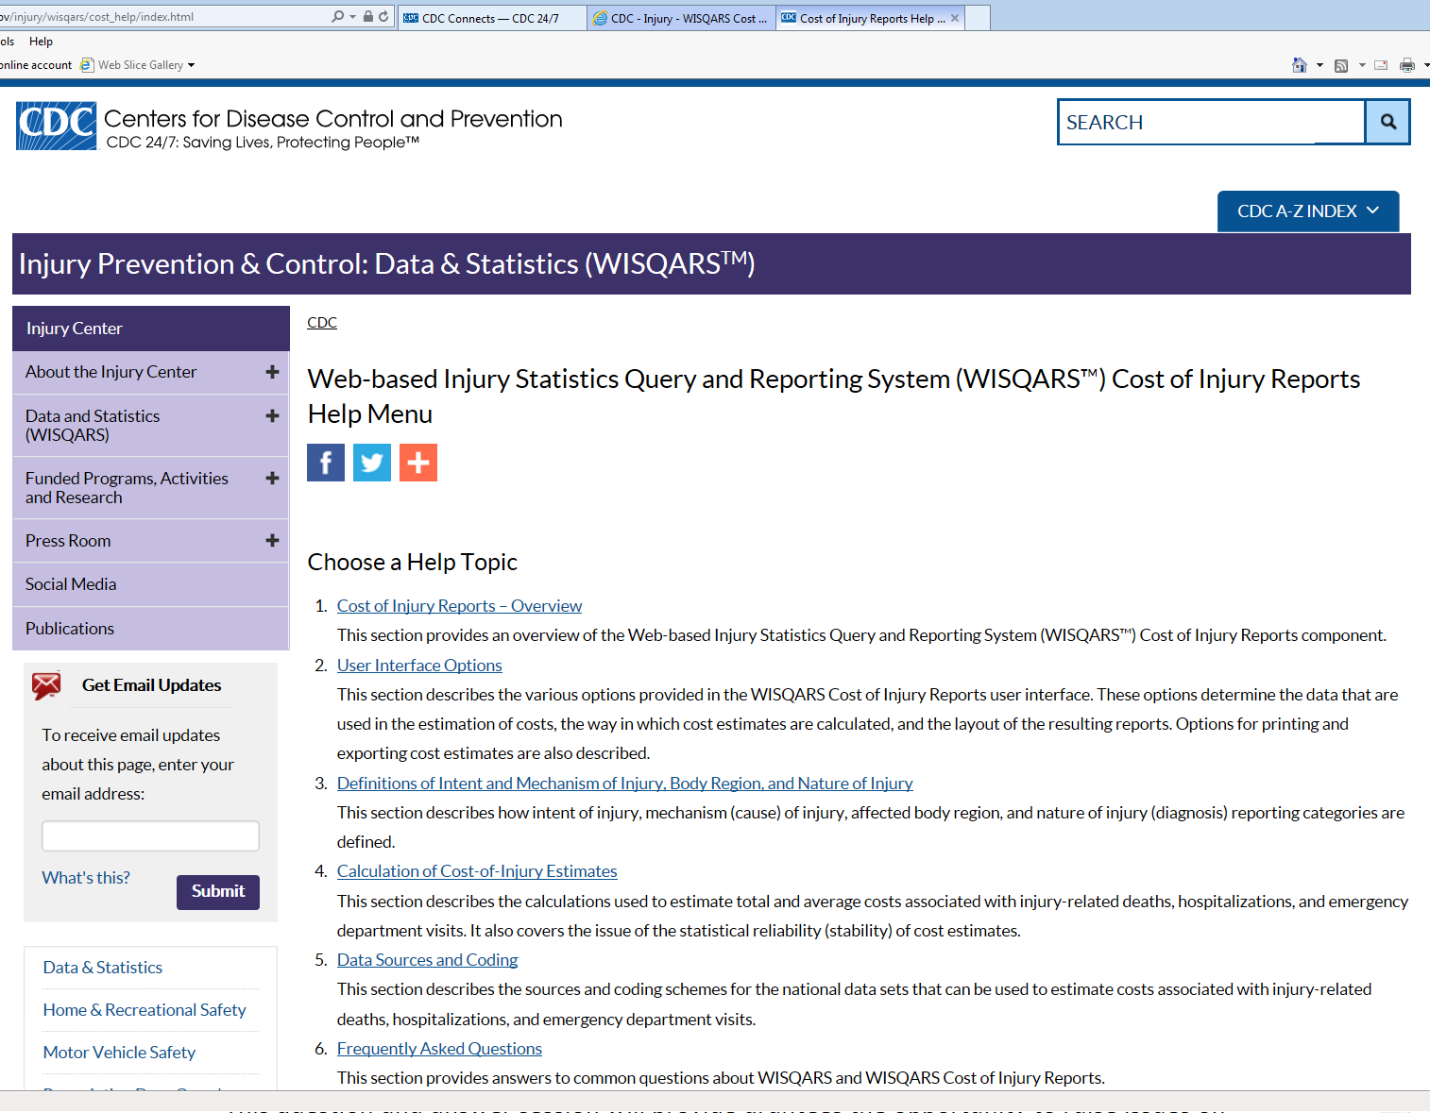
Cost of Injury Reports: User Help Guides and More!
Notes:
In addition to some serious fusion of web development, IT, statistics, and economics, we also spent a generous amount of time creating extensive user help guides and a Learn More page – accessible from the 1st screen (or welcome screen). Also note that you will want to disable your pop-up blocker to effectively use the Cost of Injury Reports module, as the help files, learn more pages, and output reports all open up in a separate window!

Slide 5
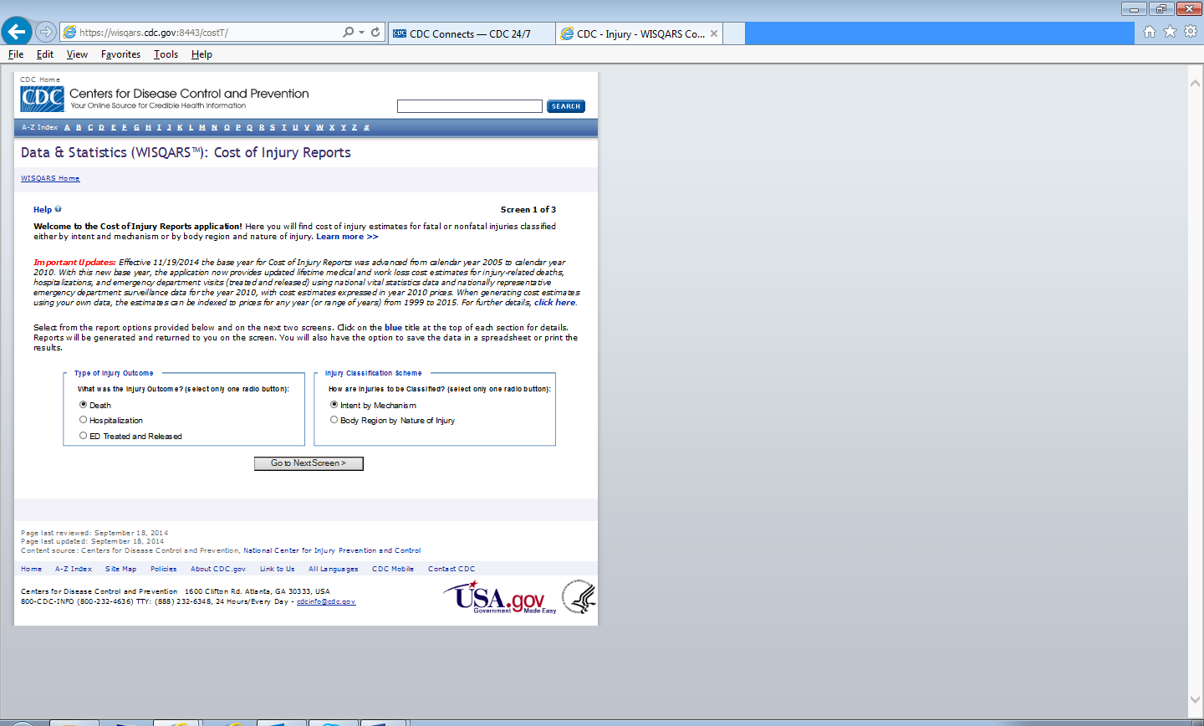
Cost of Injury Reports: Screen 1 of 3
Notes:
The Cost of Injury Reports module has 3 query screens. This is Screen 1 of 3 where you first need to select your type of injury outcome (or data source) and your injury classification scheme. The default selections are fatal injuries classified by intent by mechanism. We’ve captured multiple screenshots of each and included in the handouts. Your selections from this screen populate what you will see on the following screen. Also, note where the Learn More and Help file options are accessed from this page.

Slide 6
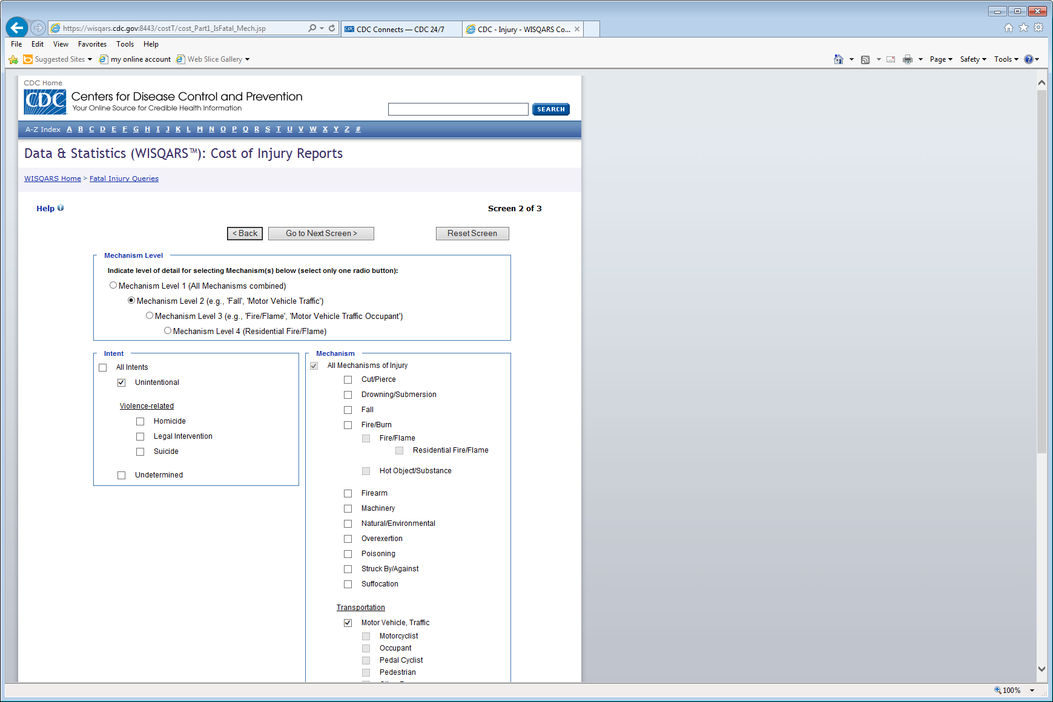
Cost of Injury Reports: Screen 2 of 3
Notes:
The second screen is where you select your intent and mechanism of injury (or body region and nature of injury). The list of mechanisms are grouped into levels of detail, similar in structure to the cause of death categorizations in the WISQARS Fatal Injury Reports Module. When you select your mechanism level, for example, say, Mechanism level 2 for Motor Vehicle Traffic, the other levels will grey-out and become unselectable. And note that you are not limited to making just one selection: on this screen, for example, you can select all of the causes available within a detail level.

Slide 7
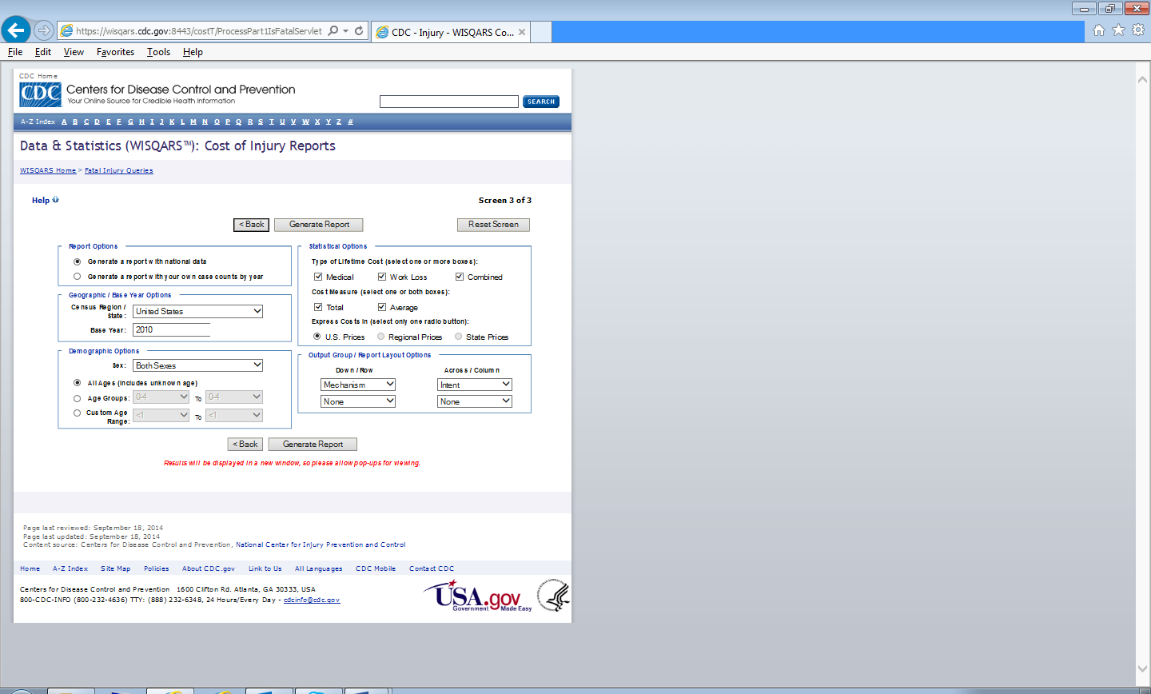
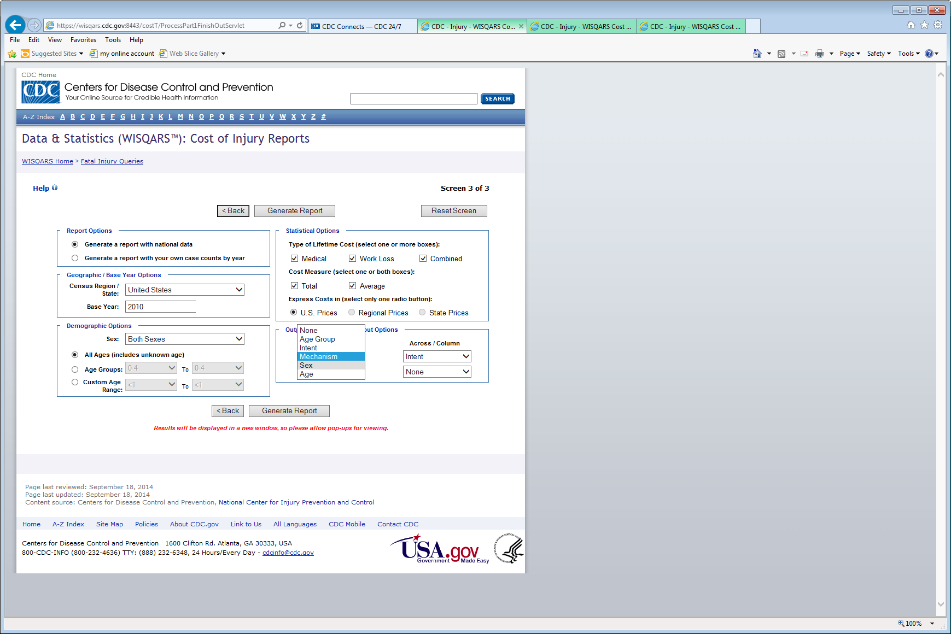
Cost of Injury Reports: Screen 3 of 3
Notes:
The final query screen is Screen 3 of 3. This is the place where you select specific report options including geographic region, your demographic interests, and also which type of Estimated Lifetime Cost statistics requested. You can also control the report layout and select how your report options will be grouped for display. Note the bright red reminder to allow pop-ups in order to view your output report. For this report, I changed my output groupings from the default options of Mechanism and Intent to instead group by Sex and Intent, and here’s what that looks like: (next slide)

Slide 8
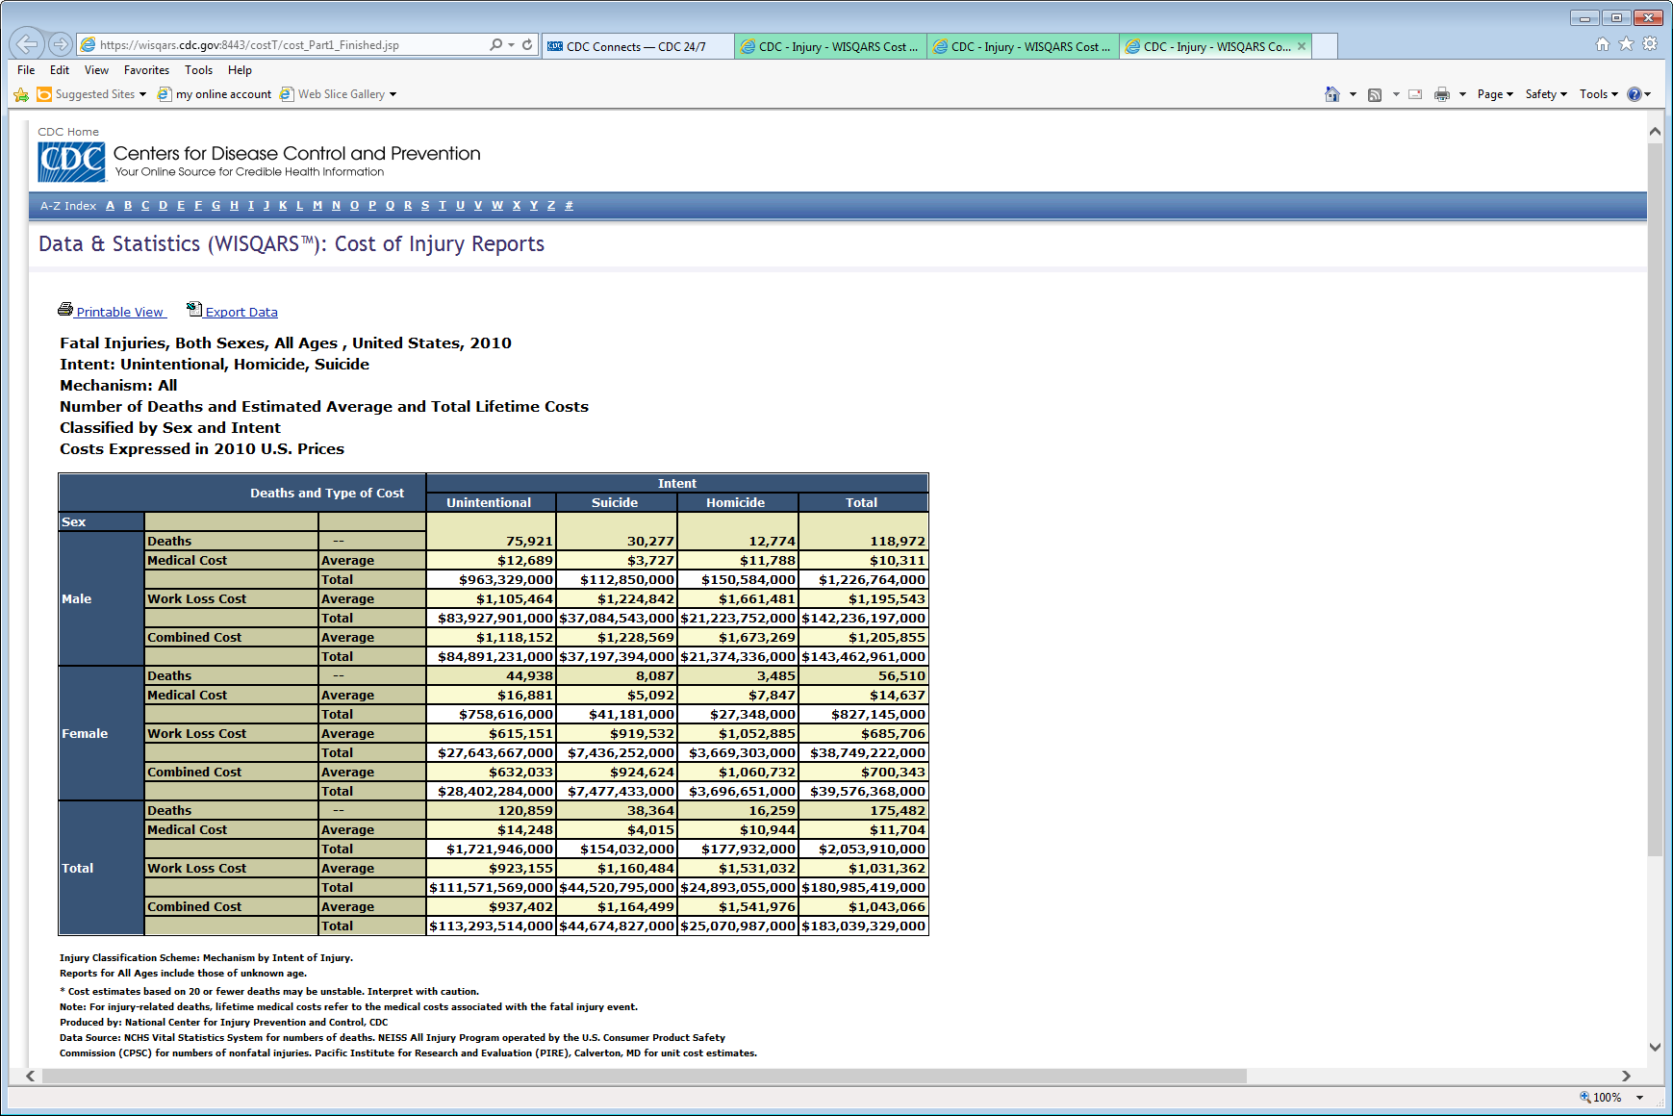
Cost of Injury Report Output using default option: Generate a Report with National Data
Notes:
Base Year 2010 (circled here) to remind us that these lifetime estimated costs were generated using 2010 national fatal data. Also, several footnotes were created to accompany each output report to assist the user in best interpreting what the estimated costs represent and more. Let’s look at a simplified version of this output more closely, yes? (next screen)

Slide 9
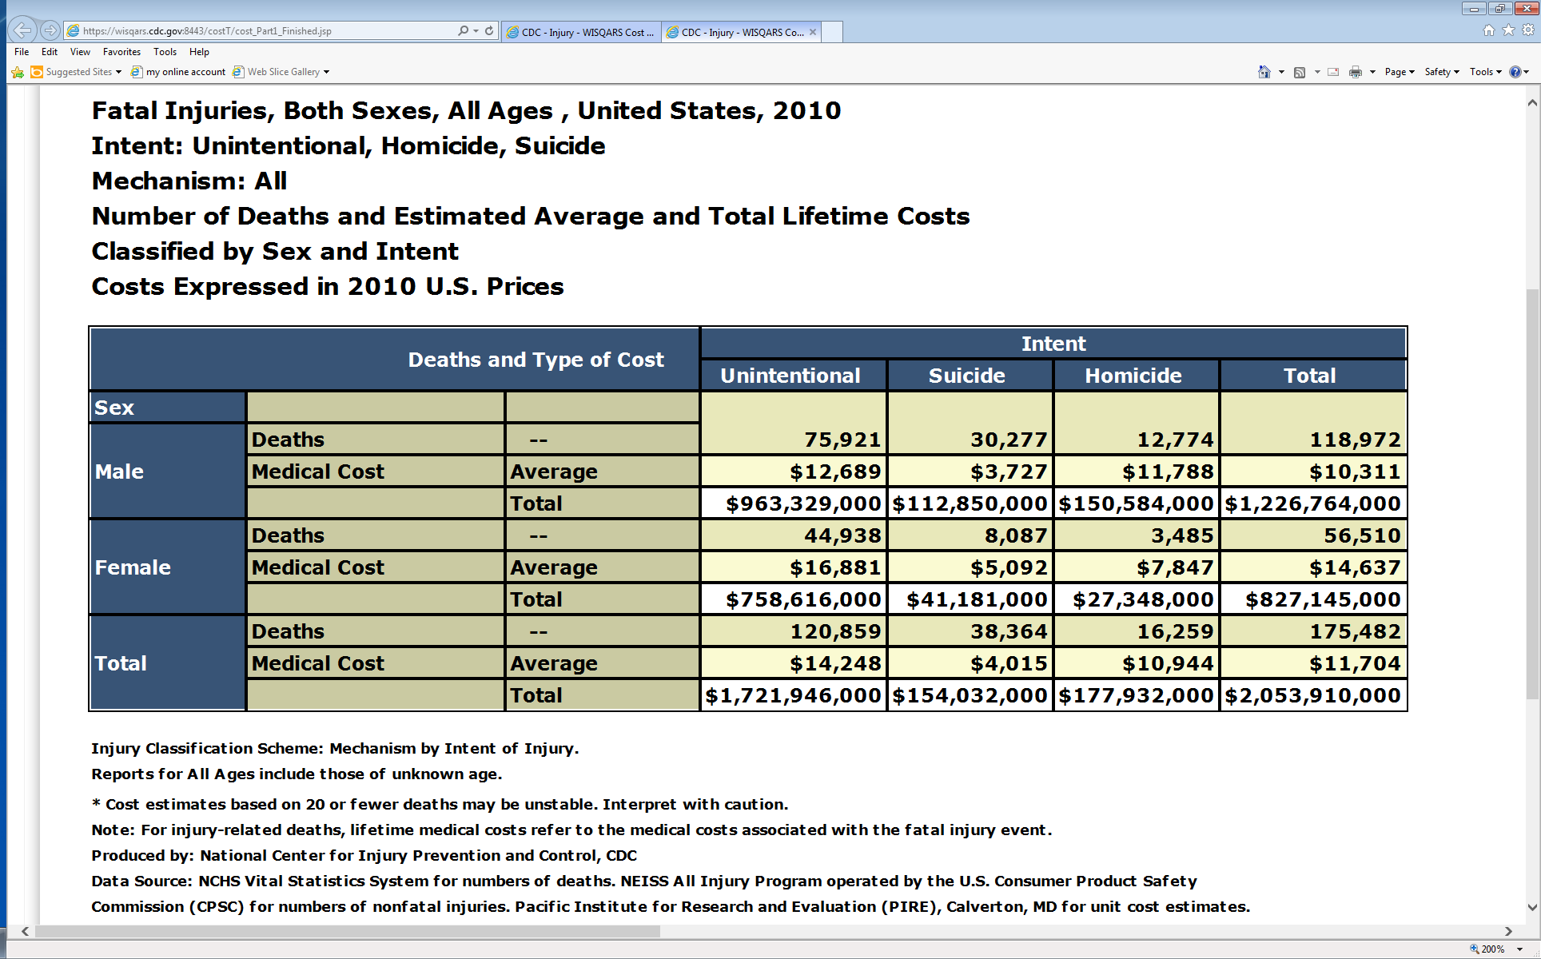
Cost of Injury Report Output using default option: Generate a Report with National Data

Slide 10
Cost of Injury Reports:
A Scenario using State Data
The Scene
You are a Core SVIPP Grantee for the State of Florida.
Your focused area of research is in unintentional motor vehicle (MV-traffic) injuries.
You have obtained both fatal and nonfatal data for year 2015 and would like to enter your own case counts into the WISQARS Cost of Injury Reports Module to obtain lifetime estimates of the burden or costs associated with motor vehicle injuries.

Slide 11
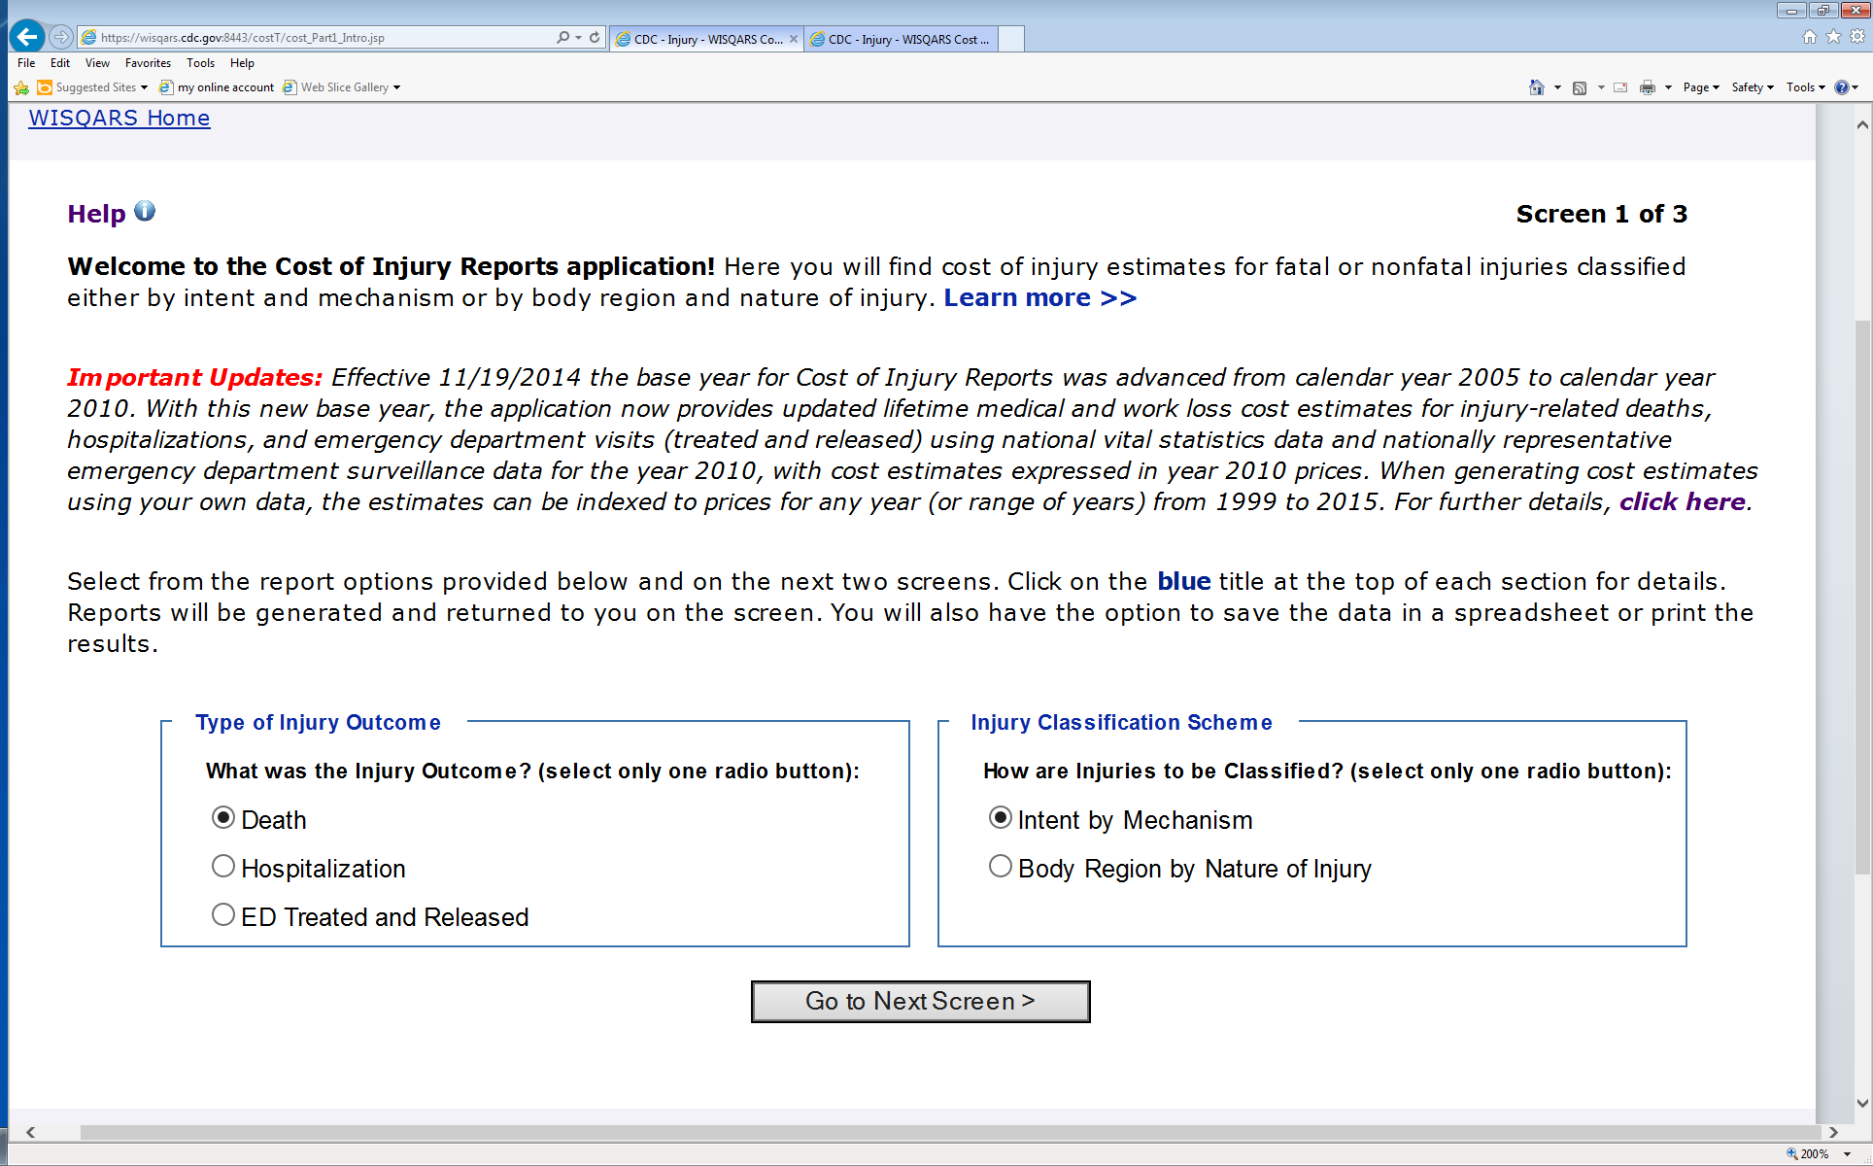
Cost of Injury Reports:
A Scenario using State Data (Fatal - Screen#1)
Notes:
So, let’s go through each of the 3 screens, step by step. The first screen has both fatal and nonfatal data options, but note though we will need to make 3 separate runs, as the module is not currently set up to process both fatal and nonfatal data together. So, let’s start with entering our fatal State data… we’d choose to keep both default selections as they are … since we are first entering our fatal case counts, and the default injury classification scheme selected, which is Intent by Mechanism, since we have unintentional MV-traffic data…

Slide 12
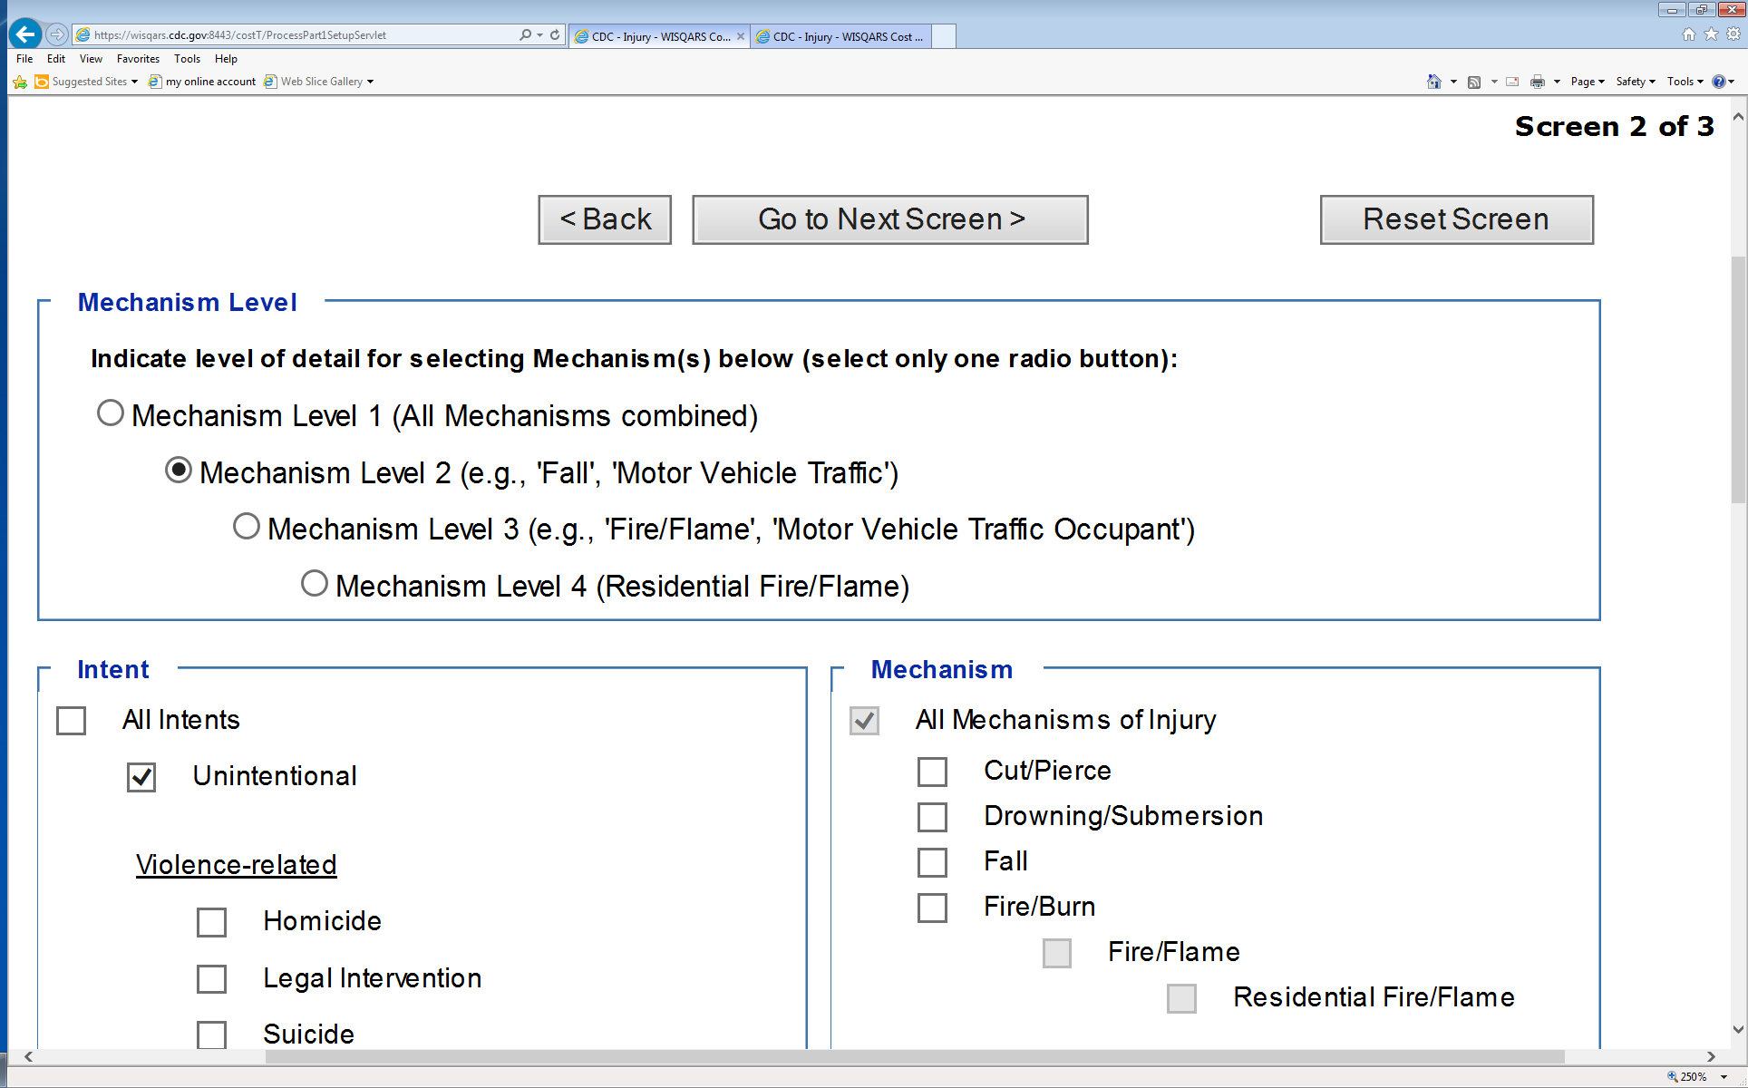
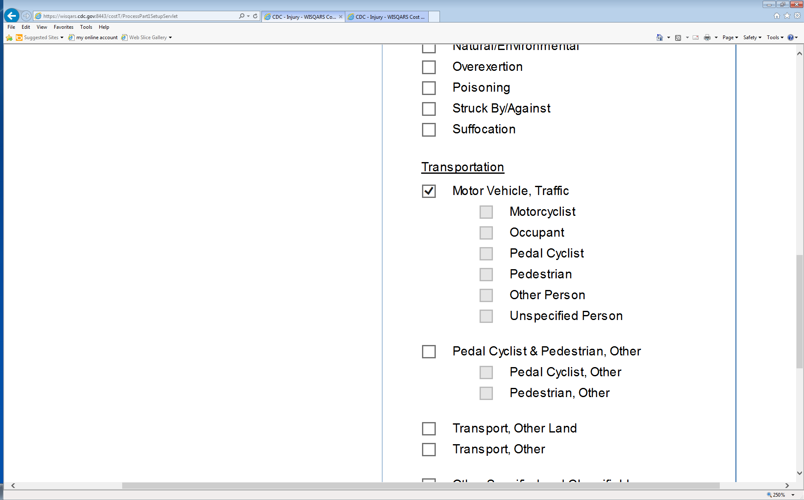
Cost of Injury Reports:
A Scenario using State Data (Fatal - Screen#2)

Slide 13
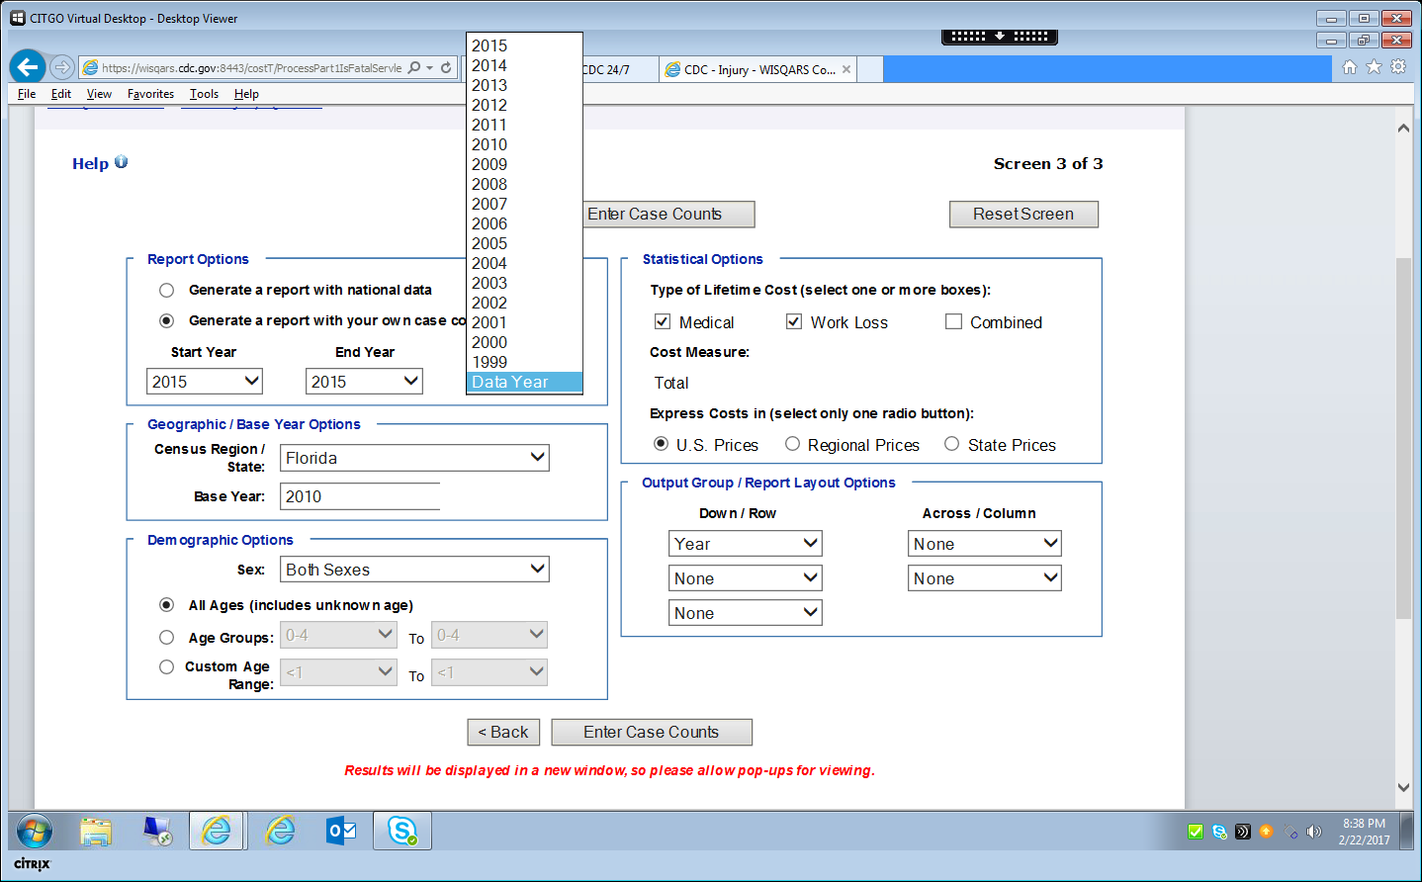
Cost of Injury Reports:
A Scenario using State Data (Fatal - Screen#3)
Notes:
Here comes the fun! =)
The 3rd screen selections are key, as this is where you toggle down to the ‘Generate a Report with your own data’ button. It opens up some additional dropdown menu options, called Start Year, End Year, and Index Costs to picklists.. Note that the State of Florida was selected, and also that I removed all but the Year parameter in the report layout options section. For this example, I chose to have the costs expressed in U.S. Prices. So, once finished here, we hit the Enter Case Counts button and. (next slide)

Slide 14
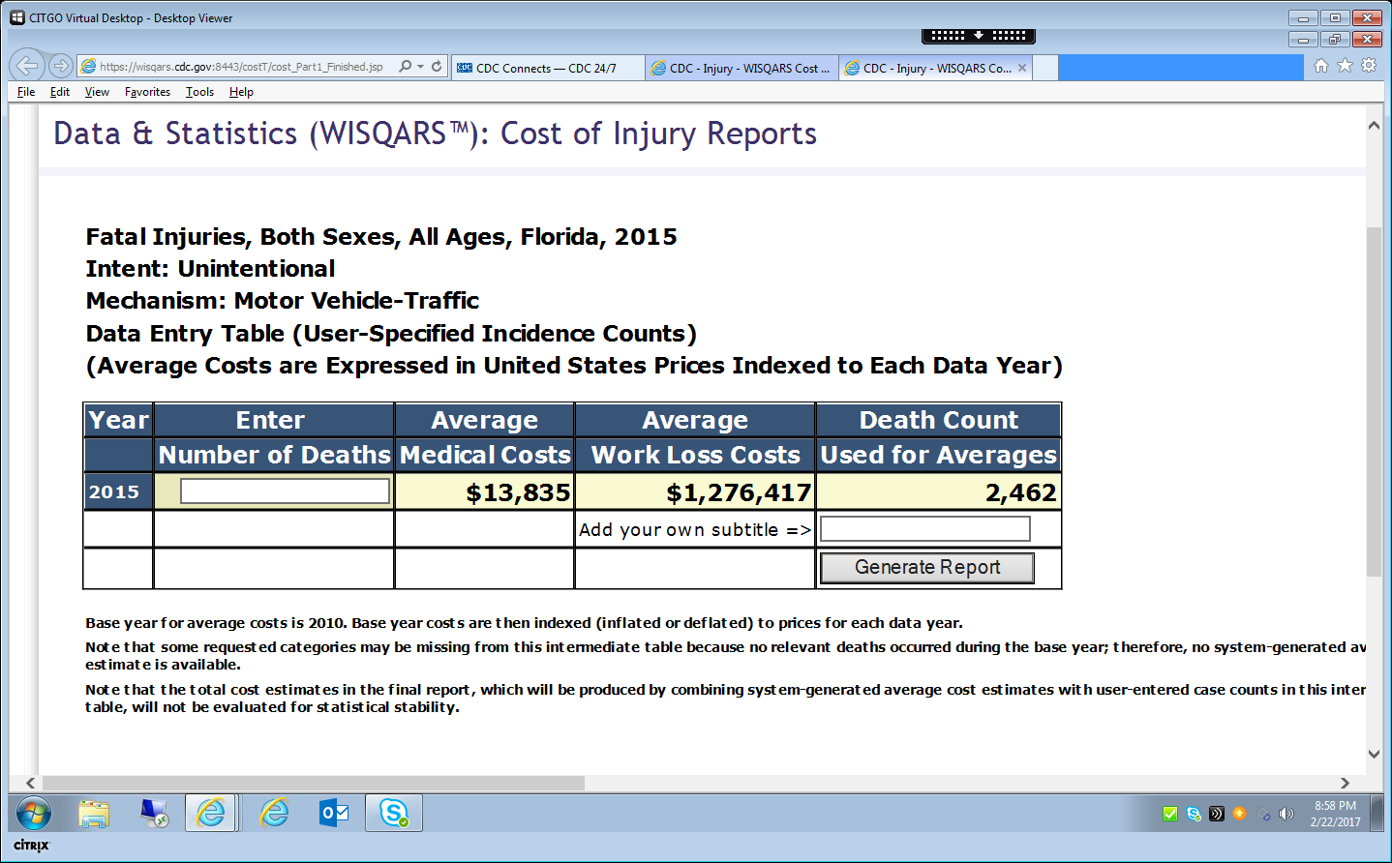
Cost of Injury Reports:
Data Entry Screen
Notes:
We’ve arrived at our 1st Data Entry Screen… =)
Unit cost measurements are calculated using the following formulas: medical unit costs determined by place of death, sex, and age; work loss costs calculated based on sex and age

Slide 15
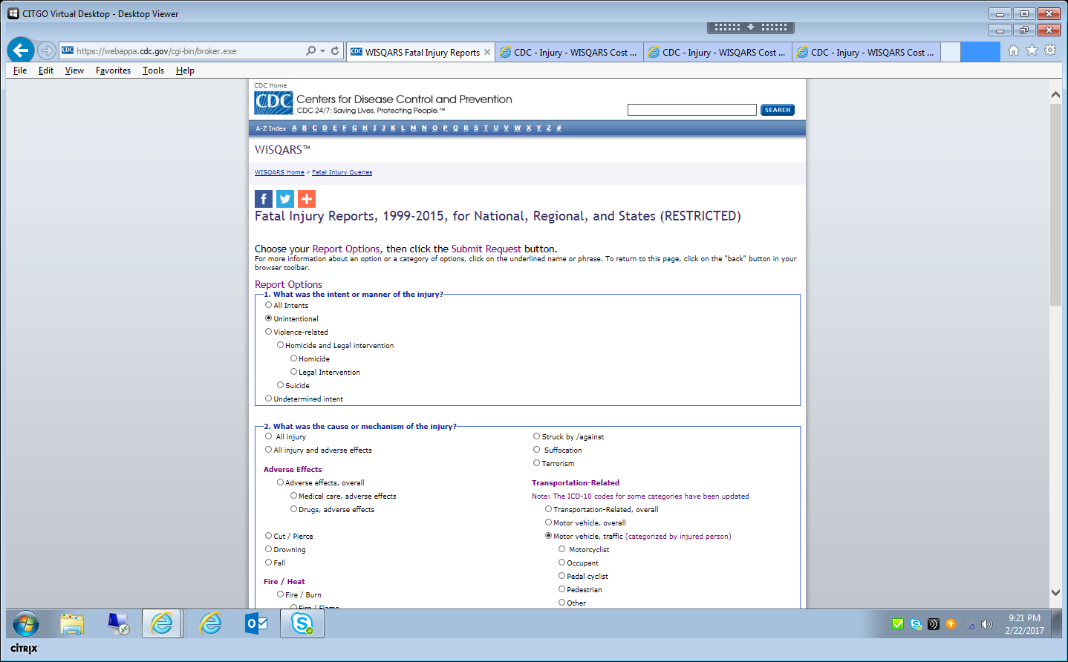
WISQARS Fatal Injury Reports Query Page

Slide 16
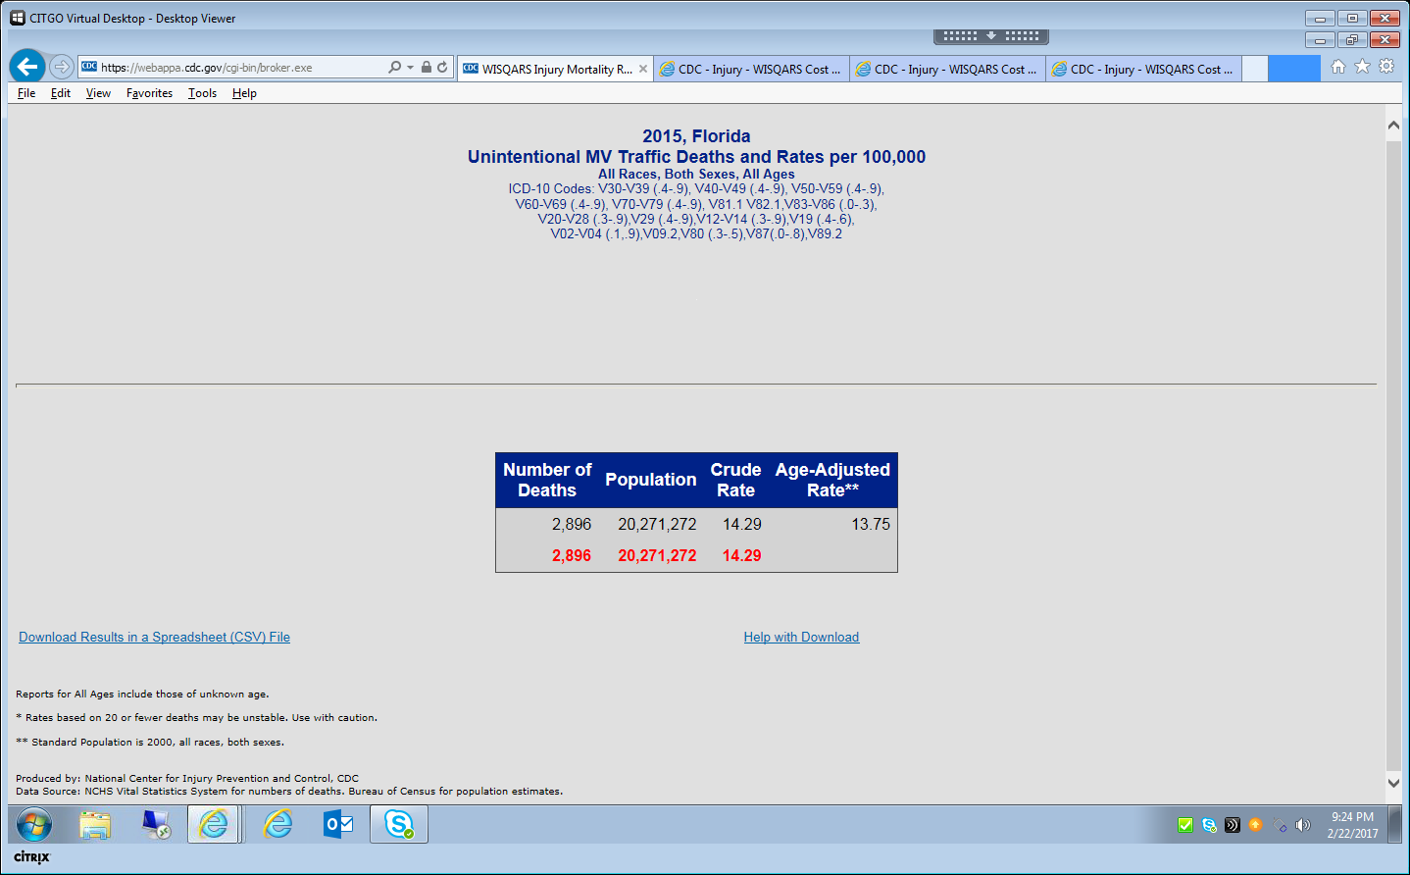
For Data-Entry: Fatal Injury Reports Results Page

Slide 17
Cost of Injury Output Report (Fatal Injuries)

Slide 18
Cost of Injury Reports:
A Scenario using State Data (Nf Hosp - Screen#1)

Slide 19
Cost of Injury Reports:
A Scenario using State Data (Nf Hosp - Screen#2)

Slide 20
Cost of Injury Reports:
A Scenario using State Data (Nf Hosp - Screen#3)

Slide 21
Cost of Injury Output Report (Hospitalizations)

Slide 22
Cost of Injury Output Report (ED Treated and Released)

Slide 23
The Results are IN! =)
Cost of Injury Reports Module with Focus on Generating a Report using your own Case Counts
You found…
Estimated costs for Fatal Injuries = $3,736,568,000
Estimated costs for Hospitalizations = $2,734,891,000
Estimated costs for ED Treated & Released = $1,692,152,000
_________________________________________
Total estimated costs = $8,163,611,000 (!)
National Center for Injury Prevention and Control
Notes:
, And, the Results are IN!
From entering the Fatal numbers, the total estimated lifetime costs for fatalities from Unint. MV-traffic injuries were about 3.7 billion
The total estimated costs for Unintentional MV-traffic hospitalizations were about 2.7 billion
And, the total estimated costs for Emergency Department Treated and Released Unintentional MV-traffic injuries were almot 1.7 billion!
Summing these estimated lifetime costs results in a staggering total of just over $8.1 billion dollars! This number represents the economic burden of 2015 unintentional MV traffic fatal and nonfatal injuries for the state of Florida

Slide 24
An Overview of the WISQARS Cost of Injury Reports Module with Focus on Generating a Report using your own Case Counts
Q&A
Plans for a WISQARS Cost of Injury Reports Module enhancement
We’re exploring data visualization options for WISQARS
… and more!
National Center for Injury Prevention and Control
Notes:
In conclusion, this module is unique for many reasons, some of the most noteworthy being that (1) it ESTIMATES the burden of injury in the U.S. by calculating estimated medical and work loss costs, (2) it is the only WISQARS module that allows queries on both fatal or nonfatal data, and allows the user to generate estimated lifetime costs using their own data!

Slide 25
Thank You
Cost of Injury Reports Overview with Focus on Generating Report using your own Case Counts
Dionne D. Williams, MPS
ddwilliams@cdc.gov
For more information please contact Centers for Disease Control and Prevention
1600 Clifton Road NE, Atlanta, GA 30333
Telephone: 1-800-CDC-INFO (232-4636)/TTY: 1-888-232-6348
E-mail: cdcinfo@cdc.gov Web: http://www.cdc.gov
National Center for Injury Prevention and Control

