Slide 1
ELC Project O (Enhanced Vaccine Preventable Disease Surveillance): Multisystem Inflammatory Syndrome in Children (MIS-C)
March 16, 2021

Slide 2
Welcome
CDC Updates
Louisiana presentation with Q&A
Syndromic surveillance, ESSENCE queries, outreach activities
Minnesota presentation with Q&A
Experiences and activities with outreach to coroners and medical examiners
CDC presentation with Q&A
Postmortem guidance review and consideration of MIS-C in pediatric deaths
Additional Q&A as needed
2

Slide 3
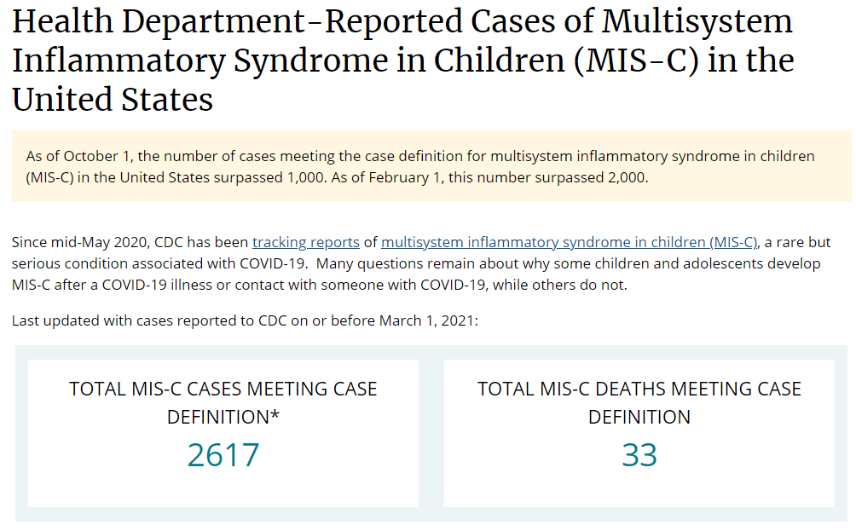
MIS-C Cases: March 4, 2021 Website Update
https://www.cdc.gov/mis-c/cases/index.html
3

Slide 4
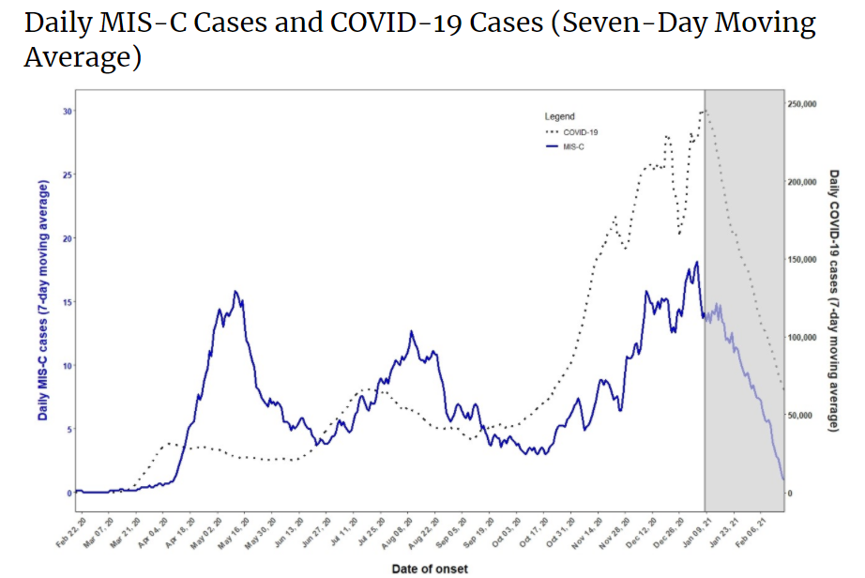
4
https://www.cdc.gov/mis-c/cases/index.html
Notes:
The graph shows the seven-day average number of MIS-C and COVID-19 cases with MIS-C date of onset between February 19, 2020 and February 21, 2021. The cases meeting case definition are reported nationally on a monthly interval.
The grayed-out area on the right side of the figure represents the most recent six weeks of data, for which reporting of MIS-C cases is still incomplete. The actual number of MIS-C cases during this period is likely larger and these numbers will increase as additional case reports are incorporated. The left Y-axis defines the number of daily average MIS-C cases and is marked in units of 5 with a scale of 0 to 30; the right Y-axis defines the number of daily average COVID-19 cases and is marked in units of 50,000 with a scale from 0 to 250,000.
5 of the 2,617 cases were missing dates.

Slide 5
Jurisdiction presentations on use of syndromic surveillance to identify MIS-C cases.
5

Slide 6
MIS-C Syndromic Surveillance
Louisiana Department of Health, Infectious Disease Epidemiology Section
Julie Hand, MSPH, Gillian Richardson, MPH, Elizabeth Mytty, MPH
March 16, 2021

Slide 7
MIS-C in Louisiana
 | Count
Confirmed Cases | 140
Deaths | 5
Age Range | 0-19
Median Age | 7
Gender
Female | 51 (36.4%)
Male | 89 (63.5%)
Clinical Status
Hospitalized | 2 (1.4%)
Discharged | 133 (95%)
Died | 5 (3.6%)
Race
Asian | 3 (2.1%)
Black | 69 (49.3%)
Other | 16 (11.4%)
White | 52 (37.1%)
Unknown | 0
Ethnicity
Hispanic | 27 (19.3 %)
Non-Hispanic | 113 (80.7 %)
Notes:
^{i}Fever >38.0°C for ≥24 hours, or report of subjective fever lasting ≥24 hours ^{ii}Including, but not limited to, one or more of the following: an elevated C-reactive protein (CRP), erythrocyte sedimentation rate (ESR), fibrinogen, procalcitonin, d-dimer, ferritin, lactic acid dehydrogenase (LDH), or interleukin 6 (IL-6), elevated neutrophils, reduced lymphocytes and low albumin
Additional comments
Some individuals may fulfill full or partial criteria for Kawasaki disease but should be reported if they meet the case definition for MIS-C
Consider MIS-C in any pediatric death with evidence of SARS-CoV-2 infection

Slide 8
MIS-C in Louisiana
Notes:
^{i}Fever >38.0°C for ≥24 hours, or report of subjective fever lasting ≥24 hours ^{ii}Including, but not limited to, one or more of the following: an elevated C-reactive protein (CRP), erythrocyte sedimentation rate (ESR), fibrinogen, procalcitonin, d-dimer, ferritin, lactic acid dehydrogenase (LDH), or interleukin 6 (IL-6), elevated neutrophils, reduced lymphocytes and low albumin
Additional comments
Some individuals may fulfill full or partial criteria for Kawasaki disease but should be reported if they meet the case definition for MIS-C
Consider MIS-C in any pediatric death with evidence of SARS-CoV-2 infection

Slide 9
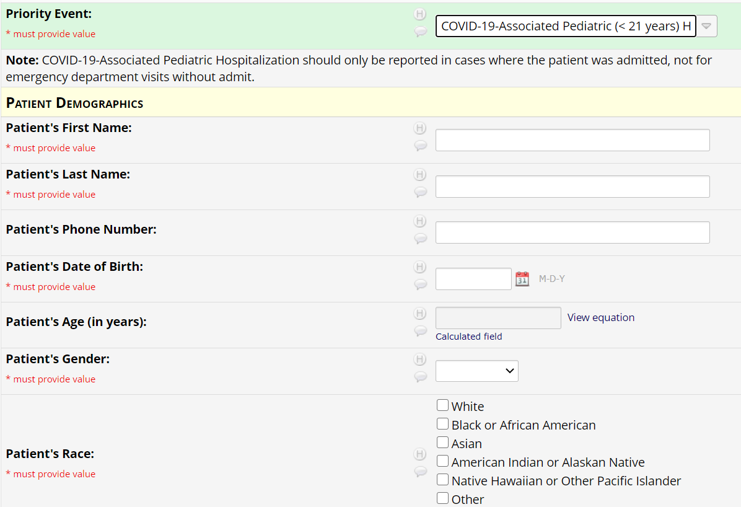
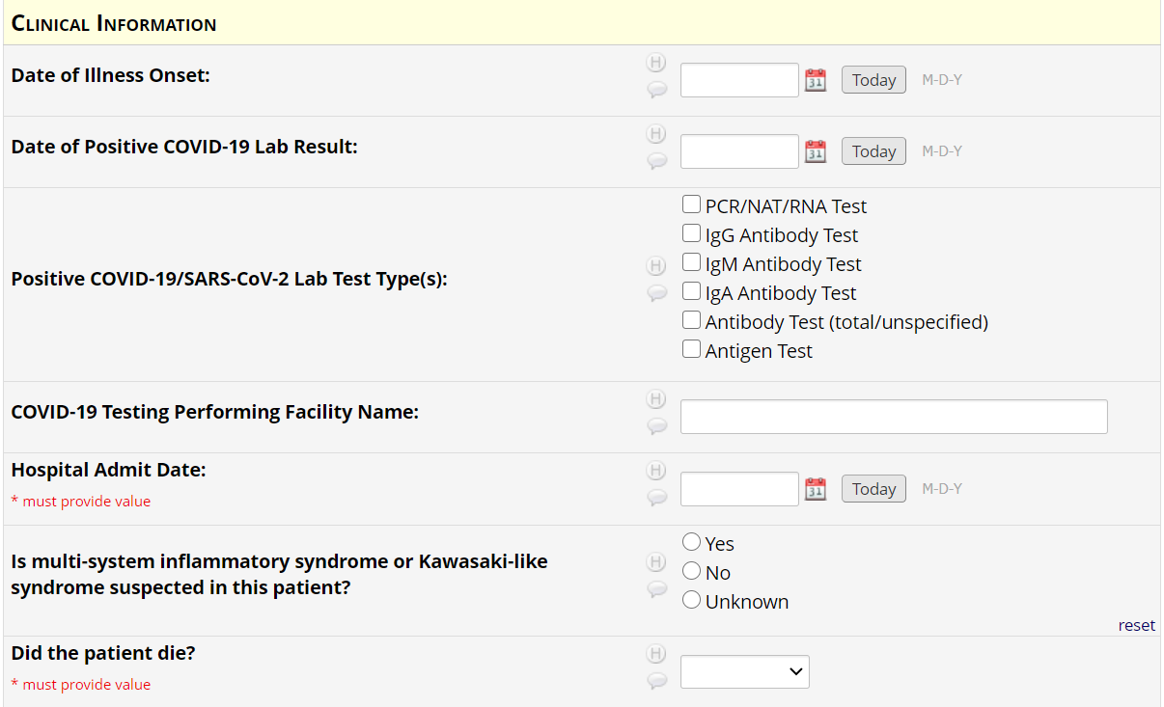
Priority Events Reporting Portal

Slide 10
Patient Follow-up

Slide 11
Objectives
Surveillance of MIS-C through ED visits using NSSP’s Biosense Platform
Trend monitoring
Detection of possible unreported MIS-C cases

Slide 12
Methodology
Using NSSP’s platform Essence, developed an exploratory, sensitive query searching for common symptoms of MIS-C
Matched this query with the Medical Record Numbers and dates of birth of known MIS-C cases
Since this number seemed low, we queried Essence for the MRNs of confirmed cases and analyzed results
Evaluated and Revised Query

Slide 13
Exploratory Query
Using NSSP’s platform Essence, developed an exploratory, sensitive query searching for common symptoms of MIS-C
Developed an exploratory query
Age < 21 years old
Included terms relevant to MIS-C case definitions
Kawasaki, various spellings and ICD 10 and SNOMED codes: M30.3,
MIS-C
Elevat and Inflam; Inflam and marker; multi and inflame;
CRP and reactive and protein
Fever and rash, or blood shot, or trouble breath, or bluish/blueish
Fever and diarrhea; Fever and vomit
Reviewed results, refined, and added exclusion terms for commonly negated terms, acronyms, misspellings and typos:
Exclusion terms: Denies fever; Crash
Vomit and vominting instead of vomiting
In November we added ICD-10 codes based on guidance from American Academy of Pediatrics for coding MIS-C in children
M35.8 and B94.8
To date, we have only seen 40 total visits associated with these ICD-10 codes, one additional confirmed case was identified from these

Slide 14
Matched Results with Confirmed Cases
Upon revision, this query was still sensitive and pulled ~400 ED visits.
Using Medical Record Numbers and Dates of Birth, we matched these ED visits identified by the query with the Medical Record Numbers and birth dates of known MIS-C cases
Resulted in 22 patient matches and 27 visits
Reviewed CCs and ICD-9, ICD-10 and SNOMED codes to crosswalk and refine definitions

Slide 15
Reverse Match
To improve identification of patients, we pulled a match of all MRNs of confirmed cases from Essence and conducted an analysis of terms
67 patients matched, including 14 with MIS-C or Kawasaki DDs
A match on DOB among those with MIS-C DDs identified one more
Total: 68 matches in Essence

Slide 16
Chief Complaints
Most frequent chief complaint terms: Fever, Vomiting, Abdominal pain, COVID, Cough, Rash, Headache, Shortness of Breath, and Diarrhea

Slide 17
Discharge Diagnoses
Most common discharge diagnoses:
R50.9 Fever
E86.0 Dehydration
R05 Cough
J06.9 Acute upper respiratory infection
R79.89 Other specified abnormal findings of blood chemistry
R06.02 Shortness of Breath
R65.10 Systemic inflammatory response syndrome of non-infectious origin without acute organ dysfunction
A41.9 Sepsis, unspecified organism
B34.9 Viral infection

Slide 18
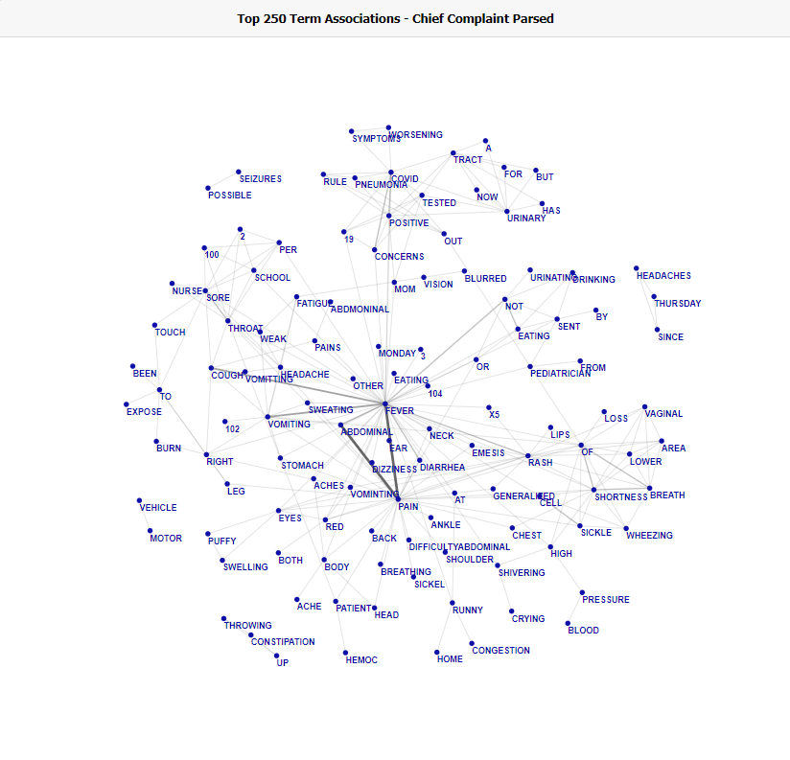
Term Associations

Slide 19
Refined Query & Key Findings
Removed GI syndrome search because non-specific
MIS-C/ Kawasaki DDs: M30.3, M35.8, B94.8, 75053002, 16025471000119107,
Additional DDs: R79.89, R65.1, A41.9
Key terms: Various spellings of Kawasaki, MIS-C, and Inflammatory syndromes to capture visits with missing DDs
Age<21
Apply to CCDD Free Text, Clinical Impressions, and Triage Notes
Use both the MIS-C/Kawasaki discharge diagnoses to review more specific visits, and the combination CCDD query to find additional visits that are missing discharge diagnoses and find possible MIS-C cases

Slide 20
Thank you!
Julie Hand – Julie.Hand@la.gov
Gillian Richardson – Gillian.Richardson@la.gov
Lizzie Mytty – Elizabeth.Mytty@la.gov
20

Slide 21
MIS-C in Minnesota Outreach to coroners and medical examiners
Sarah Lim, MBBCh
Medical Specialist, Infectious Disease Epidemiology, Prevention and Control

Slide 22
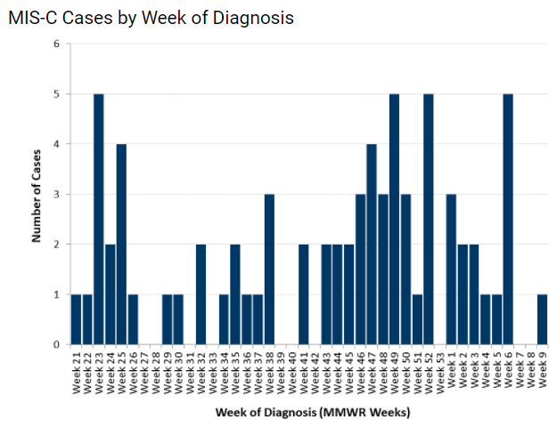
MIS-C: Case reporting in MN
74 confirmed cases since May 2020
Average age 8
M:F 72%: 28%
58% Black or Hispanic
Cases reported by pediatric providers and reviewed individually by MDH ID physician

Slide 23
Current Communication Activities
Weekly all-state conference call with adult and pediatric ID providers on COVID-19 including updates and education on MIS-C/MIS-A
MDH webpage with case statistics and demographics
Monthly MDH hosted multidisciplinary case conference for providers on MIS-C/MIS-A
Letter to Minnesota coroners and medical examiners in October 2020 with information on case definition and reporting of MIS-C
Webinar with coroners/MEs in December 2020 to review MIS-C
Quarterly search of vital records death certificate data to identify any late post-discharge deaths in known existing MIS-C cases AND searching cause of death by ICD-10 codes (including new MIS-C ICD-10 code) and MIS-C related terms to identify unreported deaths attributed to MIS-C

Slide 24
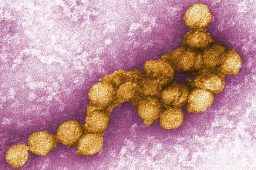
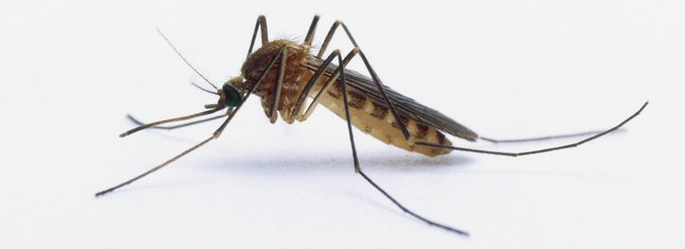
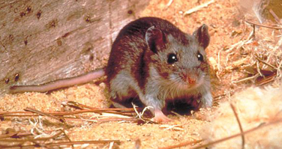
Unexplained Death and Critical Illness of Possible Infectious Etiology (UNEX Surveillance)
Initiated in MN in 1995 as part of the CDC Emerging Infections Program
Goals:
Identify novel and emerging pathogens
Identify unusual manifestations of known diseases
Describe epidemiology of fatal infections
Improve pathology-based diagnostic testing
Notes:
Infectious disease surveillance does not typically capture all cases occurring in a population, including fatal infections that go undiagnosed or occur outside the healthcare system.
The Unexplained Death and Critical Illnesses of Possible infectious etiology or UNEX Surveillance was initiated in MN in 1995 as part of the CDC Emerging Infections Program
The goals of this project were to identify novel and emerging pathogens
Identify deaths due to known pathogens presenting as sudden unexplained deaths allowing unusual or severe manifestations of common diseases to be identified and enable a better estimate of the true burden of disease
Characterize epidemiologic features of fatal infections.
And improve pathology-based diagnostic testing.

Slide 25
UNEX Surveillance
Any unexplained death or critical illness with infectious disease hallmarks is reportable
Priority given to persons previously healthy and <50 years of age
Additional testing conducted by MDH PHL or CDC Infectious Disease Pathology Branch (IDPB)
Dependent on presenting clinical syndrome, prior testing, and specimen availability
MDH works closely with medical examiners, infectious disease physicians and other providers, public health practitioners, and the public to report and investigate potential UNEX cases
Notes:
Any unexplained death or critical illness with infectious disease hallmarks such as fever or leukocytois, but for which all routine testing was negative, is reportable and may be investigated; however, priority is given to persons <50 years of age with no significant underlying medical conditions. Additional testing is conducted by the Minnesota Department of Health or (MDH) or CDC’s Infectious Disease Pathology Branch (IDPB) on specimens collected from reported patients or decedents. The focus of additional testing is dependent on the presenting clinical syndrome, prior testing and specimen availability. MDH works closely with medical examiners, infectious disease physicians, healthcare and public health practitioners, and the public to report and investigate potential UNEX cases.

Slide 26
Expanded UNEX activity during COVID-19 response
Mortality tracking unit
Review deaths in persons who have a positive test for SARS-CoV-2
Classify deaths as confirmed or probable according to the Council for State And Territorial Epidemiologist case definitions
Provide logistical support for postmortem testing
Report results
Daily communication with Office of Vital Records
600+ specimens of suspected COVID-19 cases sent to MDH

Slide 27
Communications with MEs via UNEX
Communication typically informal, based on longstanding relationships
Periodic email updates to ME partners on testing criteria and soliciting reporting of unexplained respiratory deaths
Individual outreach to ME offices about COVID-19 testing protocols
Many MEs routinely sending samples and reaching out about individual cases
MEs that work routinely with funeral homes and cremation also notifying MDH if death is suspected to be COVID-19 or in a LTCF resident

Slide 28
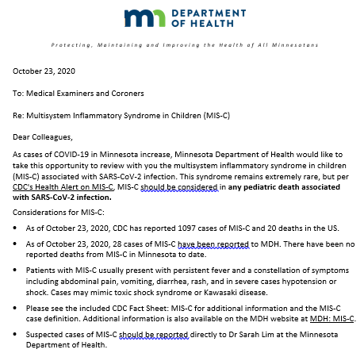
Letter to MN coroners and medical examiners
October 2020: letter to all members of the MN association of MEs and coroners (~100 members)
Reminder of MIS-C as a specific syndrome, clinical features, details of how to report any suspected cases

Slide 29
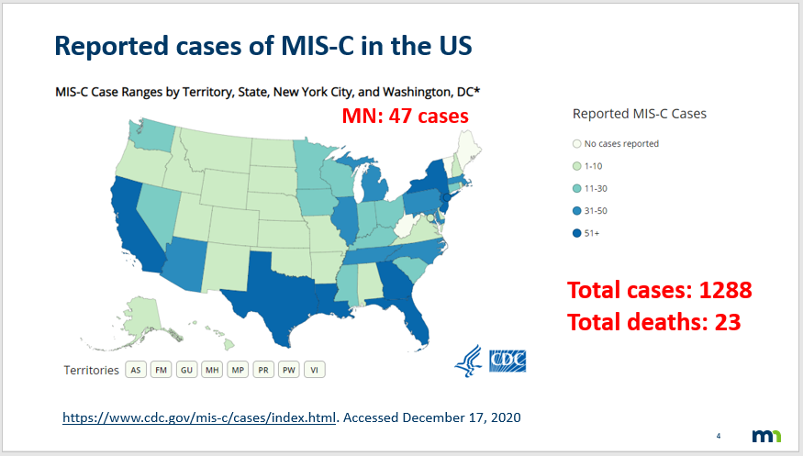
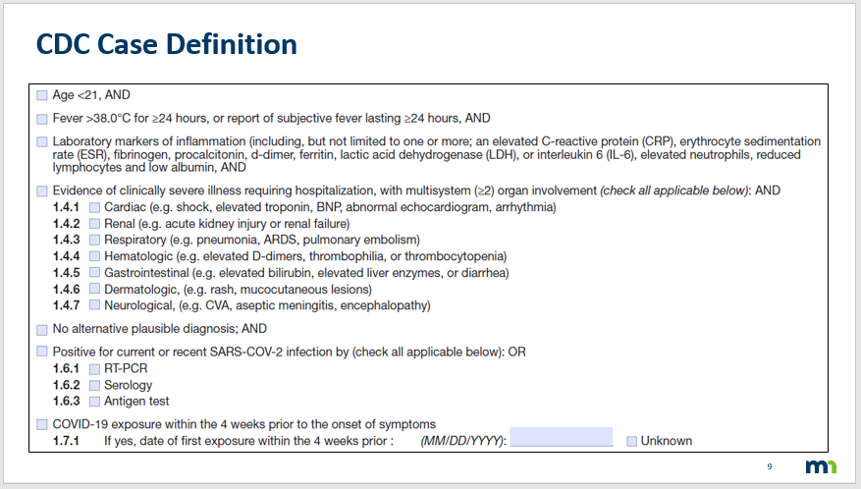
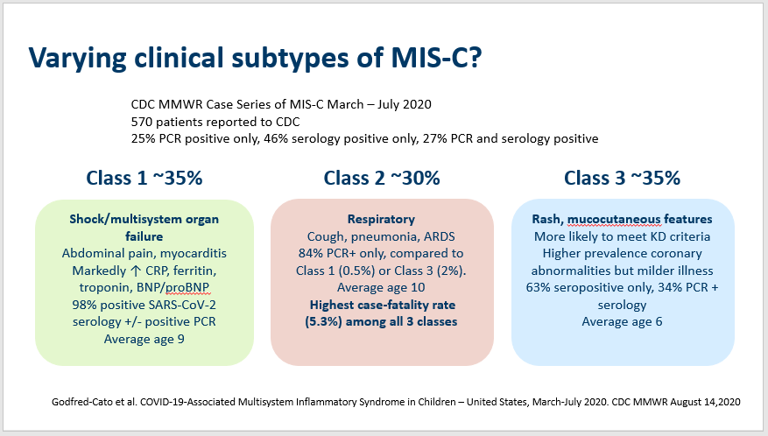
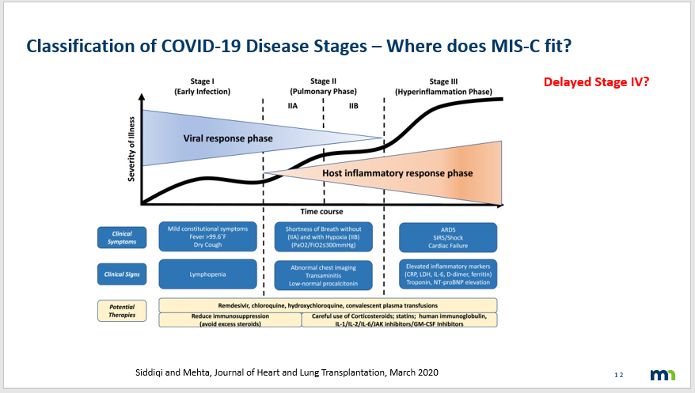
Webinar December 2020
Overview of MIS-C cases, demographics, case definition, theories about pathophysiology, clinical subtypes
Attendance ~40
No attendee had seen a potential case
Questions about typical cause of death in MIS-C or specific pathology findings that would indicate possible MIS-C

Slide 30
Conclusion
Directed communication to MEs/coroners about MIS-C useful to raise awareness of the syndrome in cases of unexplained deaths
Utilizing pre-existing avenues of communication such as the MN UNEX program can be helpful to disseminate targeted and timely information
Planning additional letters with case updates and could potentially hold another webinar as new evidence emerges on pathophysiology

Slide 31
Thank you!
Sarah.Lim@state.mn.us
31

Slide 32
Using Vital Records to Find Potential MIS-C Deaths
Carmen Bernu – Epidemiologist

Slide 33
Using Vital Records
Match MIS-C Cases to vital records to find missing deaths
Search vital records to find potential MIS-C cases

Slide 34
Vital Records File
Requested file of all 2020 deaths in MN
-> restrict to 21 and under
520 deaths
296 variables for each death record
-> restrict to name, DOB, death date, address, place of death, causes of death, ICD-10 codes (up to 20)
38 variables

Slide 35
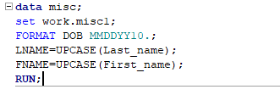
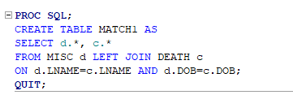
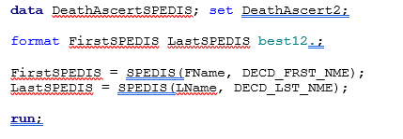
Matching MIS-C Cases to Vital Records
1. Format and Rename: Name, DOB, DOD
2. Exact Matching
Matching on name and DOB
Proc SQL
3. Fuzzy Matching
Matching on “sounds like” name. Calculates likelihood two strings of text could be the same.

Slide 36
Searching Vital Records –COD Text
Search through all causes of death for any variation of text
Create a table of individuals to look into further

Slide 37
Searching Vital Records – ICD-10
Same as before, only using ICD-10 variables
U07.1 = COVID-19, primary diagnosis AND
M35.8 = other specified systemic involvement of connective tissue, secondary diagnosis
Depending on size of Excel file, can search entire spreadsheet without having to use SAS

Slide 38
Thank you!
Carmen Bernu carmen.Bernu@state.mn.us
38

Slide 39
MIS-C Surveillance, Topics of Interest
16 March 2021
Postmortem Guidance Review and Consideration of MIS-C in Pediatric Deaths
Joy Gary, DVM, PhD, DACVP
Sarah Reagan-Steiner, MD, MPH
IDPB/DHCPP/NCEZID/Centers for Disease Control and Prevention

Slide 40
CDC Resources on Post-Mortem guidance
https://www.cdc.gov/coronavirus/2019-ncov/hcp/guidance-postmortem-specimens.html
https://www.cdc.gov/coronavirus/2019-ncov/lab/guidelines-clinical-specimens.html
https://www.cdc.gov/coronavirus/2019-ncov/lab/lab-biosafety-guidelines.html

Slide 41
Questions
Please send additional questions regarding ELC CoAg deliverables to:
MISC_info@cdc.gov
Michael Wu, MSc, oke4@cdc.gov
Angela Campbell, MD, MPH, app4@cdc.gov
Please cc VPDSurvELC@cdc.gov
Please send questions regarding Post-Mortem Guidance to:
Sarah Reagan, MD, MPH, sor1@cdc.gov
Joy Gary DVM, PhD, DACVP, ksp1@cdc.gov
Please send questions regarding DCIPHER/HHS Protect to:
Allison Miller, MPH, odh8@cdc.gov
Shana Godfred-Cato, DO, nzt6@cdc.gov
57

